Slide 1

Group Members
Devshree
Hiranshee
Prakshal
Yagnik
Dhruv
s2_g5_net
Stochastic Optimization of Spatial Throughput in Wireless
Networks under
Determinantal Scheduling

Slide 2


Project Context and Motivation
Domain: Wireless Telecommunications and Network Planning.
Why Uncertainty Exists: Radio waves interact unpredictably with the physical environment, creating unavoidable signal fading and interference.
Why is uncertainty intrinsic?
Signals fade unpredictably due to physical environments .
Device positions are unpredictable, creating chaotic, constantly changing interference patterns.
01/07/19
| ‹#›

Slide 3
Project Objective and Scope Main Goal:
Exact Objective: Find the optimal node density 𝜆 to maximise network throughput.
Deterministic Strategy:
Why it's Reasonable:
Simulating a fixed-grid spatial deployment (Square and Hexagonal) with zero randomized node placement.
Traditional cellular networks are deployed in planned, rigid grids.
| ‹#›
Notes:
‹#›

Slide 4
Project System Overview Step-by-step system:
Architecture:
Data Flow: Grid Generation ⟶ Distance Calculation ⟶ Fading Application ⟶ SINR Evaluation ⟶ Throughput Output.
Where Uncertainty Enters: Specifically at the "Fading Application" stage (the physics), while geometry remains fixed
A Monte Carlo simulation engine evaluating fixed geometries.
| ‹#›
Notes:
‹#›

Slide 5
Sources of Uncertainty in the Project
Variability: Unpredictable signal bounces (Rayleigh fading).
Noise: Aggregate interference from all active transmitters in the city.
How it is Simulated: By applying random exponential multipliers to deterministic path loss formulas.
| ‹#›
Notes:
‹#›

Slide 6
Key Random Variables and Their Roles
Fading (H): Definition: Environmental signal degradation.
Distribution: Exponential.
Role: Modifies raw received power.
Interference (I): Definition: Sum of background noise.
Distribution: Derived sum.
Role: Creates the threshold barrier for success.
| ‹#›
Notes:
‹#›

Slide 7
Probabilistic Modeling with Deterministic Decisions
Mathematical Assumptions: Minimum 2D spatial guardrail (0.02) to prevent infinite signal scaling.
Interaction: Unpredictable fading determines if the fixed decision rule passes or fails.
Relevant Equation: SINR = Signal / (Interference + Noise).
| ‹#›
Notes:
‹#›

Slide 8
Deterministic Baseline Logic
Fixed Strategy: 400 static receiver points testing a rigid grid of towers.
Step-by-Step: Calculate distances ---> Apply fixed threshold ---> Average the successes.
Strict Rule: No randomized scheduling algorithms (No Aloha, No DPP).
| ‹#›
Notes:
‹#›

Slide 9
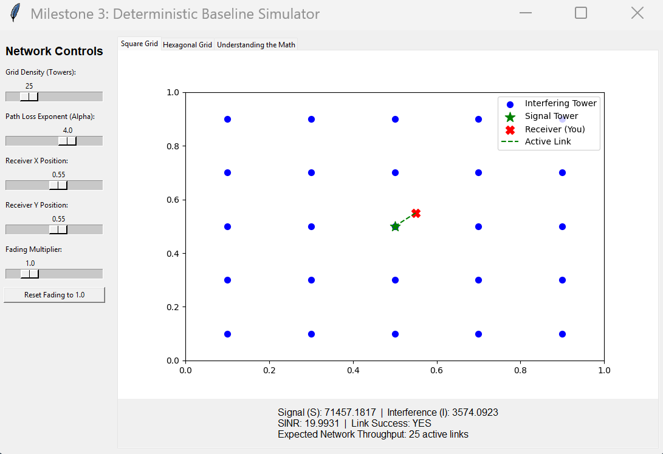
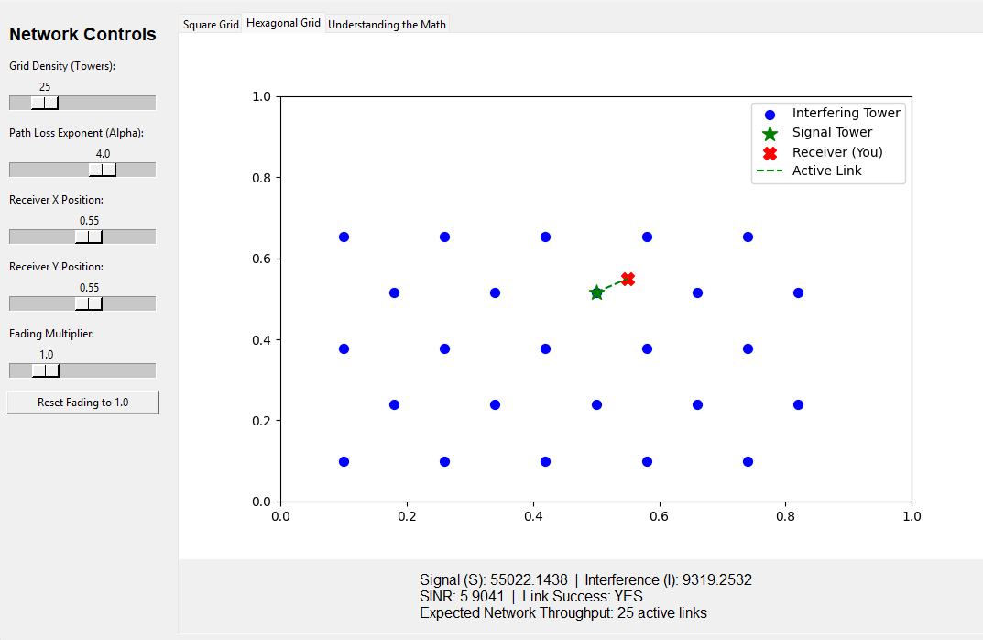
Visual Representation of Tower and Receiver

Slide 10
Simulation Implementation
Algorithms Used: Deterministic mesh grids (numpy.meshgrid) for both towers and receivers.
Code Structure: Nested Monte Carlo loops sweeping through increasing densities.
Execution: 50 fading snapshots executed at every single test point to find the true spatial average.
| ‹#›
Notes:
‹#›

Slide 11
Results and Performance Analysis
Metrics: Spatial Throughput (T) vs. Network Density (lambda).
Plots: The Baseline Throughput "Bell Curve".
Observed Behavior: Throughput scales linearly, hits an optimal peak (lambda^*), and crashes under interference.
| ‹#›
Notes:
‹#›

Slide 12
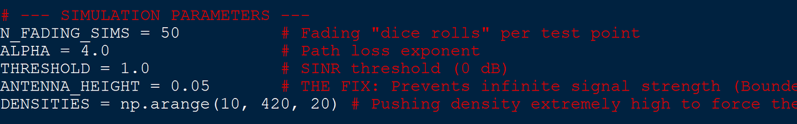
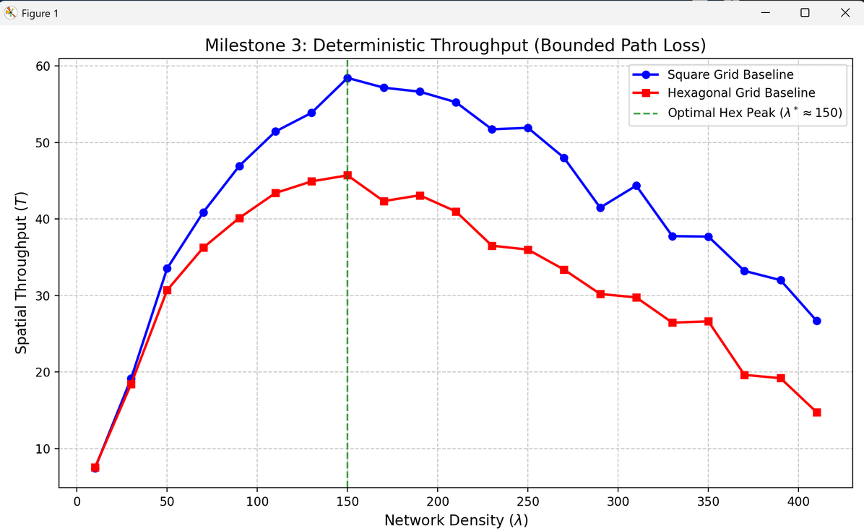
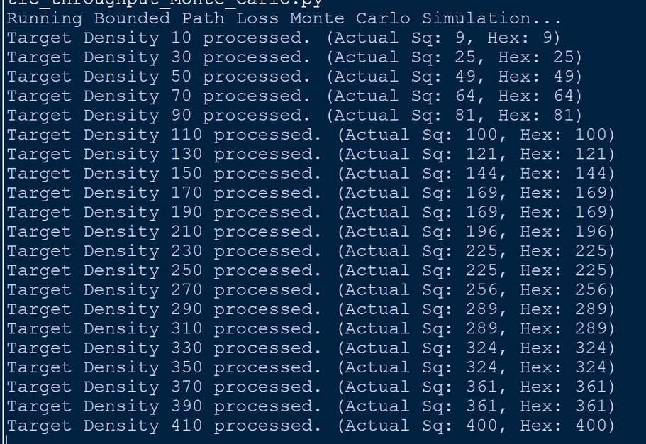
Square Vs Hexagonal Bell Curve
| ‹#›
Notes:
‹#›

Slide 13
Limitations of Deterministic Strategy
Weaknesses: Cannot model unpredictable human clustering or movement.
Boundary Anomaly: Square grids artificially beat Hexagonal grids due to edge-effects in our bounded $1 \times 1$ simulation window.
Poor Performance: Fails to represent highly dynamic, real-world urban environments.
| ‹#›
Notes:
‹#›

Slide 14
Summary and Transition to Randomized Strategies
Key Insights: Even perfectly spaced networks have a mathematical breaking point due to interference.
Why Randomization is Next: We must model the true chaos of real users (Aloha) and apply smart, repulsive scheduling algorithms (DPP).
The Goal: Beat this deterministic baseline's peak throughput in Milestone 4 and 5.
| ‹#›
Notes:
‹#›

