Slide 1
External Facing ANS Catalogue Future State
3 proposed catalogue structures for discussion, including:
Customer Type Service Groupings
Service Category Groupings
Hybrid Model
ANS catalogue requirements in RVTM are high level and do not prescribe qualitative or quantitative success criteria.
Service catalogue structures developed in consideration of following objectives
Enhance user experience by providing clear service descriptions
Simple and intuitive navigation
Leverage existing ANS content, minimise new content creation.
Maximise customer self service - reduce call centre enquiries (measurable?)
Enhance regulatory compliance (measurable?)
Prepare future state CRM pathways – Automate service process initiation. Eventual eliminate email submission of pdf forms.
Requirements (From RTVM) | Status
An assessment needs to be undertaken to understand whether any communications, training or changes to the website are required to support customers through any process changes or to create the awareness of the new fees. | Complete
Perform current state analysis of the external website to determine: The location of all the external customer impacted ANS Fees on the EE Website. Document navigation path (no of clicks) & content summary for all customer impacted ANS Fees on the EE website. | Complete
Perform a benchmarking exercise with competitors (Ausgrid & Endeavour Energy) to assess user experience (Navigation & Content) on ANS and identify solution | Complete
Develop a ANS Service Catalogue in plain English for internal and external customers. Consider inclusion of pictorial information to help communicate ANS services for Field staff and external customers | In Progress
Develop external facing Service Catalogue documents and pictorials to Essential Energy corporate communications team for formal Publication and distribution | In Progress

Slide 2
Proposed Options for External ANS Catalogue Structure
Model | Description | Top Level Headings | Advantages | Disadvantages
Customer Type | Top level of hierarchy is structured based on Customer Segment that service falls into | Residential Customers Commercial and Industrial (C&I) Customers ASPs and Electrical Contractors B2B (Retailers) | Intuitive pathway for customers | Duplication of services across customer segments More services per customer category
Service Group | Top level of hierarchy is structure based on high level service grouping | Connections & Metering Services Safety Related Services Training Services Access and Authorisation Inspection and Commissioning Services Design Information and Certification | Less services per category limit duplication of service descriptions Simple to leverage existing ANS content on website Clear ownership of each service stream by process owner – content maintenance | Customers may not immediately know which category a service fits within Some service categories will have large number of services within, need to be further broken down.
Hybrid Model | Hybrid Structure where top level contains key customer groups and key service categories. | Contestable Works (ASPs and Contractors) Chargeable Works (EE Services) Connections and Metering Safety Services Training, Authorisation and Permits | Most accessed ANS Services immediately visible Provides clear pathway for specific customers (ASPs | Duplication of services across service groupings More services in some categories, to be further broken down.

Slide 3
Current State EE Website
ANS Services are spread throughout entire EE website
Services have limited or no reference on website.
Some services referenced via PDF Information pack
For ANS services that are mentioned, information is typically very limited.
Limited description of service
Rarely indicates associated fees
Application processes unclear
Many of these pages could be included in ANS catalogue, with adaptation to content to improve service descriptions
Detailed list of ANS services and links to existing content on EE Website found here (link to excel document)
*Items highlighted in gold reference ANS services

Slide 4
Proposed ANS Catalogue Structure – Option 1 Customer Groups
Customer Groups structure matches more closely to customer use cases of websites.
e.g. Residential Customer, Business Customer, ASP etc
Some duplication across customer categories – mitigated as long as generic information linked to by both sides or;
Creating variation of content for each customer category . E.g. business connections vs residential connections.
Are there any customer categories not captured in this structure?
Does it make sense to duplicated and customise content where services are common across customer groups? E.g. Connections
Does creating content for ANS Services not activated through website add value? E.g. B2B and Retailer requested services.

Slide 5
Proposed ANS Catalogue Structure – Option 2 Services Groups
Services structure considers a more informed customer
Target audience – Type of customer accessing services and expected industry knowledge for that service (primarily business and ASPs)
Catalogue structure informed by least and most accessed services
Most services can be logically categorised/grouped – where should standalone or miscellaneous services sit? E.g. Retailer of Last Resort

Slide 6
Proposed ANS Catalogue Structure – Option 3 Hybrid Model
Hybrid Model considers combination of most accessed services and key customers
Key customers accessing services are informed and assumed industry knowledge for services (ASPs)
Volume of traffic accessing catalogue services – e.g. least and most accessed services
Types of services – which services can be logically categorised/grouped vs standalone services.

Slide 7
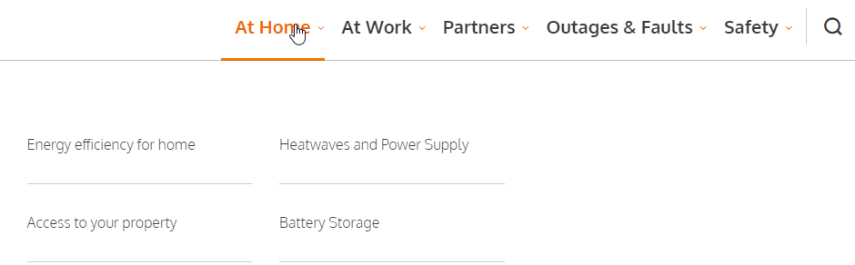
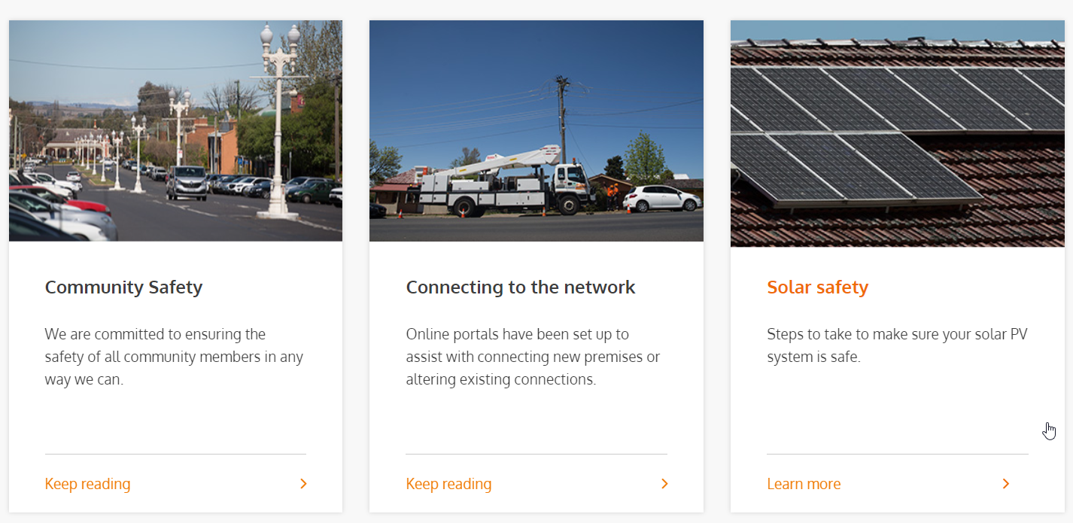
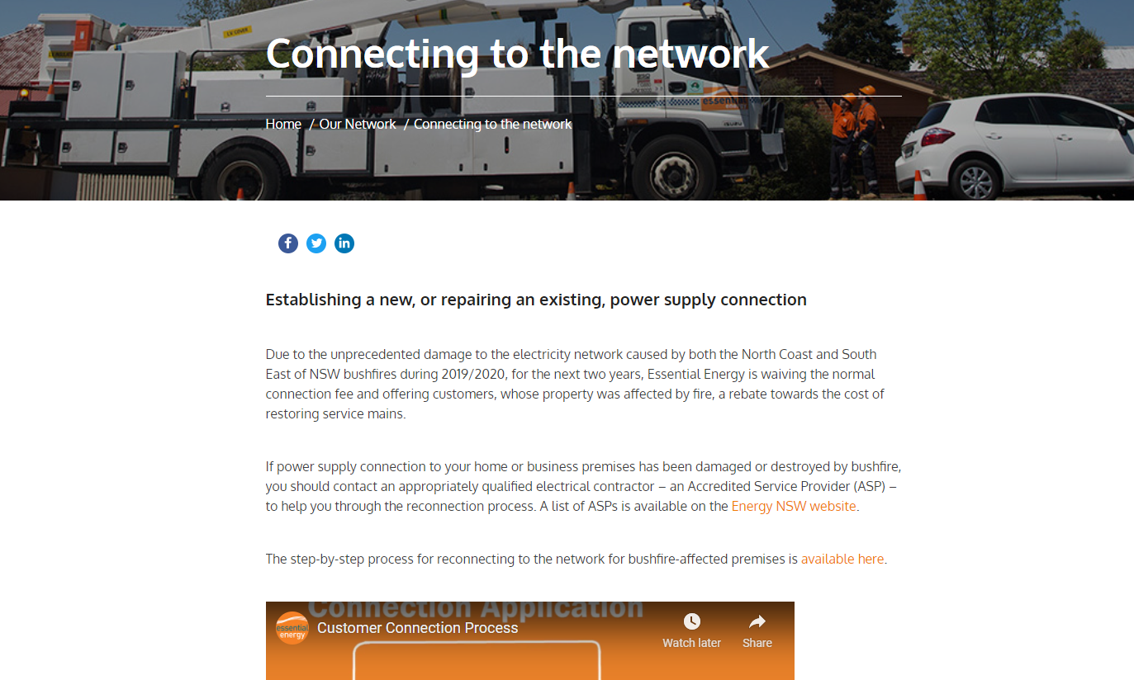
Website Constraints & Content Formatting Considerations
Current website template has content format limitations that inform shorter term solution
Limited interactive capability No tile flipping to provide summary of tile heading etc. this is a common features found on competitor websites to allow summaries of services groupings without clicking through to next level in service catalogue hierarchy
No expanding menu capability Allowing customer to expand only the content they are focussed on, while allowing more content to exist on single page – solves exposing to too much information per page.
Limited capability does exist for main navigation menus
Limited tiles per page – max recommended 9 to 12
70% of website traffic is from mobile - content and text formatted to suit mobile access
Website is undergoing improvement works in near future (3+ Months) to increase formatting capabilities
David advised not to hold off as no committed timeline for new website functionality.
No guidance on CRM integration at this point
Add ANS Catalogue ‘Our Services’ link to main navigation menu
Approval not (necessarily) required to add additional link to main navigation menu
Expanding menu function to list
Content created should be consistent throughout the catalogue, use customer-centric language and include
Description of Service
Outline of process, application pathway etc.
Inform customer of fees structure and where to locate fees (link to item in ANS fee schedule)

Slide 8
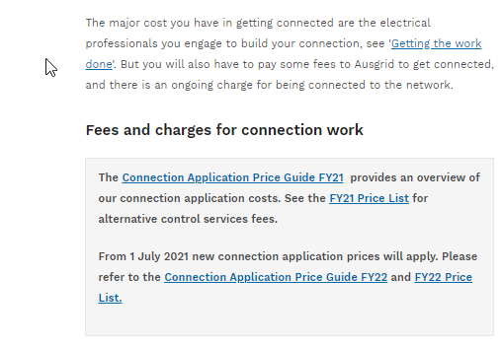
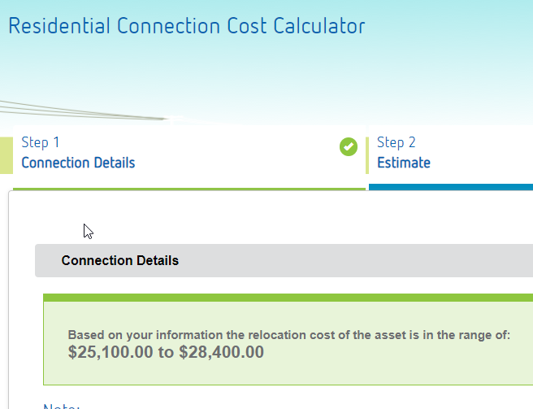
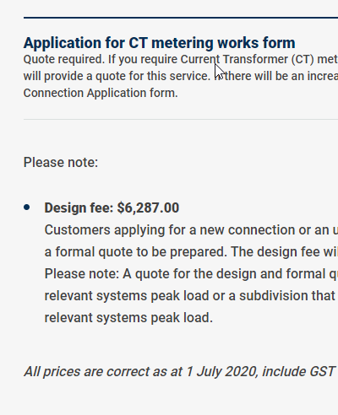
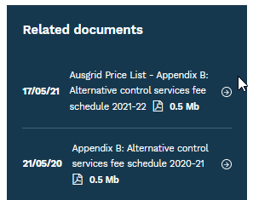
Indicating ANS Fees
A key objective of ANS catalogue is to inform customers that there are fees associated with ANS services.
Most networks mention fees & charges without publishing pricing directly to website, instead providing typical price range or referring customers to their published regulator approved price list (pdf format)
Link to Centralised PDF Price List | Indicative Price Range / Cost Calculator | Full Pricing Provided
Avoids risk of incorrect (non-regulator approved) pricing appearing on website and reduces manual effort required to update website Customer needs to open price list and locate relevant service to identify fees. | Avoids risk of incorrect (non-regulator approved) pricing appearing on website Indicates price range to customer without requiring them to view whole price list | Exposes provide to risk of incorrect pricing appearing on website, increases manual effort required to update. Customer has full knowledge of incurred charges without having to reference separate document
Ausgrid – “Connection application price guide provides an overview of our connection application costs. See the FY21 Price List…” | Ausnet – “Based on your information the relocation cost of the asset is in the range of: $25,100.00 to $28,400.00” | Horizon Power – “All prices are correct as at 1 July 2020, include GST (except where noted otherwise), and are subject to change at any time.”

Slide 9
Approach to indicating ANS Fees
When indicating ANS fees:
Avoid listing actual pricing on webpage, instead provide link to appropriate item in official ANS Price Schedule document
Reduces duplication of effort to update pricing on webpages
Avoids potential misrepresentation of prices
Specific pricing terminology to be avoided E.g. ‘fixed fee’ – pricing can change and terminology can ‘offend’ customers
Proposed approach to indicating fees includes providing descriptions of cost build up and linking to specific item in ANS Schedule of Fees, examples below:
Price Type | Application Fee | Hourly Rate | Fixed Fee
Service | 8.7 High Load Escorts | 8.7 High Load Escorts | 8.6 Warning Markers – Tiger Tails
Existing Content | https://www.essentialenergy.com.au/partners/high-load-permit |  | https://www.essentialenergy.com.au/safety/construction-safety
Example Pricing Content | An application fee to process High Load Permit requests is being introduced. This fee is to recover the costs associated with the risk assessment of the route and processing the permit request. The permit application fee must be paid prior to the permit being processed. Should the route be found to be outside safe limits, you will receive an assessment with available options, including whether an Essential Energy escort is required. | Where an EE escort is required, customers will be charged a standard rate per hour found. Refer to Network Safety Services item 8.7 and Table 1-1: Technical Specialist – Outdoor Technical Officer (R2b) in our Price Schedule for Ancillary Network Services - 1 July 2021 | Tiger tails are split synthetic tubes installed over powerlines, they protect tradesmen such as roof tilers, plumbers, builders etc from any accidental contact with live powerlines but do not provide full protection from live electricity, they also provide a visual indication of overhead powerlines. Tiger Tails are available for hire from EE. These can be requested by completing the form CEOF1130 - Request For Safety Advice - Working Near Powerlines and emailing it to construction.works@essentialenergy.com.au for actioning. Refer to Network Safety Services items 8.6 ‘Hire - Tiger Tails’ in our Price Schedule for Ancillary Network Services - 1 July 2021

