Slide 1
Final Presentation for Analysts
EMC Education Services
Data Science & Big Data Analytics
19.01.2017

Slide 2
Project Goals
Group data and highlight most important classes
Create models and find relations
Train models and take answers does the people with input data can take a loan

Slide 3
Project Goals
Situation
People need to know in advance whether they will issue a mortgage bank
Complication: Create a model that will predict answer copied by real broker.
Implication: It helps reduce the number of rejected applications.
Goals of FPC “Analytic Project”
Would it be more effective to develop different models or one model? Why? If different models, focus on a single one for the initial study.
Should we ask for personal demographic information, or can we build a good enough model without it?
How accurate is the model, in terms of the thresholds that the stakeholders set in their discussion (75% and 50%)? What is the coverage of the threshold regimes?

Slide 4
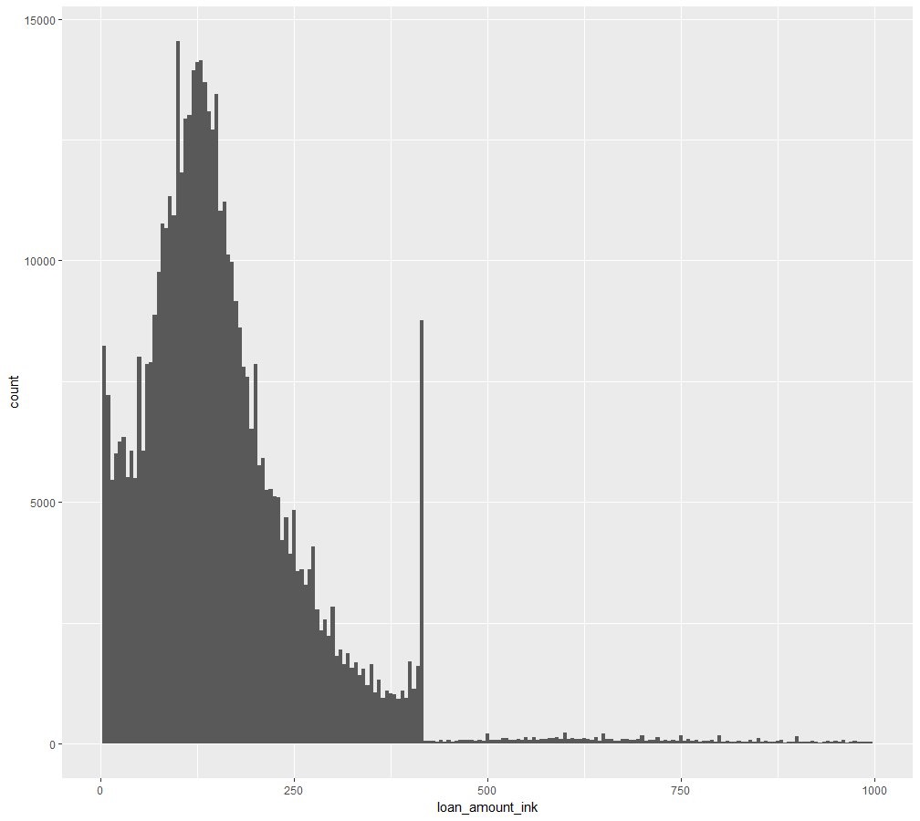
Executive Summary
A mortgage for more than the conforming limit set by Fannie Mae and Freddie Mac. In most counties, any mortgage of more than $417,000 is a jumbo loan. In counties with high home prices, the conforming limit is higher -- up to $625,500.
Spike
  It shows difference between data before and after 417k
  That’s why we need to use different models to this data
4

Slide 5
Approach
Collaborated with IT to identify relevant data sets, assess data quality and availability
Developed two models in R using a Decision tree and Logistic regression
  Provided their comparison
  Plotted ROC curves for the models

Slide 6
Logistic Regression Model Description
Overview of Basic Methodology: Consider the scope of the data you will need to include in the analysis, and filters you may need to set to construct the data set for your analysis.
Model: Logistic regression model
Dependent variable: Numeric variable, action_type
Scope:
  Model was used for Texas state.
  Occupancy=1, Property_type=1 and Action_Type <= 4
Sampling
  Training sample: 80% of initial data
  Testing sample: 20% of initial data
The model developed has enough predictive power for making reasonable advices
  We created a baseline model and checked that the predictive power was ~80%
  This model is good for loan_amount < 417k$
  On this range it shows better results than other models

Slide 7
Decision Tree Model Description
Overview of Basic Methodology: Consider the scope of the data you will need to include in the analysis, and filters you may need to set to construct the data set for your analysis.
Model: Decision tree model
Dependent variable: Numeric variable, action_type
Scope:
  Model was used for Texas state.
  Occupancy=1, Property_type=1 and Action_Type <= 4
Sampling
  Training sample: 80% of initial data
  Testing sample: 20% of initial data
The model developed has enough predictive power for making reasonable advices
  We created a baseline model and checked that the predictive power was ~80%
  This model is good for all range of loan_amount

Slide 8
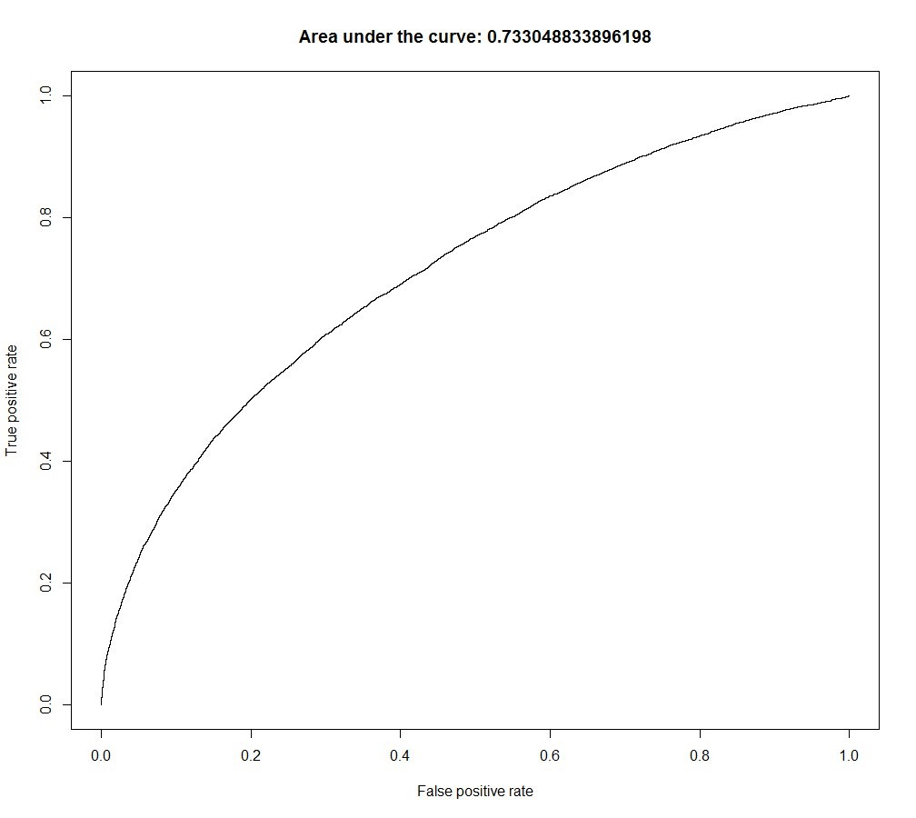
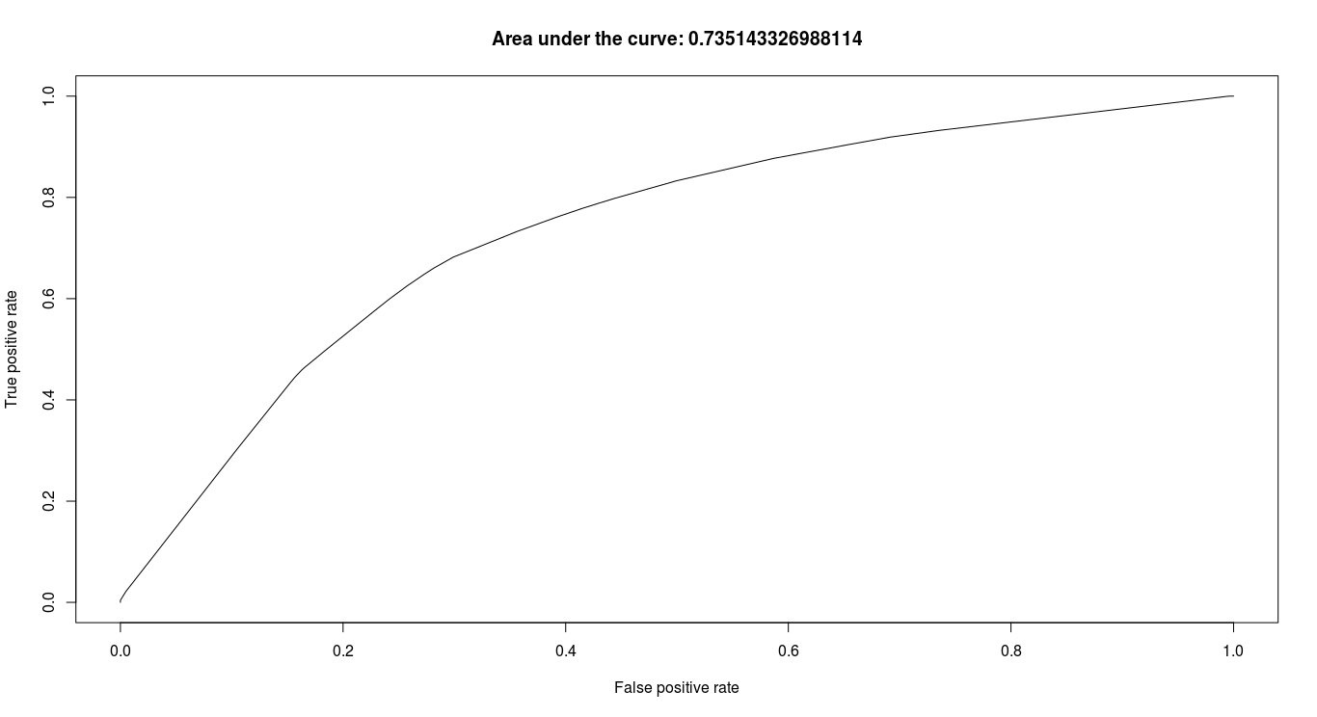
Key Points
Decision tree model
Logistic Regression model

Slide 9
Logistic Regression Model Details
We used data with the following conditions: Occupancy=1, Property_type=1 and Action_Type <= 4 for Texas state
Through discussion and analysing, we reduced 18 variables to the 13 most predictive
Logistic Regression model built in R :
  mylogit <-glm(action_type ~ applicant_sex
  + log(applicant_income_ink)
  + log(loan_amount_ink)
  + loan_purpose
  + lien_status
  + minority_population_pct
  + tract_to_msamd_income_pct
  + log(hud_median_family_income)
  + applicant_race_1
  + number_of_owner_occupied_units
  + applicant_ethnicity
  + co_applicant_ethnicity
  + hoepa_status
  ,data=lr.data
  ,family=binomial(link="logit"),
  na.action=na.pass)

Slide 10
Decision Tree Model Details
We used data with the following conditions: Occupancy=1, Property_type=1 and Action_Type <= 4 for Texas state
Through discussion and analysing, we reduced 18 variables to the 13 most predictive
Decision tree model built in R :
  fit <- rpart(action_type ~ applicant_sex
+ log(applicant_income_ink)
+ log(loan_amount_ink)
+ loan_purpose
+ lien_status
+ minority_population_pct
+ tract_to_msamd_income_pct
+ log(hud_median_family_income)
+ applicant_race_1
+ number_of_owner_occupied_units
+ applicant_ethnicity
+ co_applicant_ethnicity
+ hoepa_status
+ county_name,
method="class", data=train.tr.data,
control=rpart.control(xval=3,cp=0.001),parms=list(split='information'))

Slide 11
Recommendations
Implementing our model on site for users -
  It can help to reduce number of wrong applications
Collecting data from next years and continue to train model
  Use datasets for improvement of predictive model
Develop targeted customer surveys to investigate the causes of churn, which will make the collection of data easier.
Collecting data from social networks
  Adding extra parameters to the models for improvement predictive power

