Slide 1
Linudio: Multi-Agent Video Translation & Dubbing
Project End-Semester Evaluation Presentation
By: Rupen Kumar

Slide 2
Introduction
The Problem
Language barriers in video content.
Manual dubbing is expensive and slow.
The Solution
An automated, asynchronous pipeline that handles Transcription (STT), Neural Machine Translation (NMT), and Text-to-Speech (TTS).
Key Innovation
Optimized for consumer-grade hardware (CPU) using Quantization.

Slide 3

System Architecture
Extraction
yt-dlp extracts audio -> faster-whisper generates timestamped JSON segments.
Translation
NLLB-200 converts segments while preserving semantic meaning.
Synthesis
MeloTTS generates localized audio.
Final Assembly
FFmpeg merges audio back into video with automated "Time-Stretching."

Slide 4



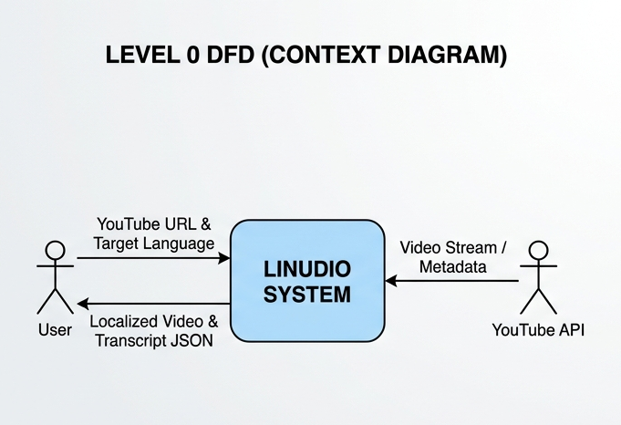
Level 0 DFD

Slide 5
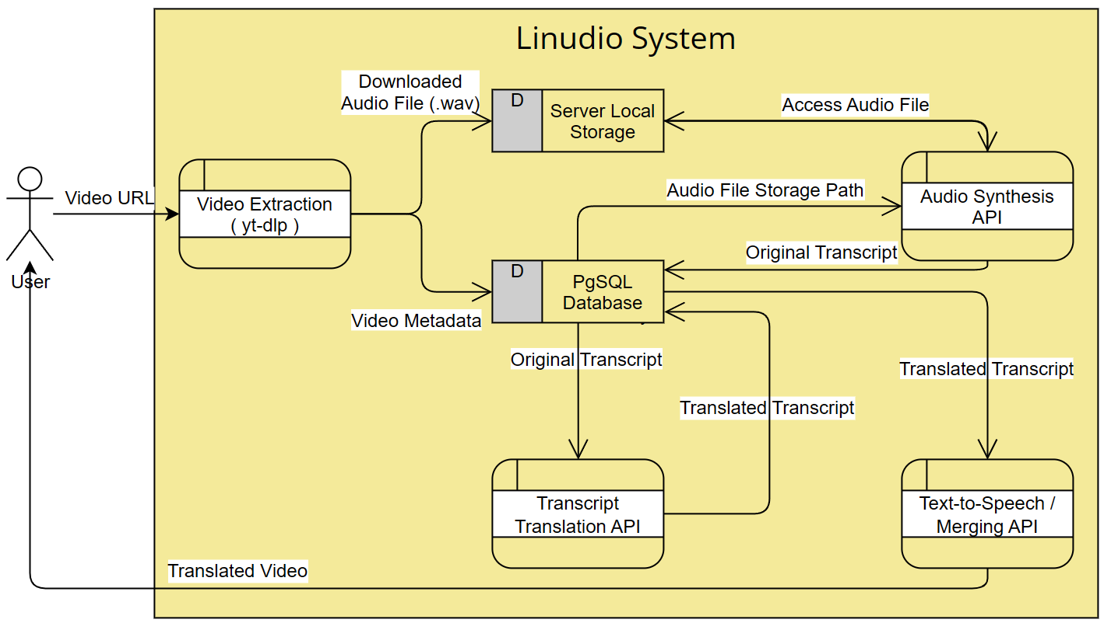
Level 1 DFD

Slide 6
Open-Source Model Selection
Whisper (Large-v3-Turbo)
State-of-the-art STT from OpenAI. Chosen for its accuracy in multi-speaker environments.
NLLB-200 (Distilled 600M)
Meta’s "No Language Left Behind." Supports 200+ languages directly.
MeloTTS
Modern, lightweight synthesis models having impressive inference speeds.

Slide 7
Optimizations for Inference on CPU
INT8 Quantization
Converted models from FP32 (Full Precision) to INT8 (Integer 8-bit). This increased inference speed on CPUs.
CTranslate2 Engine
Replaced standard HuggingFace code with CTranslate2 for 4x–10x faster translation on CPU.
Lightweight Models
Chose specialized models with fewer parameter count, to reduce RAM Usage by upto 75%.
Thread-pooling
Offloads CPU-bound AI inference to separate threads, preventing API timeouts.

Slide 8
Asynchronous Workflow & User Interface
Non-Blocking Logic
Immediate Task ID response (202 Accepted) to the client.
Real-time Feedback
Frontend polling to show progress spinners while the CPU handles heavy lifting.
Human-in-the-Loop
A dedicated "Review & Edit" screen where users can verify translations before the final dub is generated.

Slide 9
Hardware / Software Used
Type | Name
Processor | AMD Ryzen 5 5600GT (6C/12T)
Backend | FastAPI, SQLAlchemy, PostgreSQL
Processing | CTranslate2, faster-whisper, FFmpeg
Frontend | Next.js 16

Slide 10
Conclusion
Summary: Built a scalable, low-cost localization tool using only open-source tech.
Future: Implementing Wav2Lip (visual sync) and Zero-Shot Voice Cloning to match the original speaker's timbre.

Slide 11
Bibliography
Radford, A., et al. (2022). Robust Speech Recognition via Large-Scale Weak Supervision. (OpenAI Whisper).
Costa-jussà, M. R., et al. (2022). No Language Left Behind: Scaling Human-Centered Machine Translation. (Meta AI).
FastAPI Documentation. Concurrency and async / await. https://fastapi.tiangolo.com/
Kim, J., et al. (2021). Conditional Variational Autoencoder with Adversarial Learning for End-to-End Text-to-Speech. (VITS/MeloTTS foundations).

