Slide 1
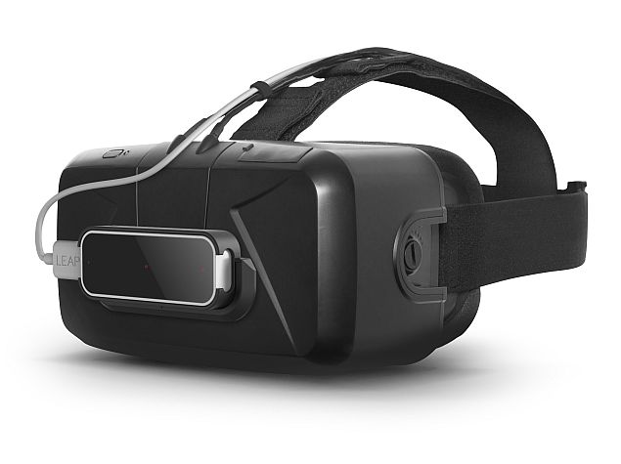
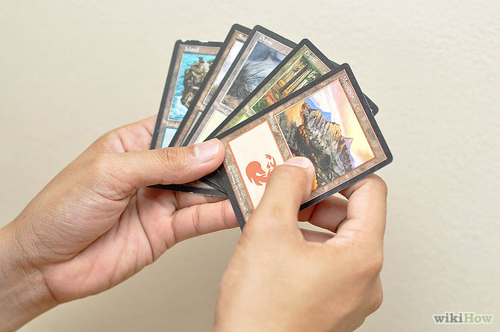
Augmented Virtual Reality Card Game
Notes:
<Nummer>

Slide 2
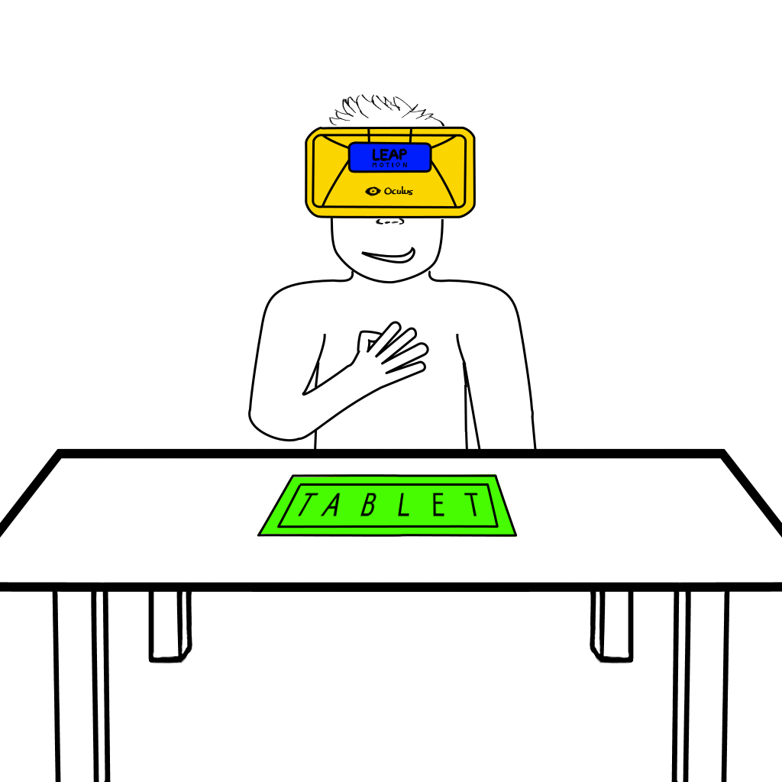
Overview
Notes:
<Nummer>

Slide 3
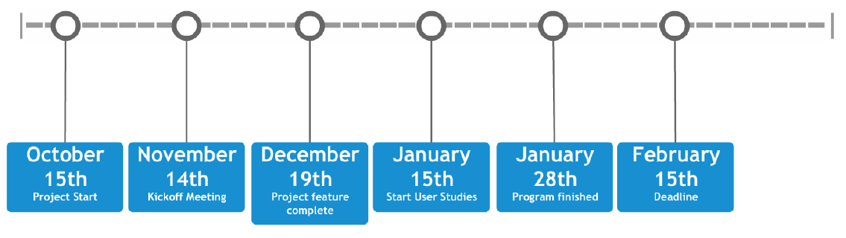
Timeline
Notes:
<Nummer>

Slide 4
Outline
Visualizations
  Environment
  Selection of cards
  Buttons
  Infobox
Interactions
  Leap Motion
    Interactions
  Tablet
    Interactions
  Challenges
Notes:
<Nummer>

Slide 5
Environment
Player positioned at virtual table
Room or environment can be used to build up the atmosphere
Display of hands and body
Notes:
<Nummer>

Slide 6
Card Content
Text on cards too small to read => Custom display system necessary
Outline
  Selection of cards
  Buttons
  Info Box
Notes:
<Nummer>

Slide 7
Selection of cards
Selection by looking at an object
Selection by moving the virtual hand towards the object
Cursor necessary?
Notes:
<Nummer>

Slide 8
Selection of cards
Selection by looking at an object
Selection by moving the virtual hand towards the object
Cursor necessary?
Notes:
<Nummer>

Slide 9
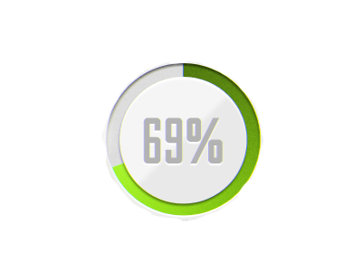
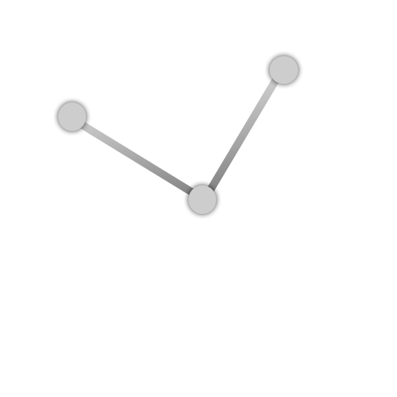

Buttons
Timer
Three-dots
Progress
Mind map
Notes:
<Nummer>

Slide 10
Info box
Table display
Variable display
Notes:
<Nummer>

Slide 11
Leap Motion
Mounted on the Oculus Rift
Tracks the player's hands and fingers in his field of view
Used to animate virtual hand models
Detects gestures of the player in mid air
Notes:
<Nummer>

Slide 12
Leap interactions
Player will be able
to move around his virtual hands
to hold cards in his virtual hands
select a card with his right hand
place a card in his left hand
Notes:
<Nummer>

Slide 13
Tablet
Located in front of the player on physical desk (in real world) and also visualized as play area in the virtual world
Provides haptic feedback
Used to track touch gestures that cannot be detected by the Leap
Position and orientation need to be calibrated to match virtual world's dimensions
Notes:
<Nummer>

Slide 14
Tablet interactions
Player will be able
to place or discard cards on the virtual desk
to draw or take cards from the virtual desk
to move cards on the virtual desk
Notes:
<Nummer>

Slide 15
Challenges
Smooth raw data for good visualization of hands
Provide a feeling of control for the player
Use and detection of natural gestures
Synchronize virtual and real world via network (between Tablet and LeapMotion + Oculus Rift)
Calibration of the Multi-Device Setup
Notes:
<Nummer>

