Slide 1
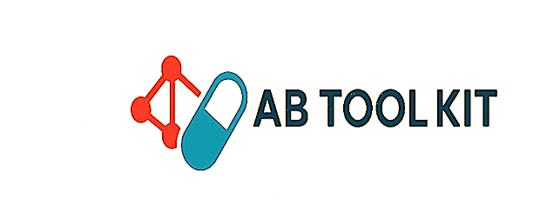
AI-driven Clarity for Diabetes Risk
Hellen Nakabuye(Team Lead)

Slide 2
comments
Reduce text
Prediction to replace diagnosis
Increase visuals
Add some numbers(stats)
Highlight uniqueness

Slide 3
Background
Diabetes is a growing public health challenge across Uganda, driven by urbanization, lifestyle changes, aging populations, and genetic susceptibility.
Type 2 diabetes, also known as Diabetes Mellitus is the most common form and is increasing rapidly due to reduced physical activity, unhealthy diets, and rising obesity levels.
Many people are diagnosed late because of limited screening, low awareness, limited screening services, and stigma associated with chronic diseases.
Complications—such as kidney disease, blindness, cardiovascular disease, and limb amputations—are often more severe in Africa due to late diagnosis and limited access to quality care.
Uganda’s health system faces challenges in providing regular monitoring, medicines (like insulin), and patient education, especially in rural areas.
The government and organizations have begun implementing programs for non-communicable disease (NCD) prevention, but resources remain insufficient

Slide 4
Problem Statement
Diabetes is one of the leading non-communicable diseases in Uganda, and its burden continues to grow.
Accurate diagnosis of type 2 diabetes often requires multiple laboratory tests, which are costly and time-consuming for both patients and health facilities.
However, Health Centre (HC) IVs routinely collect a wide range of patient health data that remains underutilized.
Leveraging this existing data through machine learning offers an opportunity to support early, low-cost, and efficient prediction of type 2 diabetes, ultimately improving patient outcomes and reducing pressure on the healthcare system.

Slide 5

Justification
Type 2 diabetes is a growing challenge in Uganda, and diagnosis relies on multiple laboratory tests that are costly, time-consuming, and often inaccessible
Delayed diagnosis leads to severe complications, higher treatment costs, and reduced quality of life.
Health Centre (HC) IVs already collect rich clinical and demographic data, but it remains underutilized.
Machine learning can transform this existing data into a low-cost, efficient, and early-detection tool.
An ML model would help health workers identify high-risk patients early, prioritize confirmatory tests, and reduce financial strain on patients and the health system.
This project strengthens diabetes care and promotes data-driven decision-making within Uganda’s healthcare system.

Slide 6
State of the Art
Traditional Diagnostic Methods (Still Gold Standard) include HbA1c testing, Oral Glucose Tolerance Test (OGTT), Fasting Plasma Glucose (FPG), remain common because they are well-validated and relatively inexpensive.
They can miss early dysglycemia or individuals at risk (prediabetes).
Researchers are actively exploring new molecular markers to improve earlier and more precise diagnosis.
One of the biggest frontiers is using digital health (wearables, sensors) and AI to detect T2D risk, progression, or even predict complications.
Wearable and Continuous Monitoring Technologies are also available for Type 1
Challenges include; Validation and Clinical Translation, Population Diversity, clinical integration, and data privacy policies

Slide 7
Objectives
Goal: Develop an AI model to predict the risk of diabetes based on basic, easily collected data.
Primary objective: Early identification of people at risk of diabetes, encouraging further medical testing and intervention
Secondary objective: increase awareness, encourage healthier lifestyles(exercise and diet) ,and reduce healthcare costs by focusing on prevention

Slide 8
Methodology
Study Design: This study aims to develop and evaluate machine learning (ML) models capable of predicting diabetes risk (Type 2) using clinical, demographic, and lifestyle variables
Data Acquisition; the current dataset used is from Kaggle
Data Preprocessing; handling missing values, data cleaning, outliers, data splitting
Feature engineering; age(over 45!), BMI( >30 for obesity), physical inactivity, family history of diabetes, hypertension
Model Development; Random Forest, Logistic Regression, XGBoost, Support Vector Machine
Model Evaluation using AUC-ROC, Accuracy, Precision, Recall, F1-score
Deployment & Validation
Ethical Considerations

Slide 9
Datasets Used
Demographic data; age, sex, BMI(weight, height)
Lifestyle factors; diet, physical activity, smoking, alcohol use, stress levels (job could help for these)
Medical history; family history of diabetes, hypertension, gestational diabetes(women)
Health metrics; blood pressure, hypertension, fasting glucose levels or HbA1c levels(if available)
Data privacy shall be ensured, diabetes clinics for private and public hospitals have this data

Slide 10
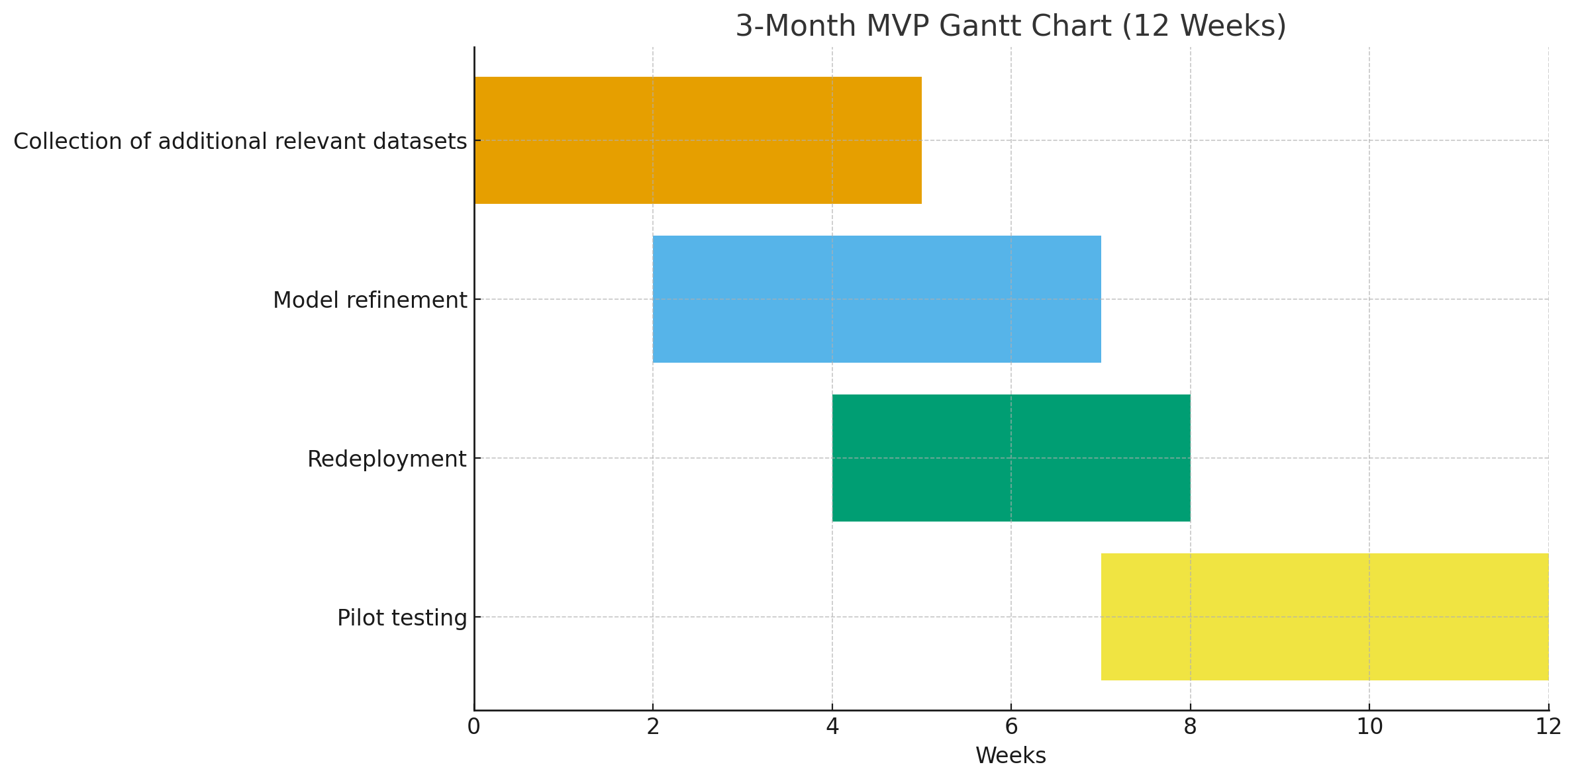
Work Plan

Slide 11
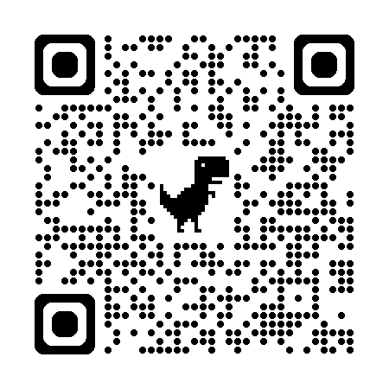
THANK YOU!

