Slide 1



A Server-Side Feature Detection System for an Enterprise Web CMS
Master’s Thesis Presentation
Henrik Hellerøy
Spring 2013
Supervisors:
Håvard Tegelsrud
Dag Langmyhr
Notes:
Nevne hva tittelen betyr

Slide 2
Detection Schemes

Slide 3
Why do we need detection schemes?
A multitude of devices can access the Web today, all of them different in many ways:
Form factor (screen size, input methods etc.)
Feature sets
Hardware specs
Network access
A single Web page layout will not work on all devices.
Detection schemes are in place to present a best-fitting layout to the user – based on the device making the request.
Notes:
Hetrogent Web
Vanskelig å vite hva slags funksjonalitet som eksiterer på enheten

Slide 4
Popular detection schemes
Responsive Web Design (RWD)
Pros:
Accurately detects the form factor of the device based on CSS 3 Media Queries and JavaScript libraries.
Can change the layout after initial render if the viewport changes, without making additional requests.
Cons:
All of the rendering is done on the client
Superfluous files are sent to the client, regardless of usage
Notes:
En stor fil med markup for alle enheter
Krever mye ressurser fra klienten
Klienten laster ned filer som ikke vises

Slide 5
Popular detection schemes (cont.)
User Agent (UA) Detection, aka. Device Experiences (DE)
Pros:
All logic on the server instead of the client
Can be used along with Device Description Repositories (DDR) to determine the features of the requesting UA
Cons:
UA strings can be faked or otherwise misrepresented
Commonly relies on HTTP redirects
DDRs are dependent on people keeping them up-to-date
Notes:
Man får ikke mye data fra UA strengen alene
UA strengen er ikke pålitelig

Slide 6
A possible solution
Responsive Web Design + Server Side Components (RESS)
Pros:
Does the layout rendering on the server based on the requesting device class
Only necessary files are sent over the network
No HTTP redirects
Less load on the client compared to RWD
Cons:
Still reliant on UA strings to uniquely identify requesting devices
Notes:
RWD metoder fortsatt brukt for komponenter
Rendering av komponenter bestemt på server
Ingen HTTP redirects betyr mindre latency

Slide 7
Research Question
Can a Web site be made responsive without having the user agent do all the work, thus improving performance?

Slide 8
Implementation

Slide 9
Finding a case
I assume larger Web sites could benefit the most (performance wise) from an improved system for making responsive layouts.
Larger Web sites commonly use Enterprise Web CMSs to author and administrate their sites.
Bekk uses such a system on several larger Web projects – Enonic CMS.
“Is it possible to make RESS work in Enonic?”
Notes:
CMSer blir ofte sett på som gammeldagse og lite fleksible idag
“CMS’es are the mainframes of our time”

Slide 10

Enonic CMS
Based on Java EE
Uses common Java libraries such as Maven and Spring
Uses XML datasources and XSLT for rendering
Used for several large Web site projects in Norway: Posten, TINE, Statens Vegvesen, NAV, Gjensidige, etc…
Has its own device detection based solely on UA string parsing
Supports plugins!
“Let’s make a plugin that adds RESS functionality to Enonic!”
Notes:
Enonics innebyggede system får bare data fra UA strenger – dette veldig lite data og gir ikke mye fleksibilitet

Slide 11
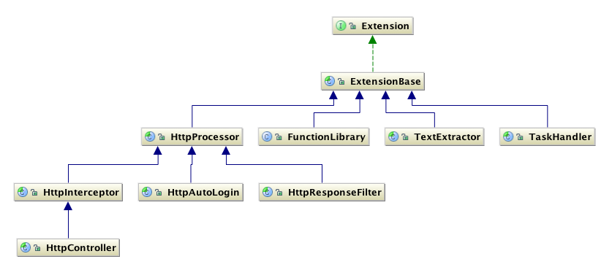
Plugins for Enonic
Enonic has a plugin environment API that exposes ways to extend the core functionality of the system.

Slide 12
Concept for the plugin
Intercepts requests before they reach the CMS and identifies the requesting UA using the UA string.
If the UA string is not recognized, it sends JavaScript-based feature tests to the client. The result is sent back to the server in a cookie on page reload.
The results of the feature tests are stored in a database, using the UA string as a key.
Device classes can be defined by site administrators using the features detected by the plugin.
Device classes are resolved using a FunctionLibrary extension.
Notes:
Deler er basert på Dave Olsens “Detector” system

Slide 13
The Interceptor
Request
Unknown UA
Known UA
Test results
No test results
Store results in DB
Send tests to client
Look up UA in DB
Do nothing

Slide 14
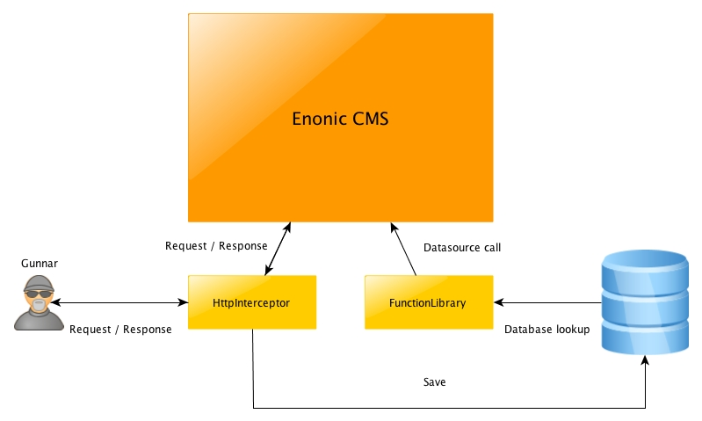
Utilizing the Plugin API
Notes:
Gunnar vil se på nettsiden min…

Slide 15



Technologies
Java EE
Spring for dependency injection
Maven for building and deployment
MongoDB used for the database
Modernizr used for client-side feature tests

Slide 16
Defining device classes
{
"chrome" : {
"uaFamily" : "Chrome",
"isMobile" : false,
"features" : {
"video" : {
"h264" : true,
"webm" : true
}
}},
"notmobile" : {
"isMobile" : false,
"features" : {
"flexbox" : true
}
},
"mobile" : {
"isMobile" : true
}}
Non-mobile chrome with h264
and WebM video format support
Based on these definitions,
different layouts can be defined by using simple conditionals in the XSLT style sheet.

Slide 17
Improving performance

Slide 18
Web Performance
Several factors affect the performance of Web sites:
Network latency – especially in cellular networks (3G, LTE etc.)
Wi-fi and cellular are affected by external interference (radios, microwaves, physical and electromagnetic barriers).
The physical locations of GPRS nodes can increase latency
System resources
Mobile devices especially have limited CPU and memory
Resource-intensive processes adversely impacts battery life

Slide 19
Performance gains using the plugin
To improve the performance of Web sites, especially in the mobile context, the plugin aims to:
Reduce the amount of data being transferred to the client by only serving what’s needed
Help developers create less resource-intensive Web pages by providing solutions for tailoring them to each specific device class
The added logic on the server could affect performance negatively, though, so performance tests were conducted.

Slide 20
Performance tests
Three tests were conducted:
Front-end performance
Execution time of JavaScript tests
Back-end performance
Request round-trip time
Server processing time

Slide 21
Javascript tests

Slide 22
Round-trip time

Slide 23
Server Processing time

Slide 24
Summary and Conclusions

Slide 25
Potential Problems
The plugin is wholly reliant upon UA strings, they are unreliable because:
They can be spoofed by the client
They can be changed by a proxy before reaching the server
It is impossible for the server to distinguish between a UA lacking JavaScript support and it being disabled by the user.
Caching of HTML documents on reverse proxies will effectively disable the core functionality of the plugin.

Slide 26
Solutions
UA strings:
Have a time to live (TTL) on all entries, to avoid false entries staying for too long
Statistics! Aggregate several sets of features for each UA string and select the most common set as “true”
Unsupported or disabled JavaScript:
TTL on entries (again)
Store “nojs” entries on a per-session basis
Caching on reverse proxy:
Don’t cache HTML documents

Slide 27
Future Work
Test in production setting
Put measures in place to alleviate problems with UA strings
Solve the problem with detecting a lack of JS support
Make independent of CMS – make it a service!

Slide 28
Conclusions
The plugin supports dynamic feature detection of unknown UAs, which, along with the device class definition system improves upon Enonic’s built-in solution.
Compared to Enonic’s own detection system, the plugin does not adversely affect the performance of the back end to any significant degree.
The performance hit from running client-side tests is negligible, even on mobile devices.
The plugin is a solution that has the possibility of improving performance of responsive Web sites by moving a lot of the work over to the server, instead of the client.

Slide 29
Thank you

