Slide 1
Cyber Learning Environment
M.Naga Sai Bharadwaj - 10831A0530

Slide 2
Abstract
Description
Cyber Learning Environment is implemented in PHP platform with mysql and javascript.
It is often perceived as a group effort, where content authors, instructional designers, multimedia technicians, teachers, trainers, database administrators, and people from various other areas of expertise come together in order to serve a community of learners.
In this project we suggest to combine the areas of Cyber learning and Web services, by providing electronic learning offerings as (individual or collections of) Web services as well.

Slide 3
Existing System
The existing system is classroom teaching where a faculty teaches to a group of students. It has the following drawbacks.
Educational focus is Teacher-Centered.
Faculty-Student communication is limited in the existing system which proves to be a major drawback.
The learning process is passive learning.
Mostly theoretical in nature.

Slide 4
Proposed System
The proposed system has different kinds of users like Administrators, Normal Users (Students) and Faculty.
The proposed system removes the limitations of the existing system by providing the following
Web based application for online course design, course calendar publishing, and student’s registrations for self-paced learning (Student-Centered).
Content administration, assignments, and assessments.
Cyber classrooms (for distance learning).
Separate forum for interaction among students and faculty.

Slide 5
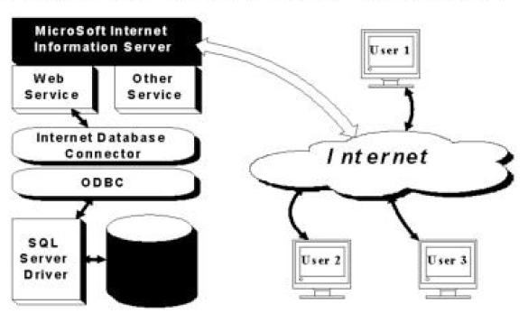
System Architecture

Slide 6
System Requirements
Software Requirements
Hardware Requirements
Operating System: Windows XP and later.
Apache Web Server.
Mysql Database Server.
MySql workbench 5.2
Web browser (Preferred Google Chrome or Mozilla Firefox).
RAM - 512 MB.
Hard Disk - 80 GB.
CPU –Intel Pentium IV or later.
Internet Connection.
Standard Windows Keyboard.
Two/Three Button mouse.

Slide 7
Software Requirement Specification
The development and usage of CLE requires different software such as
Xampp,
MySql workbench,
Notepad (or) any editor,
Web browsers.
The software requirements are divided into two groups.
Developer side.
User side.

Slide 8
Software Requirement Specification
Developer side:
XAMPP: Xampp is used to provide the developer with a server using which the php pages can be identified by the browser. Xampp also has SQL server.
MySql workbench: MySql workbench is used to create and store the databases. All the databases related to the CLE are created using MySql workbench.
Zend Eclipse: This is the special editor designed for writing PHP programs which has different color codes for simplifying the code writability and readability.

Slide 9
Software Requirement Specification
User side:
The Prerequisites for using CLE by an user are very less.
The two important things that a user must have are:
Internet Connection: Since the CLE is completely web-based, the internet connection is a must have for any user.
Web Browser: User can access the CLE from any browser but preferred browsers are Mozilla Firefox and Google Chrome.

Slide 10
Literature Review
Title: An Overview of Cooperative Learning
Author(s): Roger T. and David W. Johnson
Year: 1994
Description: How students perceive each other and interact with one another is a neglected aspect of instruction. Much training time is devoted to helping teachers arrange appropriate interactions between students and materials (i.e., textbooks, curriculum programs) and some time is spent on how teachers should interact with students, but how students should interact with one another is relatively ignored. It should not be. How teachers structure student-student interaction patterns has a lot to say about how well students learn, how they feel about school and the teacher, how they feel about each other, and how much self-esteem they have.

Slide 11
Literature Review
Title: Tips and Secrets for Online Teaching and Learning: An Inside View
Author: Robert. M. Corderoy
Year: 1997
Description: Web based computer conferencing combines the various aspects of telecommunications, computers, and the world wide web providing the participants with an asynchronous forum in which the free exchange of ideas can take place. In many instances, potential participants are unable to attend 'live' conferences for geographic and economic reasons and must rely on publications and the like to be informed of current trends and practice. The use of the web for such conferences is gaining in popularity and acceptance amongst academics as a legitimate alternative to the more traditional conference. Lefoe, Corderoy and Wills (1996) identified some of the issues confronting organizers and attendees of such conferences in the evaluation of Teleteaching '96, a conference which included both on site and off-site participants.

Slide 12
Literature Review
Title: Learning in the new millennium: Building New Education Strategies for Schools
Author(s): P. Dillenbourg
Year: 2000
Description: In Web-based environments, learning activities range from multiple choice questionnaires to problem solving. Simulations are indeed virtual learning environments as well. While originally restricted to physical models, they cover now a broad spectrum of domains. However, what is more specific to virtual learning environments is the set of activities in which the students construct and share objects. Most often these objects are Web pages. Writing are very popular in schools. Students are not restricted to consuming Web information, they become information producers, they enter in the game. There is quite a difference between writing a critique of a novel which will be read only by the teacher or which can be read by potentially anybody.

Slide 13
Literature Review
Title: Staying on track: Reviewing our use of technology
Author(s): JISC magazine
Year: 2002
Description: The JISC looks to the output of a new group – the Distributed and Electronic Learning Group(DELG). The DELG was recently established by the Learning and Skills Council of England (LSC) to advise on the ways in which distributed and electronic learning can contribute to the Council’s mission. It is chaired by Professor BobFryer (Assistant Vice Chancellor, University of Southampton) and has a membership drawn from the Council itself and from other key figures from the worlds of business, education, technology and the media. Malcolm Read (JISC Executive Secretary) sits on the DELG as the JISC representative. The Group’s first major task is to provide advice to the Council on a coordinated strategy for securing delivery of new forms of learning, specifically the innovative use of information technology, locally, regionally and nationally.

Slide 14
Literature Review
Title: Learning Environments in Higher Education
Author(s): Walker, Scott L.
Year: 2003
Description: Globally, as distance education has become firmly embedded as a part of the higher education landscape, governments and institutions are calling for meaningful research on distance education. This study involved designing, developing and validating a learning environment survey instrument for use in distance education-delivered courses in post-secondary education. Specifically it involved merging two distinctive areas of study: psychosocial learning environments research and distance education research. The unique social structure of asynchronous distance education learning environments requires a unique and economical instrument for measuring the perceptions of distance education course participants. The research followed a three-stage instrument-development process of identifying salient scales, developing survey items, and field testing and analyzing data using item analysis and validation procedures.

Slide 15
UML Diagrams
The following UML diagrams are shown for the Cyber Learning Environment.
Class Diagram.
Use case Diagram.
Activity Diagram for
News Feed.
Personal Message System.
User console.
Upload files.
Deployment Diagram.

Slide 16
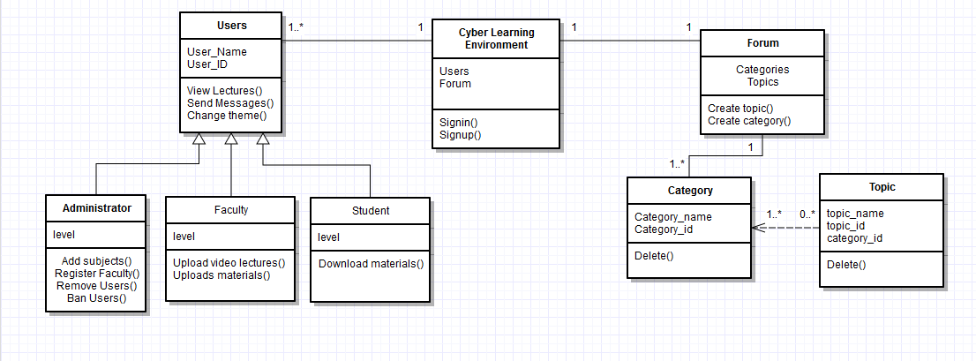
Class Diagram

Slide 17
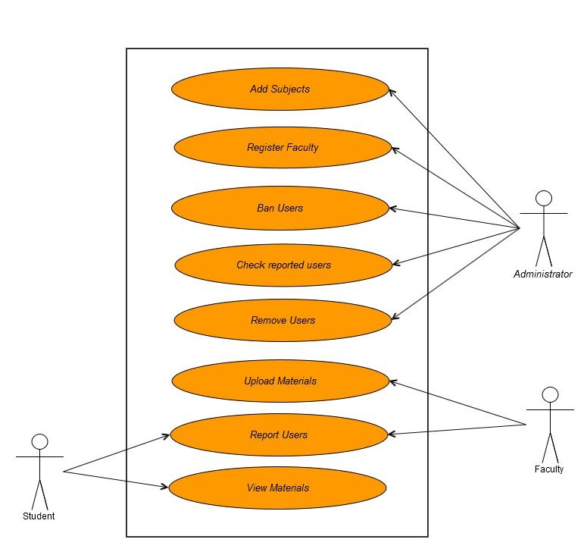
Use case Diagram

Slide 18
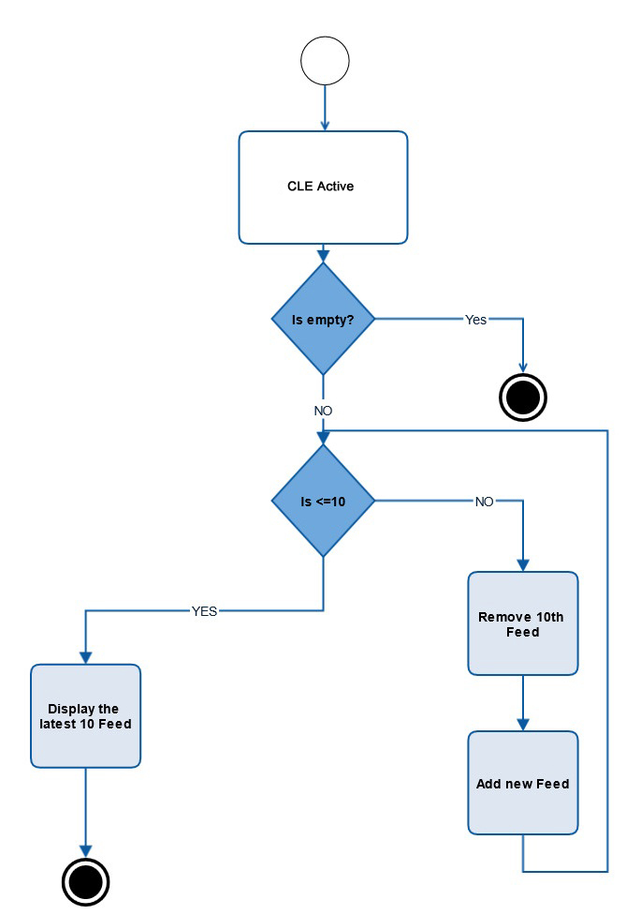
Activity Diagram for News Feed

Slide 19
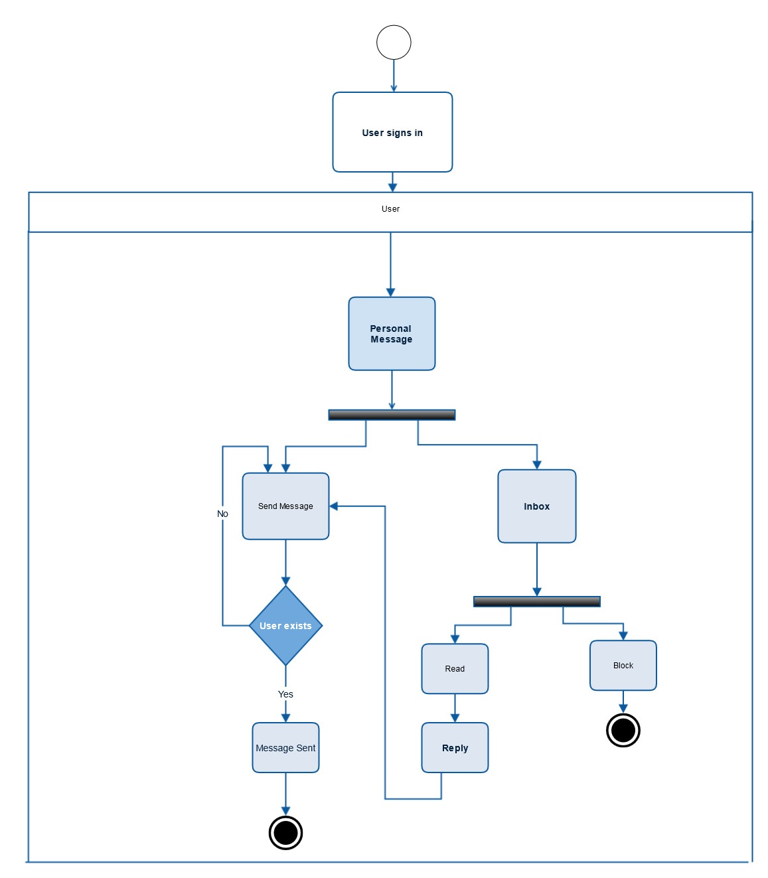
Activity Diagram for PM

Slide 20
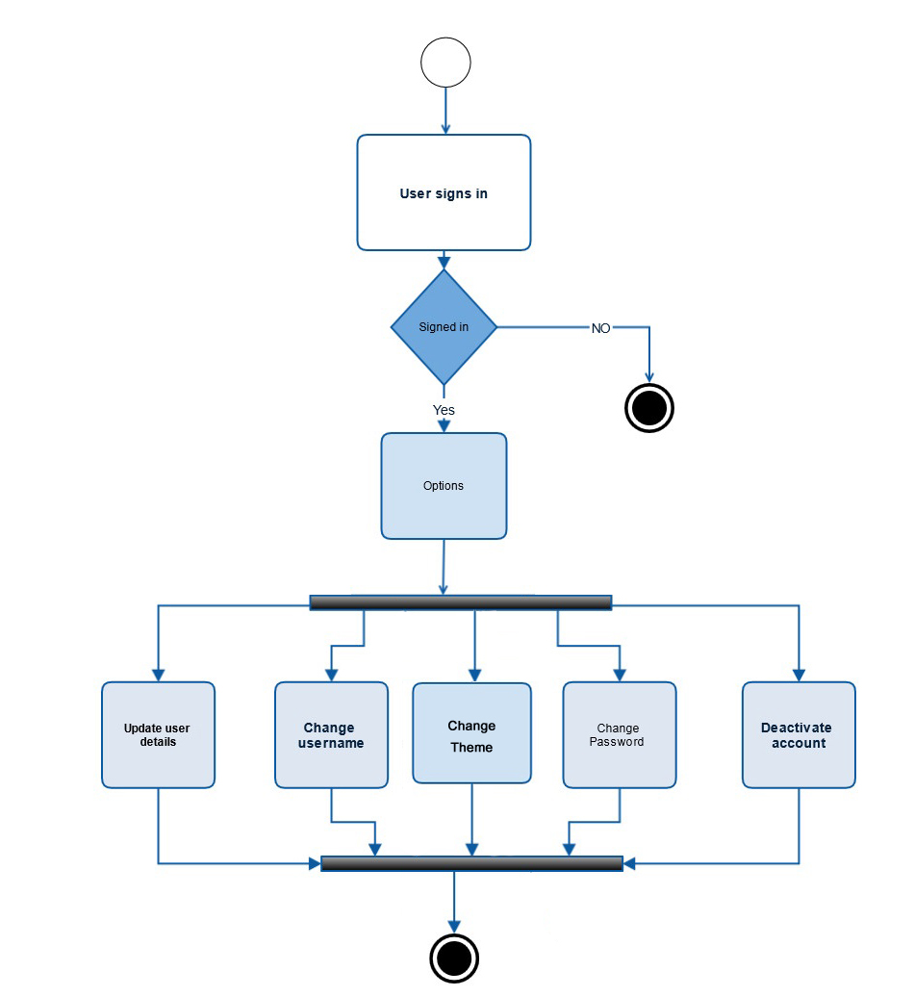
Activity Diagram for User Console

Slide 21
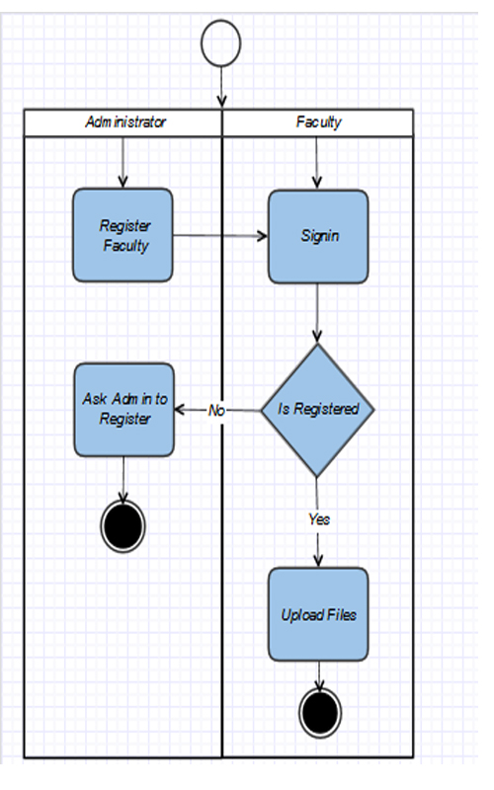
Activity Diagram for Upload Files

Slide 22
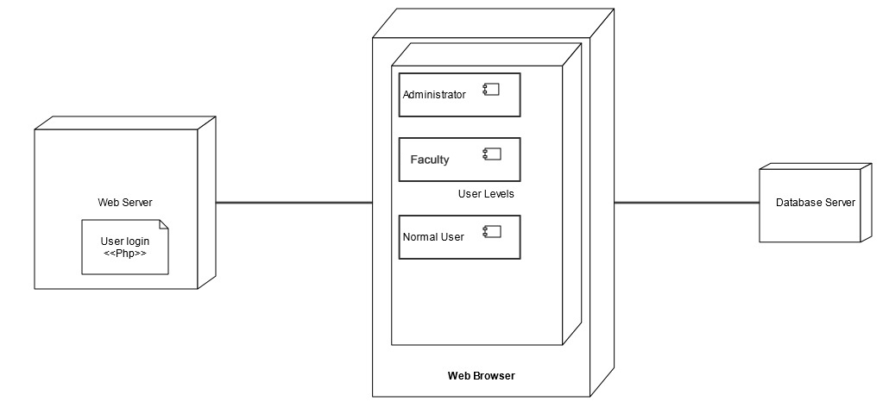
Deployment Diagram

Slide 23
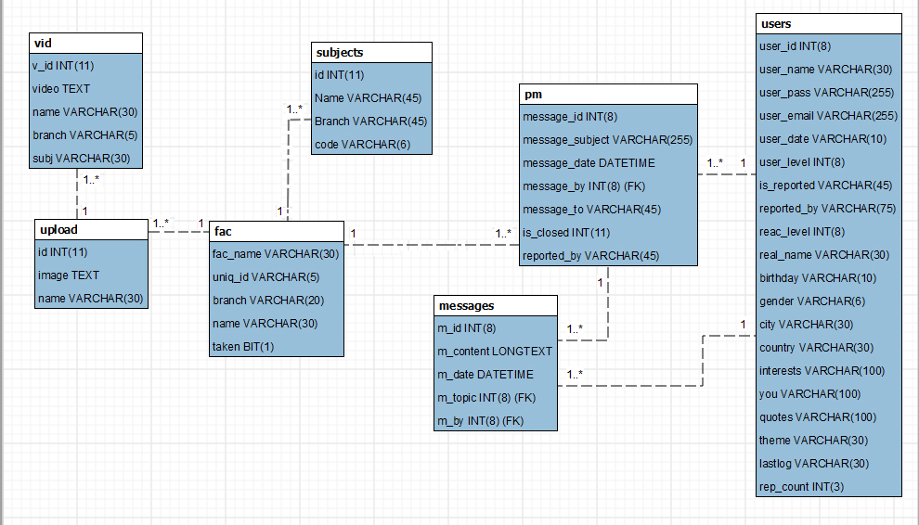
E-R Diagram

Slide 24
Test Cases
Test case ID: T01 Test Description: User account creation Function to be tested: User account should be created Environment: Win 7 Test Execution: 1. Open website 2. Type username 3. Type password 4. Click Create.
Expected Result: Shows a successful registration notice.
Actual Result: pass

Slide 25
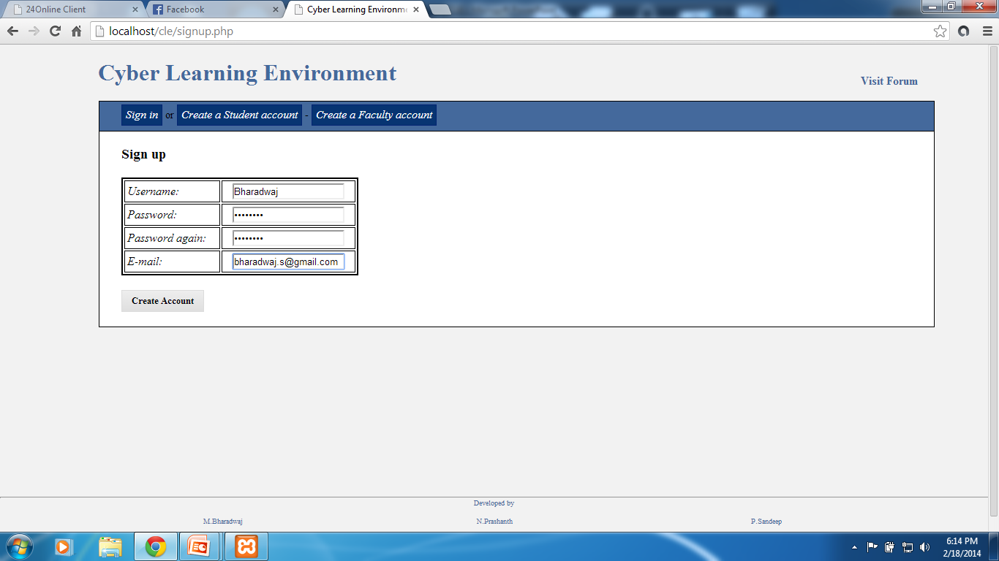
User account creation

Slide 26
Test Cases
Test case ID: T02 Test Description: User Login Function to be tested: Open Home Page after successful login. Environment: Win 7 Test Execution: 1. Open website 2. Type username 3. Type password 4. Click Login.
Expected Result: Redirects user to home page.
Actual Result: pass

Slide 27
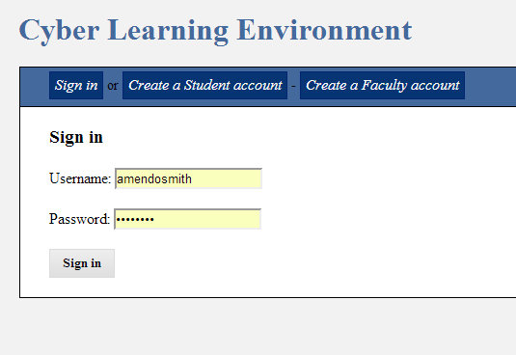
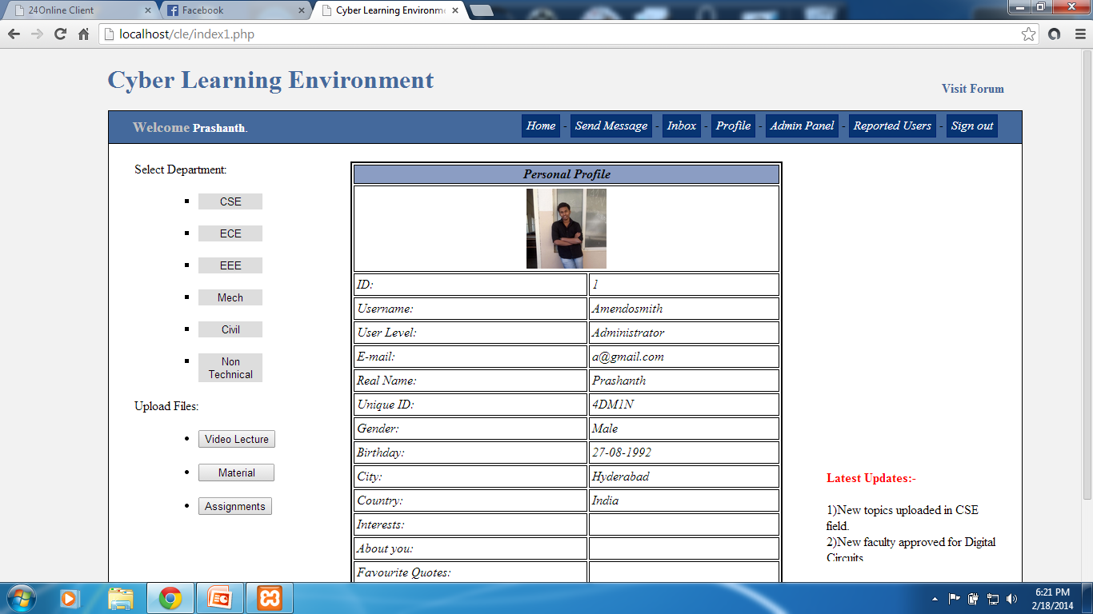
User Login
Before Sign-in
After Sign-in

Slide 28
Test Cases
Test case ID: T03 Test Description: Adding Faculty Function to be tested: Faculty account should be added.
Environment: Win 7 Test Execution: 1. Open website 2. Login as Admin 3. Go to Admin Panel
4.Add Faculty details with Unique ID. 5. Click Register.
Expected Result: Faculty Unique ID added to database.
Actual Result: pass

Slide 29
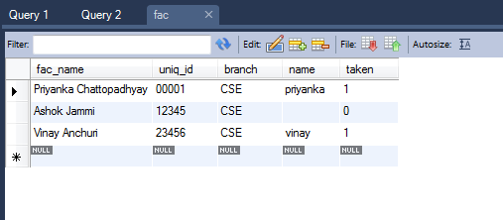
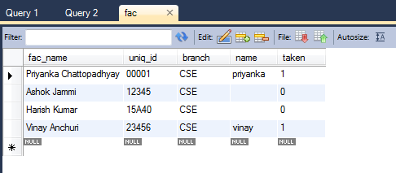
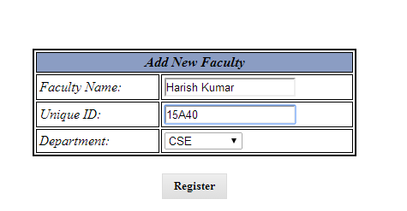
Adding Faculty
Before Registering
After Registering

Slide 30
Test Cases
Test case ID: T04 Test Description: Upload Files Function to be tested: Files must be uploaded to server Environment: Win 7 Test Execution: 1. Open website 2. Login as either Faculty or Admin 3. Select the type of resource to upload.
4.Fill the details of file 5. Click Upload.
Expected Result: Shows a successful upload notice.
Actual Result: pass

Slide 31
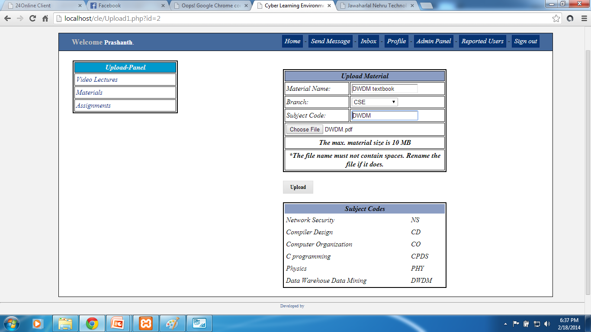
Upload Files

Slide 32
Test Cases
Test case ID: T05 Test Description: Sending Messages Function to be tested: Correct user must receive the message. Environment: Win 7 Test Execution: 1. Open website 2. Login with user-id. 3. Go to Send Messages page.
4.Create your message 5. Click Send.
Expected Result: Opens the sent message in conversational threaded style.
Actual Result: pass

Slide 33
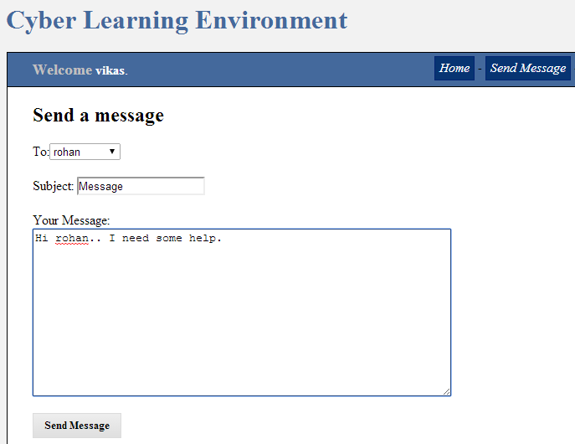
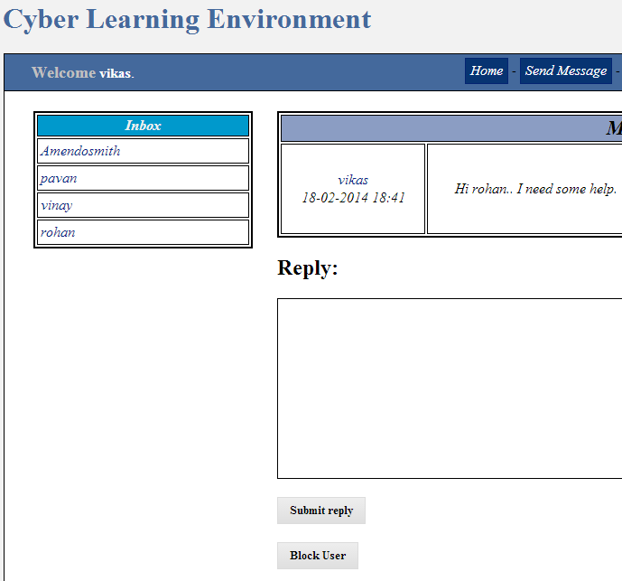
Sending Messages
Before
After

Slide 34
Test Cases
Test case ID: T06 Test Description: Report users Function to be tested: Specific user must be reported. Environment: Win 7 Test Execution: 1. Open website 2. Login as student or faculty 3. Go to users reporting page 4. Check the specific user
5.Click Report.
Expected Result: Lists the selected user under reported users list.
Actual Result: pass

Slide 35
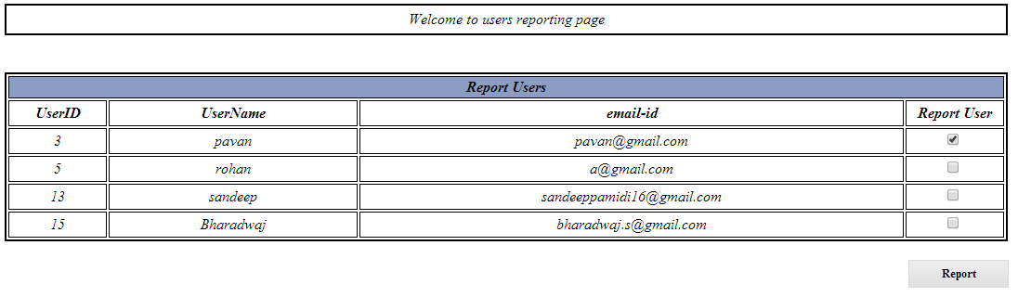
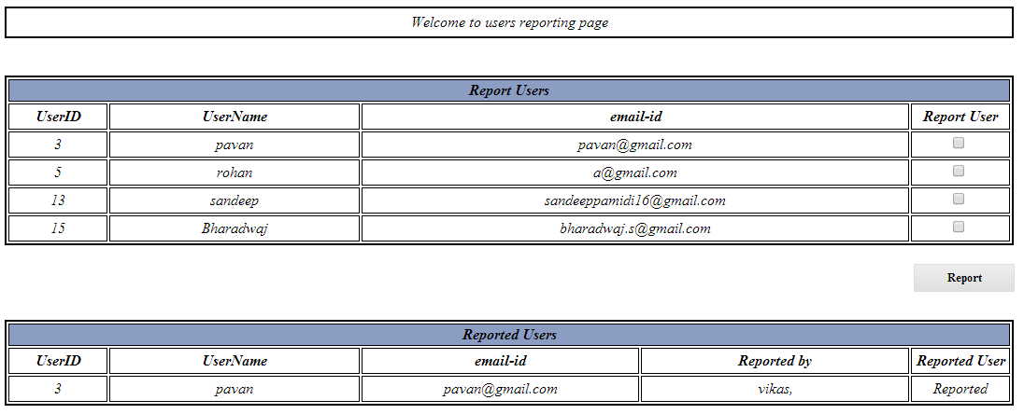
Reporting Users
Before
After

Slide 36
Test Cases
Test case ID: T07 Test Description: File upload limit test Function to be tested: Size and type of files to be accepted for upload Environment: Win 7 Test Execution: 1. Open website 2. Login as Admin or Faculty 3. Select the type of resource to upload.
4.Select a file larger than upload limit or of different type. 4. Click Upload.
Expected Result: Shows a notification with the reason for upload failure.
Actual Result: pass

Slide 37
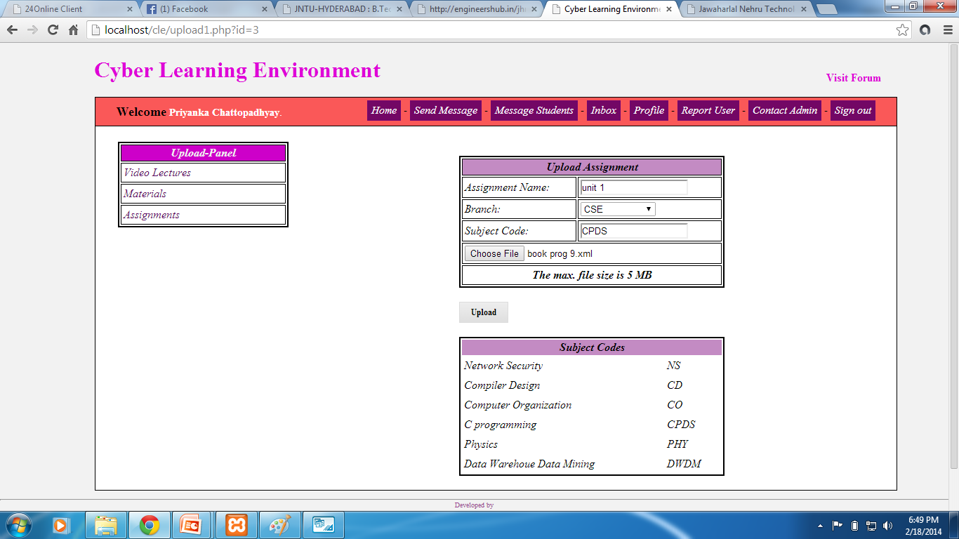
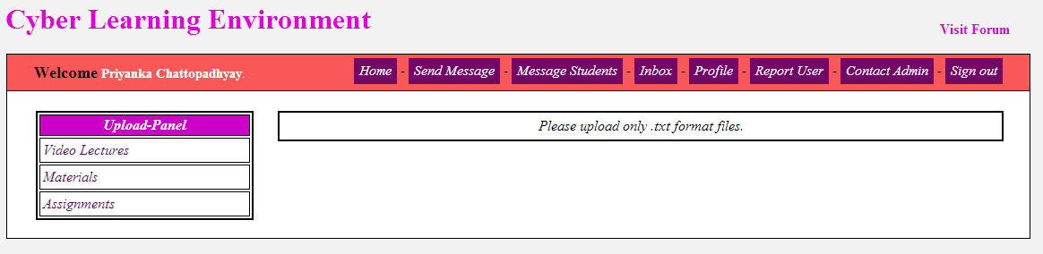
File Upload Limits

Slide 38
Working Screenshots

Slide 39
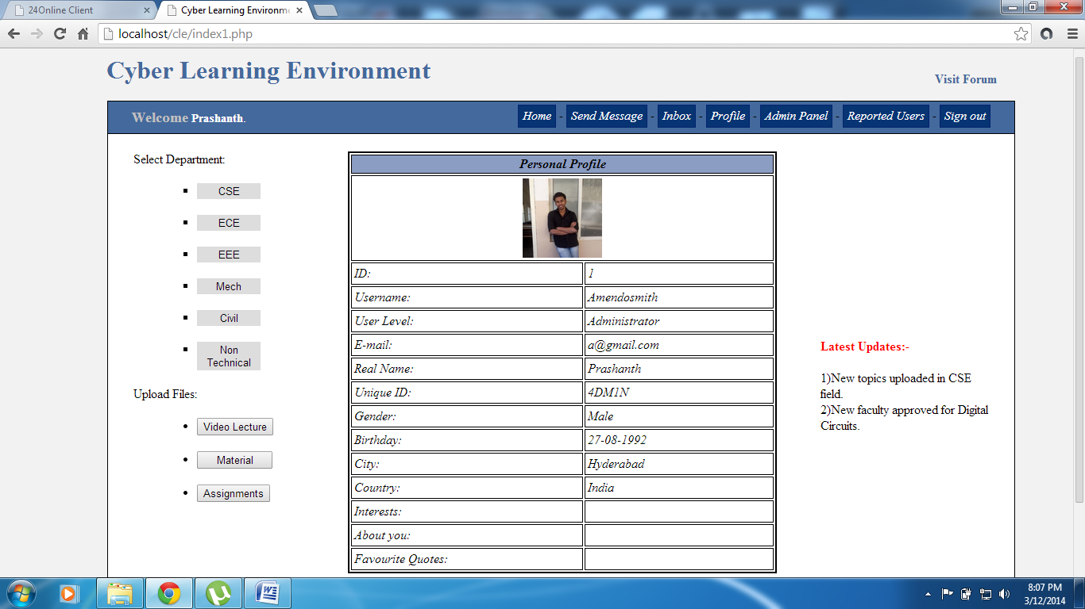
Home Page

Slide 40
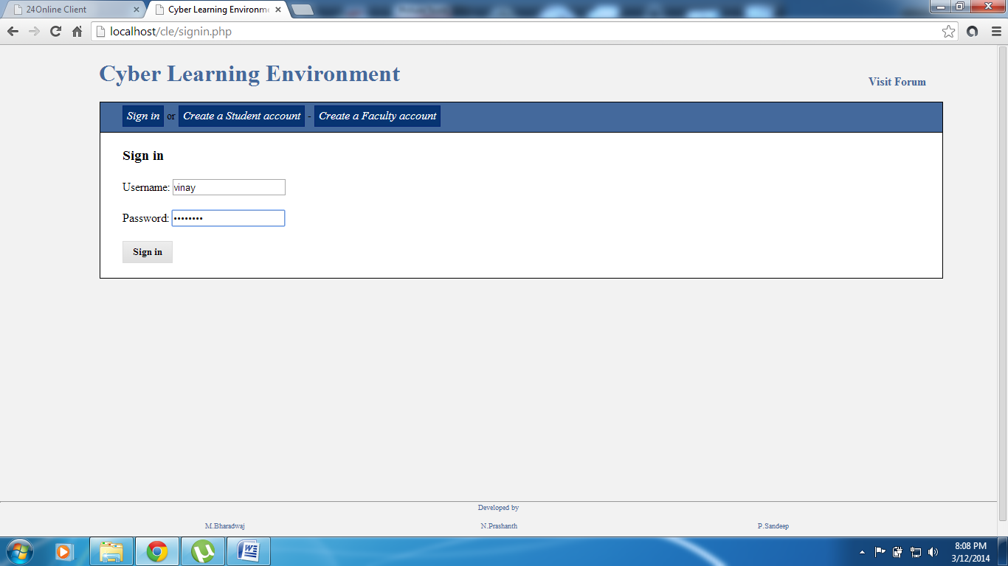
Sign-in Page

Slide 41
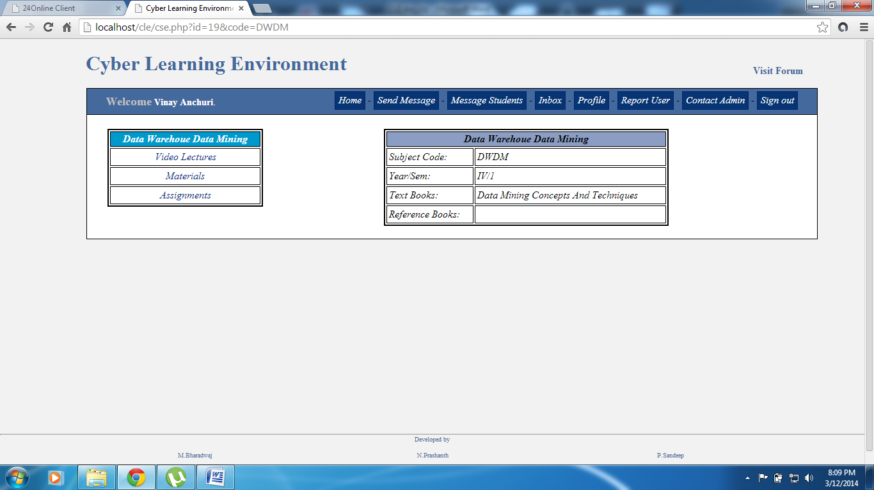
Subject Materials

Slide 42
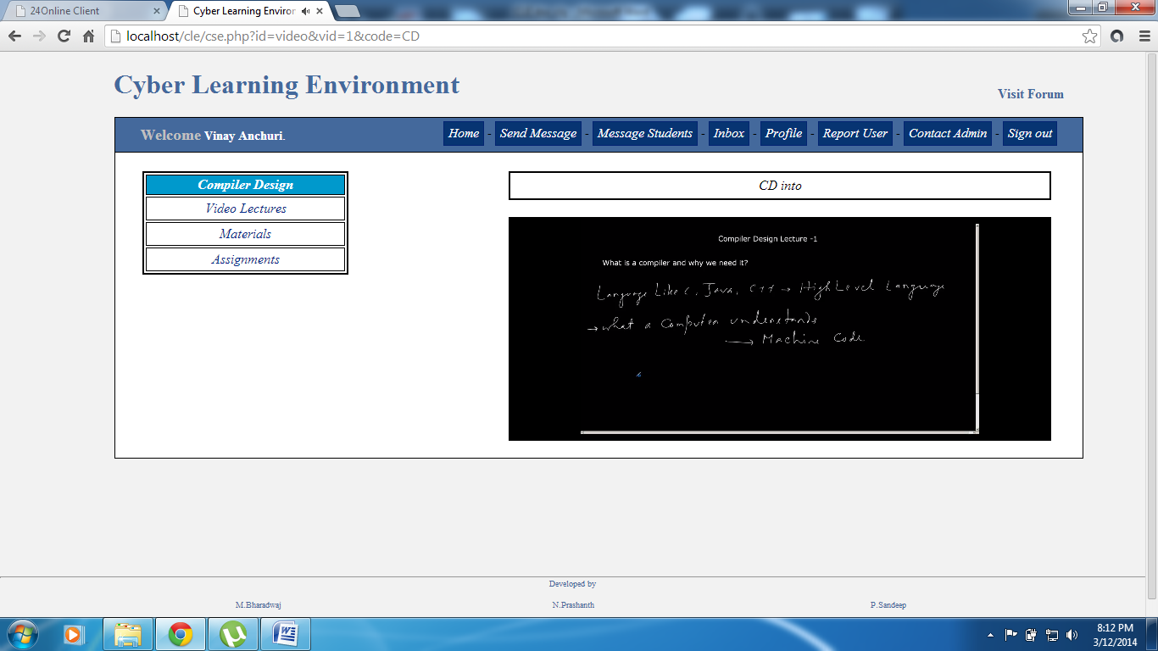
Video Lectures

Slide 43
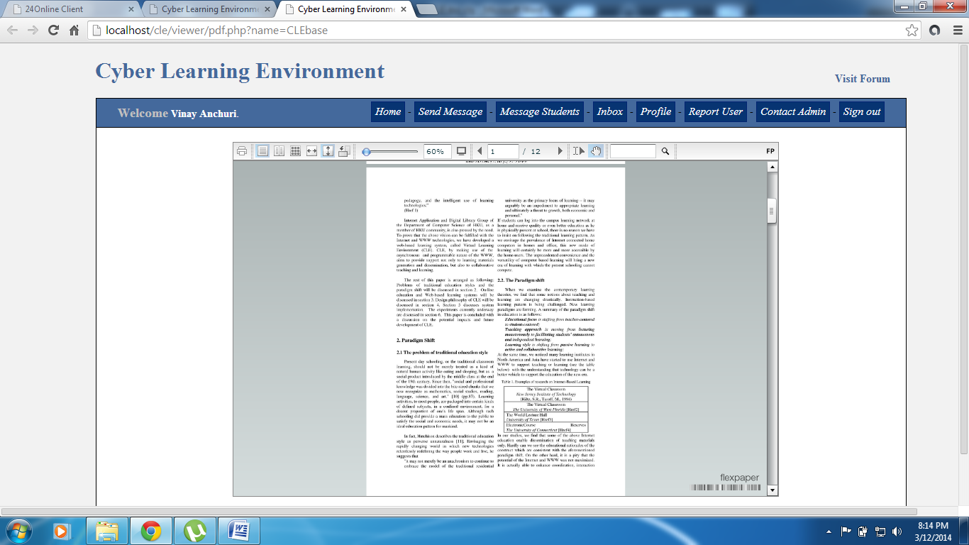
Pdf Viewer

Slide 44
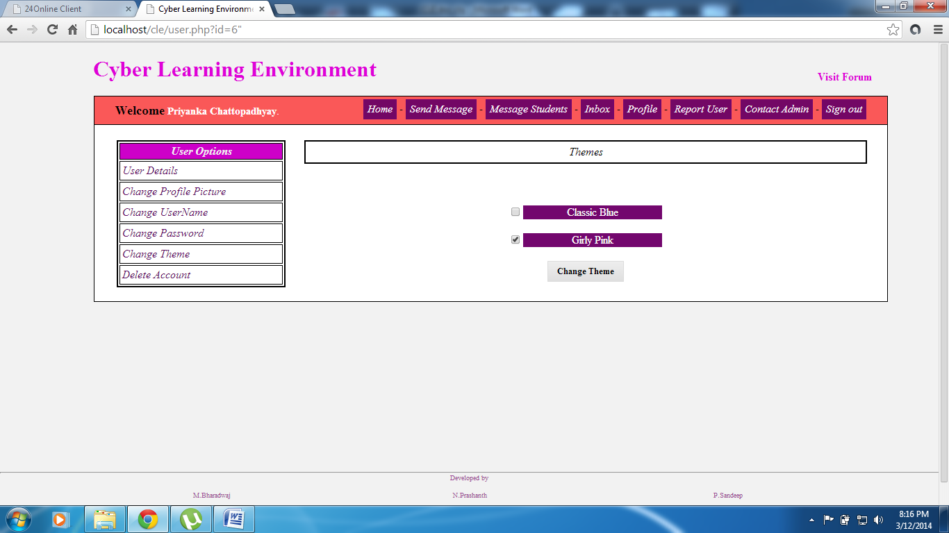
Themes

Slide 45
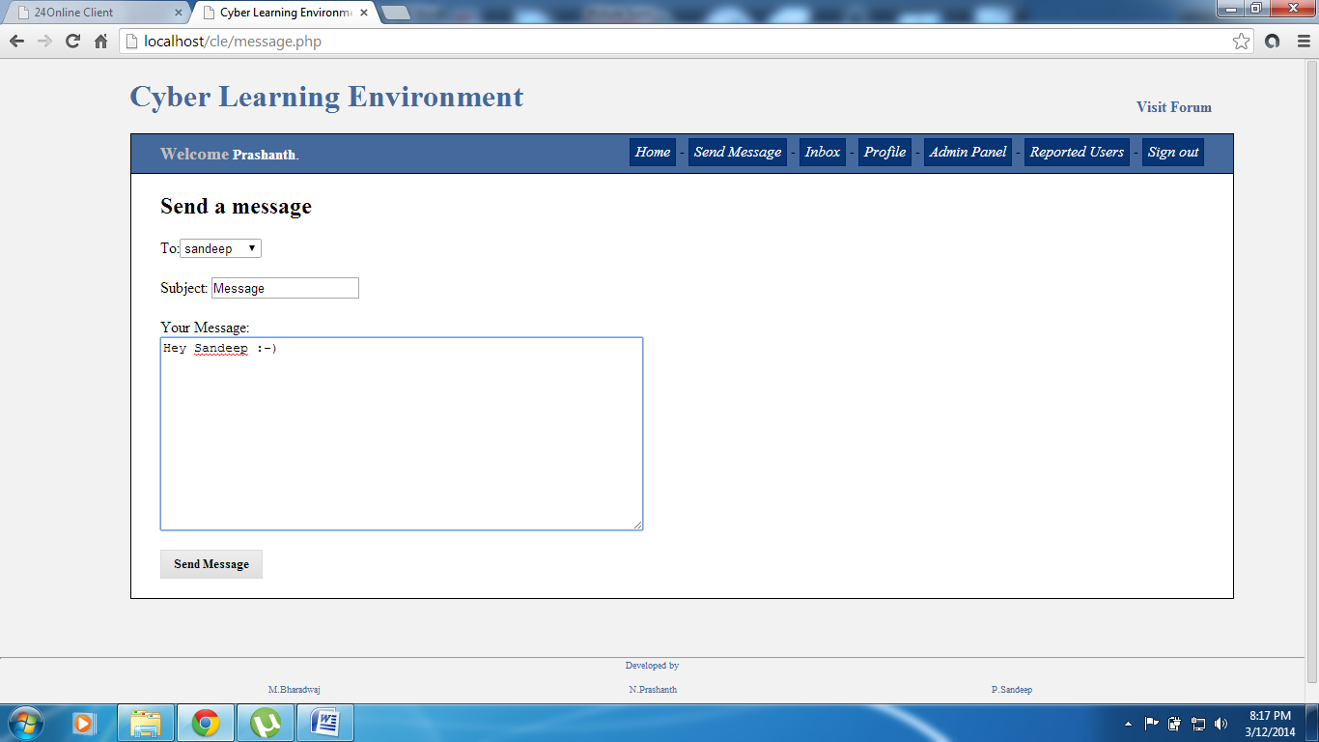
Sending Messages

Slide 46
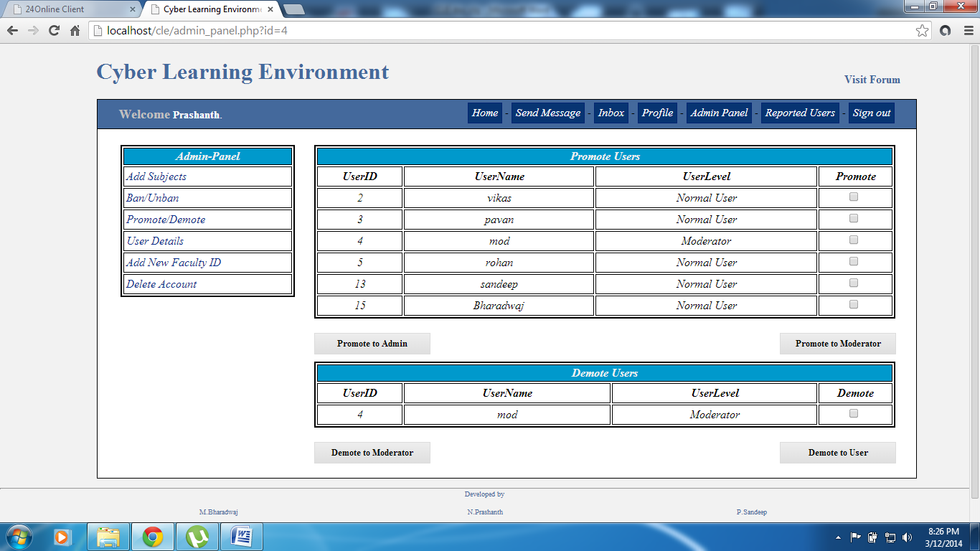
Promote Users

Slide 47
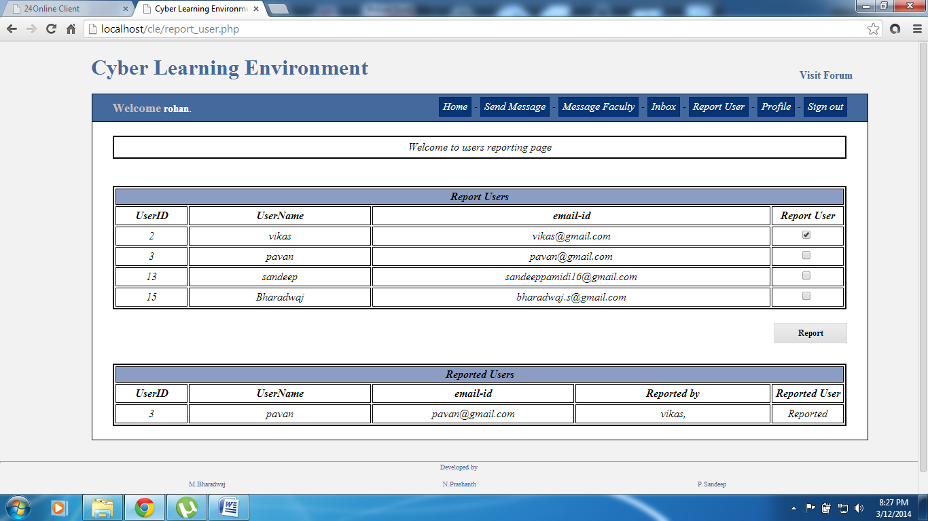
Report Users

Slide 48
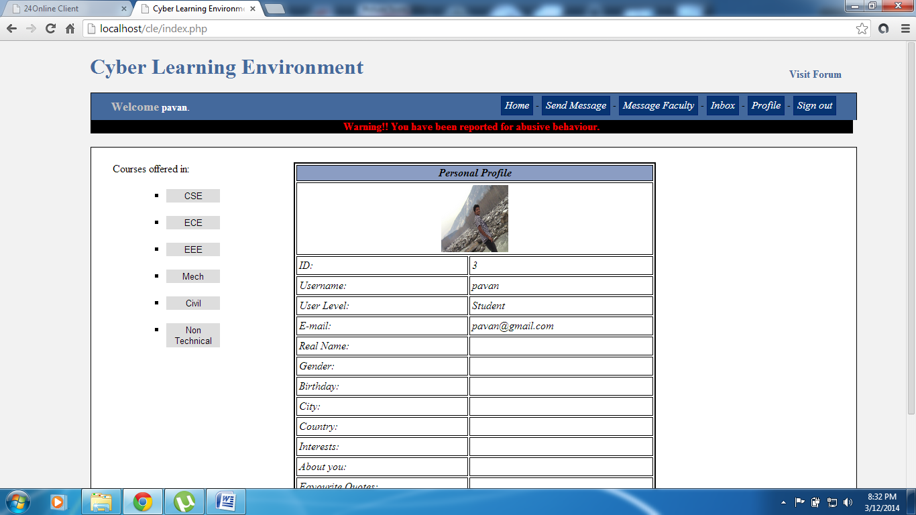
Reported Users Home Page

Slide 49
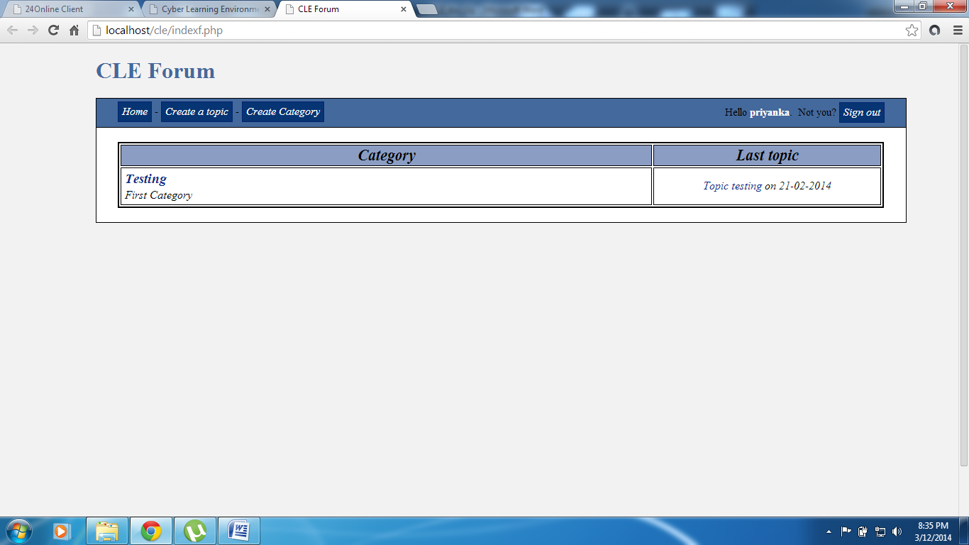
Forum

Slide 50
Any Queries??
Thank You

