Slide 1



Benchmarks for a 176-Person Network Infrastructure
As we analyze the benchmark for a 176-person network infrastructure, it's crucial to consider various factors such as scalability, security, and performance.
by HENIN Stephane

Slide 2
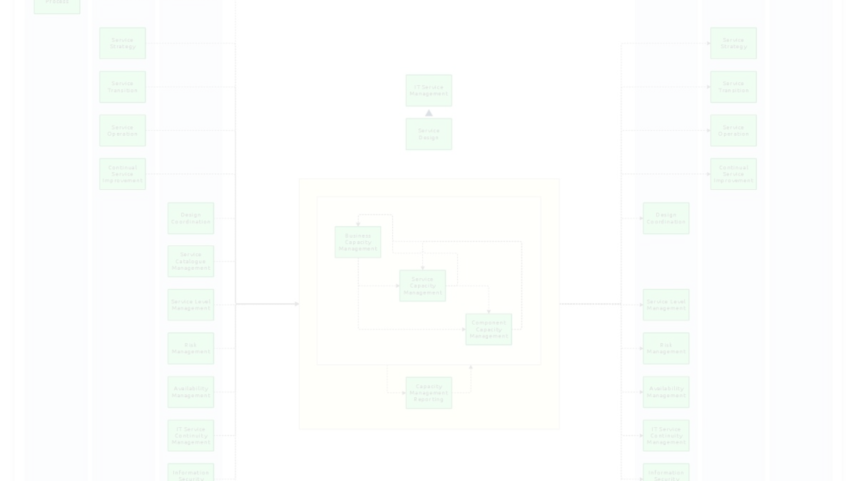
Capacity Planning
1
Bandwidth Requirements
2
Server Load Balancing
3
Future-Proofing
Consider scalability to ensure the network can accommodate future growth and technological advancements.
Calculate the bandwidth needs for smooth data transmission and user experience across the network.
Implement load balancing to evenly distribute network traffic and prevent server overloads.

Slide 3
Security Measures
Firewalls
Intrusion Detection Systems
Access Control Policies
Utilize firewalls to monitor and restrict unauthorized access while allowing legitimate data to pass through.
Define and enforce access policies to ensure that only authorized individuals can access the network resources.
Implement IDS to detect and respond to potential security threats in real-time.

Slide 4
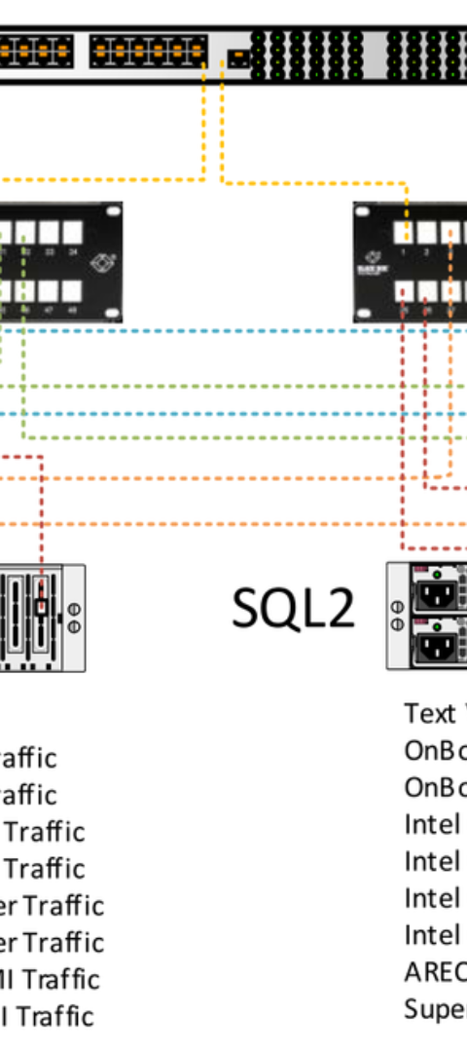
Scalability and Redundancy
1
Evaluating Growth
Analyze the network's ability to accommodate additional devices and users as the company expands.
2
Implementing Redundancy
Introduce redundant systems and backups to ensure continuity of operations in the event of failures or disasters.
3
Testing and Optimization
Conduct regular testing and performance optimization to maintain seamless operations during growth.

Slide 5
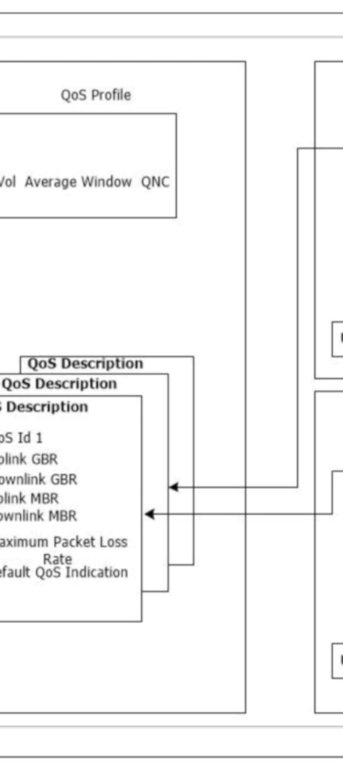
Quality of Service (QoS)
Priority Packet Handling
Bandwidth Allocation
Implement packet prioritization to ensure critical data receives preferential treatment, optimizing network performance.
Allocate bandwidth judiciously to different applications and users, maintaining a high quality of service overall.

Slide 6




Network Monitoring and Reporting
Real-Time Monitoring
Implement real-time monitoring to identify and address potential issues as they arise, ensuring network stability.
Data Analysis
Analyze network performance data to optimize configurations and preemptively address emerging trends and issues.
Comprehensive Reporting
Generate detailed reports to provide insights into network utilization, performance, and potential areas for improvement.

Slide 7
Disaster Recovery and Business Continuity
1
Backup Systems
2
Emergency Response Plan
3
Regular Testing
Implement robust backup solutions to ensure minimal data loss and quick recovery in case of network disruptions.
Conduct routine disaster recovery drills to validate and improve the effectiveness of the business continuity plan.
Establish clear guidelines and procedures to react promptly in the event of network outages or data breaches.

Slide 8
Virtual Private Network (VPN) Implementation
Secure Remote Access
Encryption Protocols
Enable secure access to the company's network for remote employees while maintaining data privacy and integrity.
Implement robust encryption methods to secure data transmitted over the VPN, safeguarding against unauthorized interception.

Slide 9


Regulatory Compliance and Data Privacy
99%
Data Privacy Compliance
Ensure stringent adherence to data privacy regulations, aiming for a 99% compliance rate across the network infrastructure.
Policy Implementation
Audit and Validation
Enforce solid security policies and regulatory measures to protect sensitive data and maintain legal compliance.
Regularly conduct audits and validation checks to ensure continuous alignment with data privacy regulations.

Slide 10
Documentation and Knowledge Transfer
Comprehensive Documentation
Ensure thorough and up-to-date documentation of network configurations, procedures, and best practices.
Training Programs
Develop knowledge transfer programs to equip IT staff with the necessary skills for managing the network infrastructure effectively.

