Slide 1

Web scraping Public Goods
Analyzing product data to discover trends in price and rating across product categories.

Slide 2
What is Public Goods?
Public Goods is a membership-based online home goods store with a focus on quality, sustainability, and simplicity.
Members pay an annual fee of $59 to access lower priced items, with a complementary two-week trial period with your first purchase.
Product Categories are: Personal Care, Household, Grocery, Supplement & Vitamins, Pets, and CBD.
More information about their mission statement and commitment to sustainability can be found here.

Slide 3
Motivation
Inform stakeholder , in this case – Public Goods, what products are highly rated and reviewed, and if price plays a factor.
This analysis can inform R&D or Purchasing Department as to what future products to manufacture and at what price point.
Increase engagement – i.e decrease potential churn rate by way of offering promotions if customers are dissatisfied with a product.
Eliminate or improve products that aren’t well received by members or customers.

Slide 4
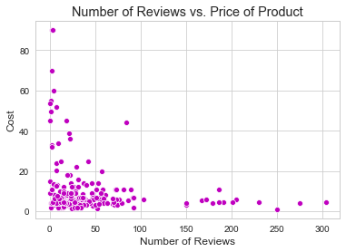
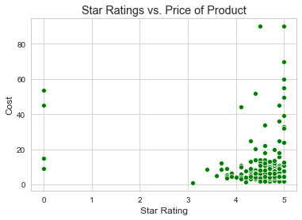
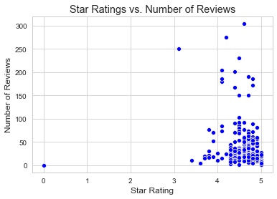
Outcomes
*In some cases, the lower the price of the product, the higher the rating. This is not true across all categories.
*Number of reviews may be affected by price point, but there are other features to consider.
*Star ratings from 3 – 4 have a lower range of number of reviews. Whereas star ratings from 4 -5 have a more inclusive range.
Domestic: 154, International: 92, Domestic & International: 4
Customers love their grocery and pet products!

Slide 5
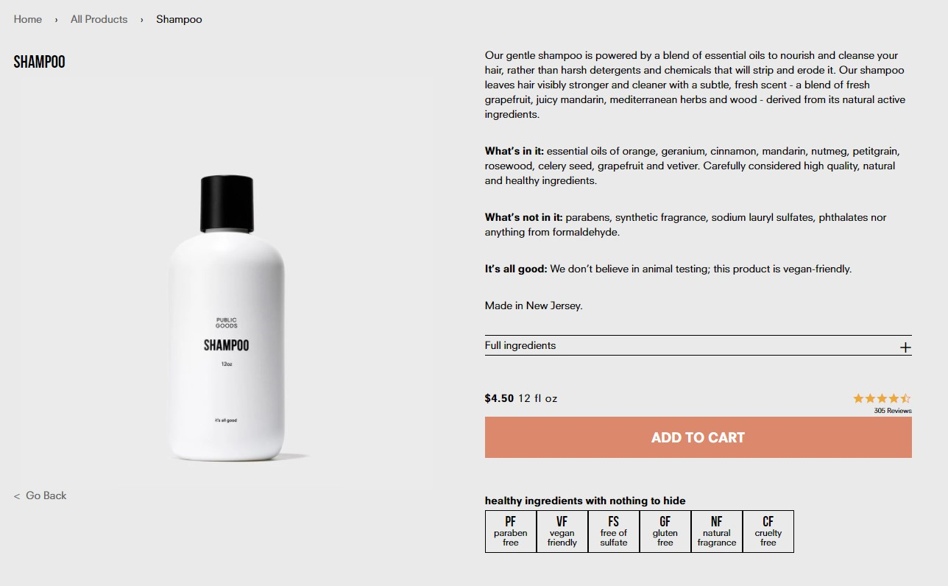
Scraped Data

Slide 6
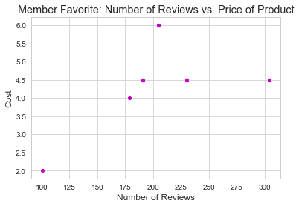
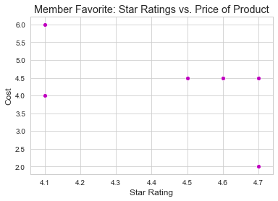
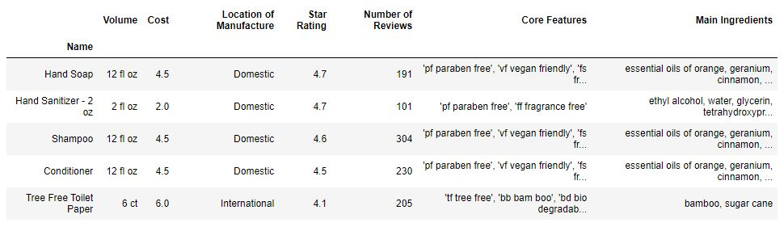
Member’s Favorite

Slide 7
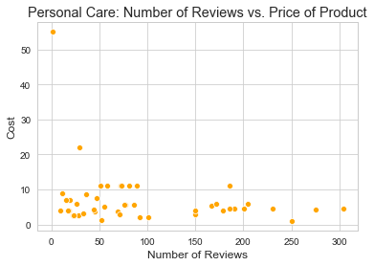
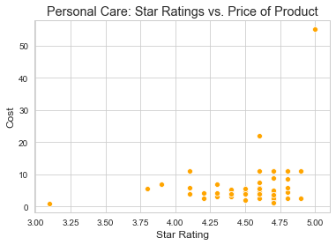
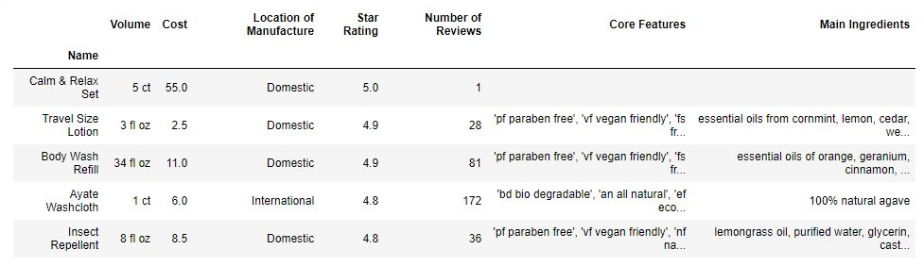
Personal Care

Slide 8
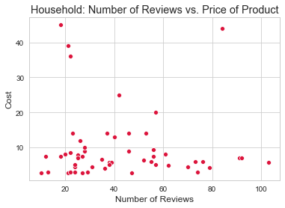
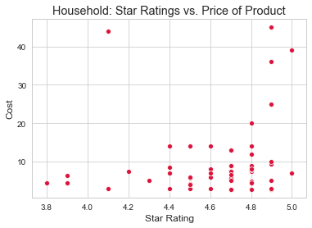
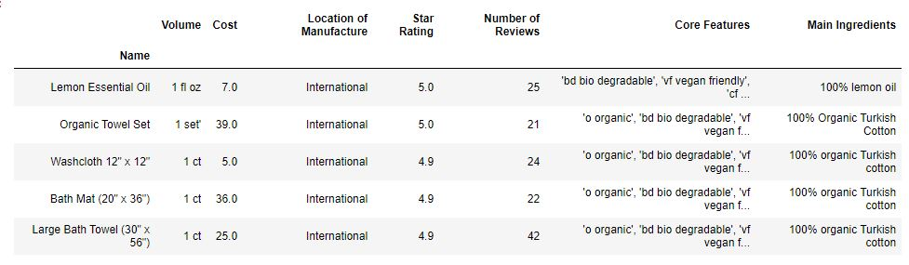
Household

Slide 9
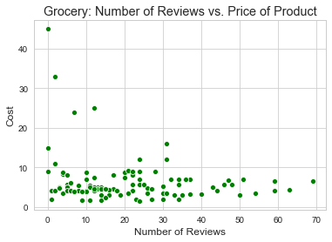
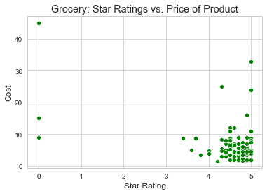
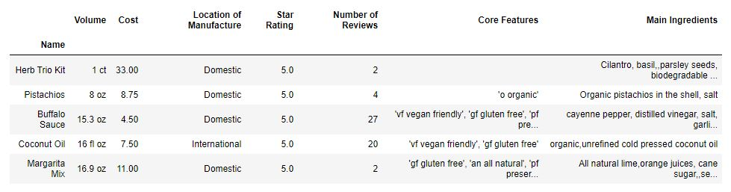
Groceries

Slide 10
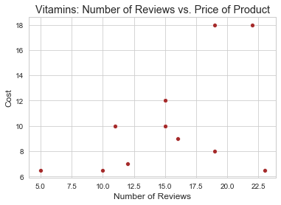
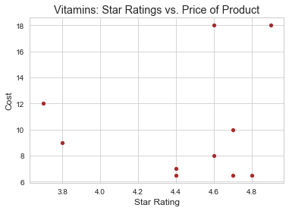
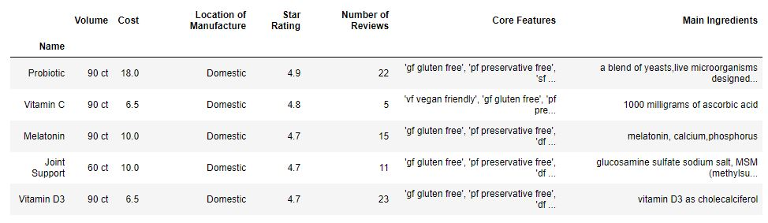
Vitamins & Supplements

Slide 11
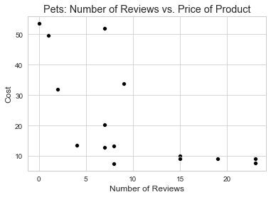
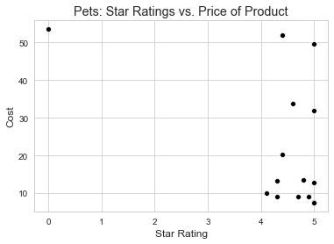
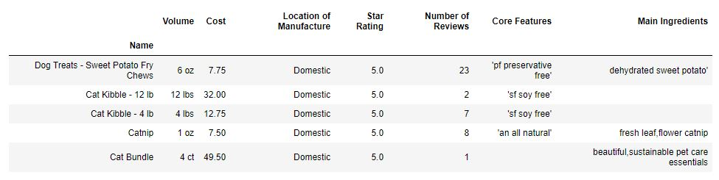
Pets

Slide 12
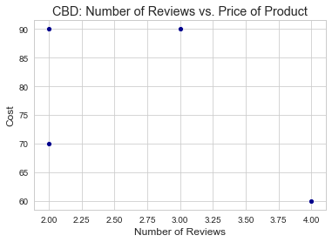
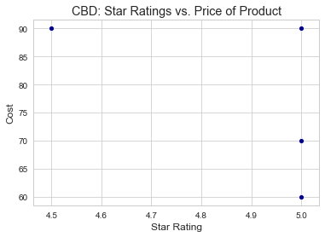
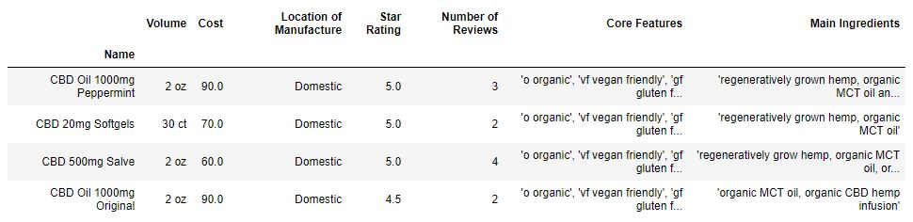
CBD

Slide 13
Next Steps
Investigating if variables such as: core features and main ingredients influence star ratings and reviews.
Text Sentient Analysis / NLP
Acquiring revenue data.
Integrating competitor data – i.e Brandless, Amazon Prime, etc.
Acquiring actual data on how negative reviews effect business revenue and churn.

