Slide 1
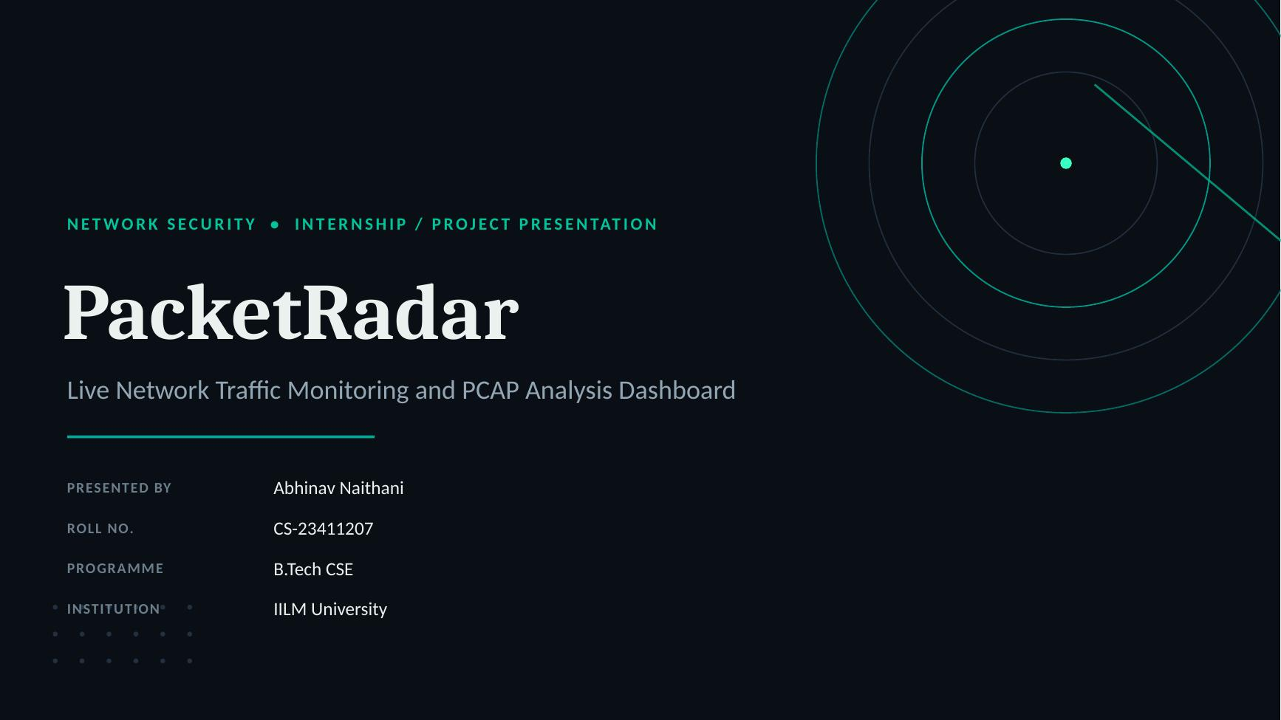

Slide 2
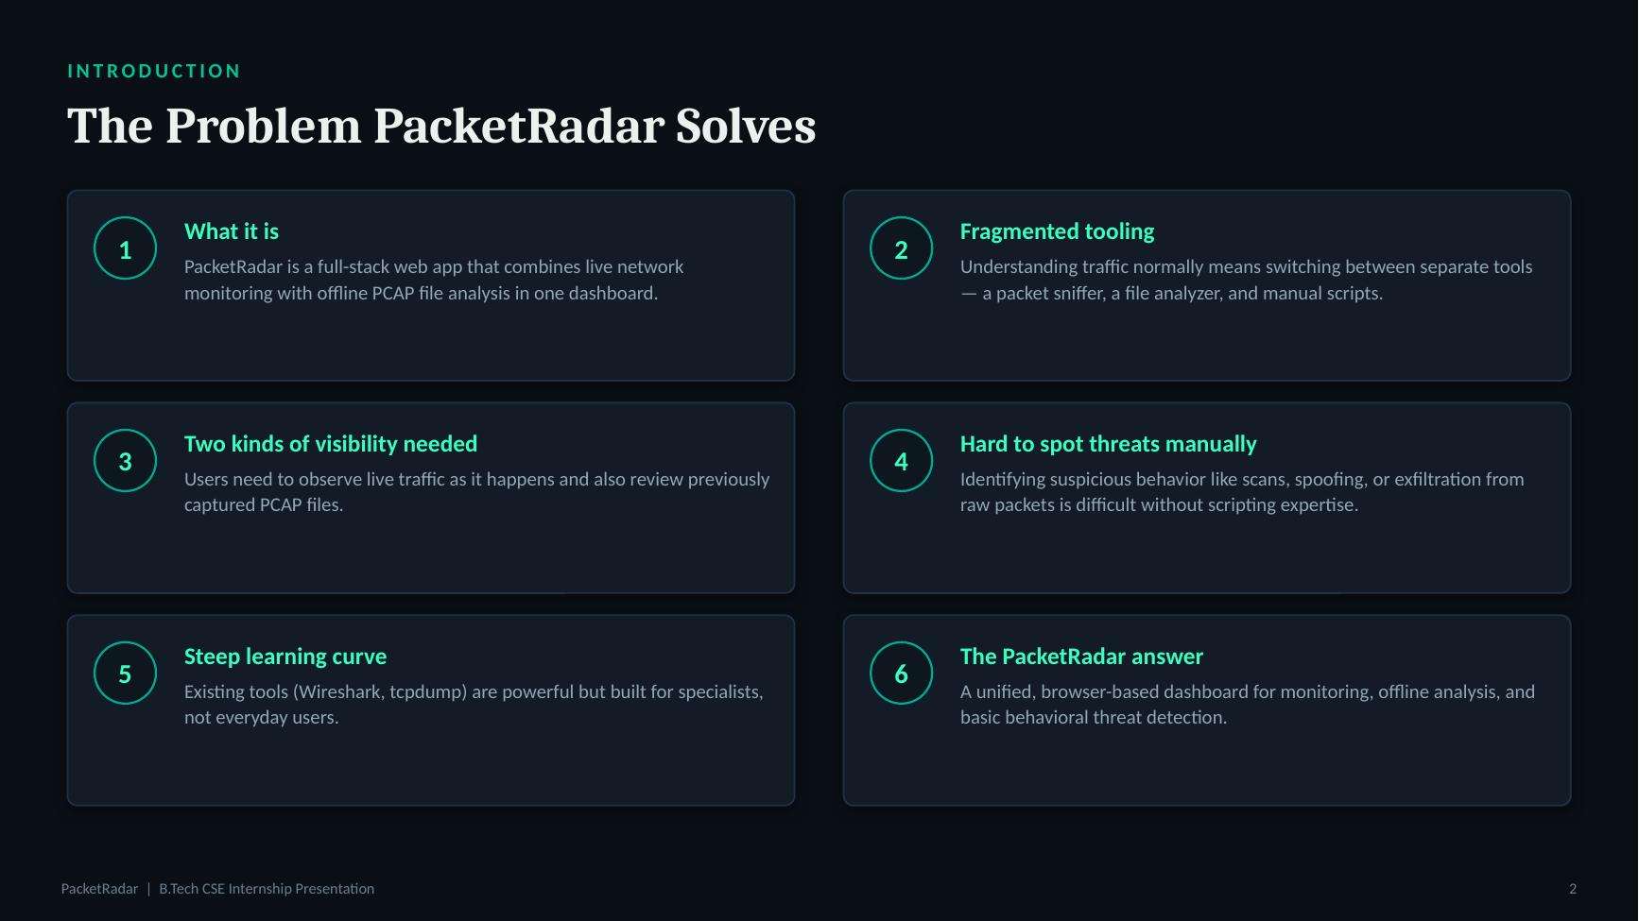

Slide 3
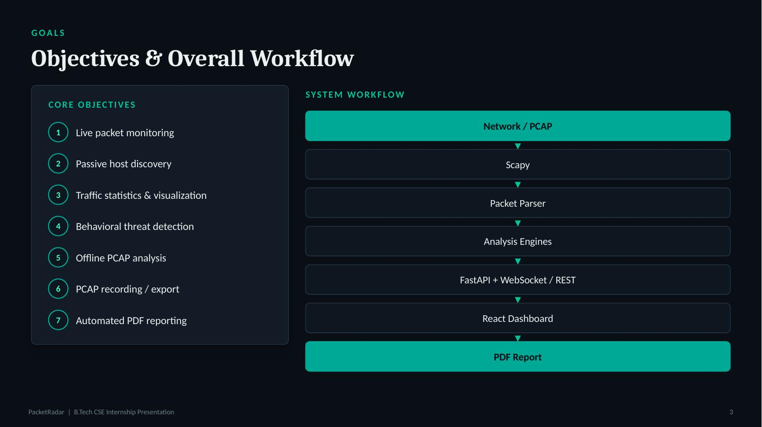

Slide 4
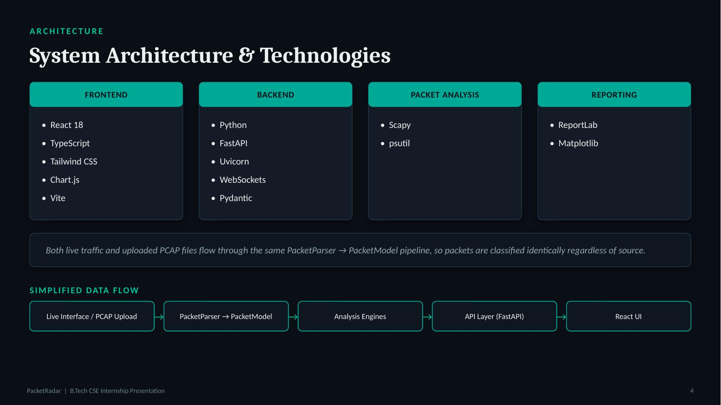

Slide 5
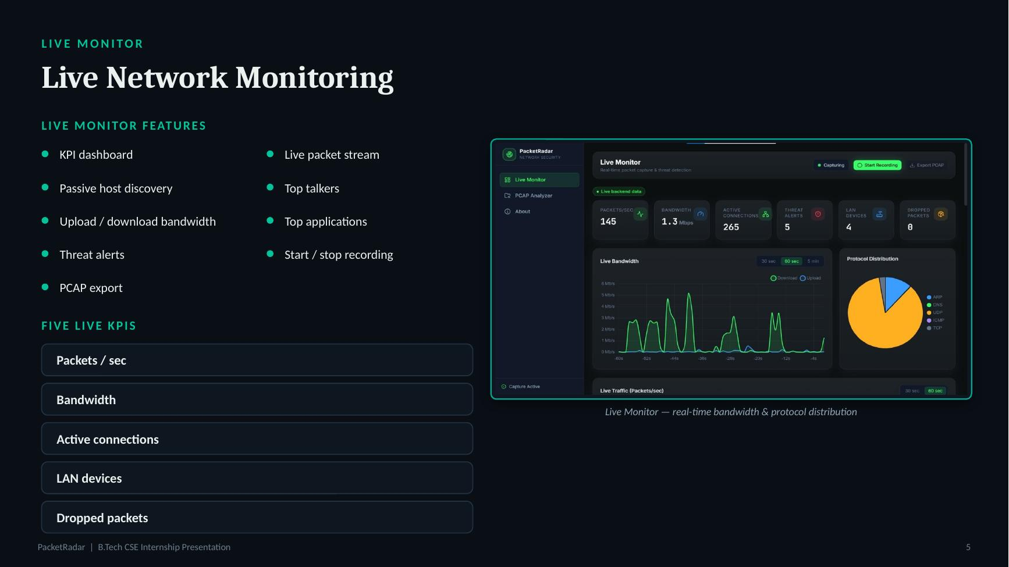

Slide 6
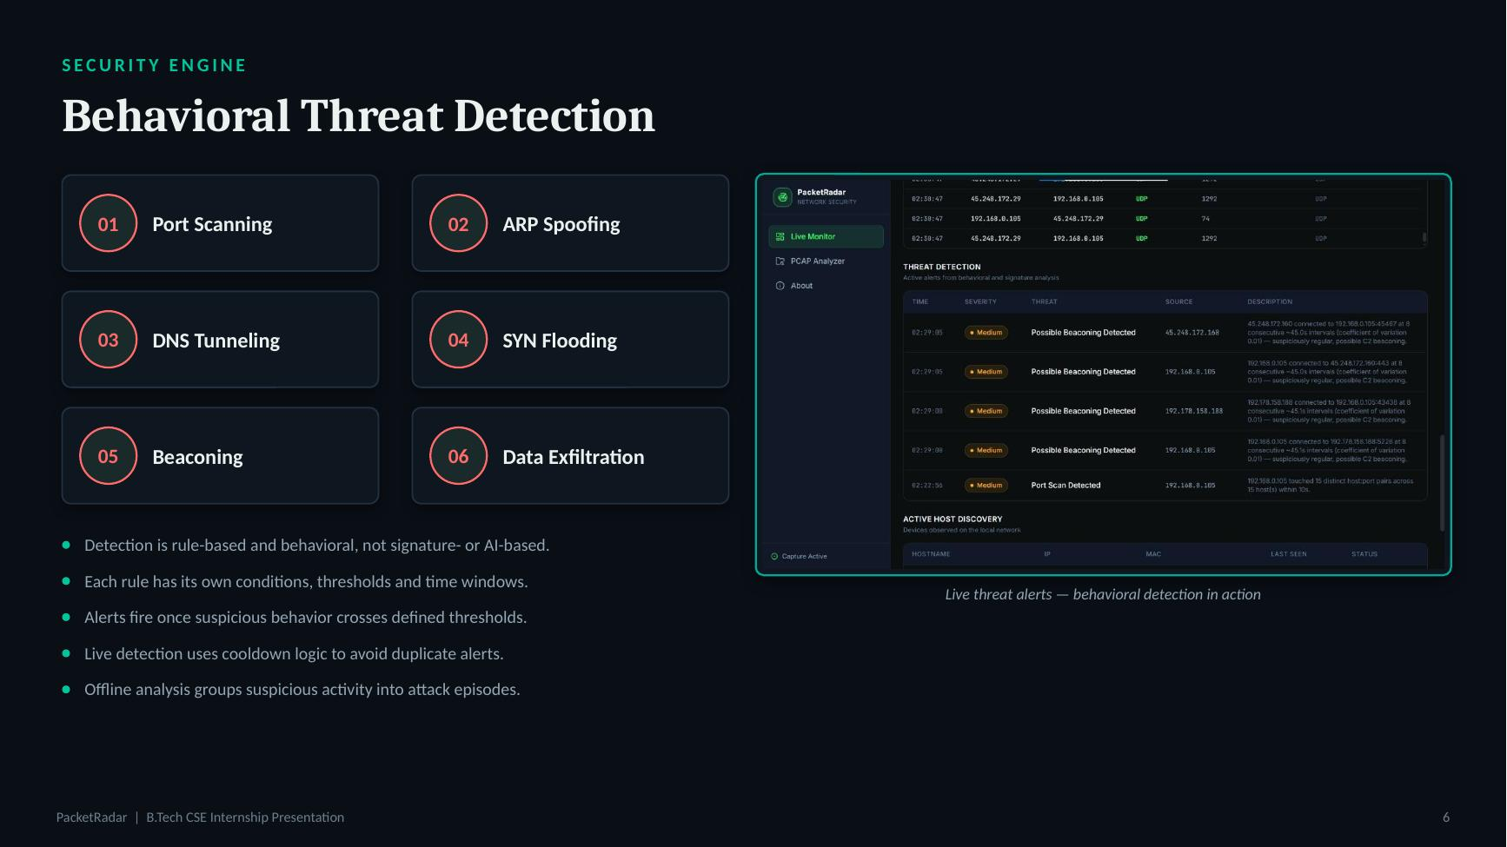

Slide 7
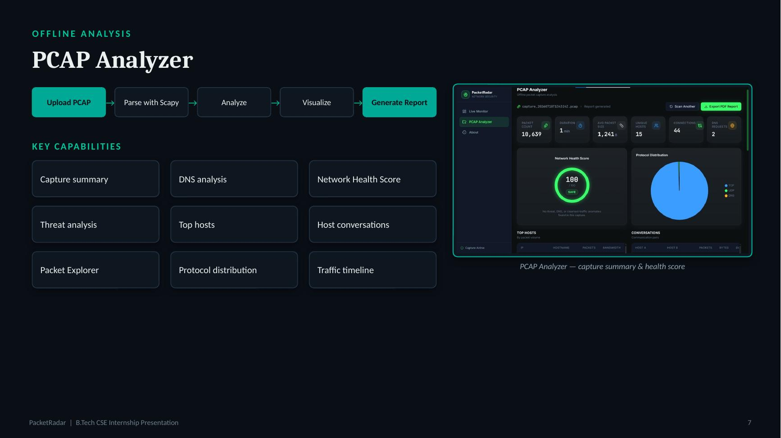

Slide 8
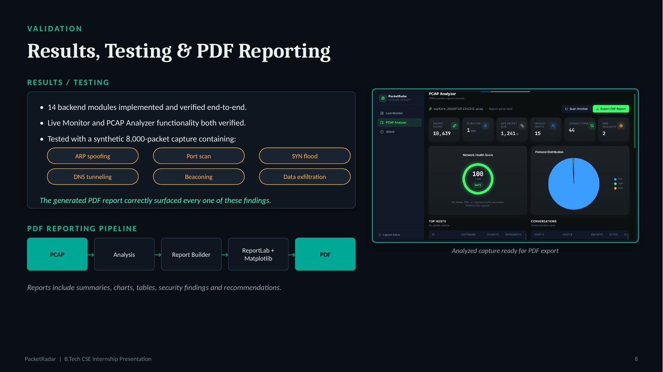

Slide 9
WRAP-UP
Limitations & Conclusion
LIMITATIONS
CONCLUSION
HTTP/HTTPS classified by port, not fully decoded at the application layer
PacketRadar demonstrates a working web-based approach for combining live network monitoring, offline PCAP analysis, behavioral threat detection and automated reporting in a single application.
TLS certificate and SNI details are not extracted
Some hostname and MAC-vendor information can remain unknown
ICMP type/code analysis is limited
TCP retransmission detection is heuristic, not full stream reassembly
Threat detection is behavioral and rule-based
No signature-based matching against known-malicious IPs or payloads
No automatic blocking of detected threats
Live monitoring + offline analysis + detection + reporting
PacketRadar | B.Tech CSE Internship Presentation
9

