Slide 1
Important Note Regarding This Microsoft PowerPoint Presentation
* Do not include this slide in your presentation *
This slide deck has been intentionally provided with very limited graphics and formatting to simplify content integration into your own preferred PowerPoint themes and styles.

Slide 2
Security Development Lifecycle (SDL) Field Content
Microsoft SDL
Threat Modeling Principles
(Level 100)

Slide 3
Agenda
Overview of the Microsoft SDL Threat Modeling process
When to threat model
Who performs threat modeling
What to threat model
The Microsoft SDL Threat Modeling process
The Microsoft SDL Threat Modeling Tool
The Microsoft SDL threat modeling requirements

Slide 4
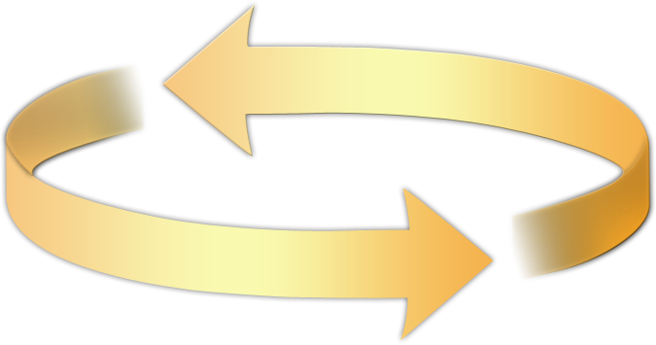
Microsoft Security Development Lifecycle (SDL)
Training
Requirem-ents
Design
Implemen-tation
Verification
Release
Response
Delivering secure software requires:
Executive commitment → SDL a mandatory policy at Microsoft since 2004
Education
Technology and Process
Accountability
Ongoing Process Improvements → 6 month cycle

Slide 5
Microsoft SDL Threat Modeling Overview
Microsoft SDL Threat Modeling: A process to understand security threats to a system, determine risks from those threats, and establish appropriate mitigations
Key requirement for applications developed with the Microsoft SDL
Microsoft SDL Threat Modeling
Diagramming
Threat Enumeration
Mitigation
Validation
Can be performed by both security and non-security experts

Slide 6
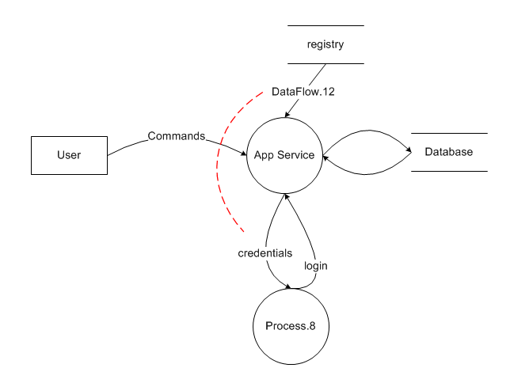

Microsoft SDL Threat Modeling Illustrated
Registry
R
I
✓
S
T
D
E
Database Server
Application Service
Authentication / Authorization
Services

Slide 7
When to Threat Model
Training
Requirem-ents
Design
Implemen-tation
Verification
Release
Response
Best performed during the application design phase
Easiest to make application changes
Less costly than adding mitigations and testing them after code has been implemented and onwards

Slide 8
Who Performs/Drives Threat Modeling?
The Microsoft SDL Threat Modeling process can be performed by:
Security experts
Non-security experts
The threat modeling process should be driven by:
Application designers; however, developers and testers should be involved

Slide 9
What To Threat Model
The application as a whole
Security and privacy features
Features whose failures have security or privacy implications
Features that cross trust boundaries

Slide 10
Top Microsoft SDL Threat Modeling Advantages and Disadvantages
Advantages
Can be used to find threats to a system early in the development process
Can be used by both security experts and non-security experts
Can be used to guide other security assessment activities
Disadvantages
Upfront costs (training, software, and setup)

Slide 11
The Microsoft SDL Threat Modeling Process
Vision
Step 1: Model
Step 2: Enumerate Threats
Step 3: Mitigate
Step 4: Validate
Product
Development

Slide 12
Step 1: Diagramming
Step Objective: To model an application design as a data flow diagram to drive threat analysis
Data flow diagrams (DFDs)
Widely used and easily understood graphical representation
Most attacks based on data flowing through an application or system
Trust boundaries

Slide 13
Data Flow Diagrams (DFDs) Elements
Element | Represented By | Description
External Entity |  | Any entity not within the control of the application, such as people and external systems
Process |  | Code, such as native code executables and .NET assemblies
Data Store |  | Data at rest, such as registry keys and databases
Data Flow |  | How data flows between elements, such as function calls and network data

Slide 14
Additional Element: Trust Boundaries
Element | Represented By | Description
Trust Boundary |  | A point within an application where data flows from one privilege level to another, such as network sockets, external entities and processes with different trust levels

Slide 15
Step 2: Threat Enumeration
Step Objective: To identify threats for each data flow diagram element in the threat model
Experts: Brainstorming and other informal methods
Experts and Non-Experts: STRIDE threat types
Based on Microsoft Security Response Center (MSRC) issues and Common Vulnerability and Exposures (CVE) (see http://cve.mitre.org for more information)

Slide 16
STRIDE Threat Types
Desired Property | Threat | Definition
Authentication | Spoofing | Impersonating something or someone else
Integrity | Tampering | Modifying code or data without authorization
Non-repudiation | Repudiation | The ability to claim to have not performed some action against an application
Confidentiality | Information Disclosure | The exposure of information to unauthorized users
Availability | Denial of Service | The ability to deny or degrade a service to legitimate users
Authorization | Elevation of Privilege | The ability of a user to elevate their privileges with an application without authorization

Slide 17
Identifying STRIDE Threats by Data Flow Diagram Element Type
Element | S | T | R | I | D | E
External entity |  |  | 
Process |  |  |  |  |  | 
Data Store |  |  |  |  | 
Data Flow |  |  |  |  | 

Slide 18
Step 3: Mitigation
Step Objective: To address identified threats to an application design
Approaches to threat mitigation (in order of preference):
Redesign
Use standard mitigations
Use unique mitigations
Accept risk in accordance with policies

Slide 19
Examples of Standard Mitigations
Threat | Example Standard Mitigations
Spoofing | IPsec Digital signatures Message authentication codes Hashes
Tampering | ACLs Digital signatures Message Authentication Codes
Repudiation | Strong Authentication Secure logging and auditing
Information Disclosure | Encryption ACLs
Denial of Service | ACLs Quotas High availability designs
Elevation of Privilege | ACLs Group or role membership Input validation
Refer to Chapter 9 of the Microsoft SDL for a more complete listing
http://www.microsoft.com/learning/en/us/books/8753.aspx

Slide 20
Step 4: Validation
Step Objective: To help ensure that threat models accurately reflect application design and potential threats
Validation of the model
Validation of enumerated threats
Validation of mitigations
Validation of assumptions

Slide 21
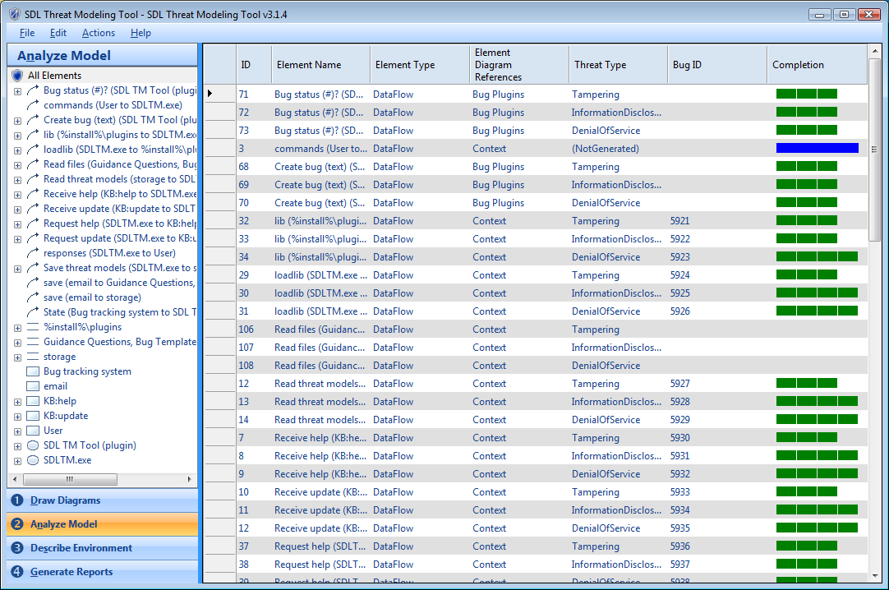
The Microsoft SDL Threat Modeling Tool
Refer to the following link for more information regarding this tool
http://msdn.microsoft.com/en-us/security/dd206731.aspx

Slide 22
Microsoft SDL Threat Modeling Requirements
Threat models must:
Be created for all functionality identified during the cost analysis phase (stage 2) of the Microsoft SDL
Meet minimal quality requirements (refer to chapter 9 of the Microsoft SDL book, http://www.microsoft.com/learning/en/us/books/8753.aspx)
Be reviewed and approved by at least one developer, one tester and one program manager
Be stored using document control systems

Slide 23
Conclusion
Overview of the Microsoft SDL Threat Modeling process
Advantages and disadvantages
Steps of the Microsoft SDL Threat Modeling process
Microsoft Threat Modeling Tool
Microsoft SDL threat modeling requirements

Slide 24
Appendix

Slide 25


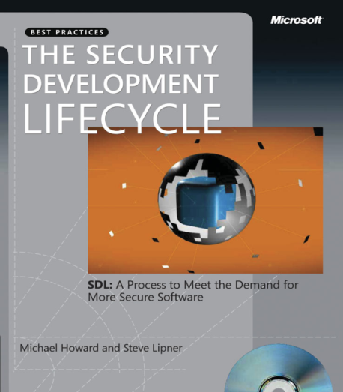


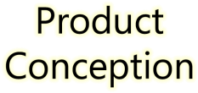
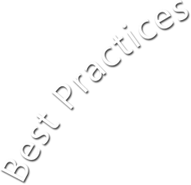
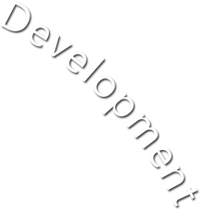













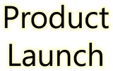







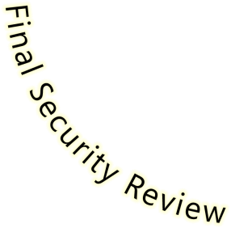
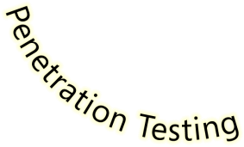

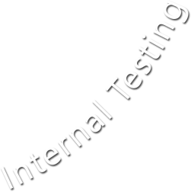





Microsoft Security Development Lifecycle (SDL)
SDL Book:
http://www.microsoft.com/mspress/books/8753.aspx
Official SDL Web Site: http://www.microsoft.com/sdl

Slide 26
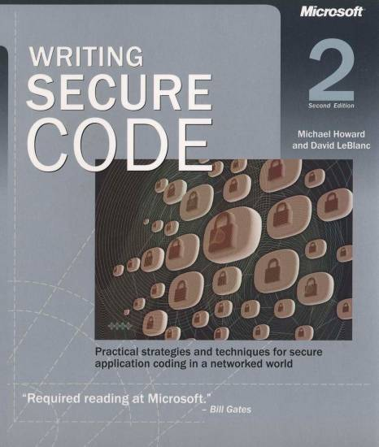
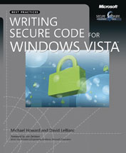
Microsoft Writing Secure Code Book Series
Writing Secure Code,
2nd Edition:
http://www.microsoft.com/mspress/books/5957.aspx
Writing Secure Code for Windows Vista:
http://www.microsoft.com/mspress/books/10723.aspx

Slide 27
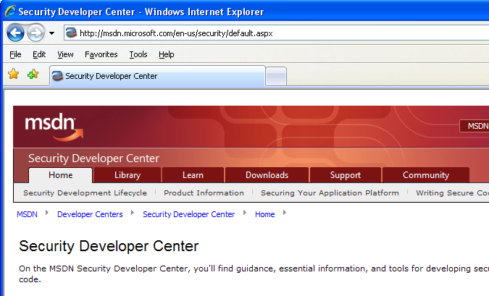

Microsoft Developer Network (MSDN) Security Developer Center
Official Web site: http://msdn.microsoft.com/security

Slide 28
Secure Development Blogs
The Microsoft Security Development Lifecycle (SDL) Blog: http://blogs.msdn.com/sdl
Michael Howard’s Blog: http://blogs.msdn.com/michael_howard

Slide 29

Microsoft Hunting Security Bugs
Hunting Security Bugs:
http://www.microsoft.com/mspress/books/8485.aspx

Slide 30
Additional SDL Training Content
Secure Design Principles
Secure Implementation Principles
Secure Verification Principles
SQL Injection Vulnerabilities
Cross-Site Scripting Vulnerabilities
Buffer Overflow Vulnerabilities

