Slide 1
Reinforcement Learning
Pavlos Protopapas

Slide 2
Motivation

Slide 3
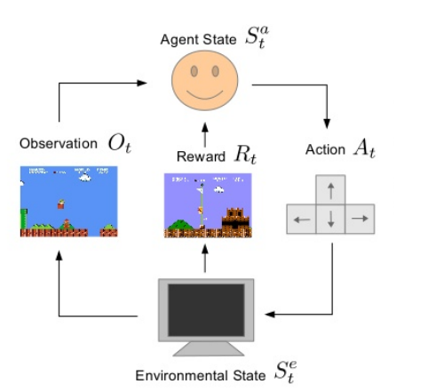
What is Reinforcement Learning ?
Learning to make sequential decisions in an environment so as to maximize some notion of overall rewards acquired along the way.
Learner has a state and choses an action.
Nature responds with new observation/state and a reward.
Learner learns from reward and makes better decisions.

Slide 4
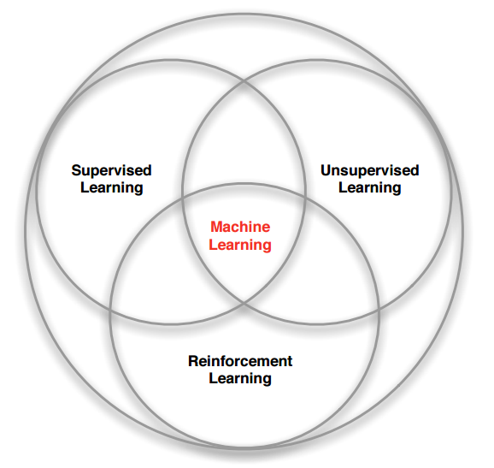
RL within the ML Spectrum
What makes RL different from other ML paradigms ?
No supervision, just a reward signal from the environment
Feedback is sometimes delayed (Example: Time taken for drugs to take effect)
Time matters - sequential data
Feedback - Agent’s action affects the subsequent data it receives ( not i.i.d.)

Slide 5
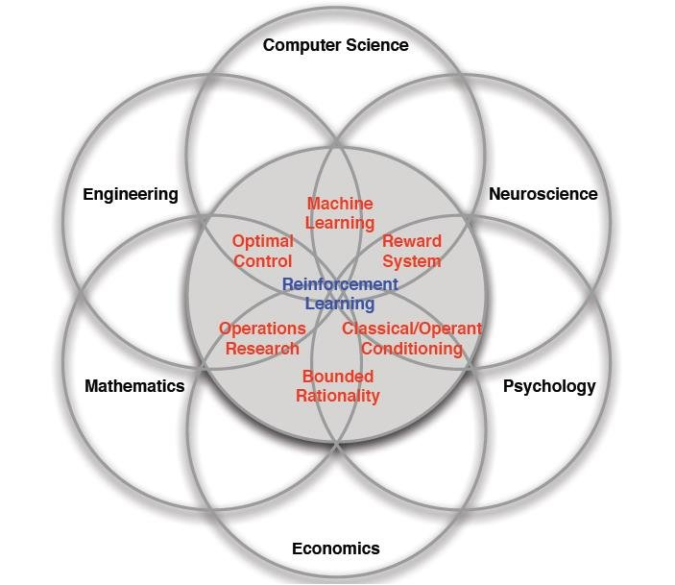
Many Faces of Reinforcement Learning
Defeat a World Champion in Chess, Go, BackGammon
Manage an investment portfolio
Control a power station
Control the dynamics of a humanoid robot locomotion
Treat patients in the ICU
Automatic fly stunt manoeuvres in helicopters

Slide 6
MDP + Formal Definitions

Slide 7
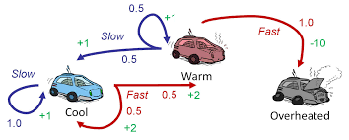
Markov Decision Process
A Markov Decision Process is a 4-tuple (S,A,R,S’) where
S - finite set of states (e.g. : Warm, Cool, Overheated)
A - Finite set of actions that an agent can take from any state s. (e.g. : Slow, Fast)
Markovianity : P(s’,s) - Under action a from state s, the joint probability of seeing (s,s’) in succession is independent of the history - i.e. P_{a}(s’,s) = P(s_{t+1} = s’ | s_{t} = s, a_{t} = a) = P(s_{t+1} = s’ | s_{t},a_{t},s_{t-1},a_{t-1},s_{t-2},a_{t-2}…..s₀,a₀)
R_{a}(s) - The rewards collected for taking an action a from state s.

Slide 8
State S
Observations are what the agent perceives from the external world (e.g. an image frame in a video game)
States are the agent’s internal representations of the observation.
If we call history H as the collection of observations seen until now, we define any state s_{t}= f(H_{1:t}) (Remember LSTMs for instance.)
States are Markovian. Once a state s_{t}is known, we can throw away the history H_{1:t}
States are Markovian internal representations of the observations.

Slide 9
Rewards R
Rewards - A scalar feedback signal
Indicates how well the agent is doing at current step t.
Reinforcement Learning is entirely built on the premise of reward hypothesis.
All goals can be described by the maximisation of some expected cumulative reward.

Slide 10
Policy 𝛑
A policy is defined by the set of actions an agent takes from the state that it is in.
It is a map from an agent state to an action
Deterministic Policy : a = 𝛑(s)
Stochastic Policy : 𝛑(a|s) = P(a_{t} =a |s_{t} = s)

Slide 11
Dynamics Model / Transition Model
Dynamics Model/Transition model represents how the agent would transition from one state to the next.
T(s’,a,s) = P(s_{t+1}=s’|s= s_{t,} a = a_{t}) suggests the probability of transitioning between the states.
Optimizing policy with Model (known or learned) - Model based RL
Optimizing policy without Model - Model free RL

Slide 12
State Value Function V(s)
Value Function measures the “long-term goodness of a state”. Value Function is induced by a policy. (E_{T} means expectation on P(s_{t+1}|s_{t,}a_{t}) under T)
V_{𝛑}(s_{t}) = E_{𝛑,T} (R(s_{t},a_{t}) + 𝛄R(s_{t+1},a_{t+1}) +𝛄² R(s_{t+2},a_{t+2}) +.......)
Note that V_{𝛑}(s_{t}) = R(s_{t},a_{t} ~ 𝛑) + 𝛄 E_{T} (V_{𝛑}(s_{t+1}))
𝛄 - discount factor denotes future uncertainty. Makes sum of rewards finite.
An optimal policy 𝛑* is one that maximizes the expected value function
𝛑* = argmax_{𝛑} V_{𝛑}(s)

Slide 13
State - Action Value Function Q(s,a)
The sum of the one-step rewards for taking an action from a state and then the value function of the subsequent state.
Quantifies how the value function changes if we take an action from a particular state. Provides a convenient form for policy-optimization
Q_{𝛑}(s_{t},a_{t}) = R(s_{t},a_{t}) + 𝛄 E_{T} (V_{𝛑}(s_{t+1}))
Q*(s,a) = R(s,a) + 𝛄 E_{T} (V*(s’)); V*(s) = max_{a} Q*(s,a)
V(s) =

Slide 14
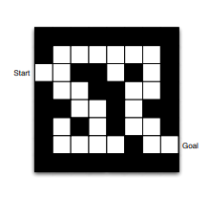
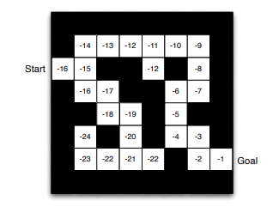
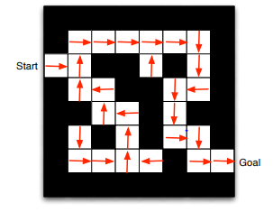
Maze Example
Rewards of -1 for each step.
Four actions - U,D,L,R
Goal ends the episode.
Policy
Value Function under the policy

Slide 15
Learning Optimal Policies
Dynamic Programming Methods (Value and Policy Iteration)

Slide 16
Dynamic Programming
Remember that value functions are recursive.
Dynamic Programming - Breaking down a big problem into smaller subproblems and solving the smaller subproblems, store its values and backtrack towards bigger problems.
WORKING BACKWARDS :
V(s_{T-1},a_{T-1}) = R(s_{T-1},a_{T-1}); V(s_{T-2},a_{T-2}) = R(s_{T-1},a_{T-1}) + V(s_{T-1},a_{T-1}) ; …… (T is terminal state)

Slide 17
Value Iteration
Start with some arbitrary value assignments V₀
Update Policy and repeat until |Vn+1(s) - Vn(s)| < 𝛆
Q_{n}(s,a) = R(s,a) + 𝜸 E_{T}[V(s’)]
V_{n+1}(s) = argmax_{a} Q_{n}(s,a)
INTUITION : Iteratively improve your value estimates using Q, V relations.

Slide 18
Policy Iteration
Start with some policy 𝛑₀
Compute the value of the states V(s) using current policy. (Policy Evaluation)
(Policy Improvement) Update Policy and repeat steps (2) and (3) until 𝛑_{k+1} = 𝛑_{k}
𝛑₁(s_{i}) = argmax_{a}{r(s_{i},a_{i}) + 𝜸E_{T}[V_{𝛑0}(s_{j})]} - Transition from s_{i} to s_{j}
INTUITION : At each step, you are modifying your policy by picking that action which gives you the highest Q-value. (Remember the fixed point eqns from slide 13)

Slide 19
Value and Policy Iteration
Demo : https://cs.stanford.edu/people/karpathy/reinforcejs/gridworld_dp.html
Convergence in value means convergence in policy, vice versa not true. REASON : Multiple reward/value structures can cause the same policy.
Both algorithms have theoretical guarantees of convergence.
Policy Iteration is expected to be faster.

Slide 20
Model-Free Methods
Q-Learning and SARSA

Slide 21
Why Model-Free Methods ?
Learning or providing a transition model can be hard in several scenarios.
Autonomous Driving, ICU Treatments, Stock Trading etc.
What do you have then ?
An ability to obtain a set of simulations/trajectories with each transition in the episodes of the form (s,a,r,s’)
E.g. Using sensors to understand robot’s new position when it does an action, Recording new patient vitals when given a drug from a state etc.

Slide 22
On-Policy vs Off-Policy Learning
On-Policy Learning
Learn on the job.
Evaluate policy 𝛑 when sampling experiences from 𝛑.
Off-Policy Learning
Look over someone’s shoulder.
Evaluate policy 𝛑 (target policy) while following a different policy Ѱ (behavior policy) in the environment.
Some domains prohibit on-policy learning. For instance, treating a patient in ICUs you cannot learn about random actions by testing them out.

Slide 23
Temporal Difference (TD) Learning
Remember : V_{𝛑}(s) = R(s,a ~ 𝛑)+ 𝜸E_{T}[V(s’)]. For any policy, execute and learn V.
Given a transition (s,a,r,s’), a TD Update adjusts the value function estimate in line with Bellman-Equation
V^{new}_{𝛑}(s) ← V^{old}_{𝛑}(s) + ⍺ [ R(s,a ~ 𝛑)+ 𝜸V^{old}(s’) - V^{old}_{𝛑}(s) ]
Perform many such updates over several transitions and we should see convergence. When it converges(V^{new}=V^{old}), we expect Bellman Equation to hold. i.e.
R(s,a ~ 𝛑)+ 𝜸V(s’) - V_{𝛑}(s) = 0

Slide 24
Q-Learning
Start with a random Q-table (S X A). For all transitions collected according to any behavior policy, perform this TD Update
Q(s,a) ← Q(s,a) + ⍺ [ R(s,a) + 𝜸max_{a’}Q(s’,a’) - Q(s,a) ]
OVER-OPTIMISTIC : Assumes the best things would happen from the next state onwards - Greedy (Hence the max operation over future Q-values)
OFF-POLICY : Q directly approximates the optimal action value function independently of the policy being followed (max over all actions)

Slide 25
SARSA
Start with a random Q-table (S X A). For all transitions (collected by acting according to 𝛑 that maximizes Q) perform this TD Update
Q(s,a) ← Q(s,a) + ⍺ [ R(s,a) + 𝜸 Q(s’,a’ ~ 𝛑) - Q(s,a) ]
𝛑 - Data collection policy
ON-Policy Learning : While learning the optimal policy it uses the current estimate of the optimal policy to generate the behaviour

Slide 26
Q-Learning and SARSA Algorithm
Start with a random Q-table (S X A).
Choose one among the two actions
(𝜀-greedy) With probability 𝜀, choose a random action (EXPLORATION)
With probability 1-𝜀, an action that maximizes Q-value from a state.(EXPLOITATION)
Perform an action and collect transition (s,a,r,s’)
Update Q-table using the corresponding TD updates.
Repeat steps 2-5 till convergence of Q-values across all states.

Slide 27
Q-Learning vs SARSA
Demo : https://studywolf.wordpress.com/2013/07/01/reinforcement-learning-sarsa-vs-q-learning/
Q-Learning converges faster since Q values directly try to approximate the optimal value.
Q-Learning is more risky since it is over-optimistic of what happens in the future. Could be risky for real-life tasks such as robot navigation over dangerous terrains.

Slide 28
Parametric Q-Learning
Often hard to learn Q-values in tabular form. E.g. Huge number of states, Continuous state spaces etc.
Parametrize Q(s,a) using any function approximator f - linear model, neural networks etc. and do usual Q-learning.
Q(s,a) = f(s,a;𝜭) 𝜭- model params
Example : Image Frames in a game - Use ConvNets to parametrize Q(s,a)

