Slide 1
Lecture 14: Introduction to Reinforcement Learning

Slide 2
Outline
What is Reinforcement Learning
RL Formalism
Reward
The agent
The environment
Actions
Observations
Markov Decision Process
Markov Process
Markov reward process
Markov Decision process
Learning Optimal Policies

Slide 3
What is Reinforcement Learning ?
Describe this:
Mouse
A maze with walls, food and electricity
Mouse can move left, right, up and down
Mouse wants the cheese but not electric shocks
Mouse can observe the environment
Lapan, Maxim. Deep Reinforcement Learning Hands-On

Slide 4
What is Reinforcement Learning ?
Describe this:
Mouse => Agent
A maze with walls, food and electricity => Environment
Mouse can move left, right, up and down => Actions
Mouse wants the cheese but not electric shocks => Rewards
Mouse can observe the environment => Observations
Lapan, Maxim. Deep Reinforcement Learning Hands-On

Slide 5
What is Reinforcement Learning ?
Learning to make sequential decisions in an environment so as to maximize some notion of overall rewards acquired along the way.
In simple terms:
The mouse is trying to find as much food as possible, while avoiding an electric shock whenever possible.
The mouse could be brave and get an electric shock to get to the place with plenty of food—this is better result than just standing still and gaining nothing.

Slide 6
What is Reinforcement Learning ?
Learning to make sequential decisions in an environment so as to maximize some notion of overall rewards acquired along the way.
Simple Machine Learning problems have a hidden time dimension, which is often overlooked, but it is important become in a production system.
Reinforcement Learning incorporates time (or an extra dimension) into learning, which puts it much close to the human perception of artificial intelligence.

Slide 7
What we don’t want the mouse to do?
We do not want to have best actions to take in every specific situation. Too much and not flexible.
Find some magic set of methods that will allow our mouse to learn on its own how to avoid electricity and gather as much food as possible.
Reinforcement Learning is exactly this magic toolbox

Slide 8
Challenges of RL
Observations depends on agent’s actions. If agent decides to do stupid things, then the observations will tell nothing about how to improve the outcome (only negative feedback).
Agents need to not only exploit the policy they have learned, but to actively explore the environment. In other words maybe by doing things differently we can significantly improve the outcome. ﻿This exploration/exploitation dilemma is one of the open fundamental questions in RL (and in my life).
Reward can be delayed from actions. Ex: In cases of chess, it can be one single strong move in the middle of the game that has shifted the balance.

Slide 9
﻿RL formalisms and relations
Agent
Environment
Communication channels:
Actions,
Reward, and
Observations:
Lapan, Maxim. Deep Reinforcement Learning Hands-On

Slide 10
Reward
Notes:
Once in a lifetime usually means all zeros until the end

Slide 11
Reward
A scalar value obtained from the environment
It can be positive or negative, large or small
The purpose of reward is to tell our agent how well they have behaved.
﻿reinforcement = reward or reinforced the behavior
Examples:
Cheese or electric shock
Grades: Grades are a reward system to give you feedback about you are paying attention to me.
Notes:
Once in a lifetime usually means all zeros until the end
Frequency: it can be every second or once in a lifetime.
Purpose: Give an agent feedback about its success

Slide 12
Reward (cont)
All goals can be described by the maximization of some expected cumulative reward

Slide 13

The agent

Slide 14
The agent
An agent is somebody or something who/which interacts with the environment by executing certain actions, taking observations, and receiving eventual rewards for this.
In most practical RL scenarios, it's our piece of software that is supposed to solve some problem in a more-or-less efficient way.
Example:
You

Slide 15
The environment
Everything outside of an agent.
The universe!
The environment is external to an agent, and communications to and from the agent are limited to rewards, observations and actions.

Slide 16
Actions
Things an agent can do in the environment.
Can be:
moves allowed by the rules of play (if it's some game),
or it can be doing homework (in the case of school).
They can be simple such as move pawn one space forward, or complicated such as fill the tax form in for tomorrow morning.
Could be discrete or continuous

Slide 17
Observations
Second information channel for an agent, with the first being a reward.
Why?
Convenience

Slide 18
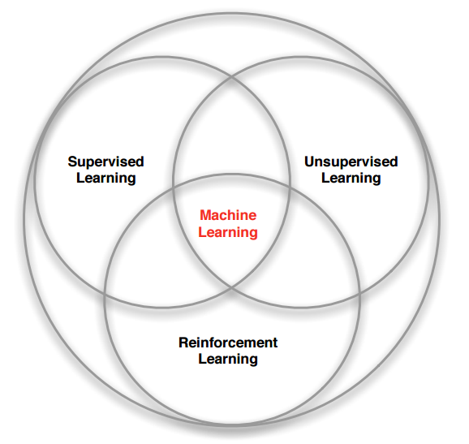
RL within the ML Spectrum
What makes RL different from other ML paradigms ?
No supervision, just a reward signal from the environment
Feedback is sometimes delayed (Example: Time taken for drugs to take effect)
Time matters - sequential data
Feedback - Agent’s action affects the subsequent data it receives ( not i.i.d.)

Slide 19
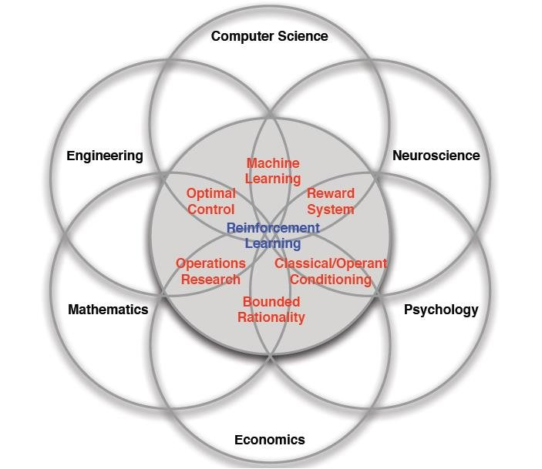
Many Faces of Reinforcement Learning
Defeat a World Champion in Chess, Go, BackGammon
Manage an investment portfolio
Control a power station
Control the dynamics of a humanoid robot locomotion
Treat patients in the ICU
Automatic fly stunt manoeuvres in helicopters
Notes:
﻿Machine learning (ML): RL, being a subfield of ML, borrows lots of its machinery, tricks, and techniques from ML. Basically, the goal of RL is to learn how an agent should behave when it is given imperfect observational data.
.
Neuroscience: We saw the dopamine system as our example, and it has been shown that the human brain acts closely to the RL model. Psychology: This studies behavior in various conditions, such as how people react and adapt, which is close to the RL topic.
Economics: One of the important topics is how to maximize reward in terms of imperfect knowledge and the changing conditions of the real world. Mathematics: This works with idealized systems, and also devotes significant attention to finding and reaching the optimal conditions in the field of operations research.
Engineering (especially optimal control): This helps in taking a sequence of optimal actions to get the best result

Slide 20
Outline
What is Reinforcement Learning
RL Formalism
Reward
The agent
The environment
Actions
Observations
Markov Decision Process
Markov Process
Markov reward process
Markov Decision process
Learning Optimal Policies

Slide 21
MDP + Formal Definitions

Slide 22
Markov Decision Process
More terminology we need to learn
state
episode
history
value
policy

Slide 23
Markov Process
Example:
System: Weather in Boston.
States: We can observe the current day as sunny or rainy
History: . A sequence of observations over time forms a chain of states, such as
[sunny, sunny, rainy, sunny, …],

Slide 24
Markov Process
For a given system we observe states
The system changes between states according to some dynamics.
We do not influence the system just observe
There are only finite number of states (could be very large)
Observe a sequence of states or a chain => Markov chain

Slide 25
Markov Process (cont)
A system is a Markov Process, if it fulfils the Markov property.
The future system dynamics from any state have to depend on this state only.
Every observable state is self-contained to describe the future of the system.
Only one state is required to model the future dynamics of the system, not the whole history or, say, the last N states.

Slide 26
Markov Process (cont)
Weather example:
The probability of sunny day followed by rainy day is independent of the amount of sunny days we've seen in the past.
Notes:
This example is really naïve, but it's important to understand the limitations.
We can for example extend the state space to include other factors.

Slide 27
Markov Process (cont)
Transition probabilities is expressed as a transition matrix, which is a square matrix of the size N×N, where N is the number of states in our model.
 | sunny | rainy
sunny | 0.8 | 0.2
rainy | 0.1 | 0.9

Slide 28
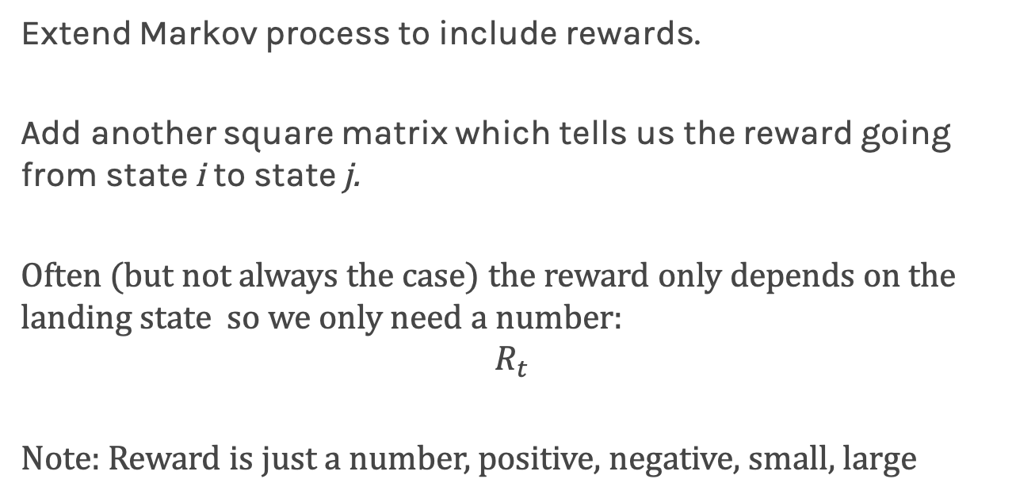
Markov Reward Process
Extend Markov process to include rewards.
Add another square matrix which tells us the reward going from state i to state j.
Often (but not always the case) the reward only depends on the landing state so we only need a number:
$$R_{t}$$
Note: Reward is just a number, positive, negative, small, large

Slide 29
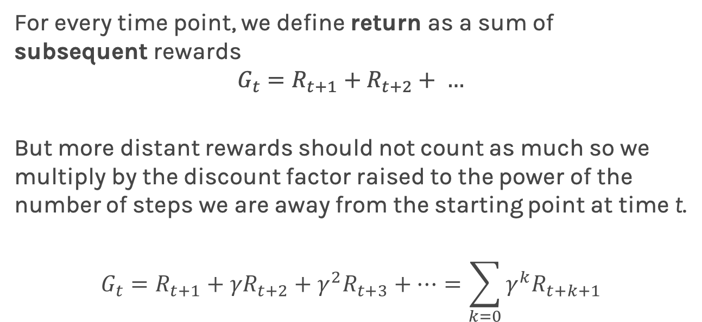
Markov Reward Process (cont)
For every time point, we define return as a sum of subsequent rewards
$$G_{t}=R_{t+1}+R_{t+2}+ …$$
But more distant rewards should not count as much so we multiply by the discount factor raised to the power of the number of steps we are away from the starting point at time t.
$$G_{t}=R_{t+1}+{γR}_{t+2}+γ^{2}R_{t+3}+…=\sum_{k=0}{γ^{k}R_{t+k+1}}$$

Slide 30
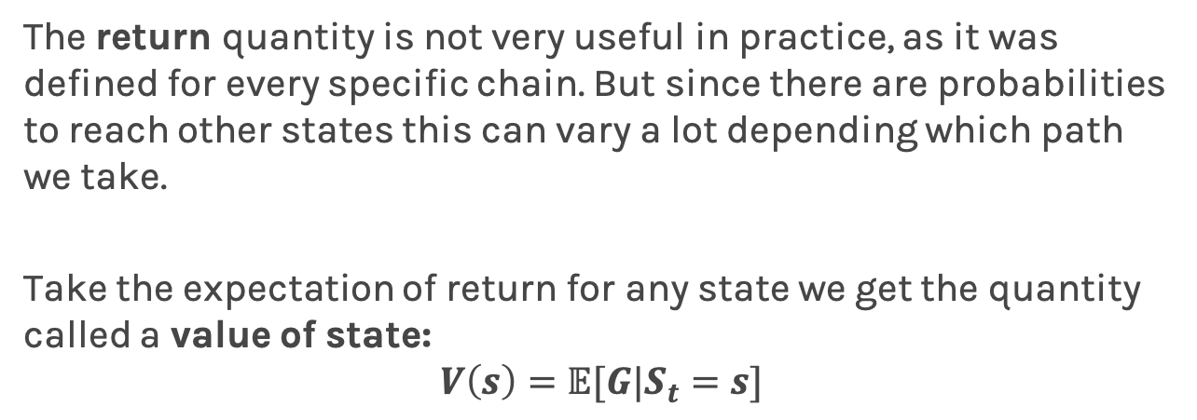
Markov Reward Process (cont)
The return quantity is not very useful in practice, as it was defined for every specific chain. But since there are probabilities to reach other states this can vary a lot depending which path we take.
Take the expectation of return for any state we get the quantity called a value of state:
$$V\left(s\right)=𝔼[G|S_{t}=s]$$

Slide 31
Markov Decision Process
How to extend our Markov Return Process to include actions?
We must add a set of actions (A), which has to be finite. This is our agent's action space.
Condition our transition matrix with action, which means the transition matrix needs an extra action dimension => turns it into a cube.

Slide 32
Markov Decision Process (cont)
Lapan, Maxim. Deep Reinforcement Learning Hands-On

Slide 33
Markov Decision Process (cont)
By choosing an action, the agent can affect the probabilities of target states, which is GREAT to have.
Finally, to turn our MRP into an MDP, we need to add actions to our reward matrix in the same way we did with the transition matrix: our reward matrix will depend not only on state but also on action.
In other words, it means that the reward the agent obtains now depends not only on the state it ends up in but also on the action that leads to this state. It's similar as when putting effort into something, you're usually gaining skills and knowledge, even if the result of your efforts wasn't too successful.

Slide 34
Markov Decision Process
More terminology we need to learn
state ✓
episode ✓
history ✓
value ✓
policy

Slide 35
Policy
We are finally ready to introduce the most important central thing for MDPs and Reinforcement Learning:
policy
The intuitive definition of policy is that it is some set of rules that controls the agent's behavior.
﻿
Notes:
For example, the robot in the grid world, the agent can have different policies, which will lead to different sets of visited states. For example, this robot can perform the following actions: Blindly move forward regardless of anything Try to go around obstacles by checking whether that previous forward action failed Funnily spin around to entertain its creator Choose an action randomly modelling a drunk robot in the grid world scenario, and so on …

Slide 36
Policy (cont)
Even for fairly simple environments, we can have a variety of policies.
Always move forward
Try to go around obstacles by checking whether that previous forward action failed
Funnily spin around to entertain
Choose an action randomly

Slide 37
Policy (cont)
Remember: The main objective of the agent in RL is to gather as much return (which was defined as discounted cumulative reward) as possible.
Different policies can give us different return, which makes it important to find a good policy. This is why the notion of policy is important, and it's the central thing we're looking for.

Slide 38
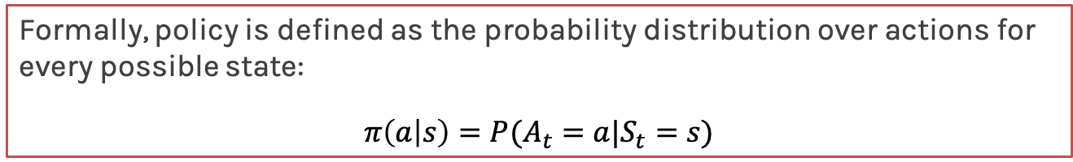
Policy (cont)
Formally, policy is defined as the probability distribution over actions for every possible state:
$$π\left(a | s\right)=P(A_{t}=a|S_{t}=s)$$
An optimal policy 𝛑* is one that maximizes the expected value function :
𝛑* = argmax_{𝛑} V_{𝛑}(s)

Slide 39
Markov Decision Process
More terminology we need to learn
state ✓
episode ✓
history ✓
value ✓
policy ✓

Slide 40
🙌

Slide 41
Learning Optimal Policies
Dynamic Programming Methods (Value and Policy Iteration)

Slide 42
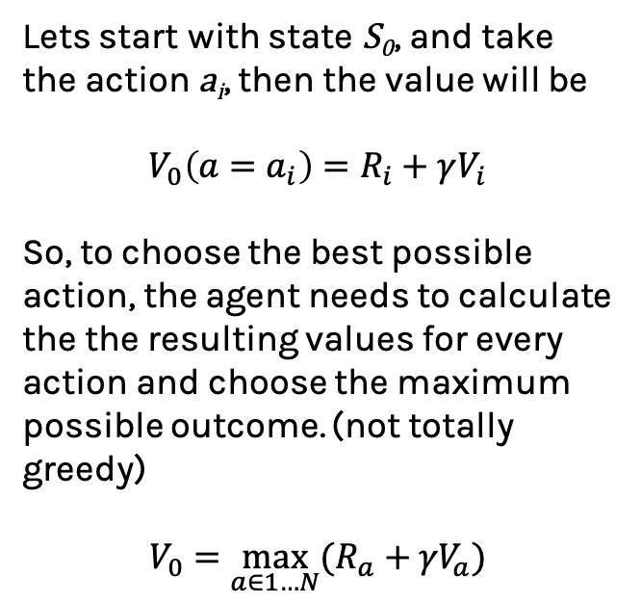
﻿Bellman equation (deterministic)
Lets start with state S₀, and take the action a_{i}, then the value will be
$$V_{0}\left(a=a_{i}\right)=R_{i}+γV_{i}$$
So, to choose the best possible action, the agent needs to calculate the the resulting values for every action and choose the maximum possible outcome. (not totally greedy)
$$V_{0}=\max_{a∈1…N}{(R_{a}+{γV}_{a})}$$

Slide 43
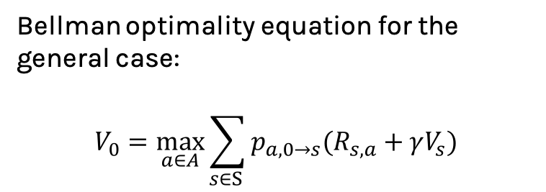
﻿Bellman equation (stochastic)
Bellman optimality equation for the general case:
$$V_{0}=\max_{a∈A}{\sum_{s∈S }{p_{a, 0→s}(R_{s,a}+γV_{s})}}$$

Slide 44
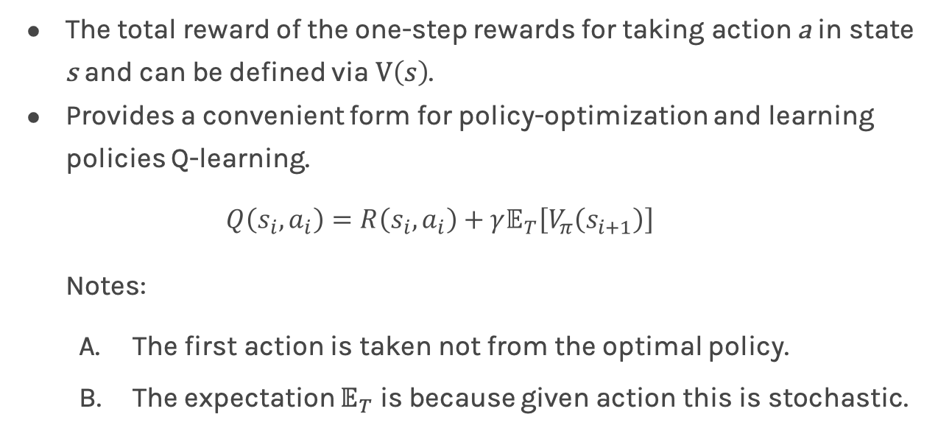
Value of Action Q(s,a)
The total reward of the one-step rewards for taking action a in state s and can be defined via $V\left(s\right)$.
Provides a convenient form for policy-optimization and learning policies Q-learning.
$$Q\left(s_{i},a_{i}\right)=R\left(s_{i},a_{i}\right)+γ𝔼_{T}\left[V_{π}\left(s_{i+1}\right)\right]$$
Notes:
The first action is taken not from the optimal policy.
The expectation $𝔼_{T}$ is because given action this is stochastic.
Notes:
Update the policy

Slide 45
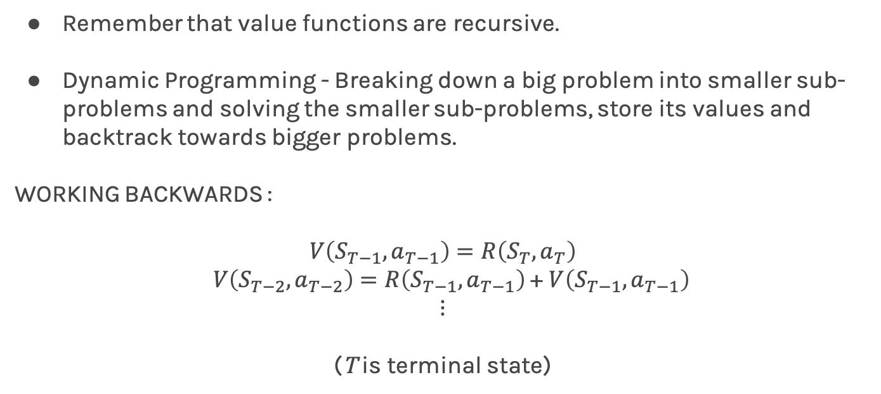
Dynamic Programming
Remember that value functions are recursive.
Dynamic Programming - Breaking down a big problem into smaller sub-problems and solving the smaller sub-problems, store its values and backtrack towards bigger problems.
WORKING BACKWARDS :
$$V\left(S_{T−1},a_{T−1}\right)=R\left(S_{T},a_{T}\right)$$
$V\left(S_{T−2},a_{T−2}\right)=R\left(S_{T−1},a_{T−1}\right)$ + $V\left(S_{T−1},a_{T−1}\right)$
$$⋮$$
(T is terminal state)

Slide 46
Model Based and Model Free Methods
Model Based:
Knowing the transition matrix.
Model Free:
Not knowing the transition matrix.

Slide 47
Model-Based Methods
Value Iteration, Policy Iteration

Slide 48
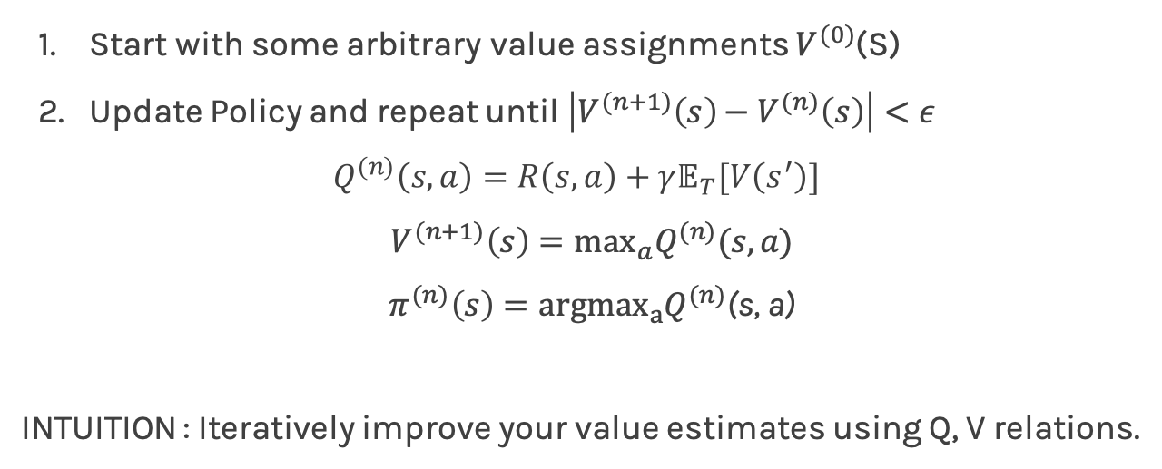
Value Iteration
Start with some arbitrary value assignments $V^{(0)}$(S)
Update Policy and repeat until $\left|V^{(n+1)}\left(s\right)−V^{(n)}\left(s\right)\right|<ε$
$$Q^{(n)}\left(s,a\right)=R\left(s,a\right)+γ𝔼_{T}[V\left(s^{′}\right)]$$
$V^{(n+1)}\left(s\right)=\max_{a}Q^{(n)}(s,a)$
$π^{(n)}\left(s\right)=argmax_{a}Q^{(n)}$(s, a)
INTUITION : Iteratively improve your value estimates using Q, V relations.

Slide 49
Example:
-1
-1
+3
S₀
S₁
S₂
-1
Actions: a₁: R (right) a₂: L (left)
Step 0: V(S₀)=V(S₁)=V(S₂) = 0
Step 1:
Q(S_{0,} a₁) = R(S_{0,} a₁) +V(S₁) = -1 + 0 = -1
Q(S_{0,} a₂) = R(S_{0,} a₂) +V(S₀) = -1 + 0 = -1
Q(S_{1,} a₁) = R(S_{1,} a₁) +V(S₂) = 3 +0 = 3
Q(S_{1,} a₂) = R(S_{1,} a₂) +V(S₀) = -1 + 0 = -1

Slide 50
Example:
-1
-1
+3
S₀
S₁
S₂
-1
Step2:
V(S₀) = max(Q(S₀,a)) = -1
V(S₁) = max(Q(S₁,a)) = 3
π(S₀) = R
π(S₁) = R

Slide 51
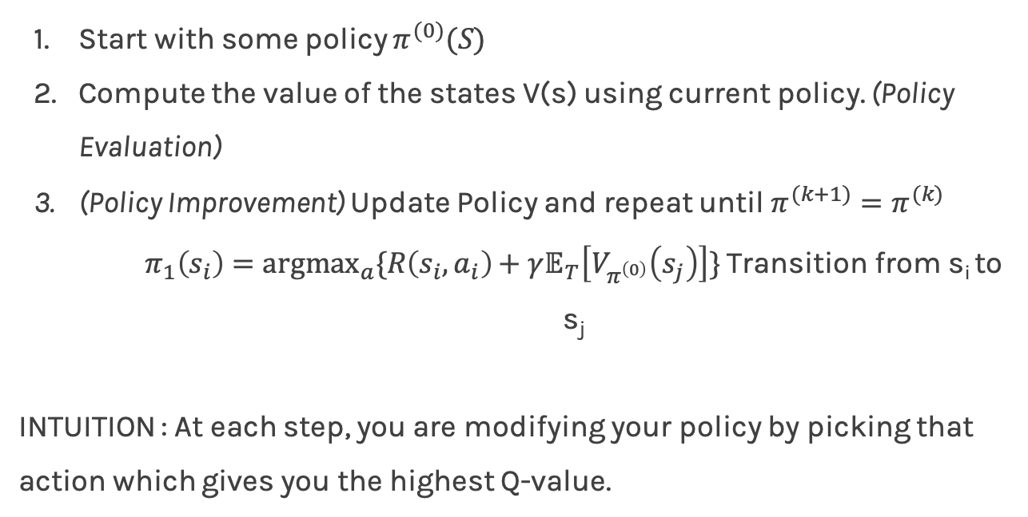
Policy Iteration
Start with some policy $π^{(0)}(S)$
Compute the value of the states V(s) using current policy. (Policy Evaluation)
(Policy Improvement) Update Policy and repeat until $π^{(k+1)}=π^{(k)}$
$π_{1}\left(s_{i}\right)={argmax}_{a}\{R\left(s_{i},a_{i}\right)+γ𝔼_{T}\left[V_{π^{\left(0\right)}}\left(s_{j}\right)\right]\}$ Transition from s_{i} to s_{j}
INTUITION : At each step, you are modifying your policy by picking that action which gives you the highest Q-value.

Slide 52
Example:
-1
-1
+3
S₀
S₁
S₂
-1
Actions: a₁: R (right) a₂: L (left)
Policy: π(S₀) = R π(S₁) = L γ=0.5
Step 0:
V(S₀; π) = R(S_{0,} a₁) + γ V(S₁)
V(S₁; π) = R(S_{1,} a₁) + γ V(S₀)
V(S₀) = -6/5
V(S₁) = -8/5

Slide 53
Example:
-1
-1
+3
S₀
S₁
S₂
-1
Step 1:
Q(S₀; a₁) = -1 + ½(-8/5)
Q(S₀; a₂) = -1 + ½(-6/5)
Q(S₁; a₁) =
Q(S₁; a₂) =
Update Policy:

Slide 54
Example:
-1
-1
+3
S₀
S₁
S₂
-1
Update:
V(S₀) = max(Q(S₀,a)) = -1
V(S₁) = max(Q(S₁,a)) = 3
π(S₀) = R
π(S₁) = R

Slide 55
Value and Policy Iteration
Demo : https://cs.stanford.edu/people/karpathy/reinforcejs/gridworld_dp.html
Convergence in value means convergence in policy, vice versa not true. REASON : Multiple reward/value structures can cause the same policy.
Both algorithms have theoretical guarantees of convergence.
Policy Iteration is expected to be faster.

Slide 56
Model-Free Methods
Q-Learning and SARSA

Slide 57
Why Model-Free Methods ?
Learning or providing a transition model can be hard in several scenarios.
Autonomous Driving, ICU Treatments, Stock Trading etc.
What do you have then ?
An ability to obtain a set of simulations/trajectories with each transition in the episodes of the form (s,a,r,s’)
E.g. Using sensors to understand robot’s new position when it does an action, Recording new patient vitals when given a drug from a state etc.

Slide 58
On-Policy vs Off-Policy Learning
On-Policy Learning
Learn on the job.
Evaluate policy 𝛑 when sampling experiences from 𝛑.
Off-Policy Learning
Look over someone’s shoulder.
Evaluate policy 𝛑 (target policy) while following a different policy Ѱ (behavior policy) in the environment.
Some domains prohibit on-policy learning. For instance, treating a patient in ICUs you cannot learn about random actions by testing them out.

Slide 59
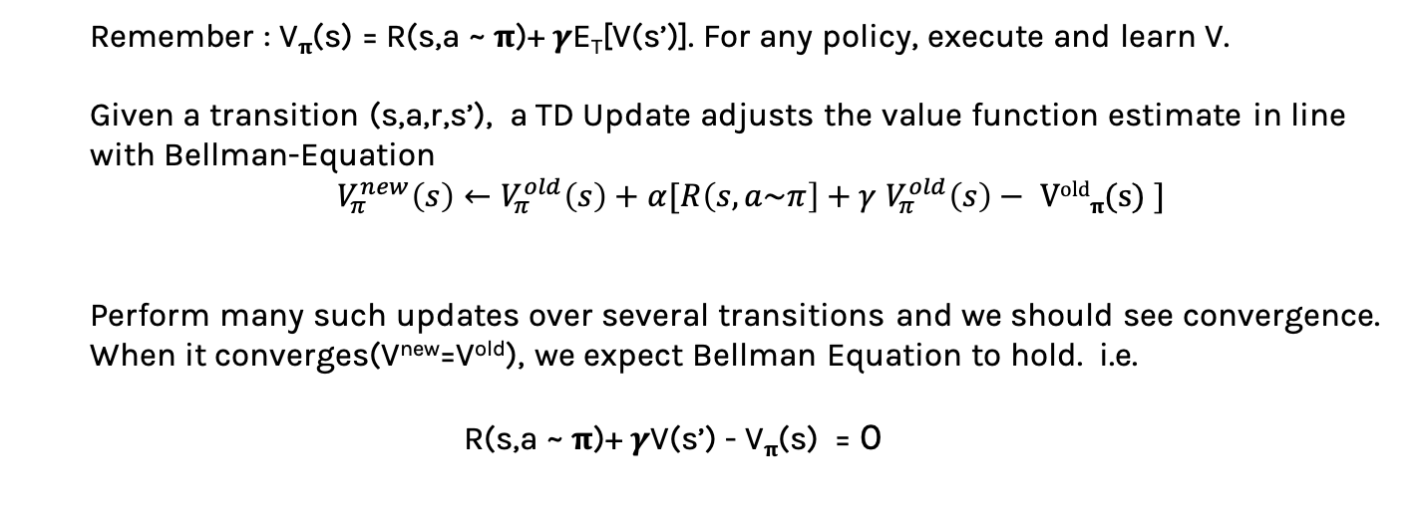
Temporal Difference (TD) Learning
Remember : V_{𝛑}(s) = R(s,a ~ 𝛑)+ 𝜸E_{T}[V(s’)]. For any policy, execute and learn V.
Given a transition (s,a,r,s’), a TD Update adjusts the value function estimate in line with Bellman-Equation
$V_{π}^{new}\left(s\right)←V_{π}^{old}\left(s\right)+α[R\left(s,a\sim π\right]+γ$ $V_{π}^{old}\left(s\right)−$ V^{old}_{𝛑}(s) ]
Perform many such updates over several transitions and we should see convergence. When it converges(V^{new}=V^{old}), we expect Bellman Equation to hold. i.e.
R(s,a ~ 𝛑)+ 𝜸V(s’) - V_{𝛑}(s) = 0

Slide 60
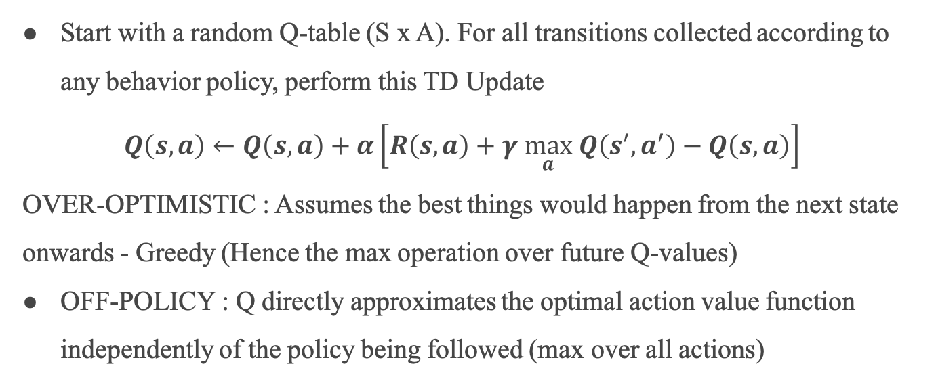
Q-Learning
Start with a random Q-table (S x A). For all transitions collected according to any behavior policy, perform this TD Update
$$Q\left(s,a\right)←Q\left(s,a\right)+α\left[R\left(s,a\right)+γ \max_{a} Q\left(s^{′},a^{′}\right)−Q\left(s,a\right)\right]$$
OVER-OPTIMISTIC : Assumes the best things would happen from the next state onwards - Greedy (Hence the max operation over future Q-values)
OFF-POLICY : Q directly approximates the optimal action value function independently of the policy being followed (max over all actions)

Slide 61
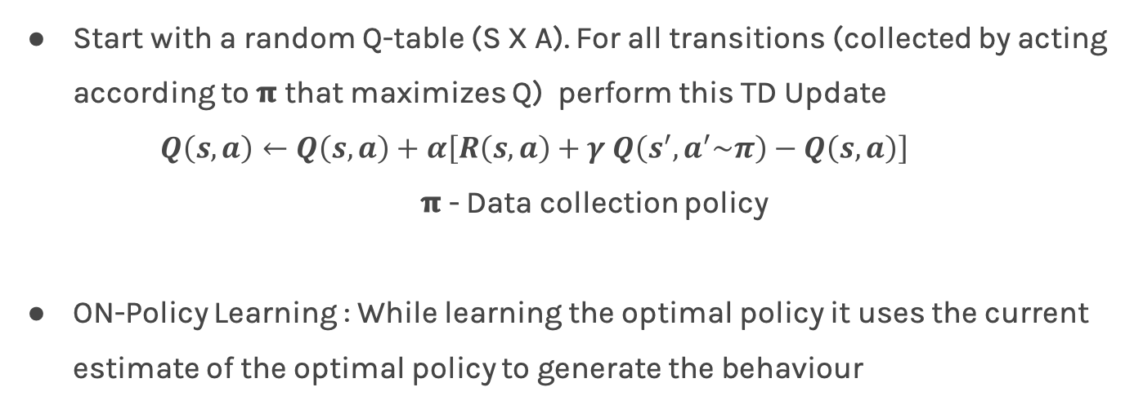
SARSA
Start with a random Q-table (S X A). For all transitions (collected by acting according to 𝛑 that maximizes Q) perform this TD Update
$$Q\left(s,a\right)←Q\left(s,a\right)+α\left[R\left(s,a\right)+γ Q\left(s^{′},a^{′}\sim π\right)−Q\left(s,a\right)\right]$$
𝛑 - Data collection policy
ON-Policy Learning : While learning the optimal policy it uses the current estimate of the optimal policy to generate the behaviour

Slide 62
Q-Learning and SARSA Algorithm
Start with a random Q-table (S X A).
Choose one among the two actions
(𝜀-greedy) With probability 𝜀, choose a random action (EXPLORATION)
With probability 1-𝜀, an action that maximizes Q-value from a state.(EXPLOITATION)
Perform an action and collect transition (s,a,r,s’)
Update Q-table using the corresponding TD updates.
Repeat steps 2-5 till convergence of Q-values across all states.

Slide 63
Q-Learning vs SARSA
Demo : https://studywolf.wordpress.com/2013/07/01/reinforcement-learning-sarsa-vs-q-learning/
Q-Learning converges faster since Q values directly try to approximate the optimal value.
Q-Learning is more risky since it is over-optimistic of what happens in the future. Could be risky for real-life tasks such as robot navigation over dangerous terrains.

Slide 64
Parametric Q-Learning
Often hard to learn Q-values in tabular form. E.g. Huge number of states, Continuous state spaces etc.
Parametrize Q(s,a) using any function approximator f - linear model, neural networks etc. and do usual Q-learning.
Q(s,a) = f(s,a;𝜭) 𝜭- model params
Example : Image Frames in a game - Use ConvNets to parametrize Q(s,a)

