Slide 1
回馈社会，全面开源“Kingst51”所有资料。
“Kingst51”开发板以0利润成本价销售（公开完整成本清单）
配套书籍：手把手教你学51单片机
--C语言版（第3版）
7-5：点阵的横向动画显示
关注各大直播平台：金沙滩电子课堂，直播授课答疑
青岛金思特电子有限公司
（金沙滩工作室）
作者：宋雪松

Slide 2
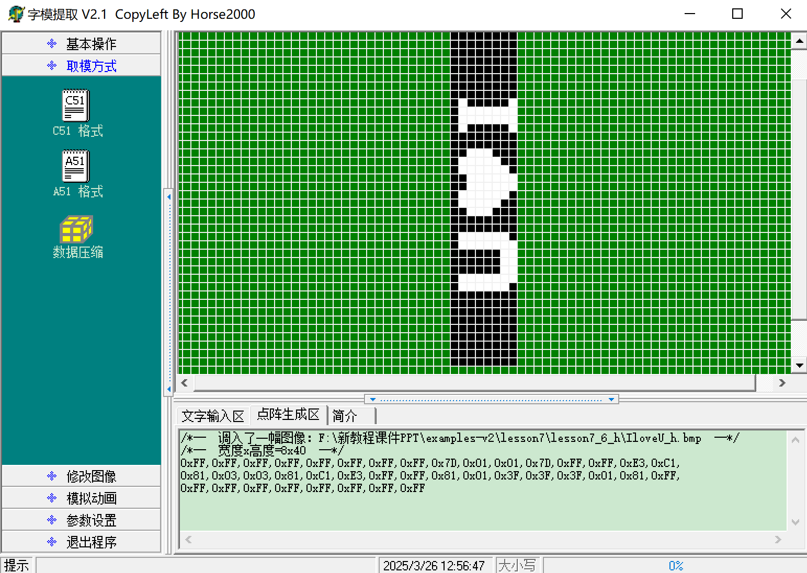
点阵的横向动画显示（一）

Slide 3
二维数组
数组类型 数组名[数组长度1][数组长度2];
例如 unsigned char a[2][3];
定义一个2行3列的无符号字符型二维数组
unsigned char a[2][3]={{1,2,3}, {4,5,6}};
unsigned char a[2][3]={1,2,3,4,5,6};
unsigned char a[2][3]={{1,2},{3,4}};
unsigned char a[2][3]={1,2,0,3,4,0};
unsigned char a[2][3]={1,2,3,4};
unsigned char a[2][3]={{1,2,3},{4,0,0}};

Slide 4
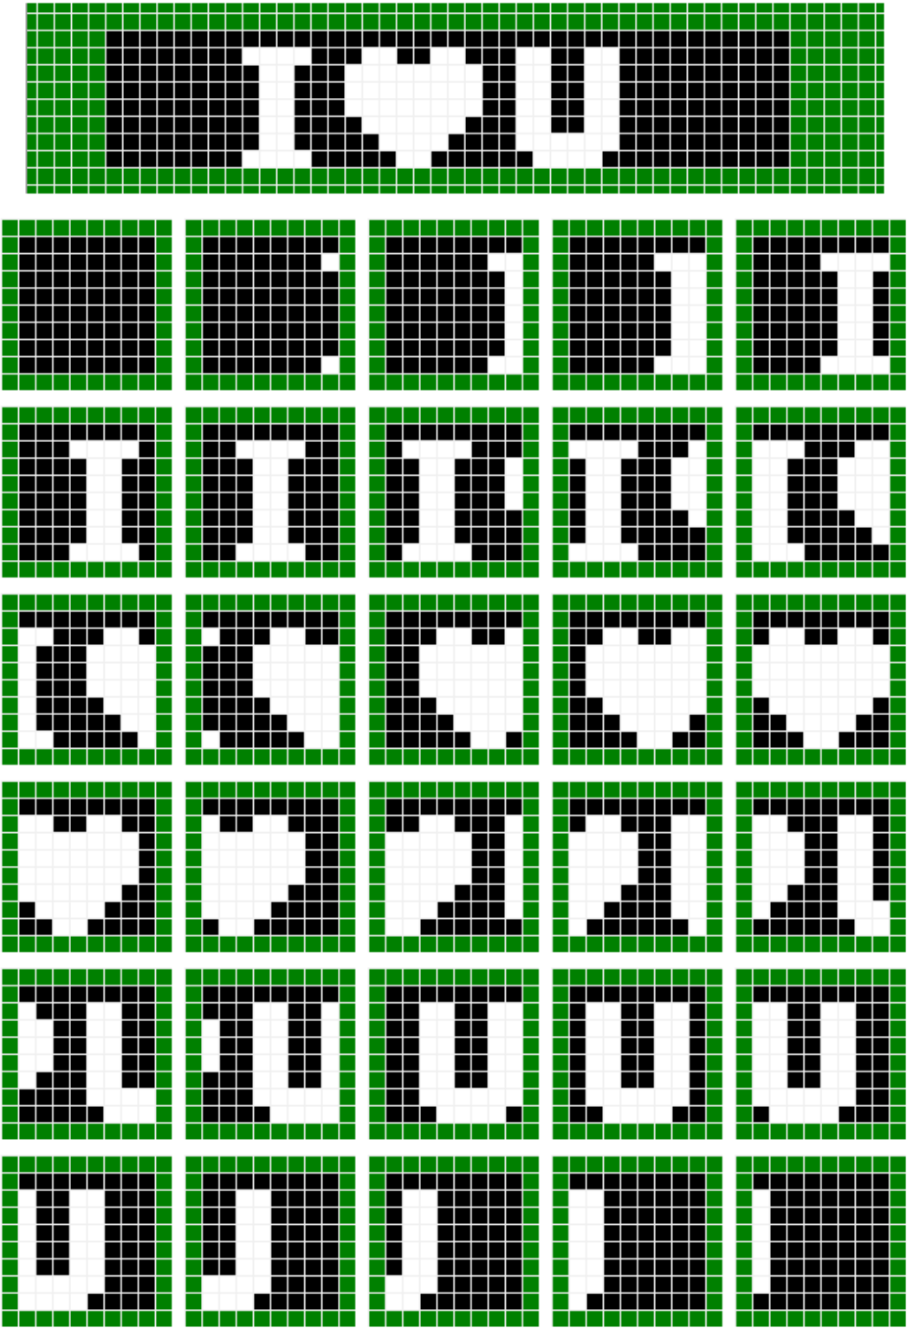
点阵的横向动画显示（二）
unsigned char code image[30][8] = {
{0xFF,0xFF,0xFF,0xFF,0xFF,0xFF,0xFF,0xFF}, //动画帧1
{0xFF,0x7F,0xFF,0xFF,0xFF,0xFF,0xFF,0x7F}, //动画帧2
{0xFF,0x3F,0x7F,0x7F,0x7F,0x7F,0x7F,0x3F}, //动画帧3
{0xFF,0x1F,0x3F,0x3F,0x3F,0x3F,0x3F,0x1F}, //动画帧4
{0xFF,0x0F,0x9F,0x9F,0x9F,0x9F,0x9F,0x0F}, //动画帧5
{0xFF,0x87,0xCF,0xCF,0xCF,0xCF,0xCF,0x87}, //动画帧6
{0xFF,0xC3,0xE7,0xE7,0xE7,0xE7,0xE7,0xC3}, //动画帧7
{0xFF,0xE1,0x73,0x73,0x73,0xF3,0xF3,0xE1}, //动画帧8
{0xFF,0x70,0x39,0x39,0x39,0x79,0xF9,0xF0}, //动画帧9
{0xFF,0x38,0x1C,0x1C,0x1C,0x3C,0x7C,0xF8}, //动画帧10
{0xFF,0x9C,0x0E,0x0E,0x0E,0x1E,0x3E,0x7C}, //动画帧11
{0xFF,0xCE,0x07,0x07,0x07,0x0F,0x1F,0x3E}, //动画帧12
{0xFF,0x67,0x03,0x03,0x03,0x07,0x0F,0x9F}, //动画帧13
{0xFF,0x33,0x01,0x01,0x01,0x03,0x87,0xCF}, //动画帧14
{0xFF,0x99,0x00,0x00,0x00,0x81,0xC3,0xE7}, //动画帧15
{0xFF,0xCC,0x80,0x80,0x80,0xC0,0xE1,0xF3}, //动画帧16
{0xFF,0xE6,0xC0,0xC0,0xC0,0xE0,0xF0,0xF9}, //动画帧17
{0xFF,0x73,0x60,0x60,0x60,0x70,0x78,0xFC}, //动画帧18
{0xFF,0x39,0x30,0x30,0x30,0x38,0x3C,0x7E}, //动画帧19
{0xFF,0x9C,0x98,0x98,0x98,0x9C,0x1E,0x3F}, //动画帧20
{0xFF,0xCE,0xCC,0xCC,0xCC,0xCE,0x0F,0x1F}, //动画帧21
{0xFF,0x67,0x66,0x66,0x66,0x67,0x07,0x0F}, //动画帧22
{0xFF,0x33,0x33,0x33,0x33,0x33,0x03,0x87}, //动画帧23
{0xFF,0x99,0x99,0x99,0x99,0x99,0x81,0xC3}, //动画帧24
{0xFF,0xCC,0xCC,0xCC,0xCC,0xCC,0xC0,0xE1}, //动画帧25
{0xFF,0xE6,0xE6,0xE6,0xE6,0xE6,0xE0,0xF0}, //动画帧26
{0xFF,0xF3,0xF3,0xF3,0xF3,0xF3,0xF0,0xF8}, //动画帧27
{0xFF,0xF9,0xF9,0xF9,0xF9,0xF9,0xF8,0xFC}, //动画帧28
{0xFF,0xFC,0xFC,0xFC,0xFC,0xFC,0xFC,0xFE}, //动画帧29
{0xFF,0xFE,0xFE,0xFE,0xFE,0xFE,0xFE,0xFF} //动画帧30
};

Slide 5
金沙滩工作室业务介绍
金沙滩工作室：单片机嵌入式教学
青岛金思特电子有限公司：逻辑分析仪、智能仪器
青岛方寸间智能科技有限公司：五子棋、围棋智能电子棋盘

