Slide 1
Chat with PDF using Langchain and Google Gemini

Slide 2
Features
Streamlit Interface: Streamlit provides an easy-to-use interface for building interactive web applications in Python.
PDF Manipulation with PyPDF2: PyPDF2 is a Python library for working with PDF files, allowing users to manipulate PDF documents seamlessly.
Advanced Text Analysis with LangChain: LangChain is a library for advanced text analysis, including capabilities such as RecursiveCharacterTextSplitter for handling complex text structures effectively.
Google Generative AI Embeddings: Leveraging Google Generative AI for intelligent embeddings, which can enhance text analysis and understanding.
Vector Stores with FAISS: FAISS (Facebook AI Similarity Search) is a library for efficient similarity search and clustering of dense vectors, which can be useful for storing and retrieving embeddings efficiently.
Chat-based Generative AI: Integration of Google Generative AI for creating engaging conversational experiences within the application.
Question Answering Chain with LangChain: LangChain's question-answering capabilities enable the application to answer queries based on the content of PDF documents.
Prompt Templates with LangChain: Using predefined templates from the LangChain prompt library can streamline interactions and provide users with prompts for generating responses.
Dotenv Integration: Dotenv integration ensures that sensitive credentials and environment variables are securely managed within the application.

Slide 3
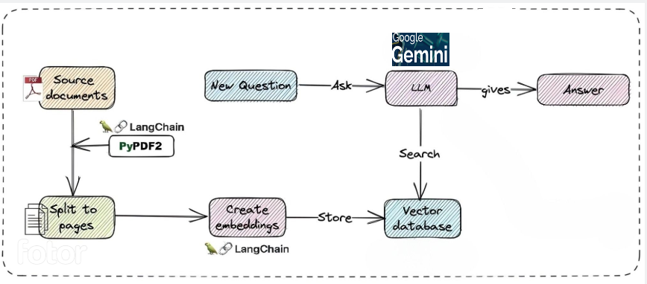
Flow Chart
Solution is deployed in google cloud using Docker
Chat with PDF using Langchain,Streamlit and Google Gemini

Slide 4
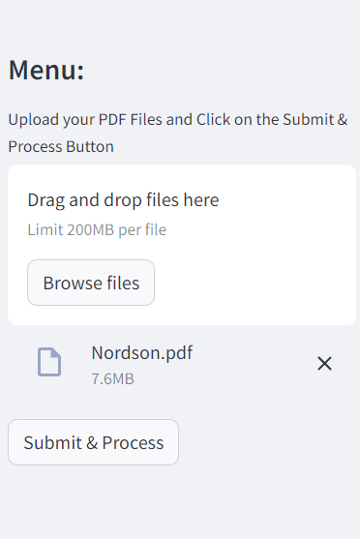
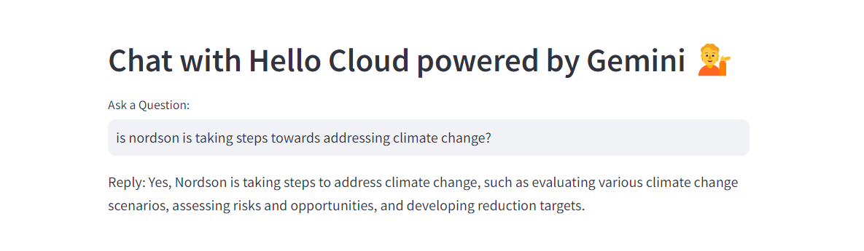
Steps to use PDF chatbot
Upload PDF and Submit
Ask questions based on PDF contents
Link to access Chat: https://wells-fargo-genai24-8374.uc.r.appspot.com/
Git: https://github.com/hellocloud-team/ragbasedchat

