Slide 1

Note: The data and information in this document is reflective of a hypothetical situation and client. This document is to be used for KPMG Virtual Internship purposes only.
Sprocket Central Pty Ltd
Data analytics approach
[Coney Hua Lu]

Slide 2
Note: The data and information in this document is reflective of a hypothetical situation and client. This document is to be used for KPMG Virtual Internship purposes only.
Agenda
Introduction
Data Exploration
Model Development
Interpretation

Slide 3
Note: The data and information in this document is reflective of a hypothetical situation and client. This document is to be used for KPMG Virtual Internship purposes only.
Introduction
The most common model for user classification problems is RFM:
R, recently, represents the time when the user recently paid/used/logged in
F, frequency, represents the frequency/frequency of user payment/use behavior
M, money, indicates the consumption amount of the user in a period of time
Because it is based on the idea of RFM, when selecting the data, the RFM data should be selected first; secondly, some other important characteristics should be considered, such as the earliest consumption date, which is an indicator of loyalty, and Construct new characteristics, average consumption, which reflects the customer's consumption tendency and level;

Slide 4
Note: The data and information in this document is reflective of a hypothetical situation and client. This document is to be used for KPMG Virtual Internship purposes only.
Introduction
Customer Analysis
Age Distribution/Class
Wealth segments
Job industry category
Number of cars own on each states
Purchase Frequency and Consumption quota

Slide 5
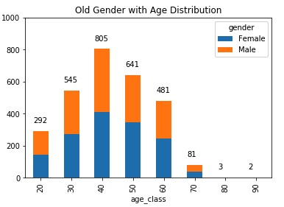
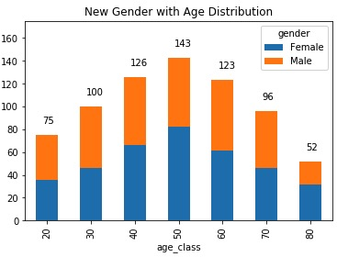
Note: The data and information in this document is reflective of a hypothetical situation and client. This document is to be used for KPMG Virtual Internship purposes only.
Data Exploration
Age Distribution/ Gender Distribution
Among the old customers, more than 50% of customers are concentrated in the age of 40-50; and among the new customers, more than 50% of the customers are concentrated in the age of 40-60, which is more extensive.
In the list of old customers, the ratio of male and female is relatively even; among new customers, there are more female than male customers.
The proportion of customers around 20 years old has not changed significantly. The proportion of customers over 50 years old has increased significantly.

Slide 6
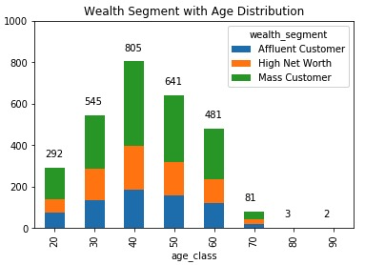
Note: The data and information in this document is reflective of a hypothetical situation and client. This document is to be used for KPMG Virtual Internship purposes only.
Model Development
Wealth Segment with Age Distribution
Wealth Segment is mainly divided into three categories: Mass Customer, High Net Worth and Affluent Customer. Among them, mass customers account for the highest proportion of all age groups.
High Net Worth had the second highest proportion of customers in all age groups, about the same as affluent customers, but significantly lower in the 20 years age group.
In the 70-year-old age group, the wealth segment for all three types of customers is almost equal.

Slide 7
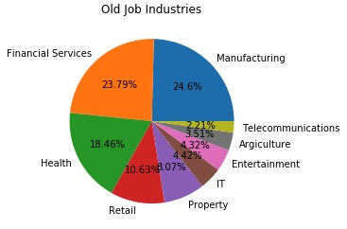
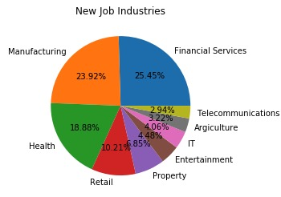
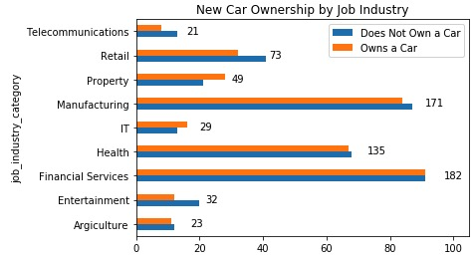
Note: The data and information in this document is reflective of a hypothetical situation and client. This document is to be used for KPMG Virtual Internship purposes only.
Model Development
Job Industry Category
Among all the customers, 24.6% of the customers were Manufacturing jobs, followed by Financial Services and Health; The first and second job categories for new customers are the opposite.
High Net Worth had the second highest proportion of customers in all age groups, about the same as affluent customers, but significantly lower in the 20 years age group.
Under the analysis of whether new customers have cars combined with job category, it can be found that more than half of customers in Manufacturing's jobs have no cars, and the same situation exists in the health industry. Financial services customers has ratio 1:1 under owns a car or not.

Slide 8
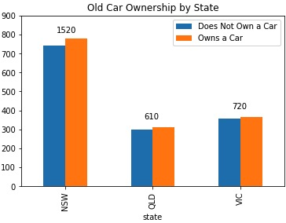
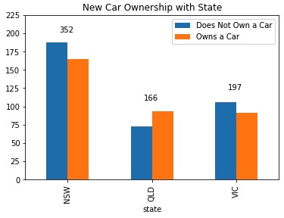
Note: The data and information in this document is reflective of a hypothetical situation and client. This document is to be used for KPMG Virtual Internship purposes only.
Model Development
Number of cars own on each state
In terms of the proportion of customers who own or do not own a car in order of states, New South Wales has 1520 customers, nearly 800 customers own a car, and 700 customers do not; Queensland and Victoria have a ratio close to 1:1.
NSW has the largest number of customers on the new customer list, but more customers do not own a cars than own a cars, also in Victoria.

Slide 9
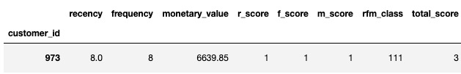

Note: The data and information in this document is reflective of a hypothetical situation and client. This document is to be used for KPMG Virtual Internship purposes only.
Interpretation
Customer Segment/ Analysis
After rating customers in four age groups according to the RFM model, all customers received one of four ratings: Gold, Silver, Bronze, Basic and one of 10 scores (i.e., r+f+m: 4+4+4=12); Customers are divided into 10 categories based on points for customers characteristics: car ownership, job category, and Wealth Segment.
Mapping the category to the new user list reveals that the Customer_id: 973 customer has the highest score and is the most promising customer.

Slide 10
Note: The data and information in this document is reflective of a hypothetical situation and client. This document is to be used for KPMG Virtual Internship purposes only.
Appendix

Slide 11
Note: The data and information in this document is reflective of a hypothetical situation and client. This document is to be used for KPMG Virtual Internship purposes only.
Appendix
This is an optional slide where you may place any supporting items.

