Slide 1
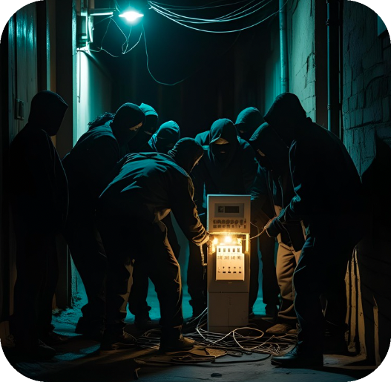
AUG 11, 2025
CATCHING ENERGY FRAUDS
ZERO_FRAUD_AI
Zero Fraud AI
Catching Energy Frauds

Slide 2
AUG 11, 2025
CATCHING ENERGY FRAUDS
ZERO_FRAUD_AI
Today’s
Agenda:
Background
Process
Final result
Q&A

Slide 3
AUG 11, 2025
CATCHING ENERGY FRAUDS
ZERO_FRAUD_AI
Meet
the Problem
01

Slide 4

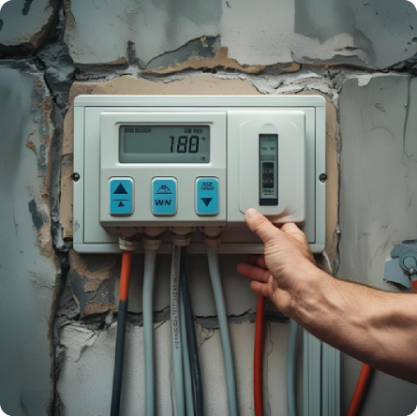
AUG 11, 2025
CATCHING ENERGY FRAUDS
ZERO_FRAUD_AI
Meter manipulation
$1.4b
304%
per year
in 6 years
13,415
$50
per year
per household
HTTPS://WWW.STAYENERGYSAFE.CO.UK/MORE-ON-ENERGY-THEFT/ENERGY-THEFT-LATEST-FACTS-AND-STATISTICS
Notes:
the most frequent fraud is to change your electricity and gas meters. 1) based on a research on estimation 1.4b is sold every year 2) 304% is increase from 2016 to 2022 3) 13,415 cases are officially reported 4) the amount that we have to bear is 50$ per household

Slide 5
AUG 11, 2025
CATCHING ENERGY FRAUDS
ZERO_FRAUD_AI
Our goal & KPIs
EARLY FRAUD DETECTION
By catching frauds, we aim to grow a healthy ecosystem
MODEL ACCURACY
Accuracy, Precision, Recall
F1 score(FPR, FNR) , AUC score
REVENUE INCREASE
Revenue = Unit price x Paying users
Our goal is to correct the unit price for fraudulent users
No user acquisition cost. Possible increase of churn rate
Notes:
our goal is to catch frauds, because we could achieve three things

Slide 6
AUG 11, 2025
CATCHING ENERGY FRAUDS
ZERO_FRAUD_AI
Process
02

Slide 7

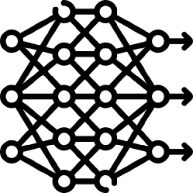

AUG 11, 2025
CATCHING ENERGY FRAUDS
ZERO_FRAUD_AI
Our data columns were not enough
Recurring invoices
Client ID
Invoice Date
Monthly consumption
Tarif type
Counter status
invoice
Client information
1 : n Problem
Classification
Fraudulent / Not Fraudulent
Client ID
Client category (enterprise, low-income)
Region
District
Creation date
Client
Notes:
why making new features were so important for us

Slide 8
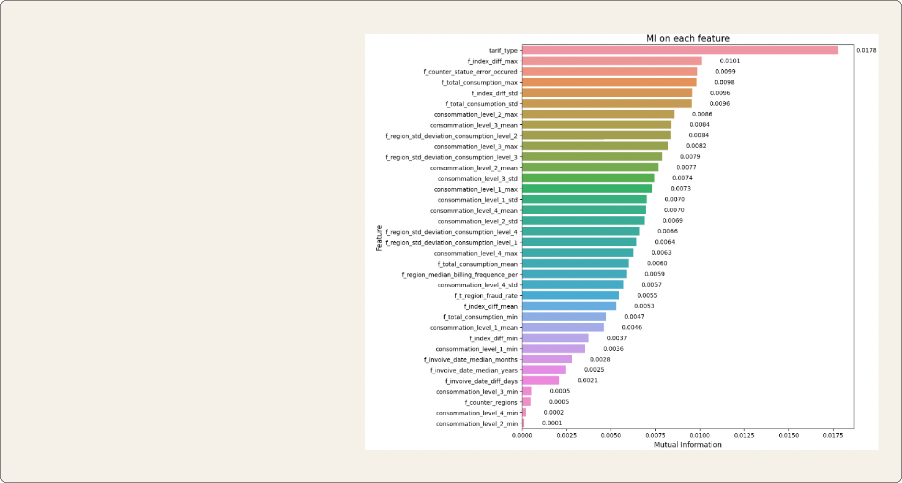
AUG 11, 2025
CATCHING ENERGY FRAUDS
ZERO_FRAUD_AI
Key Features
Tarif type (mode)
the most frequent value
Consumption (std)
severe changes in the consumption
Counter status (mode)
manually broken or something weird
Notes:
key features

Slide 9
AUG 11, 2025
CATCHING ENERGY FRAUDS
ZERO_FRAUD_AI
Baseline Model
XX%
XX%
Of people did a thing.
Of people did a thing.
XX%
XX%
Of people did a thing.
Of people did a thing.
Notes:
4 base line model logistic, a, b, c

Slide 10
AUG 11, 2025
CATCHING ENERGY FRAUDS
ZERO_FRAUD_AI
our attempts to make the models work better

Slide 11
AUG 11, 2025
CATCHING ENERGY FRAUDS
ZERO_FRAUD_AI
our attempts to make the models work better

Slide 12

AUG 11, 2025
CATCHING ENERGY FRAUDS
ZERO_FRAUD_AI
Final
Feature Engineering
Data
Modeling
Classification

Slide 13
AUG 11, 2025
CATCHING ENERGY FRAUDS
ZERO_FRAUD_AI
Final Result
03

Slide 14


AUG 11, 2025
CATCHING ENERGY FRAUDS
ZERO_FRAUD_AI
HIGH VALUE
Here’s the performance of the model
HIGH EFFORT
LOW EFFORT
LOW VALUE

Slide 15

AUG 11, 2025
CATCHING ENERGY FRAUDS
ZERO_FRAUD_AI
Our tech stack
A.
B.
C.

Slide 16

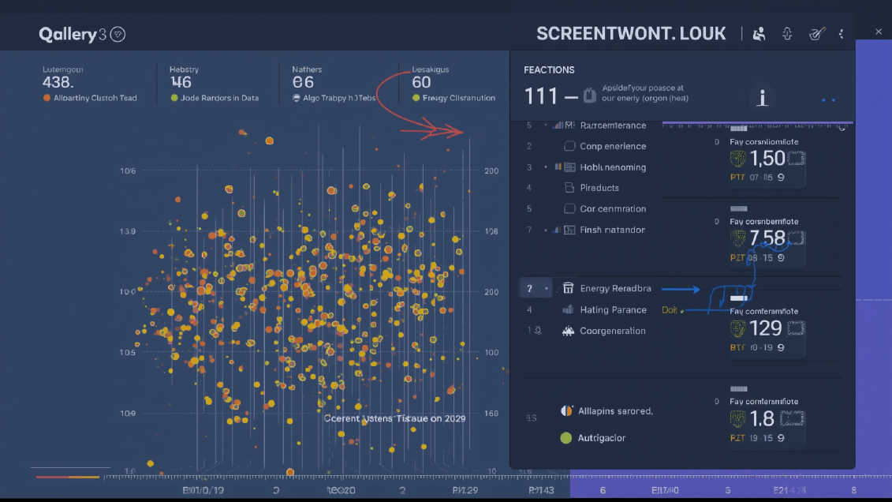
AUG 11, 2025
CATCHING ENERGY FRAUDS
ZERO_FRAUD_AI
Going forward,
Fraud Detection Web Application
This is a smart analysis feature based on our energy fraud detection model. It is a completely smart feature that detects suspicious patterns in complex consumption data and predicts fraud. Now you don't have to worry about fraud anymore! It can be said that this is our AI solution for a fair energy world.

Slide 17
AUG 11, 2025
CATCHING ENERGY FRAUDS
ZERO_FRAUD_AI
Team
Murat
Murat
Murat
Data Scientist
Data Scientist
Data Scientist

Slide 18




AUG 11, 2025
CATCHING ENERGY FRAUDS
ZERO_FRAUD_AI
How do we feel about our process?
Don’t Love It
Love It

Slide 19
AUG 11, 2025
CATCHING ENERGY FRAUDS
ZERO_FRAUD_AI
Q&A
Thank you!

