Slide 1
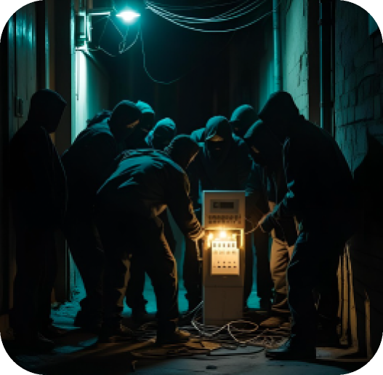
AUG 11, 2025
CATCHING ENERGY FRAUDS
ZERO_FRAUD_AI
Zero Fraud AI
Catching Energy Frauds
1
Notes:
https://docs.google.com/document/d/1T4H993XyOUdJO5O_QljRB0VoUAem2qZYGCP6iTJj84k/edit?tab=t.0

Slide 2
AUG 11, 2025
CATCHING ENERGY FRAUDS
ZERO_FRAUD_AI
Today’s
Agenda:
Background
Workflow
Final result
Q&A
2
Notes:
https://docs.google.com/document/d/1T4H993XyOUdJO5O_QljRB0VoUAem2qZYGCP6iTJj84k/edit?tab=t.0

Slide 3
AUG 11, 2025
CATCHING ENERGY FRAUDS
ZERO_FRAUD_AI
Meet
the Problem
01
3

Slide 4

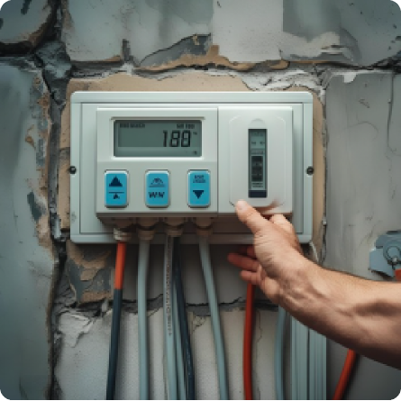
AUG 11, 2025
CATCHING ENERGY FRAUDS
ZERO_FRAUD_AI
Meter manipulation
$1.4b
304%
per year
in 6 years
13,415
$50
per year
per household
4
HTTPS://WWW.STAYENERGYSAFE.CO.UK/MORE-ON-ENERGY-THEFT/ENERGY-THEFT-LATEST-FACTS-AND-STATISTICS
Notes:
the most frequent fraud is to change your electricity and gas meters. 1) based on a research on estimation 1.4b is sold every year 2) 304% is increase from 2016 to 2022 3) 13,415 cases are officially reported 4) the amount that we have to bear is 50$ per household

Slide 5
AUG 11, 2025
CATCHING ENERGY FRAUDS
ZERO_FRAUD_AI
Our goal & KPIs
EARLY FRAUD DETECTION
By building a model, we aim to catch fraudulent activities
MODEL ACCURACY
Accuracy, Precision, Recall
F1 score, AUC score
REVENUE INCREASE
Revenue = Unit price x Paying users
Our goal is to correct the unit price for fraudulent users
5
Notes:
our goal is to catch frauds, because we could achieve three things

Slide 6
AUG 11, 2025
CATCHING ENERGY FRAUDS
ZERO_FRAUD_AI
Workflow
02
Data
Features
Metrics
Threshold
Sampling
6

Slide 7



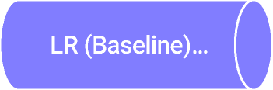
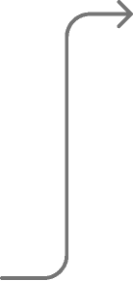
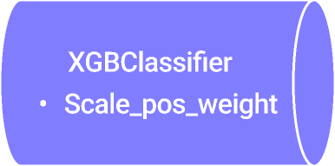



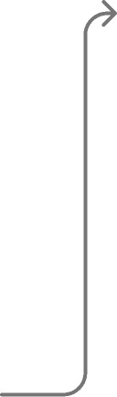
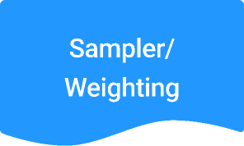

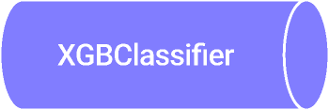
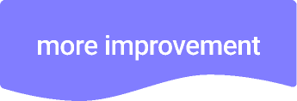

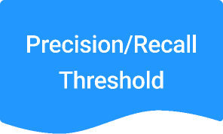
AUG 11, 2025
CATCHING ENERGY FRAUDS
ZERO_FRAUD_AI
Workflow Overview
Hyperparameter
(4)Sampler / (5)Threshold
(1)Data / (2)Features
Model/ (3) Metrics
Final Release
Mutual Information
7

Slide 8


AUG 11, 2025
CATCHING ENERGY FRAUDS
ZERO_FRAUD_AI
(1) Our data
Client information
Client ID
Client category (enterprise, low-income)
Region
District
Creation date
Client
1 : Many
Recurring invoices
Client ID
Invoice Date
Consumption Data
Tarif Type
Counter status
etc.
invoice
8
Notes:
why making new features were so important for us

Slide 9
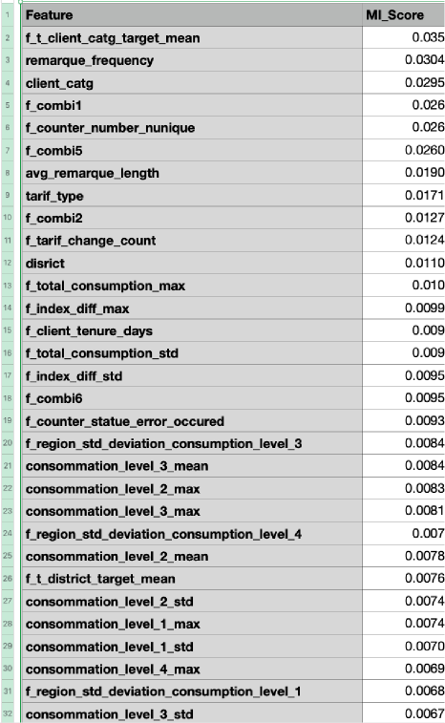
AUG 11, 2025
CATCHING ENERGY FRAUDS
ZERO_FRAUD_AI
(2) +50 new features
many aggregated features
How to select what’s really relevant :
Mutual Information Score
9
Notes:
why making new features were so important for us

Slide 10
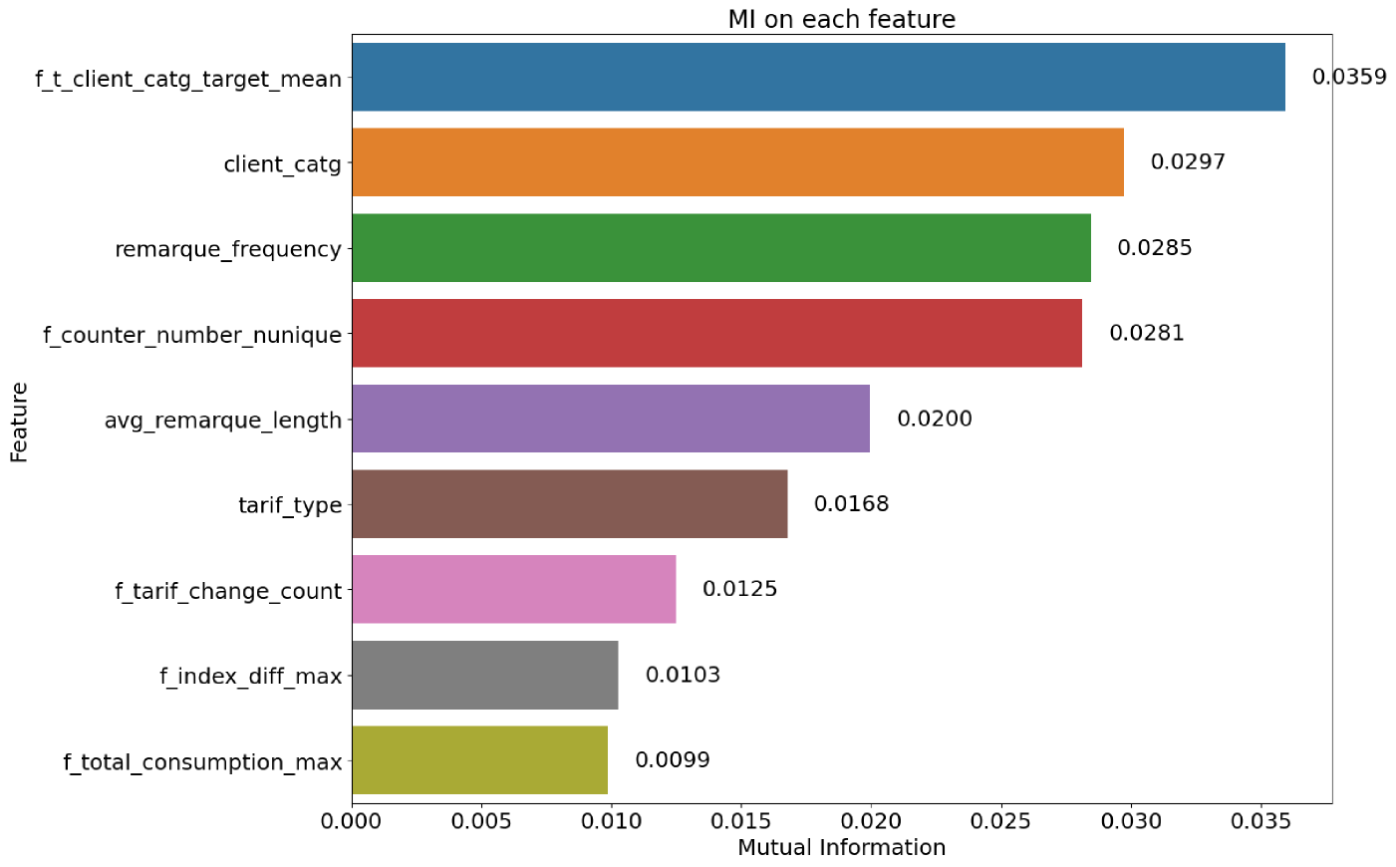
AUG 11, 2025
CATCHING ENERGY FRAUDS
ZERO_FRAUD_AI
(2) Feature evaluation: Mutual Info (Top 10)
10
Notes:
key features

Slide 11
AUG 11, 2025
CATCHING ENERGY FRAUDS
ZERO_FRAUD_AI
(3) Evaluation Metrics
CONCLUSION
High F1
→ Balanced performance
PRECISION
Measures how many of the predicted positive cases were actually correct.
High Precision → Few false alarms
RECALL
Measures how many of the actual positive cases were correctly identified.
High Recall → Few missed fraud cases
F1-SCORE
The harmonic mean of Precision and Recall.
11

Slide 12
AUG 11, 2025
CATCHING ENERGY FRAUDS
ZERO_FRAUD_AI
Baseline Model - Logistic Regression
0
0.97
0.79
1
0.11
0.19
Precision
F1-score
12
Notes:
The baseline model performs poorly mainly because the dataset is highly imbalanced. For class 1 (the minority class), precision is only 0.11 and F1-score is 0.19, meaning the model produces many false positives and fails to capture positives reliably. For class 0 (the majority class), precision and F1 are much higher (0.97 and 0.79), showing that the model is biased toward predicting the majority class correctly. A baseline model without proper handling of class imbalance (e.g., via resampling, class weighting, or threshold tuning) will typically optimize for accuracy, which can be misleading — in this case, it predicts the majority class most of the time and largely ignores the minority class. In short: The imbalance skews the learning process, so the model underperforms for the minority (positive) class, which is often the most important in fraud detection.

Slide 13
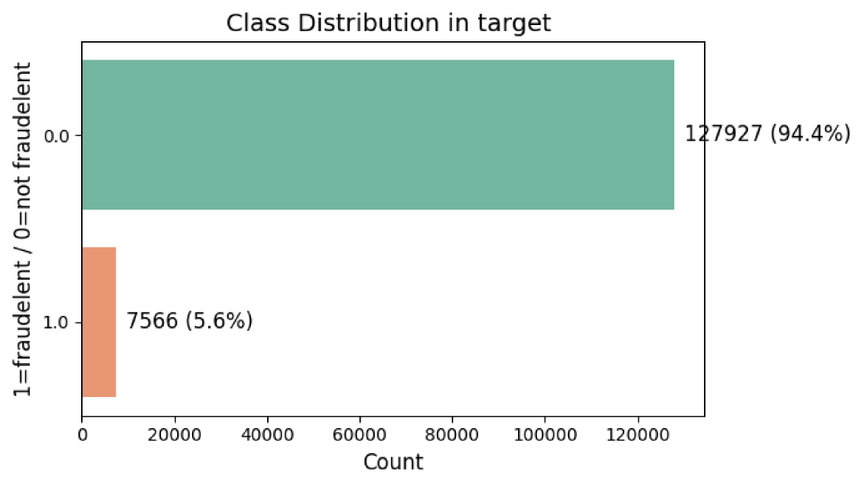
AUG 11, 2025
CATCHING ENERGY FRAUDS
ZERO_FRAUD_AI
because our target is imbalanced
13

Slide 14








AUG 11, 2025
CATCHING ENERGY FRAUDS
ZERO_FRAUD_AI
Workflow Overview
Hyperparameter
(4)Sampler / (5)Threshold
(1)Data / (2)Features
Model/ (3) Metrics
Final Release
Mutual Information
14

Slide 15
AUG 11, 2025
CATCHING ENERGY FRAUDS
ZERO_FRAUD_AI
(4) 3 Sampler & 1 Weighting to deal with imbalanced target
SMOTE
Generates synthetic examples of the minority class
scale_pos_weight
ADASyn
Does not modify the data. Instead, it tells the model to give more weight to rare fraud cases
Like SMOTE, but focuses more on hard-to-classify fraud examples by generating more near them
SMOTETomek
Combines SMOTE with a cleaning step that removes overlapping samples
15

Slide 16
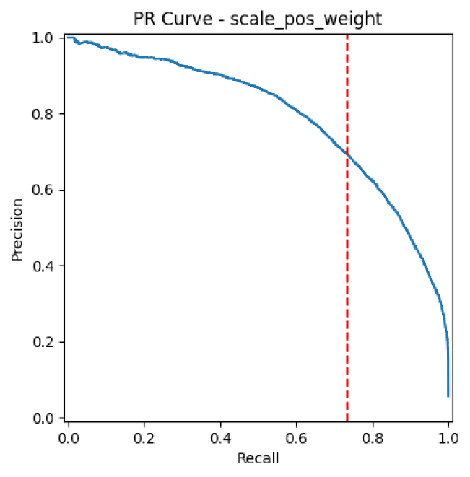
(5) XGboost with scale_pos_weight
[1] Find the best Hyperparameters
(RandomizedSearchCV, StratifiedKFold)
→ “The Best Model”
→ Crossvalidation Best Model
[2] Precision-Recall Curve with train data
→ “The Best Threshold”
[3] Predicte fraud with test data
→ using fitted threshold
16
The Best Threshold : 0.744
Notes:
Why the CV values are not visible in the curve Different data basis: PR-Curve: trained models on the entire dataset. CV metrics: models trained on training folds, averaged. Different threshold: CV metrics: threshold = 0.5. PR-Curve: threshold is varied, and the red line marks the best F1 threshold. Different aggregation: PR-Curve: a single curve from one model. CV: average from 5 different models/folds.

Slide 17
AUG 11, 2025
CATCHING ENERGY FRAUDS
ZERO_FRAUD_AI
(5) Our scores and fitted thresholds
XGBOOST MODEL
LOGISTIC
SMOTE
0.37 (thre 0.548)
0.3
ADASyn
0.36
(0.538)
0.296
SMOTETomek
0.368 (0.559)
0.301
SCALE_POS_W
0.713 (0.744)
0.316
F1 Score
(fitted threh)
F1 Score
(threh=0.5)
0.19
17
based on the training data
Notes:
https://docs.google.com/document/d/1T4H993XyOUdJO5O_QljRB0VoUAem2qZYGCP6iTJj84k/edit?tab=t.0 Best threshold for SMOTE: 0.548 with F1 = 0.370 Best threshold for ADASYN: 0.538 with F1 = 0.360 Best threshold for SMOTETomek: 0.559 with F1 = 0.368 Best threshold for scale_pos_weight: 0.744 with F1 = 0.713

Slide 18

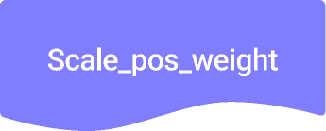
AUG 11, 2025
CATCHING ENERGY FRAUDS
ZERO_FRAUD_AI
(5) Conclusion
All samplers aim to solve the class imbalance in fraud detection, but ...
The simplest to apply
Computationally efficient
The best-performing method in our evaluation
→ ZINDI Score(AUC) : 0.82
Ranking : 219/595
18

Slide 19
AUG 11, 2025
CATCHING ENERGY FRAUDS
ZERO_FRAUD_AI
Final Result
03
18

Slide 20


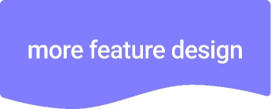
AUG 11, 2025
CATCHING ENERGY FRAUDS
ZERO_FRAUD_AI
Final Zindi Score
Zindi Ranking
Zindi Score(AUC)
193
0.83
219
0.82
19
Notes:
On this slide, you can see how feature engineering helped us improve the model. We compared two versions: one with the original features, and one after we applied basic feature combinations like multiplication, addition, and division. As you can see, just by adding these combinations, our Zindi score improved from 0.82 to 0.83, and our rank jumped from 219 to 193 — a noticeable lift in a highly competitive leaderboard. This shows that even simple transformations of existing features can significantly enhance a model's performance. Initially, we submitted the prediction to Zindi and it gave us the score of 0.82 (already high). But we did some feature engineering by feature combinations (multiplication, devision, addition, deduction) and managed to climb 26 positions in the final ranking. And we made it to Top-200.

Slide 21



AUG 11, 2025
CATCHING ENERGY FRAUDS
ZERO_FRAUD_AI
Improvement
Combine & Rank features
Add 3rd party data
20
Notes:
If we had more time, we could achieve better AUC (area under the curve) score by further combining features, trying to use other subsets of features and adding a 3rd party data. Still a lot of room for improvement for this model.

Slide 22

AUG 11, 2025
CATCHING ENERGY FRAUDS
ZERO_FRAUD_AI
Key Business Insights
Client Category
Service Remark : Frequency & Length
Number of counter changes
Tarif Type
21
Notes:
Now, let’s look at what the model tells us about the drivers of fraud. The top predictive feature was Client Category – this reflects whether the customer is residential, commercial, or industrial. Fraud patterns clearly vary across these categories. Secondly, we have Service Remarque Frequency and Length. These are the notes made by the company agents during visits – and they’re incredibly insightful. For example, if a counter shows anomalies or if the agent gives a negative score, it often correlates with fraudulent behavior. So the model picks up on these patterns. Next is the Number of Counter Changes. Frequent changes might suggest tampering, upgrades to hide consumption, or irregular maintenance – all red flags. Finally, Tarif Type plays a significant role. Some tarifs might incentivize manipulation more than others – and the model captures this subtle effect. Overall, we see that both technical meter data and observations by field agents are critical to predicting fraud. These insights can be used not just for better prediction, but also for designing more resilient operational policies.

Slide 23







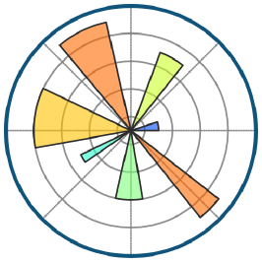


AUG 11, 2025
CATCHING ENERGY FRAUDS
ZERO_FRAUD_AI
Our tech stack
22
Notes:
We used a powerful Python-based stack including Pandas, Scikit-learn, Imbalanced-learn, and XGBoost to build and evaluate our models.

Slide 24
AUG 11, 2025
CATCHING ENERGY FRAUDS
ZERO_FRAUD_AI
Q&A
Thank you!
23
Notes:
Thanks for your attention—happy to answer your questions!

Slide 25
AUG 11, 2025
CATCHING ENERGY FRAUDS
ZERO_FRAUD_AI
Notes:
Thanks for your attention—happy to answer your questions!

Slide 26



AUG 11, 2025
CATCHING ENERGY FRAUDS
ZERO_FRAUD_AI
Workflow Overview
Hyperparameter
(4)Sampler / (5)Threshold
(1)Data / (2)Features
Model/ (3) Metrics
Final Release
Mutual Information

Slide 27
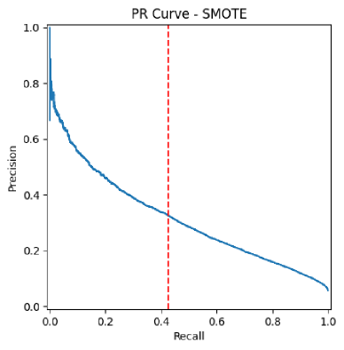
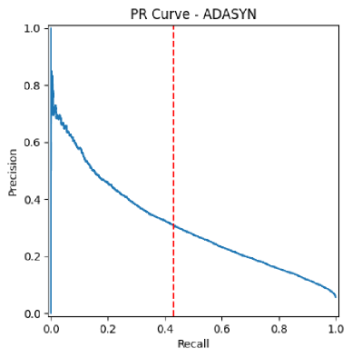
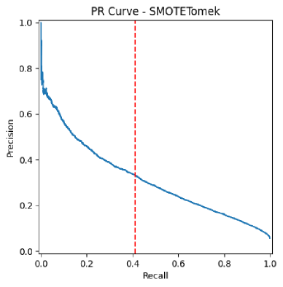
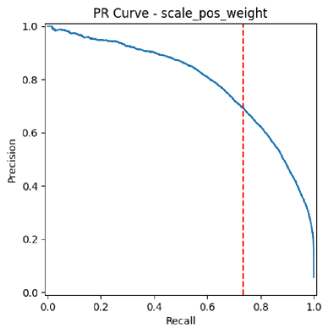
Appendix - 4 sampling methods
=== SMOTE Evaluation Summary ===
accuracy : 0.896 ± 0.002
balanced_acc : 0.662 ± 0.006
precision : 0.240 ± 0.007
recall : 0.399 ± 0.012
f1 : 0.300 ± 0.008
roc_auc : 0.804 ± 0.007
avg_precision : 0.238 ± 0.010
log_loss : -0.304 ± 0.001
mcc : 0.257 ± 0.009
Optimal Threshold : 0.548
=== ADASYN Evaluation Summary ===
accuracy : 0.894 ± 0.002
balanced_acc : 0.661 ± 0.006
precision : 0.236 ± 0.005
recall : 0.398 ± 0.013
f1 : 0.296 ± 0.006
roc_auc : 0.803 ± 0.006
avg_precision : 0.238 ± 0.009
log_loss : -0.307 ± 0.001
mcc : 0.253 ± 0.007
Optimal Threshold : 0.538
=== SMOTETomek Evaluation Summary ===
accuracy : 0.895 ± 0.002
balanced_acc : 0.664 ± 0.005
precision : 0.240 ± 0.005
recall : 0.405 ± 0.011
f1 : 0.301 ± 0.006
roc_auc : 0.805 ± 0.007
avg_precision : 0.238 ± 0.009
log_loss : -0.304 ± 0.001
mcc : 0.258 ± 0.007
Optimal Threshold : 0.559
=== scale_pos_weight Evaluation Summary ===
accuracy : 0.872 ± 0.003
balanced_acc : 0.711 ± 0.007
precision : 0.225 ± 0.005
recall : 0.529 ± 0.016
f1 : 0.316 ± 0.006
roc_auc : 0.821 ± 0.006
avg_precision : 0.286 ± 0.014
log_loss : -0.310 ± 0.004
mcc : 0.286 ± 0.007
Optimal Threshold : 0.744
Notes:
Best threshold for SMOTE: 0.548 with F1 = 0.370 Best threshold for ADASYN: 0.538 with F1 = 0.360 Best threshold for SMOTETomek: 0.559 with F1 = 0.368 Best threshold for scale_pos_weight: 0.744 with F1 = 0.713

Slide 28
(5) XGboost - scale_pos_weight
[1] Best_model after Cross-validation
[2] Precision-Recall Curve based on best-model
<scale_pos_weight >
accuracy : 0.872
balanced_acc : 0.711
precision : 0.225
recall : 0.529
f1 : 0.316
roc_auc : 0.821
avg_precision : 0.286
log_loss : -0.310
mcc : 0.286
[3] F-1 Score
0.731
Optimal Threshold : 0.744
Notes:
Why the CV values are not visible in the curve Different data basis: PR-Curve: trained models on the entire dataset. CV metrics: models trained on training folds, averaged. Different threshold: CV metrics: threshold = 0.5. PR-Curve: threshold is varied, and the red line marks the best F1 threshold. Different aggregation: PR-Curve: a single curve from one model. CV: average from 5 different models/folds.

Slide 29
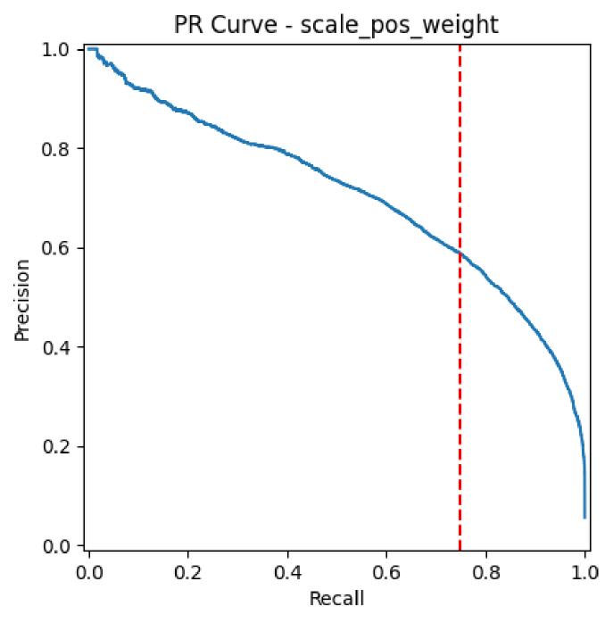
Final Model - Evaluation Metrics
Model: XGBoost with scale_pos_weight and feature design
Accuracy: 0.87
Precision: 0.24
Recall: 0.58
F1: 0.34
ROC AUC: 0.84
MCC: 0.31
F1: 0.66
Threshold: 0.72
Notes:
Here we present the key evaluation metrics for our model. Although the accuracy is relatively high at 87%, it's important to note that this is a highly imbalanced classification problem, so accuracy alone can be misleading. That's why we focus more on metrics like precision, recall, and the F1-score. Our model achieves a recall of 58%, which means it's able to correctly identify more than half of the true positive cases - a critical aspect in this context. Precision is lower, at 24%, indicating that some of the positive predictions are still false positives - a common trade-off when optimizing for recall. The F1-score balances those two and comes in at 0.34. Finally, the decision threshold was tuned to 0.72, prioritizing recall without completely sacrificing precision. Let's look at our Evaluation metrics. Cross-validation showed us high Accuracy, but as we're dealing with class imbalance, this metric may be misleading. So we were focusing mostly on optimal Precision and Recall combination, and therefore were trying to maximize our F1 score. And we managed to achieve a good Recall - more than half of our Positives were True Positives. And we did it with reasonable Precision. On the test data, we tuned the Threshold to maximize F1 score, and achieved even greater results.

Slide 30

AUG 11, 2025
CATCHING ENERGY FRAUDS
ZERO_FRAUD_AI
(4) The best Threshold
F1-SCORE (RED-LINE)
The red line : the best balance btw Recall and Precision → F1-Score reaches the maximum
PRECISION
An acceptable level of false alarms (Precision ≈ 0.68)
RECALL
Detection of large portion of fraud cases (Recall ≈ 0.75)

