Slide 1

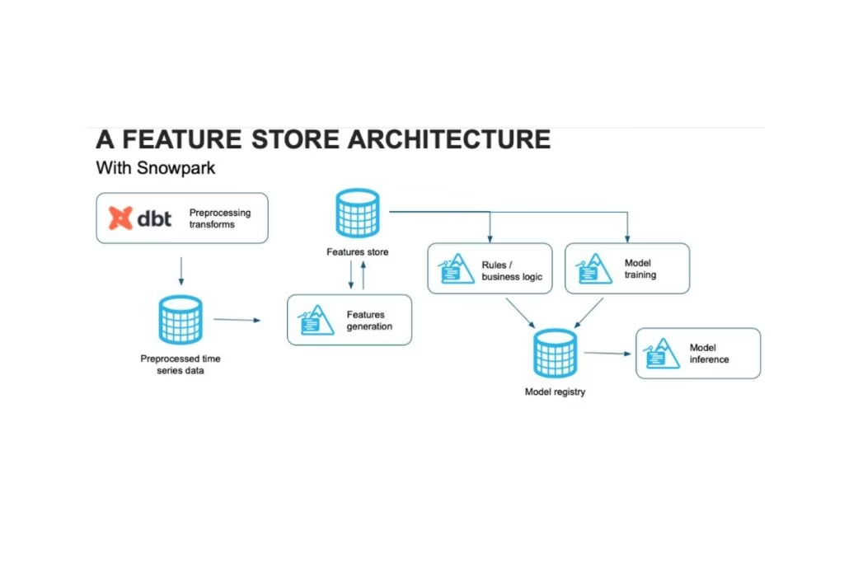

Feature Engineering Using Snowflake and Feature Stores
Presented by Sai Swaran Deepu | Vistora AI | 10-05-2025
by DEEPU D

Slide 2




Presentation Objective
Goal
Demonstrate how feature engineering works with Snowflake and Feature Stores.
Focus
Highlight workflow improvements for ML model development and deployment.
By Deepu

Slide 3

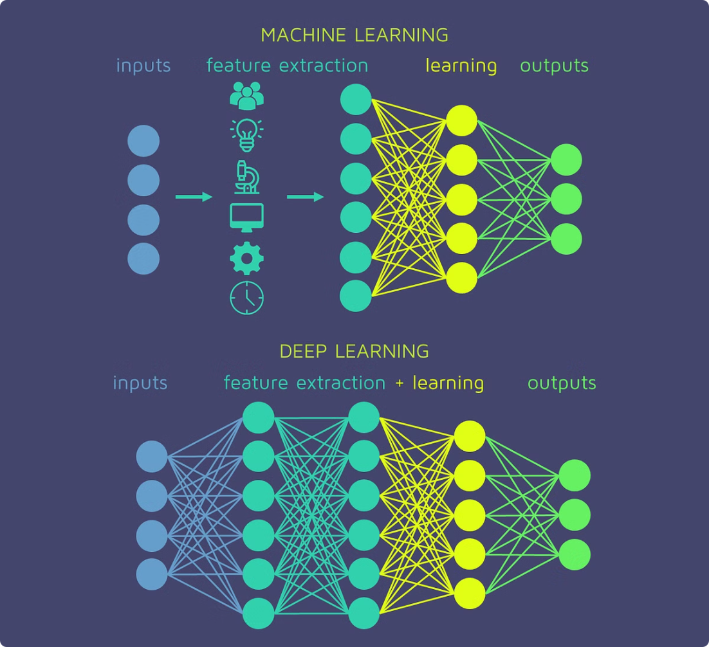
Understanding Feature Engineering
Definition
Transform raw data into informative inputs for ML algorithms.
Importance
Improves model accuracy, reduces training time, and enhances interpretability.

Slide 4





Feature Engineering Techniques
Normalization
One-Hot Encoding
Binning
Scale features to a standard range, e.g., 0-1.
Convert categorical variables to binary vectors.
Group continuous values into discrete intervals.
Date/Time Features
Aggregations
Extract day, month, or weekday from timestamps.
Summarize data by mean, count, max, etc.
By Deepu

Slide 5
Snowflake Overview
Cloud Native
Data Handling
SQL Support
Snowflake supports fully managed, scalable cloud storage.
Stores structured and semi-structured data like JSON and Parquet.
Enables powerful querying and transformation with standard SQL.
By Deepu

Slide 6




Feature Engineering in Snowflake
Sample Query
Preprocessing
Example SQL for joining user and transaction tables with aggregated spend.
Use filtering and joins to clean and enrich features.
Integration
Connect Snowflake with Python or ML frameworks for seamless pipelines.
By Deepu

Slide 7






What is a Feature Store?
Consistency
Ensures feature values are synced online/offline for training and serving.
Central Repository
Stores curated, validated features for reuse across projects.
Reusability
Enables teams to reuse trusted features, accelerating ML development.
By Deepu

Slide 8
Comparing Feature Stores
Provider
Tech base
primary users
Ops Integration
Integration Environment
AWS FS
Built into AWS SageMaker ecosystem
AWS-centric ML teams
Works with SageMaker Pipelines, Lambda
Tightly integrated within the AWS ecosystem, leveraging services such as S3, Glue, and SageMaker for end-to-end workflows
Snowflake FS
Built on SQL engine (Snowflake)
SQL analysts, data scientists
Strong with dbt, Airflow, and Snowflake workflows
Seamless integration with Snowflake’s cloud data platform, allowing easy SQL-based feature engineering and serving
Databricks FS
Built on Apache Spark
Data engineers, ML engineers
Native integration with notebooks and jobs
Operates within the Spark-based Databricks environment to enable distributed feature processing and machine learning workflows
By Deepu

Slide 9




Feature Engineering Pipeline Overview
Extract
Data pulled from Snowflake warehouse.
Transform
Preprocess and create features using SQL or Python.
Load
Features stored and catalogued in the Feature Store.
Access
ML models retrieve features for training and inference.
By Deepu

Slide 10
Simple Code Snippets for Pipeline Stages
Extract (SQL)
Transform (Python)
SELECT user_id, event_time, value FROM events WHERE event_time >= '2025-01-01';
df['hour'] = df['event_time'].dt.hour
Load (Feature Store)
Access (Model)
fs_client.write_features(feature_group, df)
X = fs_client.get_features(entity_ids)
By Deepu

Slide 11
Conclusion
GitHub Links:
https://github.com/hellodeepuu/vistora_AI/tree/main
References: https://app.snowflake.com/ https://www.databricks.com/ https://chatgpt.com/
Thank you for your attention.
By Deepu

