Slide 1
RTL DESIGN & SYNTHESIS OF A 32-BIT MICROPROCESSOR
By
Anindita Panda
Gautam Kumar Sinha
Anand Kumar Singh
Deepak Kumar Gupta
Guide: Mr. Prashant Mani

Slide 2
Objective
This is a very challenging project because processors are not as flexible as programmable logic. The ability to emulate a microprocessor on a programmable chip can lead to cheaper, more efficient and more flexible performance. But then today there is also a second stringent demand, that is miniaturization. The race is on for reaching the minimum space as possible occupied by the systems.
Our project, keeping an eye wide open on the future will mix both fields enabling us to communicate, in a digital manner, by using systems that would be integrated on an IC through programming of the IC using VHDL.

Slide 3
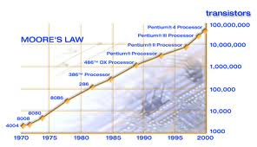
Introduction
According to the famous theory stated by Sir Moore’s
“the number of transistors that can be inexpensively
placed over an integrated circuit doubles itself every
years” the capabilities of IC has increased
exponentially over the years, in terms of
computation power, utilization of available area, yield.
Examples are embedded systems, where intelligent
devices are put inside everyday objects, and ubiquitous
Computing where small computing devices proliferate
to such an extent that even the shoes we wear may
actually do something useful like monitoring our
heartbeats!!
Graph for Moore’s Law

Slide 4
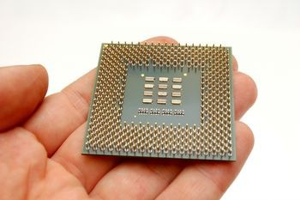
Introduction
Microprocessors are an important part in the field of engineering. The goal of our project is to design an 32-bit microprocessor using VHDL. The processor will have most all of the arithmetic and logic functions that are on a standard 32-bit microprocessor. To give the project some user interaction, we set up the instruction input to be sent in one instruction at a time via a set of dipswitches and a pushbutton on the FPGA board.

Slide 5
Acknowledgement
We are highly thankful to Mr. Prashant Mani for his relentless support & guidance. We are also thankful to our Project coordinators- Mr. Pankaj Singh, Mr. Haldar & Mr. Pankaj Agarwall for putting their faith upon us & allowing us to continue such a challenging project.
Also we are thankful to each other, as each made significant contribution by following the right strategy, & maintaining patience even in tough times.
Not to forget the contribution of our H’nble dean sir, Dr. Prof. Manoj Pandey who at the final moment provided us with his precious time suggesting several improvements in our design.
Last but not the least we would like to thank Mr. Sanjeev Rai, (Prof., Electronics & Communication Engineering, and MNNIT Allahabad) for putting his interest in our project and providing such a huge wave of encouragement in our work.
Once again we wish to acknowledge our gratitude to all those people who were involved either directly or indirectly for the competition of this task.
With Warm Regards
Deepak Kumar Gupta
Anand Kumar Singh
Gautam Kr. Sinha
Anindita Panda

Slide 6
Abstract
The ability to emulate a microprocessor on a programmable chip can lead to cheaper, more efficient and more flexible performance.
Our goal is to design a 32-bit microprocessor in VHDL. All of the functionality will come from the codes written in VHDL. The processor will have all of the arithmetic and logic functions that are on a standard 32-bit microprocessor. To give the project some user interaction, we set up the instruction input to be sent in one instruction at a time via a set of dipswitches and a pushbutton on the FPGA board. Future work would include the implementation of JUMP instructions, interrupts, and adding more addressing modes.

Slide 7
Work Plan
Studied different components & architecture of the microprocessor.
Using structural modeling these modules are combined.
Code is synthesized using Xilinx ise
Using behavioral modeling separate modules are designed.
Simulation is performed using Modelsim and Dumping is made on FPGA.

Slide 8
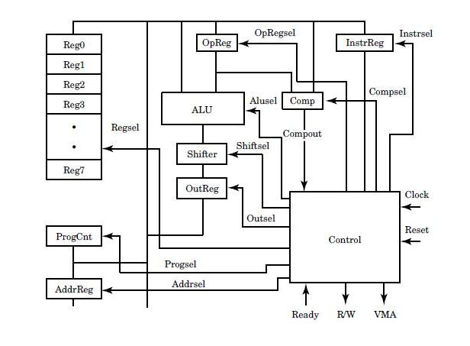
The microprocessor comprises of the following:
1. Alu
2.Control Unit
3. Shift Unit
4. Registers
5. Register Array
6. Program Counter
7. Memory
8. Tri-Register
32 Bit-Microprocessor Architecture
Work Plan
Functional Description

Slide 9
Functional Description
Alu -Performs arithmetic & logical operations.
Control Unit -Coordinates the signal
Register array -Internal storage device
Program Counter -Contains address of the current instruction in a memory.
Memory -Stores the bulk of data, instruction & the result.
Instruction Pointer -Generates the address of the instruction to be fetched from the memory & send through the memory.
Instruction Decoder -Instruction code are decoded by decoding unit & send information to timing & control unit
Timing Control Unit -Sends the control signal to all the parts of microprocessor with proper timing to perform the task specified in the instruction.
Register -The data is stored in register for processing by alu
Work Plan

Slide 10
Components:
  CPU LIBRARY
  ALU(ARITH METIC CONTROL UNIT)
  MEMORY
  SHIFTER
  COMPARATOR
  CONTROL UNIT
  REGISTER
  REGISTER ARRAY
  TRI-REGISTER
  TOP LEVEL SYSTEM DESIGN
  CPU
End
Work Plan

Slide 11
Tools Used
Xilinx 9.2i -used for coding
Modelsim 5.7f -used for simulation
Xilinx PACE -for pin assignment & generating UCF file
iMPACT -for configuring device

Slide 12
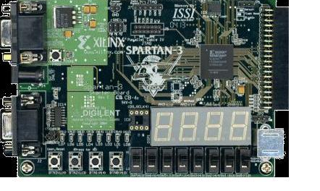
Introduction to FPGA or Field Programmable Gate Array
Spartan 3
Work Plan

Slide 13
FPGA Architecture
The Spartan®-3E family of Field-Programmable Gate
Arrays (FPGAs) is specifically designed to meet the needs
of high volume, cost-sensitive consumer electronic applications.
The five-member family offers densities ranging from
100,000 to 1.6 million system gates
Features
Very low cost, high-performance logic solution for
high-volume, consumer-oriented applications
Proven advanced 90-nanometer process technology
Multi-voltage, multi-standard SelectIO™ interface pins
Up to 376 I/O pins or 156 differential signal pairs
LVCMOS, LVTTL, HSTL, and SSTL single-ended
Signal standards - 3.3V, 2.5V, 1.8V, 1.5V, and 1.2V signaling
Work Plan

Slide 14
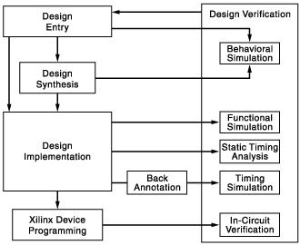
FPGA Design Flow
Design Implementation
includes the following steps:
  Translate
  Map
  Place and Route
Timing Verification
You can verify the timing of your design at different points in the design flow as follows:
Run static timing analysis at the following points in the design flow:
Xilinx Device Programming
Create a programming file (BIT) to program your FPGA.
Generate a PROM, ACE, or JTAG file for debugging or to download to your device.
Use iMPACT to program the device with a programming cable.
Design Entry
Create a project.
Functional Verification
You can verify the functionality of your design at different points in the design flow.
Design Synthesis
Synthesize your design.
Work Plan

Slide 15
FPGA Dumping
Step 1.
Assign Pin Package from user constraints.
From the PACE software place & route the pins on package view.
Step 2.
Save the work & a UCF file will be generated by PACE.
Run the whole of Implementation design.
Step 3.
Generate the Program file.
A file with extension *.bit is created.
Step 5.
Step 4.
Configure Device using IMPACT tool.
Select the *.bit for the first IC, while bypass others.
Select the device and program it while bypassing other devices.
Work Plan

Slide 16
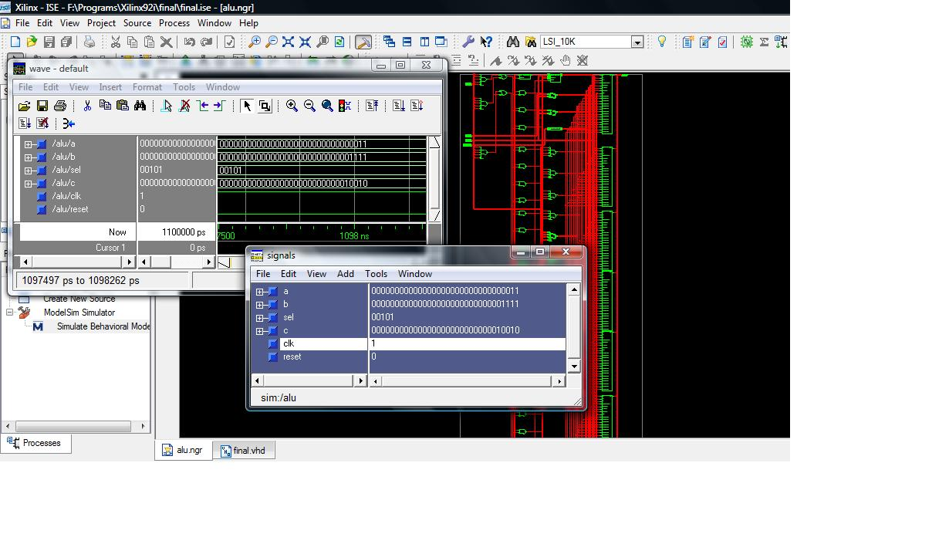
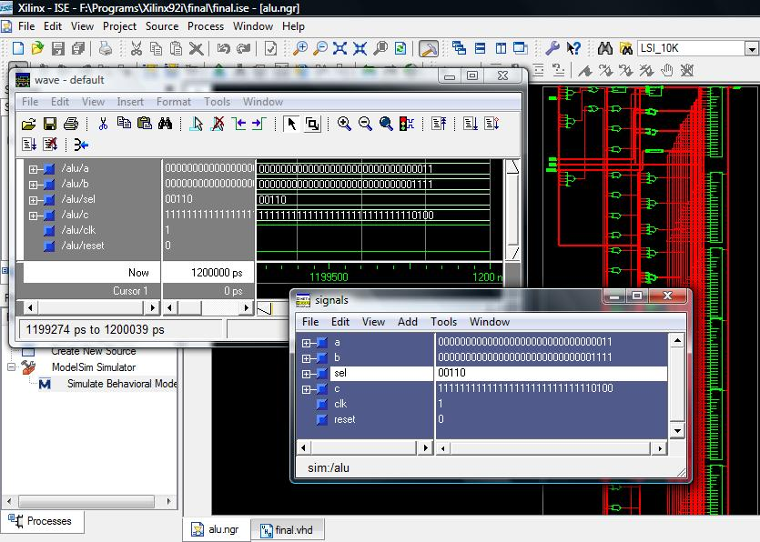
Simulation Results
Addition being performed
Subtraction being performed

Slide 17
Applications of Microprocessors
• Most modern factories are fully automated—that means that most jobs are done by a computer.
• Automobiles, trains, subways, planes, and even taxi services require the use of many
microprocessors.
• Another use is in the suspension system. A processor, controls the amount of pressure applied to keep the car leveled. During turns, a processor, slows down the wheels on the inner side of the curb and speeds them up on the outside to keep the speed constant and make a smooth turn.
• In space explorations.
• In solving various complex scientific computations.

Slide 18
References
J. Bhasker, “VHDL Primer”, VHDL Primer”,3rd Edition, Prentice Hall , Upper Saddle River, 1998.
P. J. Ashenden, “The Student’s Guide to VHDL”, Morgan Kaufmann Publishers, Inc, San Francisco,1998.
C. H. Roth, “Digital System Design using VHDL”, PWS Publishing Company, New York,1998.
Volnei A. Pedroni, “Circuit Design with VHDL”, PHI, 2005.
Xilinx website:- http://www.xilinx.com/
http://toolbox.xilinx.com/docsan/data/fndtn/vhd/vhd.htm
Google.com
Wikipedia.com

Slide 19
Thank You

