Slide 1
ADL Framework
사용자
Data Server

Slide 2
ADL Framework
<<boundary>>
Menu UI
<<Control>>
Command Executer
<<Control>>
View Manager
<<entity>>
View
<<boundary>>
Project UI
<<Control>>
Project Manager
<<Control>>
Element Manager
<<entity>>
Element
<<boundary>>
Pallet UI
<<Control>>
View Change Receiver
<<Control>>
Relation Manager
<<entity>>
Relation
<<boundary>>
View UI
<<Control>>
View Sender
<<Control>>
Source Manager
<<entity>>
Property
Architect
<<boundary>>
Dialog UI
<<Control>>
Source Update Receiver
<<Control>>
Source Parser
<<entity>>
Project File
<<boundary>>
Source UI
<<Control>>
Source
Sender
<<Control>>
Watch Dog
<<Control>>
File Manager
<<boundary>>
Code Generate UI
<<Control>>
Code Generator
<<Control>>
Log Generator
<<Control>>
Log reporter
Data Server

Slide 3
V.2

Slide 4
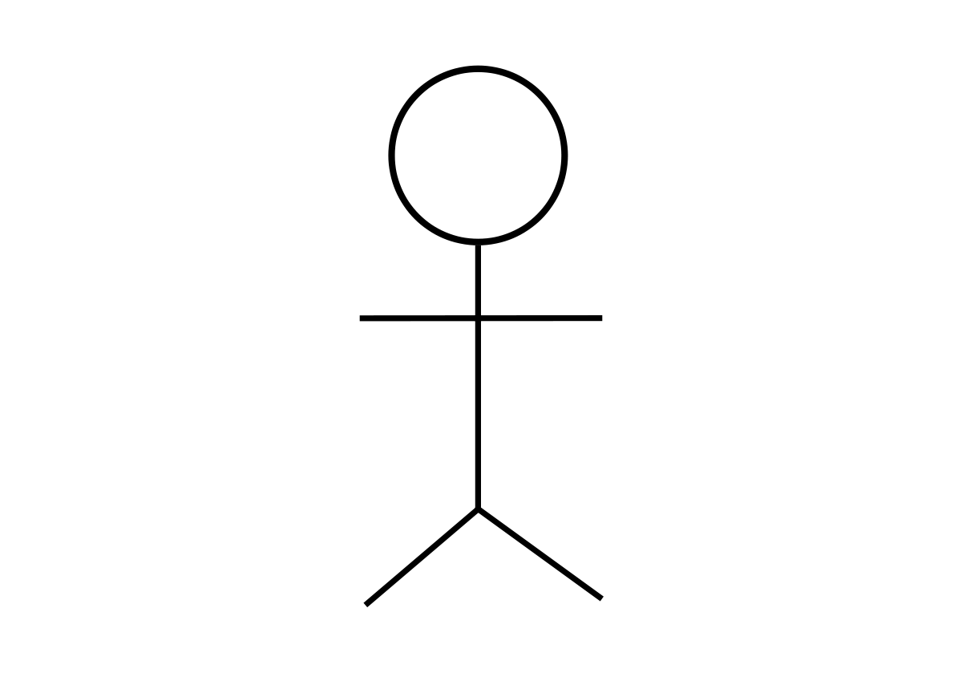
ADL 도구
구조 설계자
ADL Framework
System
Boundary
ADL 도구 개발자
Graph Visualization Library

Slide 5
ADL Framework
<<Control>>
Task Manager
<<Control>>
Element Manager
<<entity>>
Element
<<boundary>>ADL Manager
<<Control>>
State Manager
<<Control>>
Relation Manager
<<entity>>
Relation
<<Control>>
Translate Task
<<Control>>
Parser
<<entity>>
Mapping Table
ADL 도구
<<boundary>>
ADL Listener
<<Control>>
Code Generate Task
<<Control>>
Dot Generator
<<Control>>
File Manager
<<Control>>
Syntax Checker
<<Control>>
Code
Generator
<<Boundary>>
Graphviz Manager
Graphviz

Slide 6
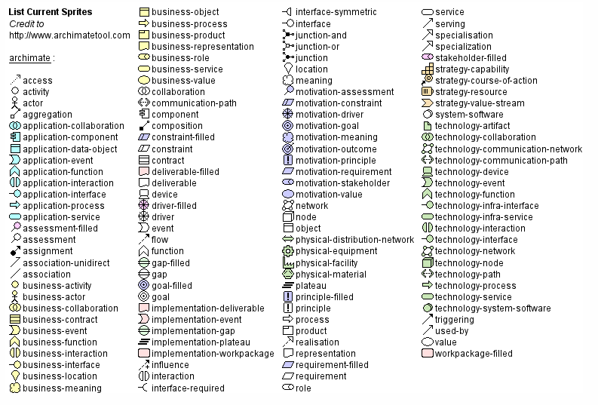

Slide 7
Element
Element Type
Type(name=name, label=“description”, color=color, fillcolor=color, style=style, shape=shape)
Attribute
Relation
Relation Type
Type(from=name, to=name, label=“description”, color=color, fillcolor=fillcolor, direction=direction)
Attribute

Slide 8
Type List
Element
ComponentAndConnector
Deployment
Activity
Service
BroadcastReceiver
ContentProvider
Model
View
Controller
Presenter
ViewModel
Component
Database
Cloud
Server
Process
Thread
Relation
Association
Dependency
Inheritance
Realization
Aggregation
Composition

Slide 9
Attribute List
Color, FillColor
“0~255, 0~255, 0~255”
#FFFFFF
Red
Cyan
Blue
DarkBlue
LightBlue
Purple
Yellow
Lime
Magenta
Olive
Green
Maroon
Brown
Orange
Black
Gray
Silver
White
Style
solid
dashed
dotted
bold
invis
filled
diagonals
rounded
Shape
box
circle
ellipse
point
Direction
up
down
left
right

Slide 10
view_ComponentView (component_view_element_name, “description”)
component_Activity(activity_element_name, “description”)
component_Service(service_element_name, “description”)
component_BroadcastReceiver(receiver_element_name, “description”)
component_ContentProvider(provider_element_name, “description”)
component(component_element_name, “description”)
activity_element_name ->(“description”) service_element_name

Slide 11
view_DeploymentView (deployment_view_element_name, “description”)
component_Library(library_name, “description”)
component_ExternalService(externalservice_name, “description”)
view_Package(package_element_name, “description”)
component_Model(model_element_name, “description”)
component_Database(database_element_name, “description”)
component_View(view_element_name, “description”)
component_Activity(activity_element_name”, “description”)
component_Control(control_element_name, “description”)
component_Service(service_element_name”, “description”)
component_ContentProvider(provider_element_name”, “description”)

Slide 12
(prefix)_(Type)(element_name, “description”)
Prefix = view_, component_,
Type

Slide 13
Lexical Analyzer
Tokens
Syntax Analyzer
Syntax Tree
Semantic Analyzer
Parse Tree
DOT Writer
DOT Code

Slide 14
View(name=view)
Fragment(name=myFragment)
Activity(name=myActivity)

Slide 15
Deployment(name=deploymentView, description=”Deployment View”)
View(name=view, fillcolor=RED)
Fragment(name=myFragment)
Activity(name=myActivity)
Association(myFragment, myActivity)
ViewModel(name=viewModel, fillcolor=BLUE)
Component(name=lifeCycleObserver)
Component(name=liveData)
Model(name=model, fillcolor=GREEN)
Database(name=myDB)
Service(name=myService)
Cloud(name=myCloud, fillcolor=WHITE)
Association(myActivity, liveData)
Association(liveData, myService)
Aggregation(myCloud, myService)

Slide 16
digraph G {
label = "Deployment View"
subgraph cluster0 {
style=filled;
myActivity[label="<<Activity>>\nmyActivity"]
myFragment[label="<<Fragment>>\nmyFragment"]
label = "View";
fillcolor = RED
}
subgraph cluster1 {
style=filled;
liveData[label="<<Component>>\nliveData"]
lifeCycleObserver[label="<<Component>>\nlifeCycleObserver"]
label = "ViewModel";
fillcolor = green
}
subgraph cluster2 {
style=filled;
label = "Model";
myService[label="<<Service>>\nmyService"]
DB[label="<<DataBase>>\nmyDB"]
color=lightblue
}
myCloud[label="<<Cloud>>\nmyCloud"]
edge[ weight = 5 ]
myActivity -> liveData
liveData -> myService
myCloud -> myService[arrowhead="odiamond"]
}

Slide 17

ADL
DOT
Graphviz

Slide 18
Token
(1)
Deployment(name=deploymentView, description=”Deployment View”)
View(name=view, fillcolor=RED)
Fragment(name=MyFragment)
Activity(name=MyActivity)
Associate(from=MyActivity, to=MyFragment)
(2)
(3)
(4)
(5)
(1)
0 | Deployment | ( | name | = | deploymentView | , |  | description | = | “ | Deployment |  | View | “ | )
(2)
4 | View | ( | name | = | view | , |  | fillcolor | = | RED | )
(3)
8 | Fragment | ( | name | = | MyFragment | )
(4)
8 | Activity | ( | name | = | MyActivity | )
(5)
8 | Associate | ( | from | = | MyActivity | , |  | to | = | MyFragment | )

Slide 19
Syntax Tree
(1)
Deployment
depth
0
name
deploymentView
description
Deployment View
(2)
View
depth
4
name
view
fillcolor
RED
(3)
Fragment
(4)
Activity
depth
8
name
MyFragment
depth
8
name
MyActivity
(5)
Association
from
MyActivity
to
MyFragment

Slide 20
Parse Tree
(1)
Deployment
name
deploymentView
description
Deployment View
Child
(2)
View
name
view
fillcolor
RED
Child
(3)
Fragment
(4)
Activity
(5)
name
MyFragment
name
MyActivity
Association
MyFragment

Slide 21
digraph G{label = "Deployment View"
subgraph cluster_view {style=filled label = "View" fillcolor = RED
MyActivity[label="<<Activity>>\nMyActivity"]
MyFragment[label="<<Fragment>>\nMyFragment"]
}
MyActivity -> MyFragment
}
Deployment
name
deploymentView
description
Deployment View
Child
View
name
view
fillcolor
RED
Child
Fragment
Activity
name
MyFragment
name
MyActivity
Association
MyFragment

Slide 22
Deployment(name=com.samsung.adlframework, description=”Deployment View”)
View(name=view, fillcolor=RED)
Fragment(name=MyFragment)
Activity(name=MyActivity)
Associate(from=MyActivity, to=MyFragment)

Slide 23
Component Type
Element |  | Relation
Name | Class Name | Name
ComponentAndConnector | - | Association
Deployment | - | Dependency
Activity | android.app.Activity | Inheritance
Service | android.app.Service | Realization
BroadcastReceiver | android.content.BroadcastReceiver | Aggregation
ContentProvider | android.content.ContentProvider | Composition
Fragment | android.support.v4.app.Fragment
Model | -
View | -
Controller | -
Presenter | -
ViewModel | -
Component | -
Database | -
Cloud | -
Server | -
Process | -
Thread | -

Slide 24
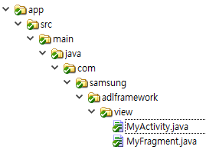
Java
Kotlin
MyActivity.java
MyActivity.kt
package com.samsung.adlframework.view;
import android.app.Activity;
public class MyActivity extends Activity {
MyFragment mMyFragment;
}
package com.samsung.adlframework.view
import android.app.Activity
class MyActivity : Activity() {
lateinit var myFragment: MyFragment
}
MyFragment.java
MyFragment.kt
package com.samsung.adlframework.view;
import android.support.v4.app.Fragment;
public class MyFragment extends Fragment {
}
package com.samsung.adlframework.view
import android.support.v4.app.Fragment
class MyFragment : Fragment() {
}

Slide 25
Final

Slide 26
ADL Framework
<<boundary>>ADL Manager
<<Control>>
Translate Task
<<Control>>
Lexical Analyzer
<<Control>>
Token Queue
<<Entity>>
Token
<<boundary>>
ADL Listener
<<Control>>
Code Generate Task
<<Control>>
Syntax Analyzer
<<Control>>
Syntax Queue
<<Entity>>
Syntax Tree
ADL 도구
<<Control>>
Task Manager
<<Control>>
Autocomplete Task
<<Control>>
Semantic Analyzer
<<Control>>
Parse Queue
<<Entity>>
Parse Tree
<<Control>>
State Manager
<<Control>>
FileManager
<<Control>>
Graph Code Generator
<<Entity>>
Relation Type
<<Entity>>
Class Prototype
<<Control>>
Error
Handler
<<Control>>
Code
Generator
<<Entity>>
Element
Type
<<Boundary>>
Graph Visualization Manager
Graph
Visualization
Library

Slide 27
Element
Relation Type
Element Type
Type myElement
myElement.setDescription(“description”)
myElement.setColor(color)
myElement.setFillColor(color)
myElement.setStyle(style)
myElement.setShape(shape)
Type myElement1, myElement2
myElement1.associateWith(myElement2)
myElement1.setAssociationDescription(“description”)
myElement1.setAssociationcolor(color)
Relation
Attribute
Type myElement1, myElement2, myElement3
myElement1.
myElement1.setAssociationDescription(“description”)
myElement1.setAssociationcolor(color)
Attribute

Slide 28
Element Type
Type myElement
Element Name

Slide 29
ADL Code
Graph
Lexical Analyzer
Syntax Analyzer
Semantic Analyzer
Graph Description Code Generator
Graph Visualization Library
Token
Syntax Tree
Parse Tree
Graph Description Code

Slide 30
ADL Code
Graph
Grape Visualization 변경 용이성
Lexical Analyzer
Syntax Analyzer
Semantic Analyzer
Graph Description Code Generator
Graph Visualization Library
Token
Syntax Tree
Parse Tree
Graph Description Code

Slide 31
D
C
eployment
atabase
l
o
ient
oud
mponent
n
tentProvider
troller

Slide 32
Element Type
Element |  | Relation
Name | Class Name | Name
ComponentAndConnector | - | Association
Deployment | - | Dependency
Activity | android.app.Activity | Inheritance
Service | android.app.Service | Realization
BroadcastReceiver | android.content.BroadcastReceiver | Aggregation
ContentProvider | android.content.ContentProvider | Composition
Fragment | android.support.v4.app.Fragment
Model | -
View | -
Controller | -
Presenter | -
ViewModel | -
Component | -
Database | -
Cloud | -
Server | -
Process | -
Thread | -

Slide 33
후보구조 1.
Element - Relation으로만 구성된 ADL
QA_01
ADL 작성의
편의성
후보구조 2.
기존 Markup language의 문법 사용
채택
후보구조 3. Programming Language형태의 ADL 명세
후보구조 4.
확장 가능한 Component Type
(+)
QA_02
GDL Code
변환성능
(-)
후보구조 5.
ADL Code분석 단계를 Pipe & Filter로 동작할 수 있도록 Data 구조 설계
후보구조 6.
Update를 위해 Token 및 Parse Tree 유지
후보구조 7.
Token, Tree 구성을 위한 Resource 선 할당
QA_03
첫 Graph
반환성능
후보구조 8.
Tree 구성을 위한 Resource 효율화
후보구조 9.
Dot language Parser library를 사용
후보구조 10.
연속적으로 Graph를 갱신
QA_04
Element Type
변경 용이성
후보구조 11.
일정한 주기로 Graph를 갱신
후보구조 12.
Translate 요청전에 Background parsing
후보구조 13.
별도의 AppModel library로 지연 바인딩
QA_05
Graph Library
변경 용이성
후보구조 14.
Decorate Pattern을 적용
후보구조 15.
Strategy Pattern을 적용
QA_06
Autocomplete
완료성능
후보구조 16.
별도의 GraphDrawer Library로 지연 바인딩
후보구조 17.
GDL Code생성과 Graph 생성 분리된 Bridge Pattern 적용
후보구조 18.
Radix Tree로 Keyword 관리
QA_07
ADL API
확장성
후보구조 19.
문맥에 따른 Autocomplete 적용
후보구조 20.
ADL 도구에 Keyword Array 전달
후보구조 21.
Interface Layer를 분리 Publish – Subscriber Pattern 적용
QA_08
Code Language
확장성
후보구조 22.
Task 기반의 Event Bus 적용
후보구조 23.
Code Generation Library 적용
후보구조 24.
Language별 Class Prototype변경
NFR_01
Parsing Error
회복성능
후보구조 25.
ADL 분석 단계에서 Error 발생시 Thread 종료
후보구조 26.
Translate 동작의 Multi Tasking

Slide 34
ADL Code
Token
Syntax Tree
Parse Tree
Graph Description Language Code
Graph

