Slide 1
ADL Framework
사용자
Data Server

Slide 2
ADL Framework
<<boundary>>
Menu UI
<<Control>>
Command Executer
<<Control>>
View Manager
<<entity>>
View
<<boundary>>
Project UI
<<Control>>
Project Manager
<<Control>>
Element Manager
<<entity>>
Element
<<boundary>>
Pallet UI
<<Control>>
View Change Receiver
<<Control>>
Relation Manager
<<entity>>
Relation
<<boundary>>
View UI
<<Control>>
View Sender
<<Control>>
Source Manager
<<entity>>
Property
Architect
<<boundary>>
Dialog UI
<<Control>>
Source Update Receiver
<<Control>>
Source Parser
<<entity>>
Project File
<<boundary>>
Source UI
<<Control>>
Source
Sender
<<Control>>
Watch Dog
<<Control>>
File Manager
<<boundary>>
Code Generate UI
<<Control>>
Code Generator
<<Control>>
Log Generator
<<Control>>
Log reporter
Data Server

Slide 3
V.2

Slide 4
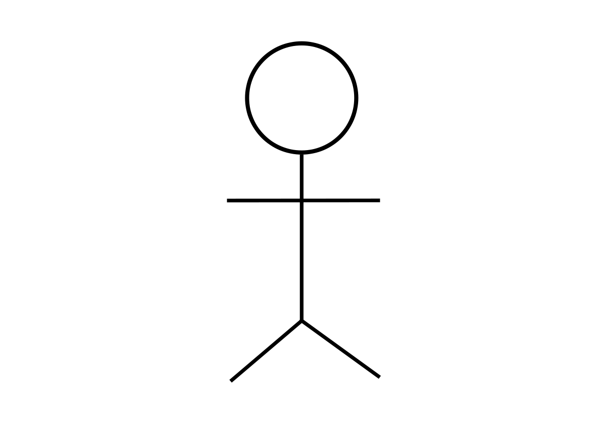
ADL 도구
구조 설계자
ADL Framework
System
Boundary
ADL 도구 개발자
Graphviz

Slide 5
ADL Framework
<<Control>>
Task Manager
<<Control>>
Element Manager
<<entity>>
Element
<<boundary>>ADL Manager
<<Control>>
State Manager
<<Control>>
Relation Manager
<<entity>>
Relation
<<Control>>
Translate Task
<<Control>>
Parser
<<entity>>
Mapping Table
ADL 도구
<<boundary>>
ADL Listener
<<Control>>
Code Generate Task
<<Control>>
Dot Generator
<<Control>>
File Manager
<<Control>>
Syntax Checker
<<Control>>
Code
Generator
<<Boundary>>
Graphviz Manager
Graphviz

Slide 6
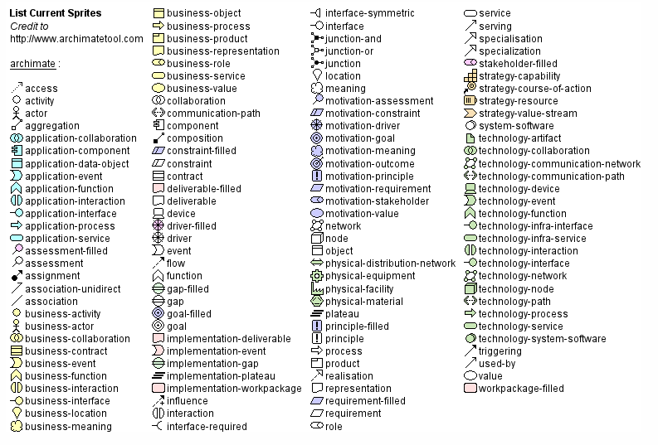

Slide 7
Element
Element Type
Type(name=name, label=“description”, color=color, fillcolor=color, style=style, shape=shape)
Attribute
Relation
Relation Type
Type(from=name, to=name, label=“description”, color=color, fillcolor=fillcolor, direction=direction)
Attribute

Slide 8
Type List
Element
ComponentAndConnector
Deployment
Activity
Service
BroadcastReceiver
ContentProvider
Model
View
Controller
Presenter
ViewModel
Component
Database
Cloud
Server
Process
Thread
Relation
Association
Dependency
Inheritance
Realization
Aggregation
Composition

Slide 9
Attribute List
Color, FillColor
“0~255, 0~255, 0~255”
#FFFFFF
Red
Cyan
Blue
DarkBlue
LightBlue
Purple
Yellow
Lime
Magenta
Olive
Green
Maroon
Brown
Orange
Black
Gray
Silver
White
Style
solid
dashed
dotted
bold
invis
filled
diagonals
rounded
Shape
box
circle
ellipse
point
Direction
up
down
left
right

Slide 10
view_ComponentView (component_view_element_name, “description”)
component_Activity(activity_element_name, “description”)
component_Service(service_element_name, “description”)
component_BroadcastReceiver(receiver_element_name, “description”)
component_ContentProvider(provider_element_name, “description”)
component(component_element_name, “description”)
activity_element_name ->(“description”) service_element_name

Slide 11
view_DeploymentView (deployment_view_element_name, “description”)
component_Library(library_name, “description”)
component_ExternalService(externalservice_name, “description”)
view_Package(package_element_name, “description”)
component_Model(model_element_name, “description”)
component_Database(database_element_name, “description”)
component_View(view_element_name, “description”)
component_Activity(activity_element_name”, “description”)
component_Control(control_element_name, “description”)
component_Service(service_element_name”, “description”)
component_ContentProvider(provider_element_name”, “description”)

Slide 12
(prefix)_(Type)(element_name, “description”)
Prefix = view_, component_,
Type

Slide 13
Lexical Analyzer
Tokens
Syntax Analyzer
Syntax Tree
Semantic Analyzer
Parse Tree
DOT Writer
DOT Code

Slide 14
View(name=view)
Fragment(name=myFragment)
Activity(name=myActivity)

Slide 15
Deployment(name=deploymentView, description=”Deployment View”)
View(name=view, fillcolor=RED)
Fragment(name=myFragment)
Activity(name=myActivity)
Association(myFragment, myActivity)
ViewModel(name=viewModel, fillcolor=BLUE)
Component(name=lifeCycleObserver)
Component(name=liveData)
Model(name=model, fillcolor=GREEN)
Database(name=myDB)
Service(name=myService)
Cloud(name=myCloud, fillcolor=WHITE)
Association(myActivity, liveData)
Association(liveData, myService)
Aggregation(myCloud, myService)

Slide 16
digraph G {
label = "Deployment View"
subgraph cluster0 {
style=filled;
myActivity[label="<<Activity>>\nmyActivity"]
myFragment[label="<<Fragment>>\nmyFragment"]
label = "View";
fillcolor = RED
}
subgraph cluster1 {
style=filled;
liveData[label="<<Component>>\nliveData"]
lifeCycleObserver[label="<<Component>>\nlifeCycleObserver"]
label = "ViewModel";
fillcolor = green
}
subgraph cluster2 {
style=filled;
label = "Model";
myService[label="<<Service>>\nmyService"]
DB[label="<<DataBase>>\nmyDB"]
color=lightblue
}
myCloud[label="<<Cloud>>\nmyCloud"]
edge[ weight = 5 ]
myActivity -> liveData
liveData -> myService
myCloud -> myService[arrowhead="odiamond"]
}

Slide 17

ADL
DOT
Graphviz

Slide 18
Token
(1)
Deployment(name=deploymentView, description=”Deployment View”)
View(name=view, fillcolor=RED)
Fragment(name=MyFragment)
Activity(name=MyActivity)
Associate(from=MyActivity, to=MyFragment)
(2)
(3)
(4)
(5)
(1)
0 | Deployment | ( | name | = | deploymentView | , |  | description | = | “ | Deployment |  | View | “ | )
(2)
4 | View | ( | name | = | view | , |  | fillcolor | = | RED | )
(3)
8 | Fragment | ( | name | = | MyFragment | )
(4)
8 | Activity | ( | name | = | MyActivity | )
(5)
8 | Associate | ( | from | = | MyActivity | , |  | to | = | MyFragment | )

Slide 19
Syntax Tree
(1)
Deployment
depth
0
name
deploymentView
description
Deployment View
(2)
View
depth
4
name
view
fillcolor
RED
(3)
Fragment
(4)
Activity
depth
8
name
MyFragment
depth
8
name
MyActivity
(5)
Association
from
MyActivity
to
MyFragment

Slide 20
Parse Tree
(1)
Deployment
name
deploymentView
description
Deployment View
Child
(2)
View
name
view
fillcolor
RED
Child
(3)
Fragment
(4)
Activity
(5)
name
MyFragment
name
MyActivity
Association
MyFragment

Slide 21
digraph G{label = "Deployment View"
subgraph cluster_view {style=filled label = "View" fillcolor = RED
MyActivity[label="<<Activity>>\nMyActivity"]
MyFragment[label="<<Fragment>>\nMyFragment"]
}
MyActivity -> MyFragment
}
Deployment
name
deploymentView
description
Deployment View
Child
View
name
view
fillcolor
RED
Child
Fragment
Activity
name
MyFragment
name
MyActivity
Association
MyFragment

Slide 22
Deployment(name=com.samsung.adlframework, description=”Deployment View”)
View(name=view, fillcolor=RED)
Fragment(name=MyFragment)
Activity(name=MyActivity)
Associate(from=MyActivity, to=MyFragment)

Slide 23
Component Type
Element |  | Relation
Name | Class Name | Name
ComponentAndConnector | - | Association
Deployment | - | Dependency
Activity | android.app.Activity | Inheritance
Service | android.app.Service | Realization
BroadcastReceiver | android.content.BroadcastReceiver | Aggregation
ContentProvider | android.content.ContentProvider | Composition
Fragment | android.support.v4.app.Fragment
Model | -
View | -
Controller | -
Presenter | -
ViewModel | -
Component | -
Database | -
Cloud | -
Server | -
Process | -
Thread | -

Slide 24
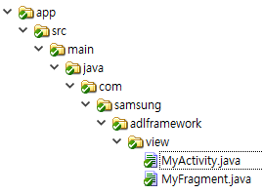
Java
Kotlin
MyActivity.java
MyActivity.kt
package com.samsung.adlframework.view;
import android.app.Activity;
public class MyActivity extends Activity {
MyFragment mMyFragment;
}
package com.samsung.adlframework.view
import android.app.Activity
class MyActivity : Activity() {
lateinit var myFragment: MyFragment
}
MyFragment.java
MyFragment.kt
package com.samsung.adlframework.view;
import android.support.v4.app.Fragment;
public class MyFragment extends Fragment {
}
package com.samsung.adlframework.view
import android.support.v4.app.Fragment
class MyFragment : Fragment() {
}

