Slide 1
New Efficient Hardware Design for Batch Normalization Based on Convolution Neural Network Training
Student: Yu-Fan Teng, Yu-Sheng Ting
Advisor: Prof. Tzi-Dar Chiueh
National Taiwan University, Taipei, Taiwan
July 11, 2020

Slide 2
Introduction
CNN has been a widely-used technique in deep learning
However, much fewer works focused on accelerating non-convolutional layers
Batch Normalization (BN)
Most past works focused on the inference process only

Slide 3
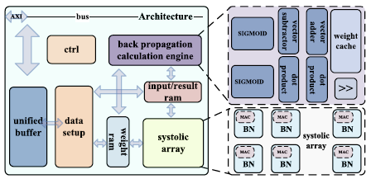
Introduction
For example: Bactran

Slide 4

Background – Forward Process
Normalization
$μ_{j}=\frac{1}{m}\sum_{i=1}^{m}{x_{j}^{(i)}}$
$σ_{j}^{2}=\frac{1}{m}\sum_{i=1}^{N}{{(x_{j}^{\left(i\right)}−μ_{j})}^{2}}$
${\hat{x}}_{j}^{(i)}=\frac{x_{j}^{(i)}−μ_{j}}{\sqrt{σ_{j}^{2}+ε}}$
Scaling
${y_{j}}^{(i)}=γ_{j}{\hat{x}}_{j}^{(i)}＋β_{j}$

Slide 5
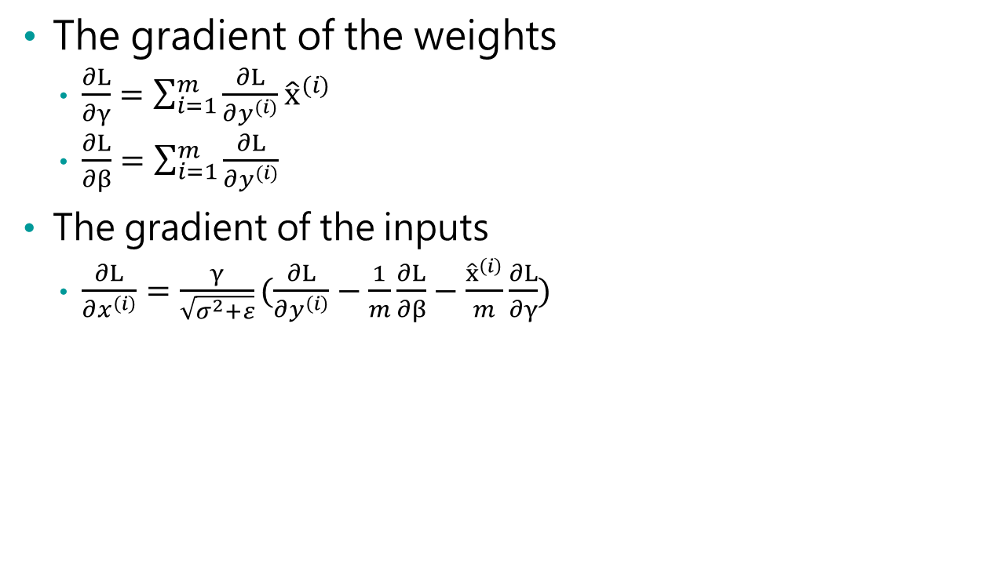
The gradient of the weights
$\frac{∂L}{∂γ}=\sum_{i=1}^{m}{\frac{∂L}{∂y^{(i)}}{\hat{x}}^{(i)}}$
$\frac{∂L}{∂β}=\sum_{i=1}^{m}{\frac{∂L}{∂y^{(i)}}}$
The gradient of the inputs
$\frac{∂L}{∂x^{\left(i\right)}}=\frac{γ}{\sqrt{σ^{2}+ε}}(\frac{∂L}{∂y^{\left(i\right)}}−\frac{1}{m}\frac{∂L}{∂β}−\frac{{\hat{x}}^{\left(i\right)}}{m}\frac{∂L}{∂γ})$

Slide 6
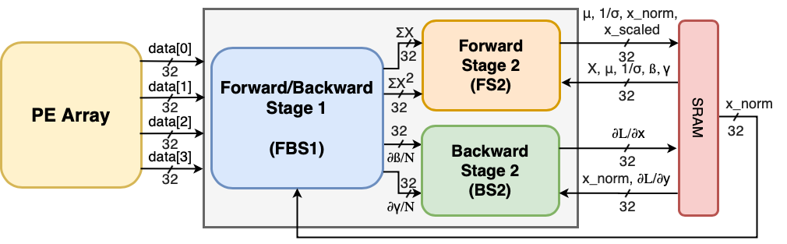
Overall Architecture
Overall Architecture
PE array
BN_processor
SRAM

Slide 7
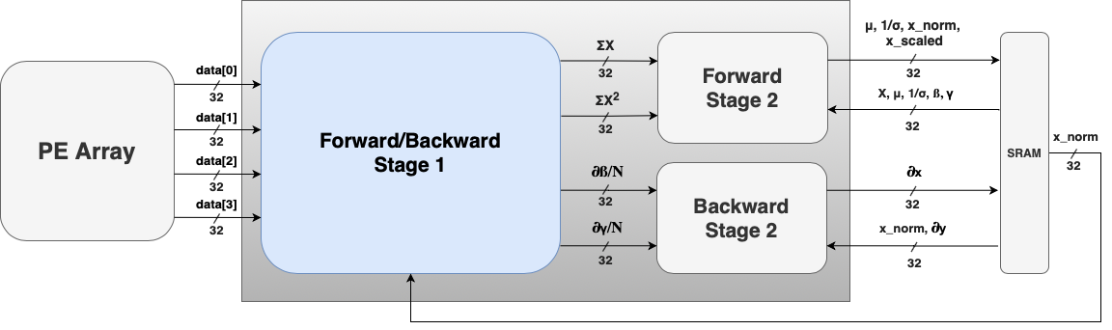
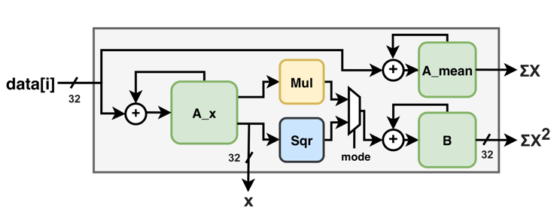
Forward/Backward Stage 1
Overall Architecture
Use the same circuit

Slide 8
Forward/Backward Stage 1
Use the same circuit
Forward
4 blocks for 4 output channel

Slide 9
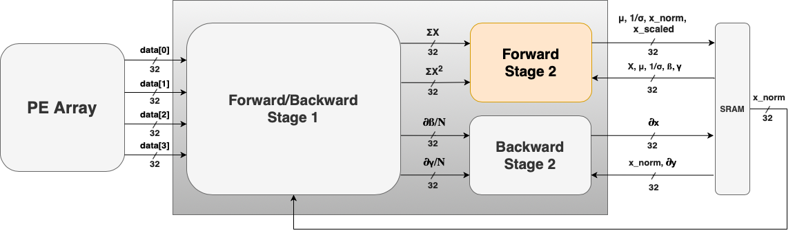
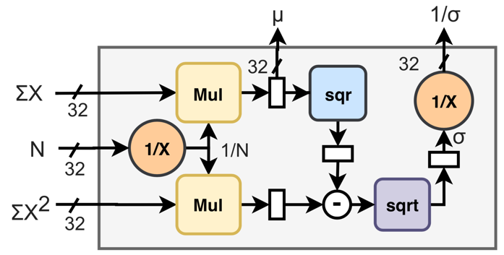
Forward Stage 2
Forward Stage 2
Two blocks
Calculating mean, 1/sigma
Calculating x_norm for backward

Slide 10
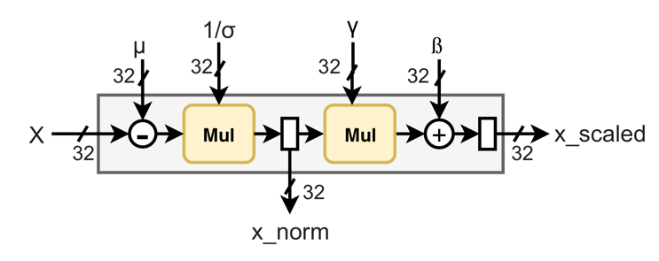
Forward Stage 2
Forward Stage 2
Two blocks
Calculating mean, 1/sigma
Calculating x_norm for backward

Slide 11
Forward/Backward Stage 1
Forward/Backward Stage 1
Use the same circuit
Backward
∂y
∂ß/N
∂γ/N
4 blocks for 4 output channel

Slide 12
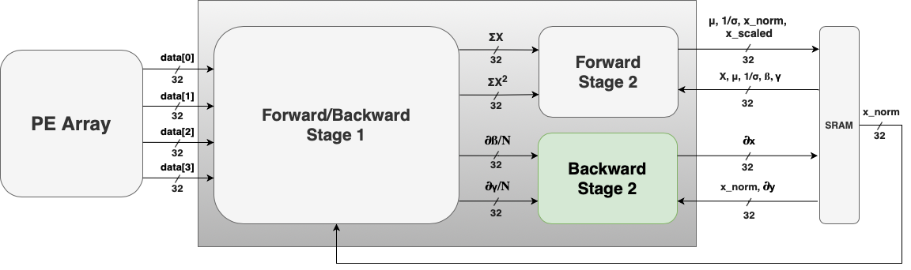
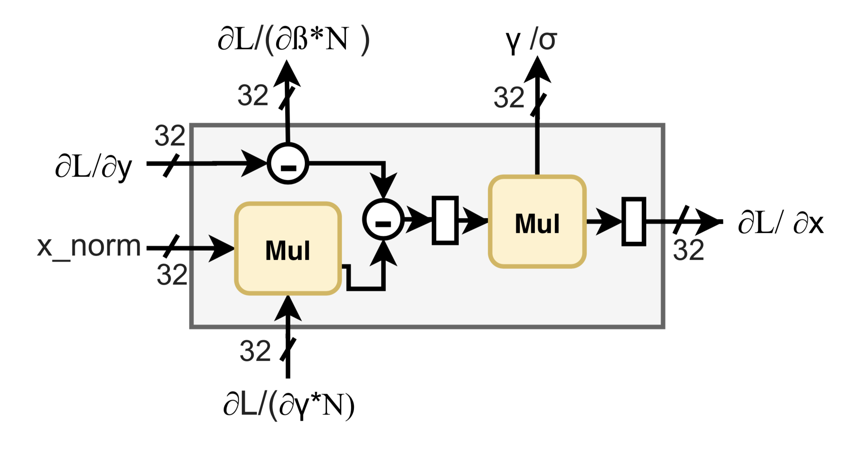
Backward Stage 2
Backward Stage 2
Calculating partial_x

Slide 13
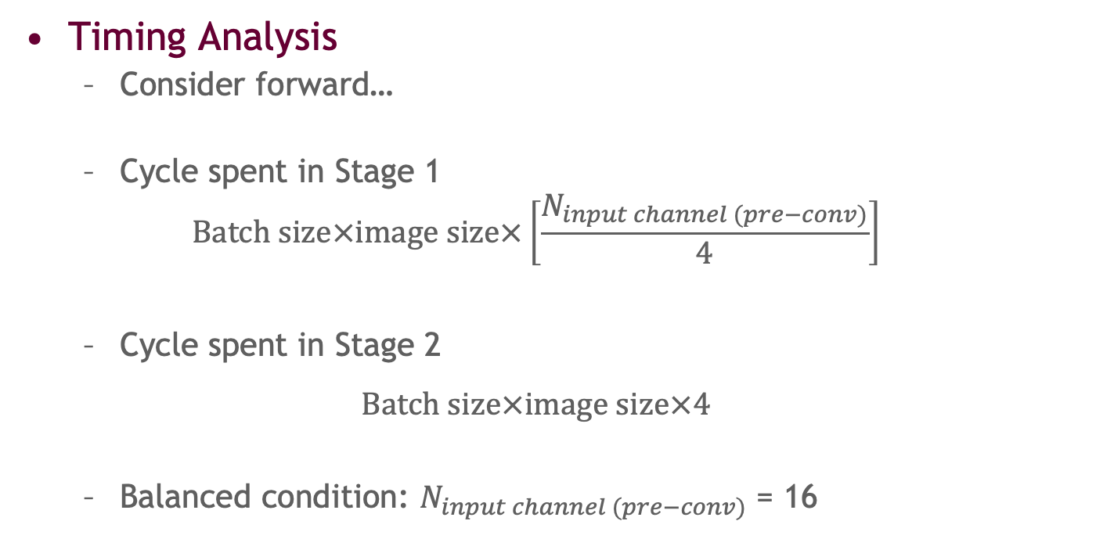
Result
Result
Timing Analysis
Consider forward…
Cycle spent in Stage 1
$$Batch size×image size×\left[\frac{N_{input channel (pre−conv)}}{4}\right]$$
Cycle spent in Stage 2
$$Batch size×image size×4$$
Balanced condition: $N_{input channel (pre−conv)}$ = 16

Slide 14
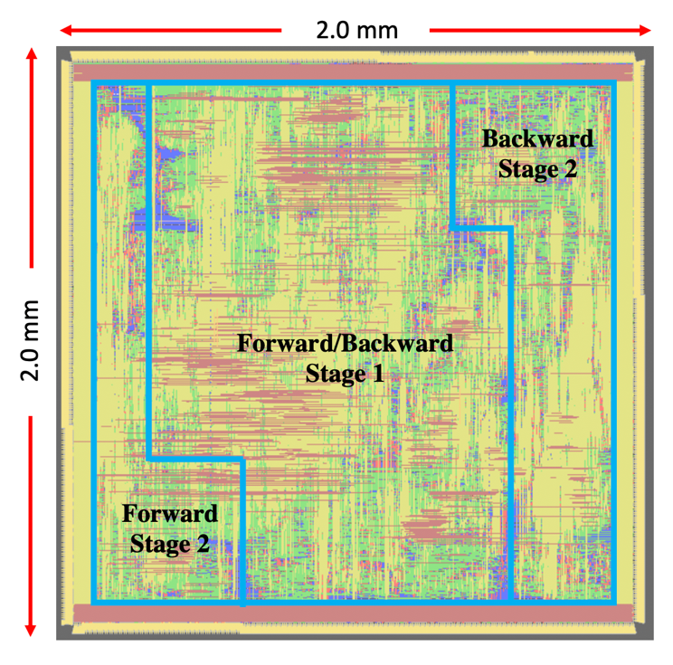
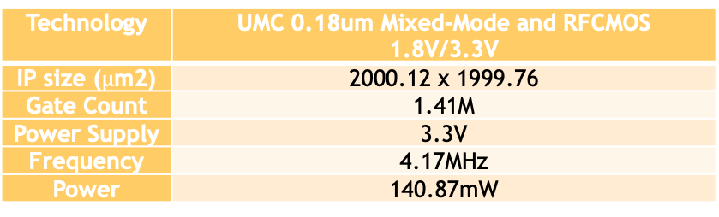
Result
APR Result
Technology | UMC 0.18um Mixed-Mode and RFCMOS 1.8V/3.3V
IP size ($μ$m2) | 2000.12 x 1999.76
Gate Count | 1.41M
Power Supply | 3.3V
Frequency | 4.17MHz
Power | 140.87mW

Slide 15
Result
Comparisons with other works
 | BNRELU | L1-Norm BN | Bactran | Our design
Supported operation | Inference only | Training and Inference | Training and Inference | Training and Inference
Interaction with convolution layer | - | No | Yes | Yes
Hardware resources sharing | - | No | No | Yes
power | - | - | 8.95W | 0.14W

Slide 16
Reference
Result
[1] ZHANG, Chen, et al. Optimizing fpga-based accelerator design for deep convolutional neural networks. In: Proceedings of the 2015 ACM/SIGDA international symposium on field-programmable gate arrays. 2015. p. 161-170.
[2] CHEN, Yu-Hsin, et al. Eyeriss: An energy-efficient reconfigurable accelerator for deep convolutional neural networks. IEEE journal of solid-state circuits, 2016, 52.1: 127-138.
[3] ALWANI, Manoj, et al. Fused-layer CNN accelerators. In: 2016 49th Annual IEEE/ACM International Symposium on Microarchitecture (MICRO). IEEE, 2016. p. 1-12.
[4] IOFFE, Sergey; SZEGEDY, Christian. Batch normalization: Accelerating deep network training by reducing internal covariate shift. arXiv preprint arXiv:1502.03167, 2015.
[5] WAI, Yap June, et al. Fixed point implementation of tiny-yolo-v2 using opencl on fpga. International Journal of Advanced Computer Science and Applications, 2018, 9.10: 506-512.
[6] GE, Jiexian, et al. BNReLU: Combine Batch Normalization and Rectified Linear Unit to Reduce Hardware Overhead. In: 2019 IEEE 13th International Conference on ASIC (ASICON). IEEE, 2019. p. 1-4.
[7] WU, Shuang, et al. L1-Norm batch normalization for efficient training of deep neural networks. IEEE transactions on neural networks and learning systems, 2018, 30.7: 2043-2051.
[8] ZHIJIE, Yang, et al. Bactran: A Hardware Batch Normalization Implementation for CNN Training Engine. IEEE Embedded Systems Letters, 2020.
[9] JUNG, Wonkyung, et al. Restructuring batch normalization to accelerate CNN training. arXiv preprint arXiv:1807.01702, 2018.

