Slide 1
Maple Engine
Compiler Team
Futurewei Inc.
1/3/2020

Slide 2
Outline
Background and Overview of Maple Engine
Maple .mir Image
Implementation of Maple Engine
Direct-threaded interpretation
Stack frame and evaluation stack
Calling convention
CLINIT (Java)
Multi-threading
Exception handling
Debugging support

Slide 3
Background
Cross platform: independent from archs, devices, OS
Maple Engine --- Runtime Engine for Maple
To run Maple program on Servers, IoT and Phone devices
SDK development environment on multiple architectures
Minimized effort to port to multiple architectures
Debugging
Supports multiple programming languages
Abstraction for language features
Support new languages

Slide 4
Overview of Maple Engine
C/C++/Java/…
Maple .mir libs
Apps
Dependencies
Third-party Shared libs
C/C++ shared libs
FE
Maple Engine
Maple IR
CG for Maple Engine
Runtime
RC/GC
Exception Handling
Signal handling
Reflection
Class loading
etc.
Maple .mir

Slide 5
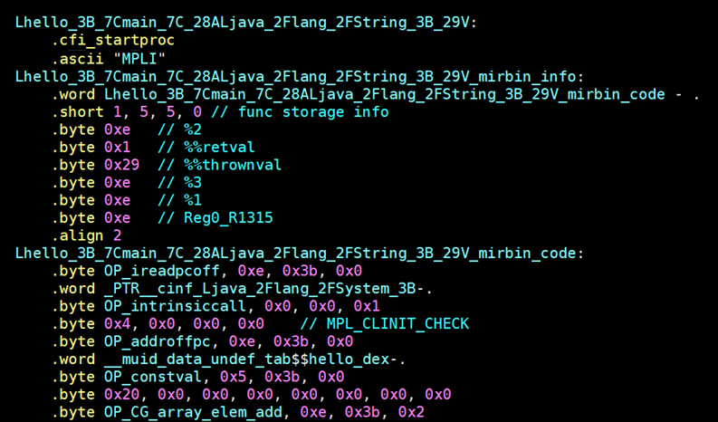
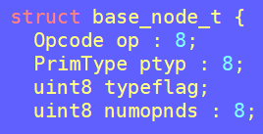
Method in Maple .mir Image
Local Info
Maple IRs

Slide 6
Direct-Threaded Interpretation
Implemented with direct-threaded interpretation
Needs computed goto extension of GCC
No centralized decoding code
Benefits compared with switch-based implementation
Less branch instructions
Better indirect branch prediction
Work together with JIT compiler

Slide 7
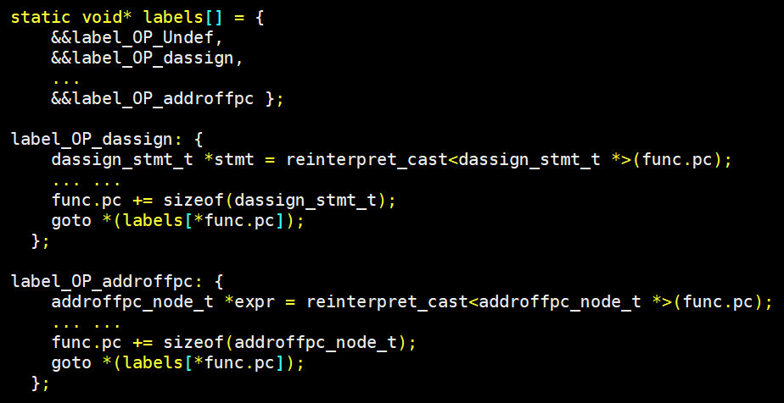
Direct-Threaded Interpretation
Label Table
Threaded Dispatch

Slide 8
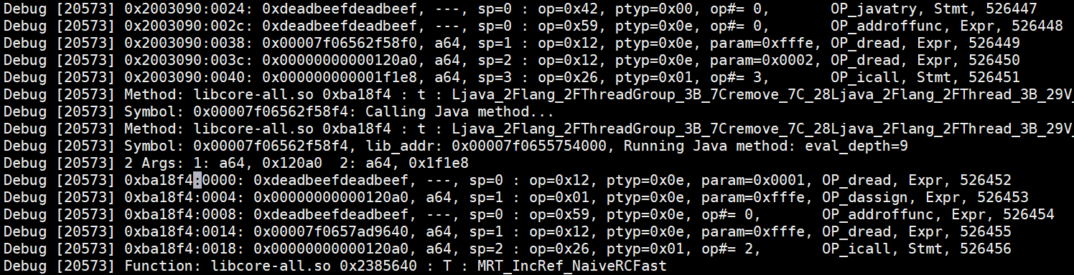
Execution Log of Maple Engine
Tid Method Offset Value-on-stack Type SP Opcode Opcode-count

Slide 9
Evaluation Stack of Maple Engine
High Addr
Caller Stack Frame
Evaluation Stack
Callee Stack Frame
Evaluation Stack
Return value
Local vars
Expr evaluation
(Args for a call)
sp →
Program Stack
Evaluation Stack

Slide 10
Args, Locals, Globals and Fields
Decodes an argument with a negative index of evaluation stack
Decodes a local variable with an index of evaluation stack
A global symbol has a pc-relative offset to Def/Undef Table
A field is decoded into a offset to the base address of an object
Return value
Local vars
Expr evaluation
Arg0
Arg1
…
Return value
Local vars
Expr evaluation
sp→
sp→
Caller
Callee

Slide 11
Calling Convention in Maple Engine
Standard calling convention
Runtime or C/C++ code calls a method which runs with Maple Engine (via variadic function)
The shim code of Maple Engine needs to create a evaluation stack for passing arguments to the callee
Or verses (via ffi_call of libffi)
Creates argument list from caller’s evaluation stack
Calling convention between methods with Maple Engine
Uses the evaluation stack of a caller to pass arguments to its callee
Callee will access caller’s evaluation stack for arguments

Slide 12
Class Initialization (Java only)
Introduces two APIs for invoking CLINIT methods
void* prepare_invoke_clinit(CLASSMETADATA* classinfo);
void finalize_clinit(CLASSMETADATA* classinfo);
Maple engine calls prepare_invoke_clinit() when checking clinit
If it returns an address of clinit method, invoke the clinit method and call finalize_clinit() afterwards;
If it returns nullptr, it indicates that clinit method has been invoked, just ignore the clinit check
Implementation of prepare_invoke_clinit() and finalize_clinit()
Obtains a lock when clinit method is not invoked, and releases it in finalize_clinit()

Slide 13
Multiple Threading
Maple Engine is thread-safe
Reuses the existing runtime for multi-threading
A new thread can be created with Java or C/C++ code
Either will work well with Maple Engine
Support exception handling

Slide 14
Exception Handling
Use C++ exception handling to perform stack unwinding
Across stack frames of Maple Engine and other functions/methods
When throwing exception, Maple engine will throw it with C++ throw statement
It will be caught by each method and re-thrown if no catcher for it
Runtime handles uncaught exception
For uncaught exception with default/user-defined exception handler

Slide 15
JNI Invocation (Java only)
Supports all existing JNI libs
Calling convention as described before via ffi_call
Registers JNI native functions in Maple Engine
Using runtime API to register JNI native functions

Slide 16
Multiple Language Support
Abstraction for multiple language features
User defined data type
Exception handling
Calling convention
Linkage

Slide 17
Maple Linker for Multiple Languages
Linkage rules for different languages
C/C++, Java or Python
Abstract Def/Undef symbol tables
Support multiple languages
Module A
bar:
call tee
tee:
DefTable:
bar, MUID
tee, MUID
Module B
foo:
call bar
DefTable:
foo, MUID
UndefTable
bar, MUID
Maple Linker

Slide 18
Debugging Support
Supports source level debugging
More debugging protocols

Slide 19
Q&A

