Slide 1
PROJECT SHOWCASE
Music Mate
Self-hosted music & video downloader
github.com/hellogunawan99/music-mate
June 2026

Slide 2
AGENDA
What we'll cover
01
The problem
02
The solution
Why most downloaders fall short
Music Mate's approach
03
Tech stack
04
Architecture
Next.js · yt-dlp · ffmpeg · Three.js
How the pieces fit together
05
Features
06
UI & 3D scene
MP3/MP4, SponsorBlock, queue, history
Design system + animated equalizer
07
Deployment
08
Roadmap
Docker + GitHub for home-lab
What's next for v2
2

Slide 3
THE PROBLEM
Why most music downloaders fall short
01
02
03
Clouds everywhere
Native apps don't work on mobile
Web apps are slow and ugly
SaaS downloaders hold your files on their servers, throttle free tiers, and get DMCA'd into oblivion. Your downloads aren't yours.
yt-dlp is pure Python. Bundling it in an APK costs 150 MB and breaks every update. The iOS App Store rejects these apps outright.
Public downloaders are plastered with ads, pop-ups, and 'verify you're human' walls. The good ones die when their hosting bill comes due.
3

Slide 4
THE SOLUTION
Music Mate, in one sentence
“
A self-hosted web app that streams audio & video from 1,800+ sites straight to your machine — no accounts, no cloud, no friction.
Self-hosted
Zero friction
Runs on your hardware. Data never leaves.
Paste link → click. No signups, no captchas.
All formats
SponsorBlock
MP3 / M4A / Opus · MP4 / WebM up to 4K.
Auto-skip sponsors, intros, outros.
4

Slide 5
TECH STACK
Three layers, each picked for a reason
FRONTEND
Next.js 16
React 19
Tailwind v4
Three.js
App router · server actions
Server components · suspense
CSS-first design tokens
Animated 3D equalizer
BACKEND
API routes
Zod
child_process
/api/info · /api/download
Request body validation
Spawn yt-dlp subprocess
SYSTEM
yt-dlp
ffmpeg
Docker
1,800+ site extractors
Audio extract + mp3 encode
Multi-stage Debian build
5

Slide 6
ARCHITECTURE
How a download flows through the system
1
User submits URL
React triggers POST /api/download with format options
2
API spawns yt-dlp
Subprocess with audio-format=mp3, bitrate=192K
3
yt-dlp fetches source
Pulls metadata + audio stream from origin server
4
ffmpeg post-processes
Extracts audio, encodes to mp3, embeds metadata
5
Stream piped back
Temp file → ReadableStream → browser save dialog
6

Slide 7
FEATURES
Everything you'd want, nothing you don't
AUDIO
VIDEO
SMART
MP3 / M4A / Opus
MP4 / WebM
SponsorBlock
Bitrate control: 128 / 192 / 320 kbps
Up to 4K resolution
Auto-skip sponsors, intros, outros
BATCH
LOCAL
PRIVACY
Queue
History
No accounts
Paste many URLs, sequential downloads
Recent downloads, stored locally
Zero auth, zero telemetry, zero cloud
7

Slide 8
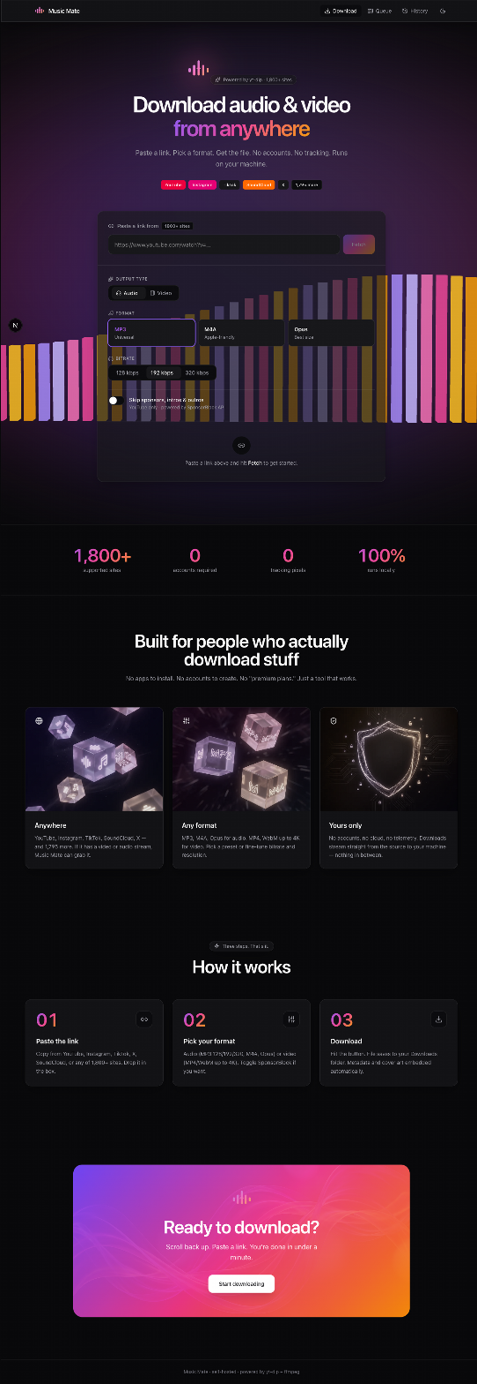
UI · 3D SCENE
Hero with animated equalizer
Three.js
64 instanced bars
InstancedMesh = single draw call
Vertex colors with gradient palette
Custom GLSL wave shader
Subtle camera parallax
prefers-reduced-motion respected
Lazy-loaded via dynamic import
8

Slide 9
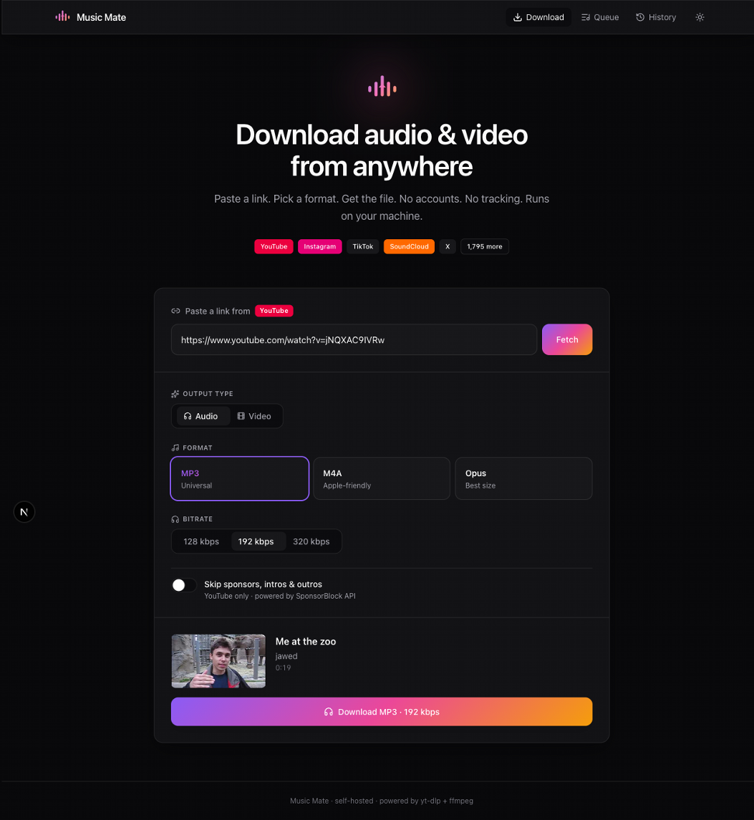
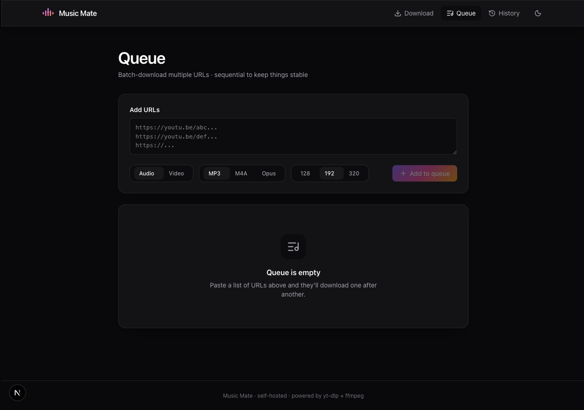
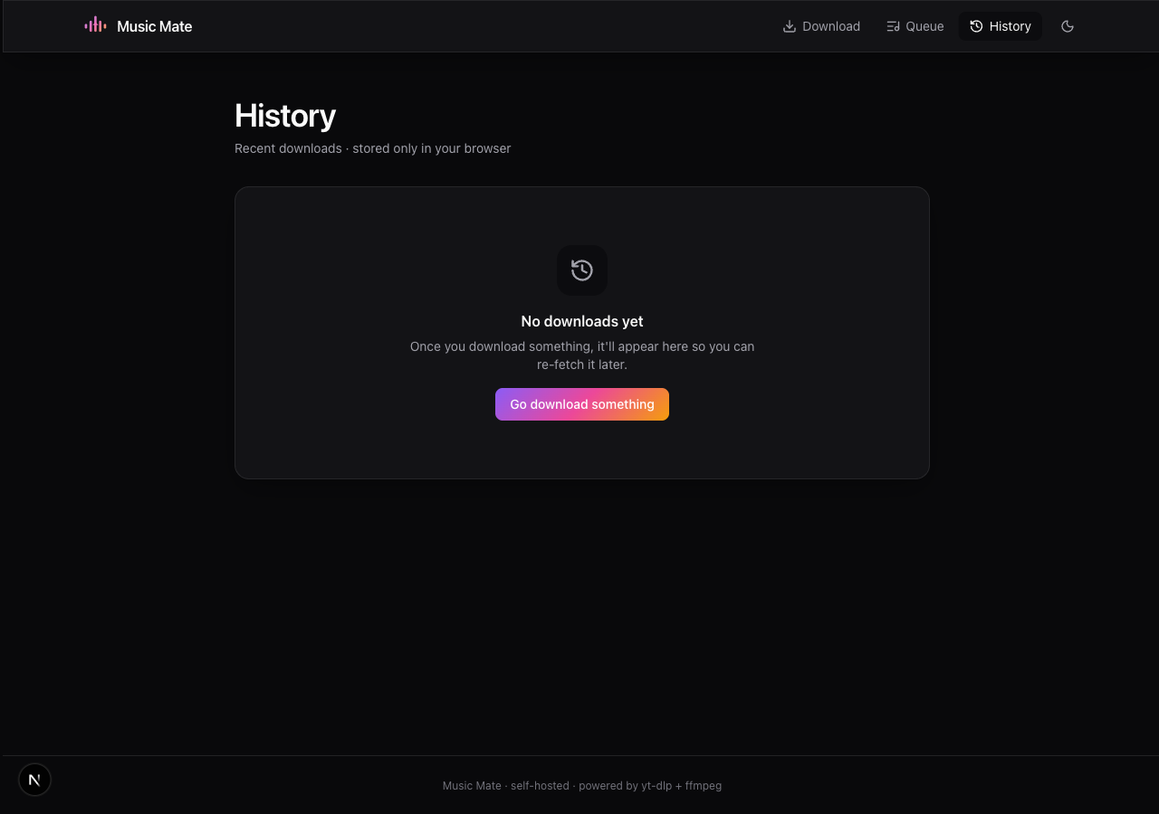
UI SHOWCASE
Three more screens, same polish
Metadata fetched
Batch queue
Local history
Title, uploader, duration, thumbnail — auto-parsed
Paste many URLs, sequential downloads with status
Re-download in one click · stored in browser only
9

Slide 10
DEPLOYMENT
One Docker image, three commands
01
02
03
Clone
Build
Run
git clone https://github.com/hellogunawan99/music-mate.git
cd music-mate
docker build -t music-mate:local .
docker compose up -d
# → http://localhost:3847
1.03 GB image · yt-dlp + ffmpeg + Node 20 · non-root · healthcheck
10

Slide 11
THAT'S IT
Thanks for watching.
Music Mate is open source. Star it, fork it, or just take it for a spin.
github.com/hellogunawan99/music-mate
Try locally: http://192.168.18.16:3847

