Slide 1

House Price Prediction
Hanqing Zhang

Slide 2
Introduction
Purchasing a home is one of the most decisions people make. It is pivotal that a prospective home buyer makes this purchase at the correct price. However, when facing a decision of such financial magnitude, people may consider that they are paying more for the house than it’s worth.

Slide 3
Data
Kaggle Dataset
https://www.kaggle.com/c/house-prices-advanced-regression-techniques/data
1460 observations, 79 features
51 categorical, 28 continuous

Slide 4
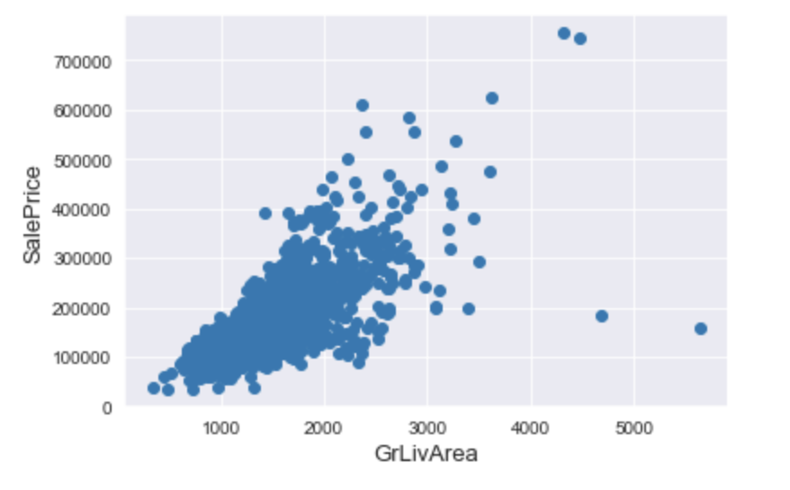
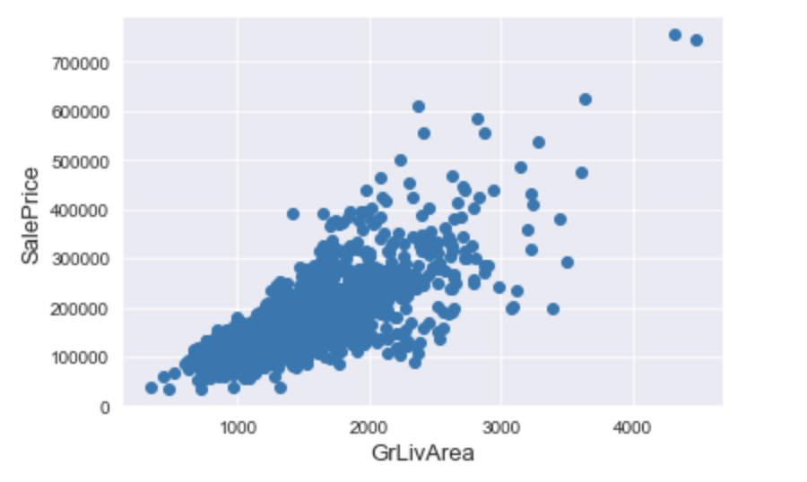
Data preprocessing– outliers

Slide 5
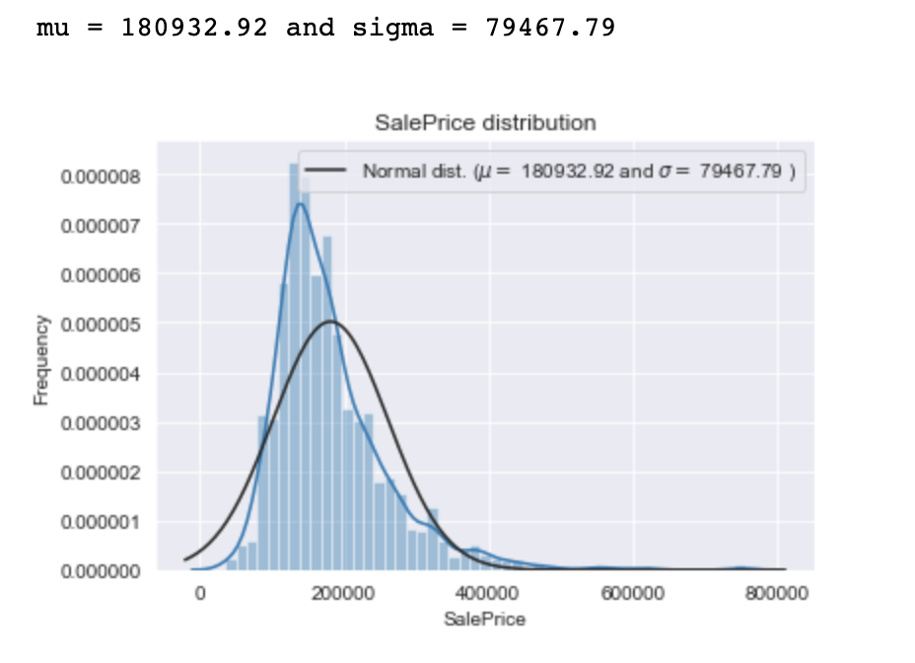
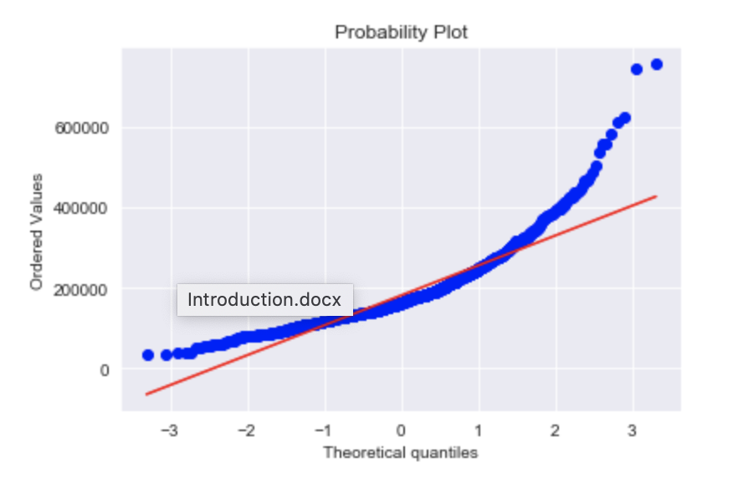
Data preprocessing
The target variable Saleprice looks right skewed

Slide 6
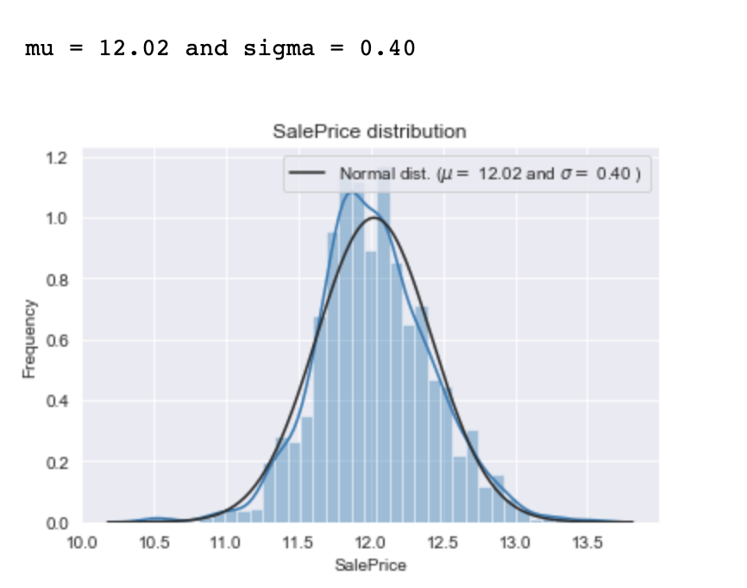
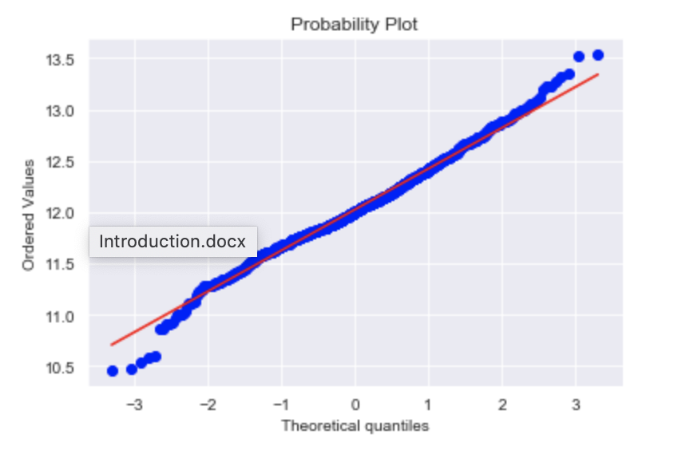
Data preprocessing
Log transformation is applied to Saleprice

Slide 7
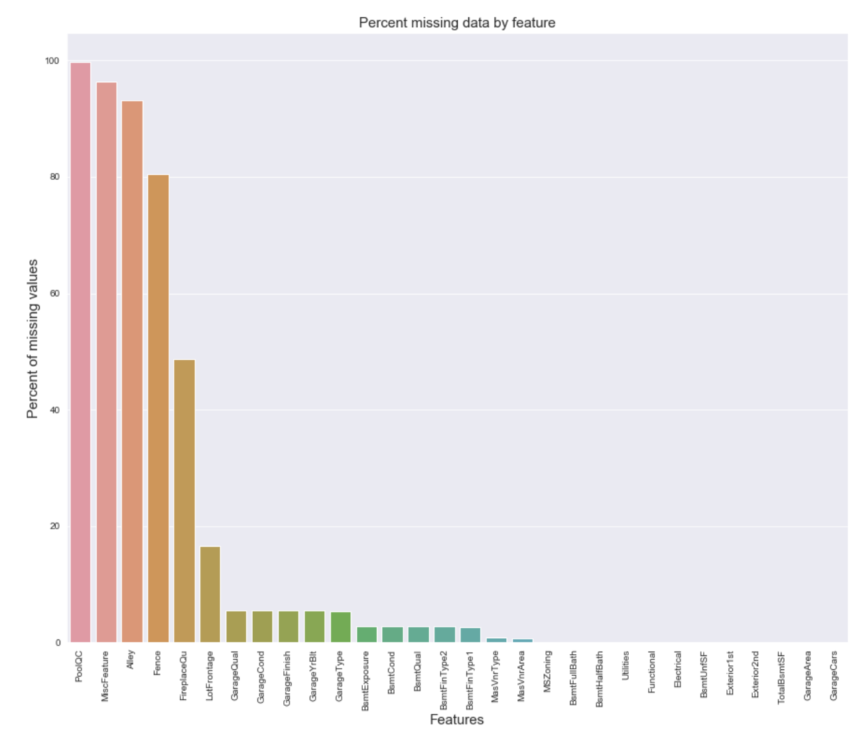
Feature Engineer
The plot shows the missing rate for each variable. According to different missing rates combined with data description, we use different ways to impute the missing values.

Slide 8
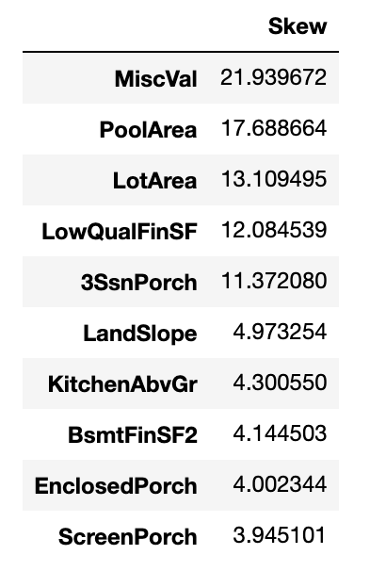
Feature Engineer
Investigating skewness for each feature, and use a box-cox method to transform the data

Slide 9
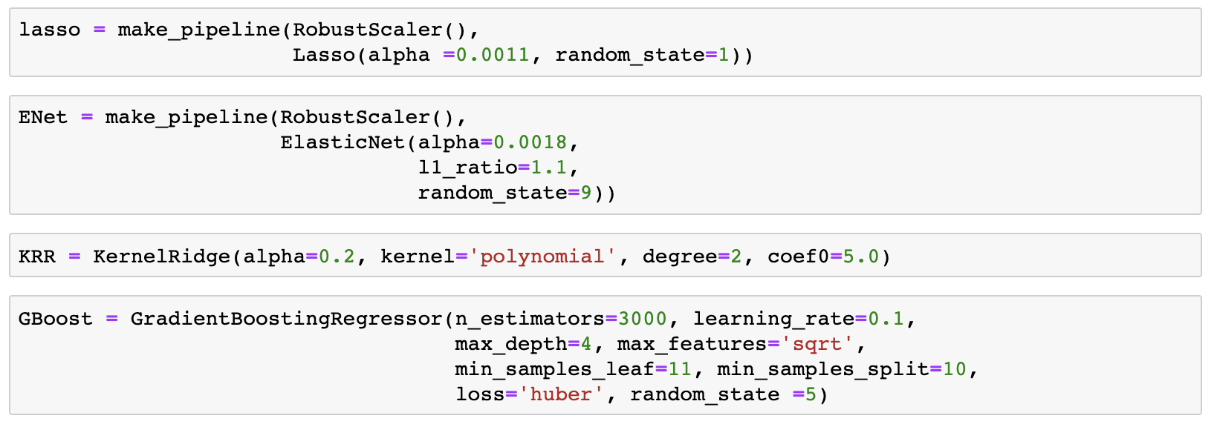
Method
We basically use four models to initialize the data, here are the tuning parameters.

Slide 10
Model AVERAGING
Model averaging is an approach to ensemble learning where each ensemble member contributes an equal amount to the final prediction. In the case of regression, the ensemble prediction is calculated as the average of the member predictions. We define a class first to allow averaging models. We first define clones of the original four models we preciously have to fit the data in; Then train the cloned base models; Finally make predictions for cloned models and average the predictions got from each model.

Slide 11
Stacking
What we do is to define the class, and first fit the data on clones of the original models; Train cloned base models then create out-of-fold predictions that are needed to train the cloned meta-model; Then train the cloned meta-model using the out-of-fold predictions as a new feature; Finally make the predictions of all base models on the test data and use the average predictions as meta-features for the final prediction which is done by the meta-model.

Slide 12
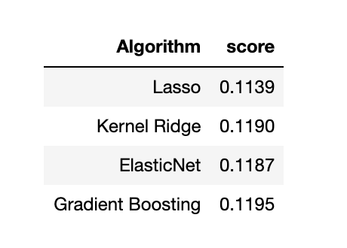
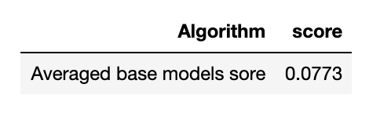
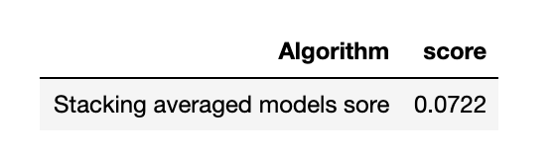
Results

Slide 13
Thank you

