Slide 1
Two-way ANOVA in R
Prerequisite: Foundations of Stats, Linear Regression

Slide 2
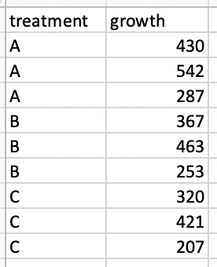
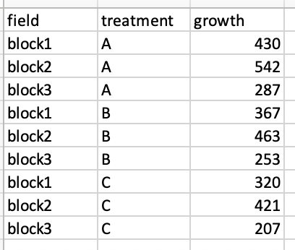
What is two-way ANOVA
Two-way ANOVA test is used to evaluate simultaneously the effect of two grouping variables (A and B) on a response variable.
The grouping variables are also known as factors. The different categories (groups) of a factor are called levels. The number of levels can vary between factors. The level combinations of factors are called cell.
Note: The data had equal numbers of subjects in each group, which is called a balanced design; Codes will show where there is an unbalanced design

Slide 3
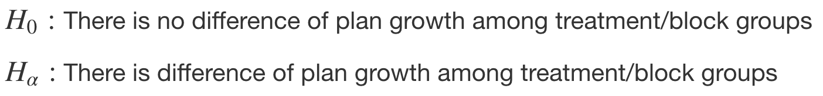
Two-way ANOVA test hypotheses
There is no difference in the means of factor A
There is no difference in means of factor B
*There is no interaction between factors A and B

Slide 4
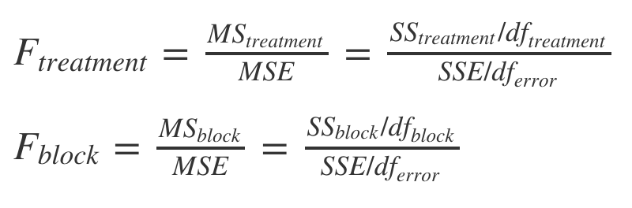

Which factors lead to different experiment results?
different treatments
different blocks
random error e.g. lights, temperatures

Slide 5
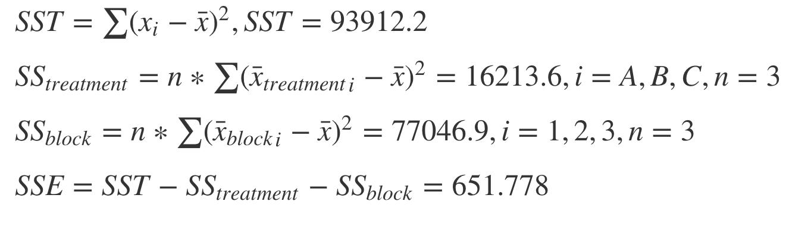

Calculations
SS_{block}
SS_{treatment}
B
block1
block3
C
A
block2

Slide 6
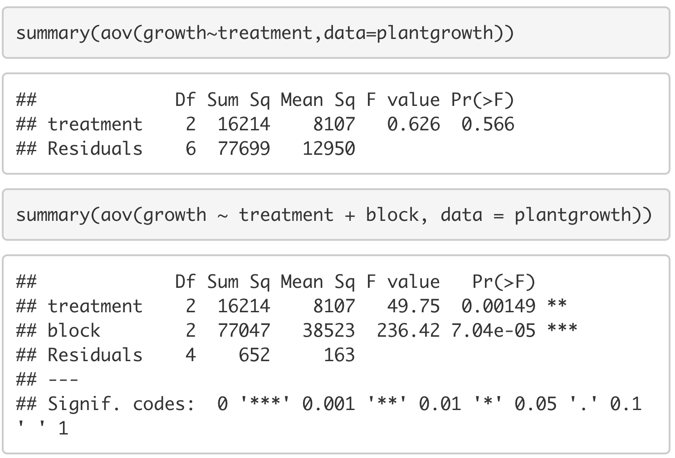
Comparing one-way and two-way ANOVA
It’s necessary to take block into consideration as it influences the result of treatment; As block is significant here as well, we may also consider adding the interaction term.

Slide 7
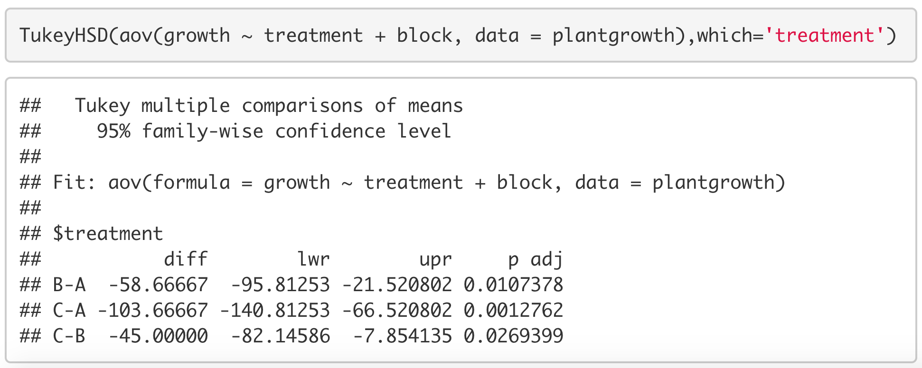
Post-hoc tests
Same with one-way ANOVA, post-hoc tests are done when we observe significant results from the main effects to make pairwise comparisons between each two levels
There are multiple methods of conducting this test including LSD, Scheffe, and Bonferroni; Here we use Tukey’s HSD for balanced design

Slide 8
More…
A two-way ANOVA is an extension of the one-way ANOVA (analysis of variances) that reveals the results of two independent variables on a dependent variable.
A two-way ANOVA test is a statistical technique that analyzes the effect of the independent variables on the expected outcome along with their relationship to the outcome itself.
ANOVA is considered to be a special case of linear regression which in turn is a special case of the general linear model.
ANOVA has many applications in finance, economics, science, medicine, and social science.

Slide 9
Assumptions of two-way ANOVA test
residuals normally distributed
equal variances

Slide 10


Thank you & Questions

