Slide 1
PYTHON UHH DAY I FORGOR
LOOP CONT. / TERMINOLOGY

Slide 2
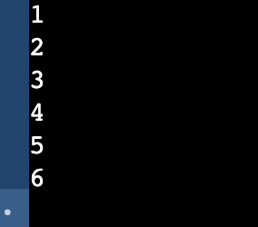
BEFORE BEGIN
WRITE A WHILE LOOP THAT PRINTS

Slide 3
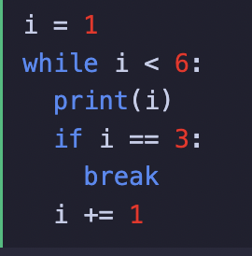
WHILE LOOPS - OTHER THINGS
Exits a loop before the condition is met

Slide 4
WHILE LOOPS - OTHER THINGS
Exits a loop before the condition is met

Slide 5
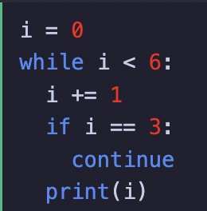
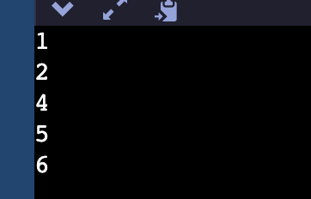
WHILE LOOPS - OTHER THINGS

Slide 6
HHEHEHUE DO NOW
Using “continue”, write a while loop that prints
1
3
5
6

Slide 7
Ygsrgoilsgjgkldjlk terminilogy ehuwh

Slide 8
Program

Slide 9
Program
A program is a set of instructions that a computer uses to perform a specific action.

Slide 10
Keywords

Slide 11
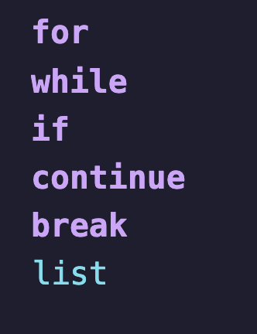
Keywords
Python keywords are special reserved words that have specific meanings and purposes and can't be used for anything but those specific purposes.

Slide 12
Argument/Parameter

Slide 13
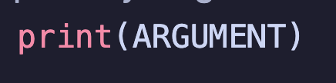
Argument/Parameter
A parameter is the variable listed inside the parentheses in the function definition. An argument is the value that are sent to the function when it is called.

Slide 14
Nested loop

Slide 15
Nested loop
A nested loop is a loop inside the body of the outer loop. The inner or outer loop can be any type

Slide 16
Program Keywords Argument/Parameter Nested loop

