Slide 1
Input, review

Slide 2
input
Listen to boxuan hahidsbj jkaweiorgb nreklf bvnklaewfnbgdfspof nkjdgbdhso

Slide 3
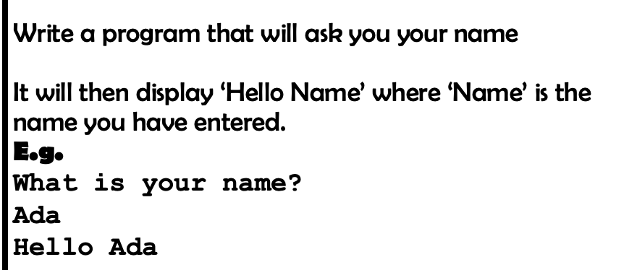

Slide 4
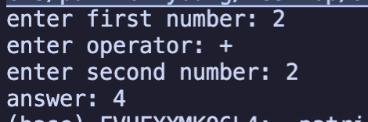
Write a program that will take 3 inputs, 2 numbers and an operator and will do the calculations accordingly
example

Slide 5
