Slide 1

Operators conditions loops

Slide 2

Conditions

Slide 3
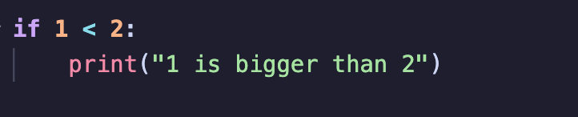
if
An if condition is basically
If smth smth, then do smth smth
For example this would output “1 is bigger than 2” because the condition 1<2 is true

Slide 4
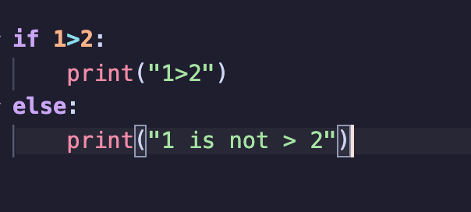
else
The else condition is a sort of addon to the if condition, like so:
\
This would output “1 is not > 2” because the else condition executes when the if statement returns False.

Slide 5
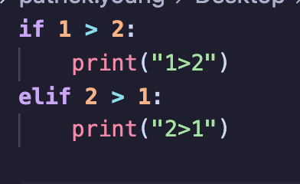
elif
The elif condition stands for else if, and is combination of said conditions.
For example
This
Would output “2>1” because although it 1>2 is not True, 2>1 is.

Slide 6
operators

Slide 7
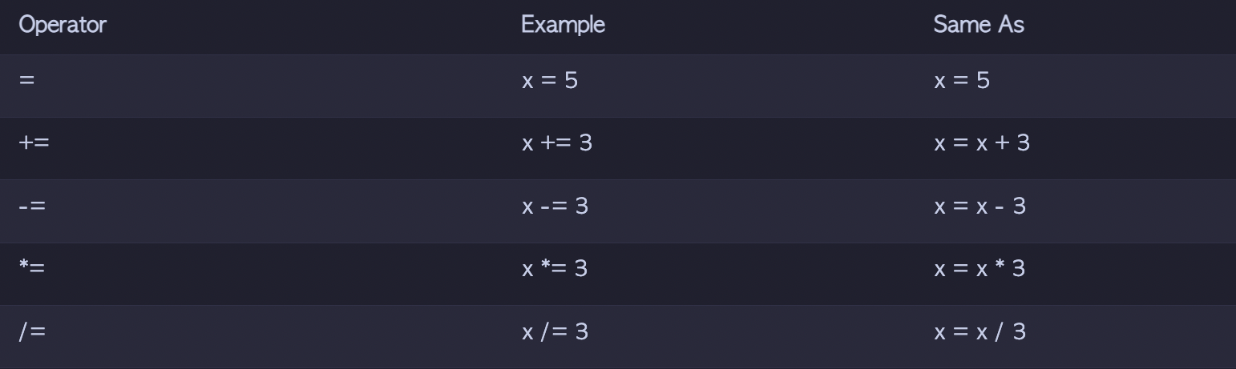
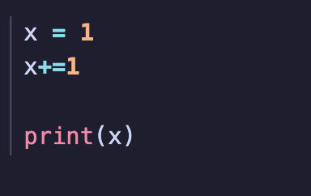
operators
Assignment Operators
Output: 2

Slide 8
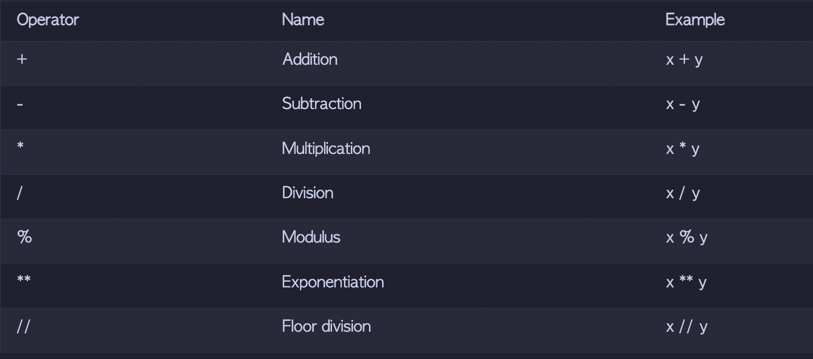
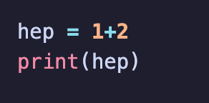
operators
Arithmetic Operators
Output: 3

Slide 9
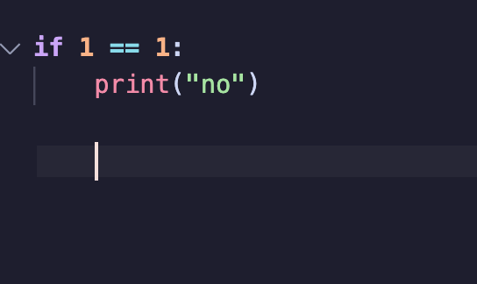
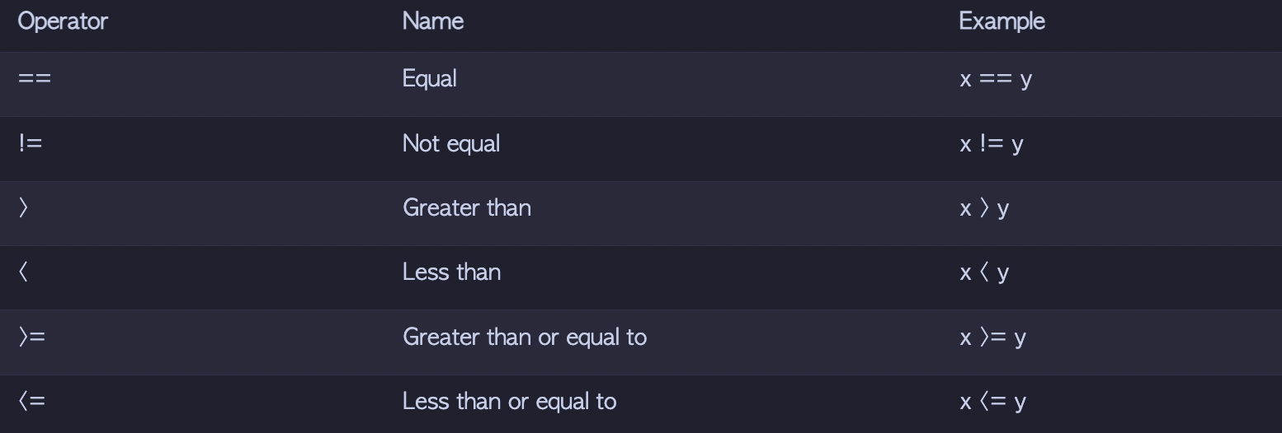
operators
Comparison Operators
Output: no

Slide 10
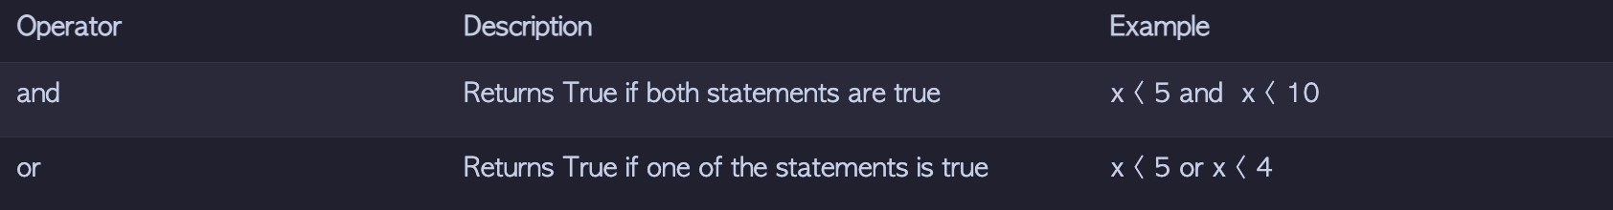
operators

Slide 11
practicar
Yknow
Like
python.this-is-a.website
lesson2pt1

Slide 12
Loops

Slide 13
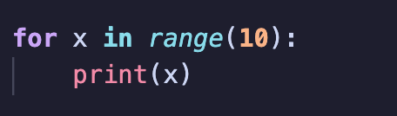
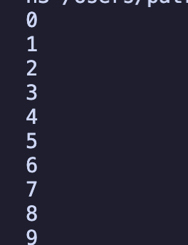
For loop
A for loop is a loop that does a program a set amount of times
This program will print
In this instance the x is the current round number

Slide 14
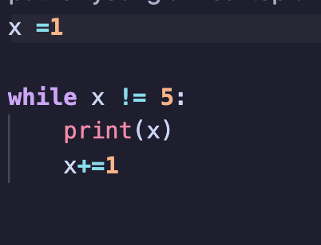

While loop
A while loop is a loop that will continue to execute code if the condition is True
So a while True: would be an infinite loop
This program will output
Because it literally means, as long as x is not 5, output x, then add 1 to x

