Slide 1
EDUCATIONAL
Funny Text Here
Python Basic – L5
Some funny latin stuff

Slide 2
CONTENTS
01
Functions
02
Packages

Slide 3
01
Functions
I paid for this template lmao

Slide 4

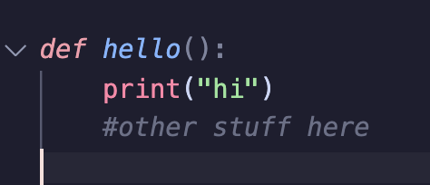
01
What are functions?
A function is a piece of code that can be executed at any time
9%
Example of a function

Slide 5
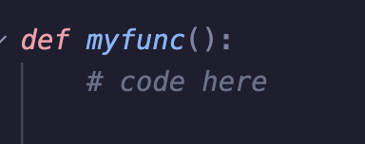
01
Defining (creating) a function
To create the function, write
9%
Note that “myfunc” here can be replaced with anything
def is short for define

Slide 6
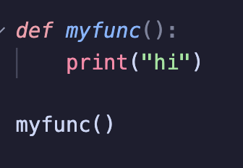
01
Calling (using) a function
To use a function later in the code, simply use the name of the function without the “def” in front
9%
Note that any code in the function will not be executed without doing so
This will output “hi”

Slide 7
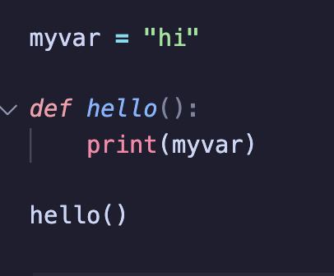
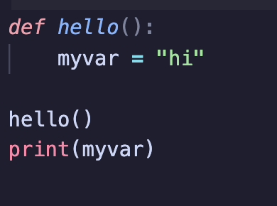
01
Local and Global variables
A global variable is a variable that can be used anywhere throughout the code.
A local variable is a variable that can only be used within a function/loop
this is an example of a global variable
this is an example of a local variable
This will output an error as local variables can only be used within a function or loop
This will output “hi”

Slide 8
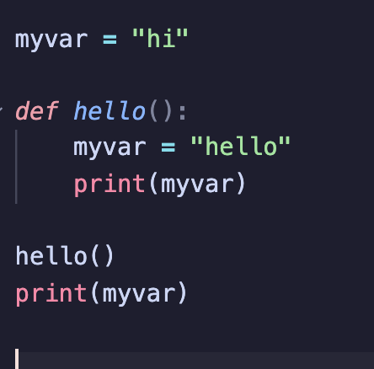

01
Local and Global variables
Don’t make this mistake
This will output. Because even though myvar has been
Given the value of “hello” in the function, Python actually creates a new local variable in the function
Essentially, the myvar outside the function and the myvar inside the function are two different variables

Slide 9
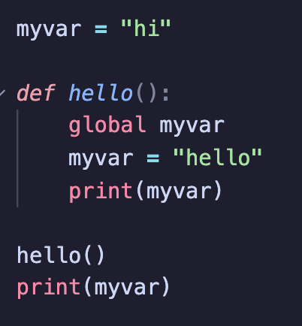
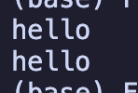
01
Local and Global variables
How to use global variables inside a function
This will tell python to use the global variable instead of creating a new local variable
Output:

Slide 10
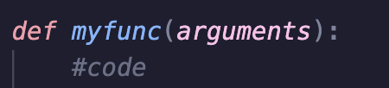
01
Inputs
Functions have another useful feature, to pass information through to the function
Remember how we added empty brackets? Lets put them to use
Defining function name. arguments
Arguments are optional but allow you to pass on some data when calling (using) the function

Slide 11
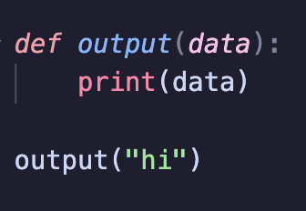
01
Inputs
What name you use for this does not really matter, what you have to remember is that this becomes a local variable with the data that has been passed on
An example would look like this
Calling the function

Slide 12
01
Exercise
Open VSC or OnlineGDB
Write a function that will take one argument (input), then print (output) that data.
Then call that function.

Slide 13
01
Packages
aaaaaaaaaaowoaaaaaaaaaa

Slide 14


01
What is a package
????????????????????????
Packages are things you can import into your code to add functionality to python
Some packages are built-in, meaning you can use them without downloading anything, others however will need to be downloaded from the internet
The two we are going to learn about today are both built in.
To use a package, added to the top of your code

Slide 15
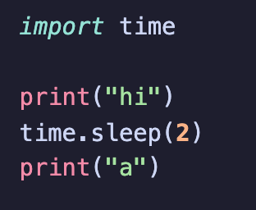
01
Time
TEGKrsjlgfdngkrsgklfdnjgdgksrlbjnv
The time package has more functionalities, though you will mostly be using only one of these. That is
time.sleep(x) bascially makes the whole program stop and wait for x amount of seconds, eg time.sleep(2) would make the whole program stop and wait for 2 seconds

Slide 16
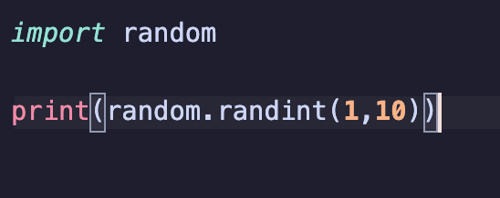
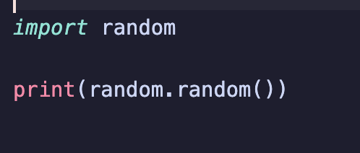
01
Random
TEGKrsjlgfdngkrsgklfdnjgdgksrlbjnv
The random package is basically a package used to randomize things, for example a random integer or a random float
To use
This prints a random number between 1 and 10
This prints a random float between
0.00000000000
And 1.0000000000

Slide 17
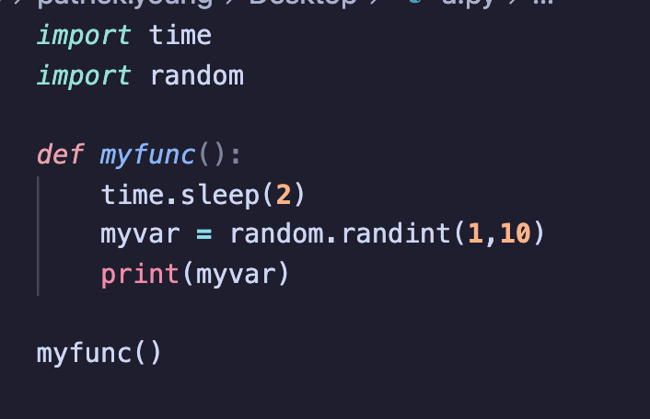
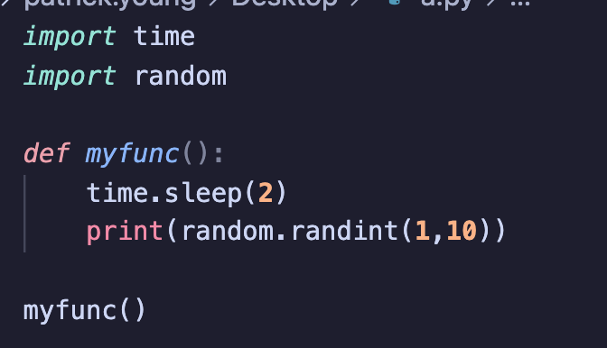
01
Practice
TEGKrsjlgfdngkrsgklfdnjgdgksrlbjnv
Write a function that will wait 2 seconds, then print a random number between 1 and 10, then call that function

Slide 18
EDUCATIONAL
PHILOSOPHY
Owo baibai
latin

