Slide 1
Lesson 2
Colored text and Dictionaries

Slide 2
Review
String methods:
.upper()
Make all text in string uppercase
.lower()
Opposite of .upper()
.capitalize()
Makes te first character in the string uppercase

Slide 3
Review
.capitalize()
Makes te first character in the string uppercase
.count(string)
Counts the amount of time a string appears in another string/list
.isalpha()
Returns whether or not a string includes only characters from the alphabet (True or False)
.replace(string1, string2)
Replace all string1 in a string variable with string2

Slide 4
Colored text

Slide 5

To make the console print out colored text
Doesn’t work?
python –m pip install colorama

Slide 6
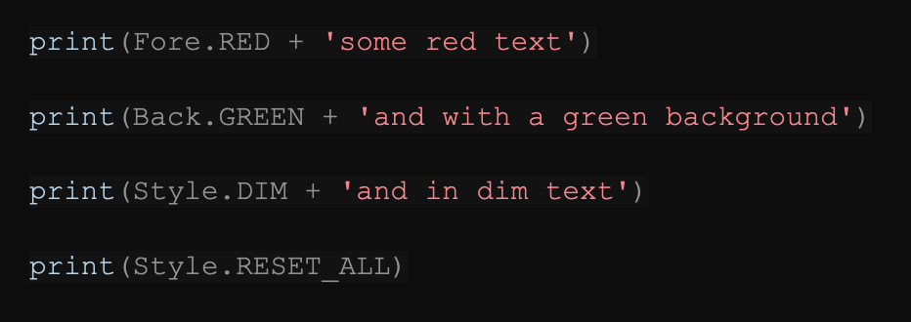
Options
Output: some red text
Output: and with a green background
Output: and in dim text

Slide 7
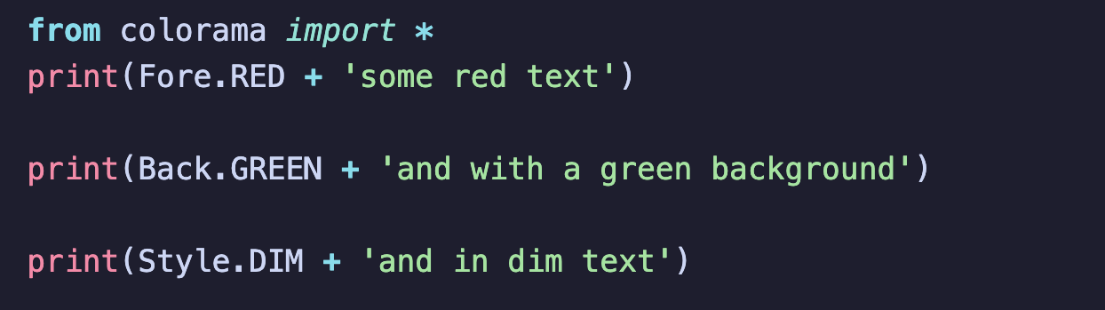
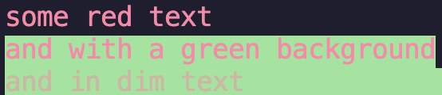
Effects can layer!
If this code segment is run together
Then the output would be:

Slide 8
Experiment!

Slide 9
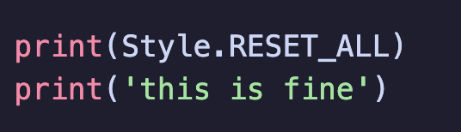
Clearing
You might have noticed that the added effects arnt going away
That’s because you have to clear them!
Try adding this at the end of your code
The layered effects should be cleared now

Slide 10
Multiple colors in one string
You can change the style and colors in a string while printing by using {},then specifying what modifier you want to use
NOTE: The F in the start is VERY IMPORTANT
o
output

Slide 11
Dictionary - a brief intro

Slide 12
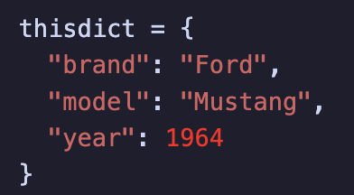
What is it?
Dictionaries are used to store data values in key:value pairs.
A dictionary is a collection which is ordered*, changeable and do not allow duplicates.
Eg:
In this example, the key “brand” corresponds to the value “Ford”

Slide 13
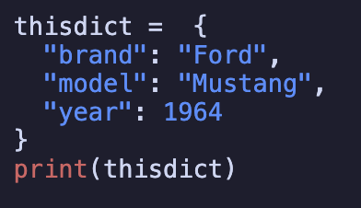
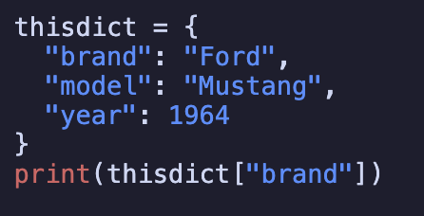

Outputs
output
output

Slide 14
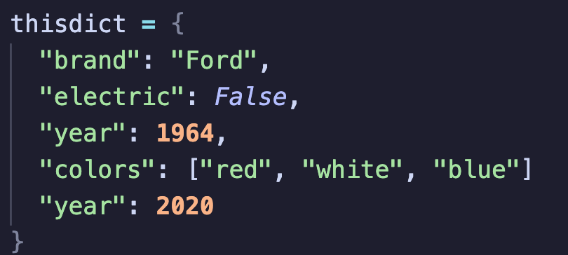
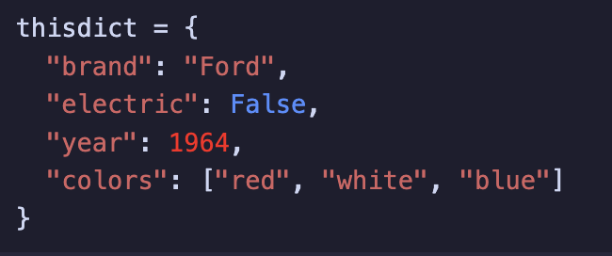


Data types
You can mix data types in a dictionary
Duplicates are NOT ALLOWED
To get a list of all the keys. Keep in mind that this is a view of the dictionary, meaning that changes
done to this will reflect onto the dictionary
To get a list of all the values. Keep in mind that this is a view of the dictionary, meaning that changes
done to this will reflect onto the dictionary

Slide 15
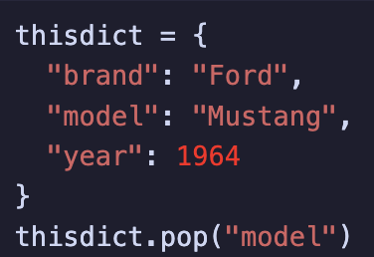
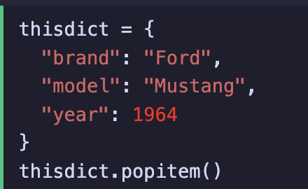
Adding(Appending)/Deleting(Removing
To add something to a dictionary
car = { "brand": "Ford", "model": "Mustang", "year": 1964 } car["color"] = "white”
This will add "color": "Mustang", to the dictionary
To remove a specific key:value
To remove the most recently added item

Slide 16
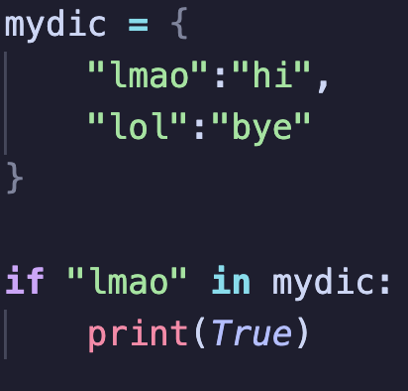
Check if key exists in a dictionary
keep in mind
In Python versions before 3.7, lists are unordered, meaning that if you used the popitem() modifier, in a version before 3.7, a random item will be deleted

Slide 17
Exersize (If we have time)

Slide 18
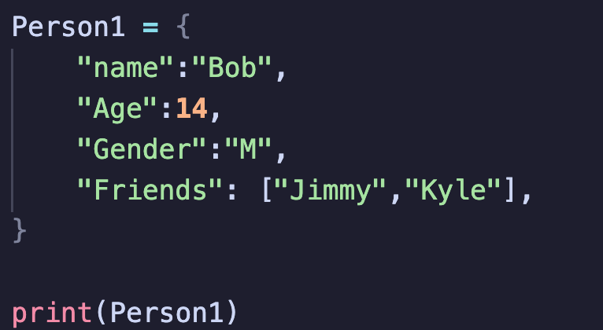
Copy down:
Oh noes! This data is outdated! Today Bob turned 15, he also made a new friend named “Jackson”, but also broke up with “Kyle” ☹
He also changed his name to Bobby becase he could
Print the dictionary before and after the changes
Call any teacher when youre done
The output should be

Slide 19
Byeeeeeeeeeee
OωO have a nice day

