Slide 1
Python Advanced L3
Dictionaries, Packages

Slide 2

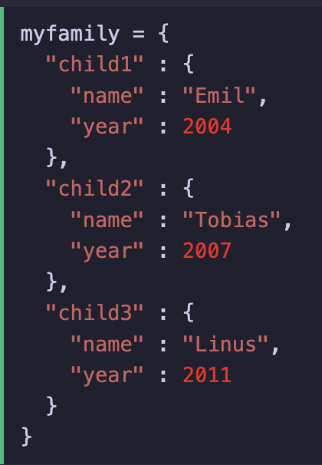
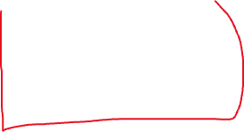

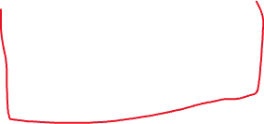
Nested dictionaries
You can make a nested dictionary, which is basically a set of dictionaries within a dictionary

Slide 3
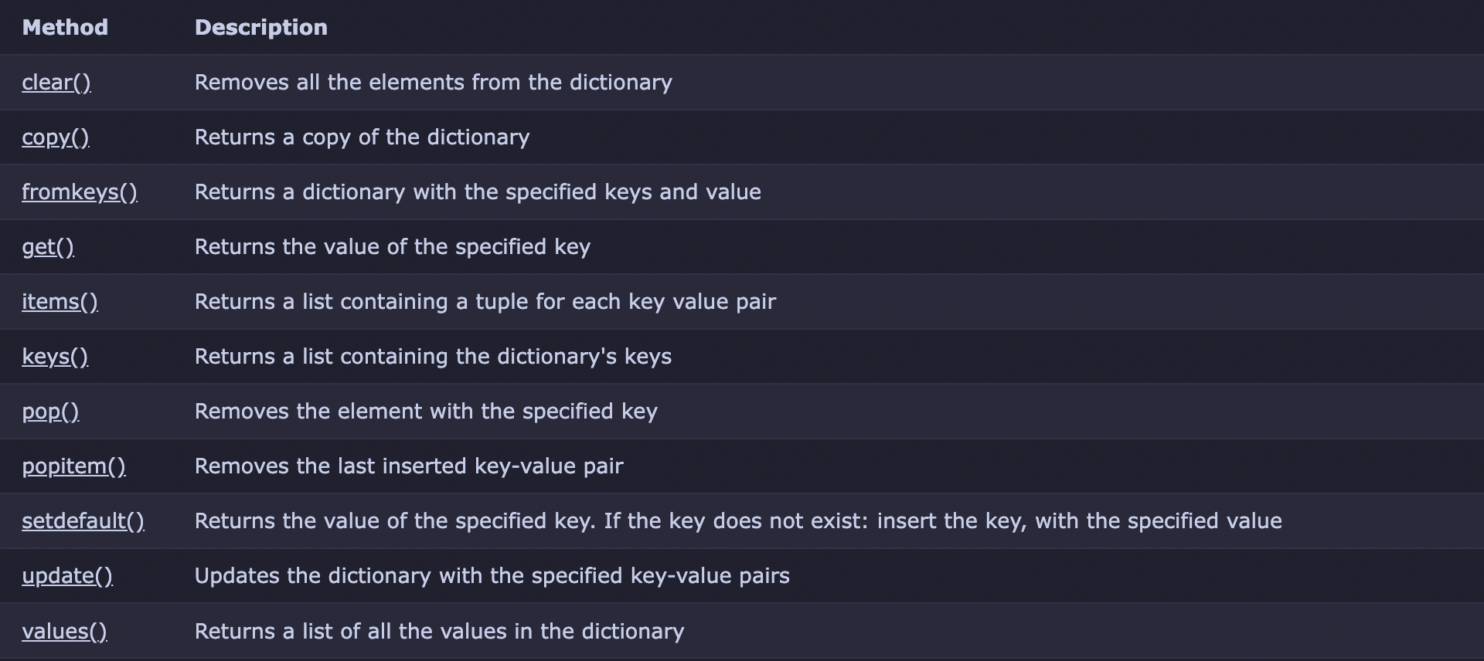
Dictionary Methods

Slide 4
WOOOOOOOOO PACKAGES

Slide 5
What is a package
A package is basically something you import to add additional functionality to python
Eg the colorama package we used last class to be able to prink colored text

Slide 6

To import a package, you simply type

Slide 7
Some packages are built in to python while others need to be downloaded from the internet
For example the ”time” package is built in while the ”colorama” needed to be downloaded

Slide 8
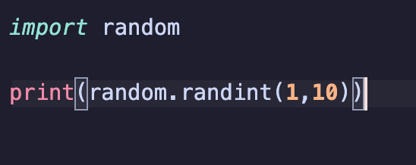
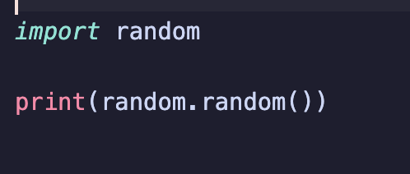
random
The random package is basically a package used to randomize things, for example a random integer or a random float
To use
This prints a random number between 1 and 10
This prints a random float between
0.00000000000
And 1.0000000000

Slide 9
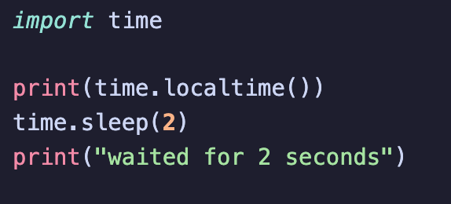
time
The time package has more functionalities, though you will mostly be using only two of these. They are as follows
time.localtime() returns the current local time, eg
time.sleep(SECS) haha funny bascially makes the whole program stop and wait for x amount of seconds, eg time.sleep(2) would make the whole program stop and wait for 2 seconds
This program will print out the.local time, wait two seconds, then print out “waited for 2 seconds”

Slide 10
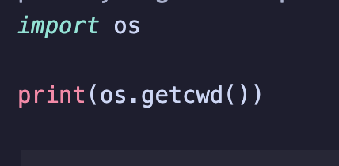
OS (Pt.1)
The os package provides countless functions, it is essentially a package for your code to directly interact with your computer eg delete files execute shell commands
We will only be scratching the surface, we will continue some more next lesson but I strongly recommend you read documentation to learn about this packages full potential
Today we will be learning how to execute shell commands as well as getting the current path of the file
Os.getcwd() will get the current path of the file (excluding the name of the file itself)
Eg this would output

Slide 11
OS (Pt.1)
The second command were going to learn about is about os.system(“”)

