Slide 1
Python Advanced
AHHHHHHHHHHHHHHHHHHHHHHHHHHHHHHHHHHHHHHHHHHHHHHHHHHHHHHHHHHHHHHHHHHHHHHHHHHHH

Slide 2

Agenda
Packages (os)
File operations

Slide 3
Package (OS)
Subtitle

Slide 4
OS (Cont.)
Last class we learned about the packages “time” and “random”, today we’re going to dive a little deeper and learn about os, a package that allows you to use python to interact with your operating system (in this case macos).

Slide 5
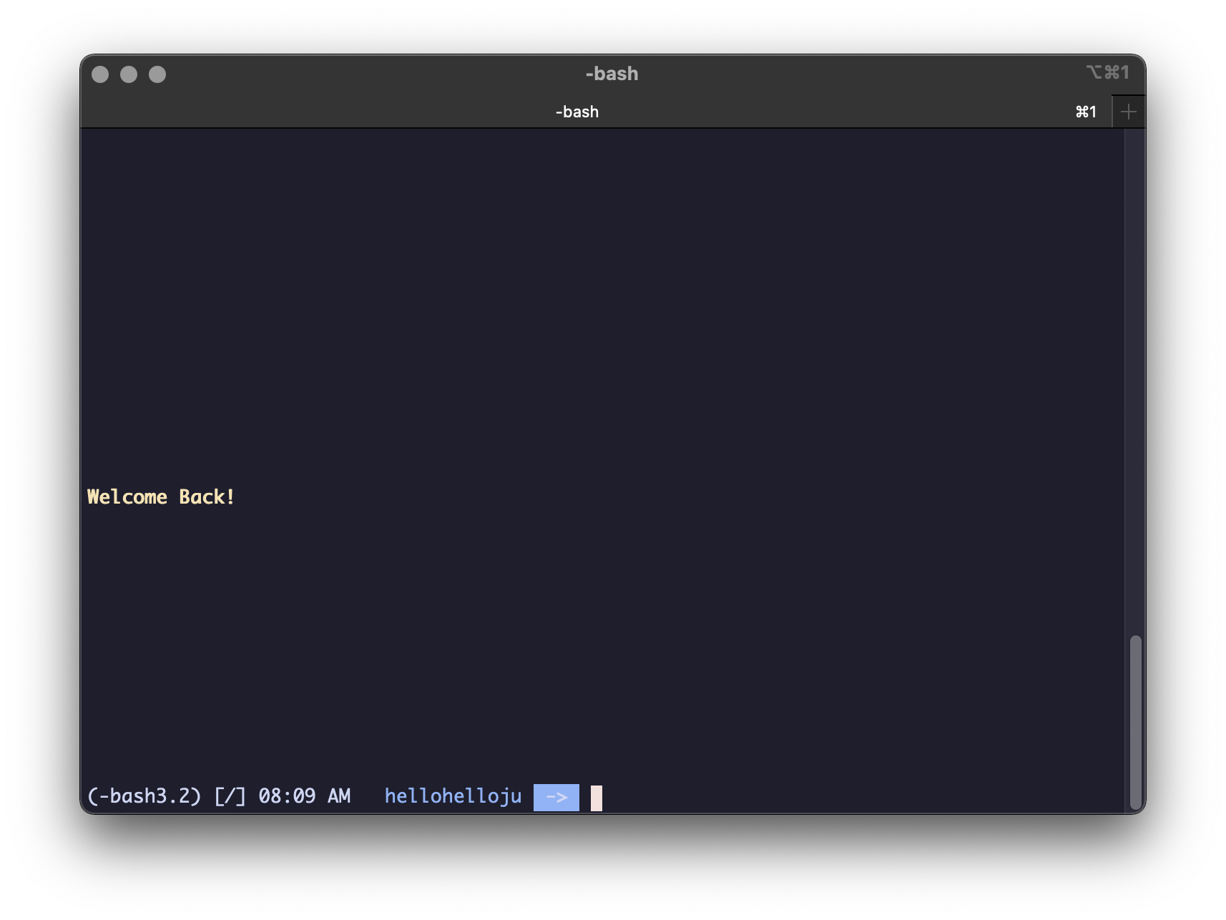
os.system(param)
The os.system(“”) allows you to run any shell command right through python (the shell is this)
Anything within the quote will be run
To quit every app on your mac
You can do: os.system(“quit -9 -1”)

Slide 6
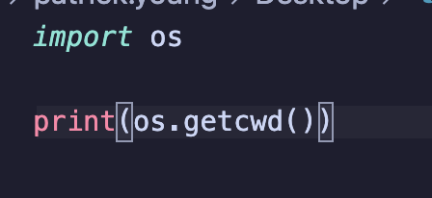

os.getcwd()
os.getcwd() gets the current directory of the file
For example
Would give the output

Slide 7
File Operations
Name Title
Name Title
Name Title
Name Title

Slide 8


To interact with files, do you have the following:
You can set a variable as a file (confusing ik I don’t get it either) by doing
But by default you can only read from the file, so if you want to write to it, you can do:
To open it in write mode

Slide 9
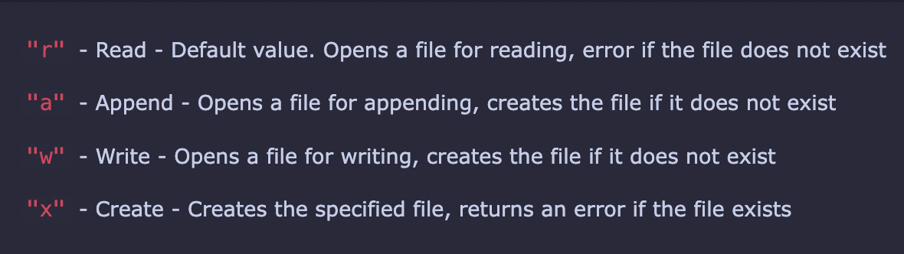
a
There are also ways to open the file, all of them being:

Slide 10
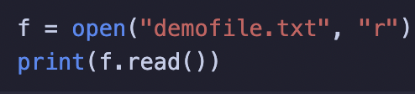
a
Now that you’ve opened the file, lets learn how to read and write to the file!
First, you set the file as a variable
Then, you use .read()
To read the contents of said file
(keep in mind that this will only see files from your current directory of the file)

Slide 11
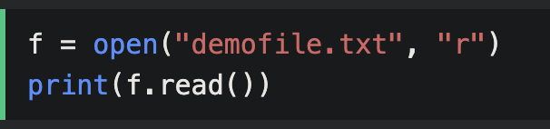
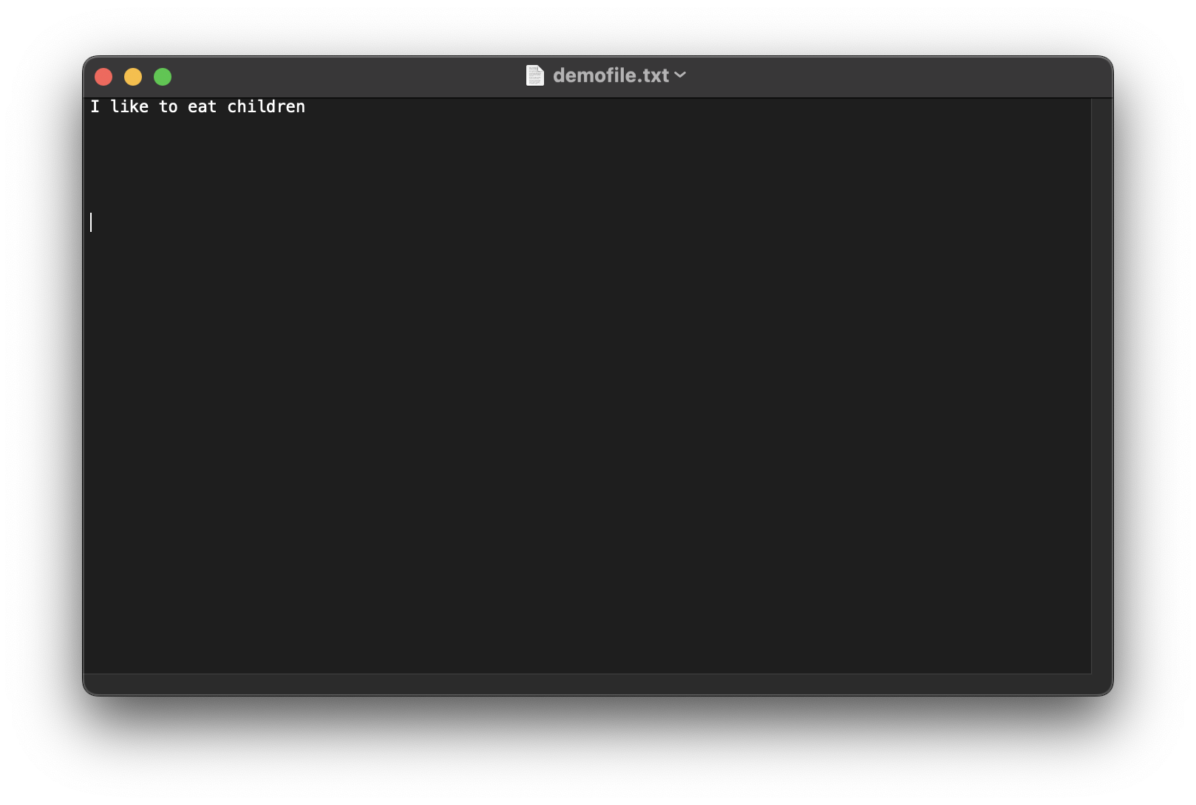
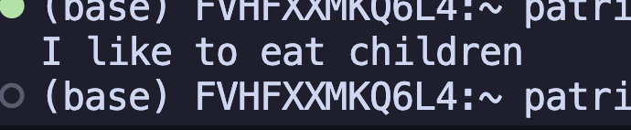
.read()

Slide 12
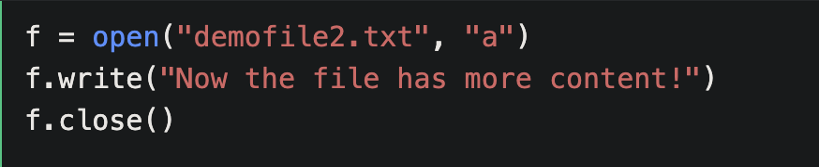
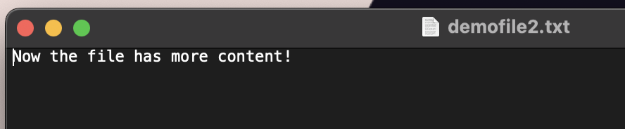
.write()

Slide 13
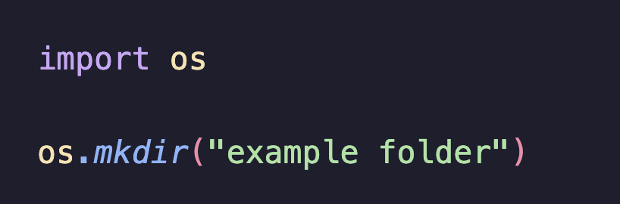
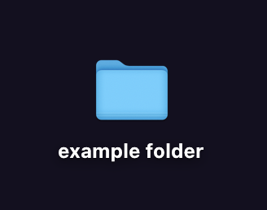
Os.mkdir()
Make a folder in a director

Slide 14
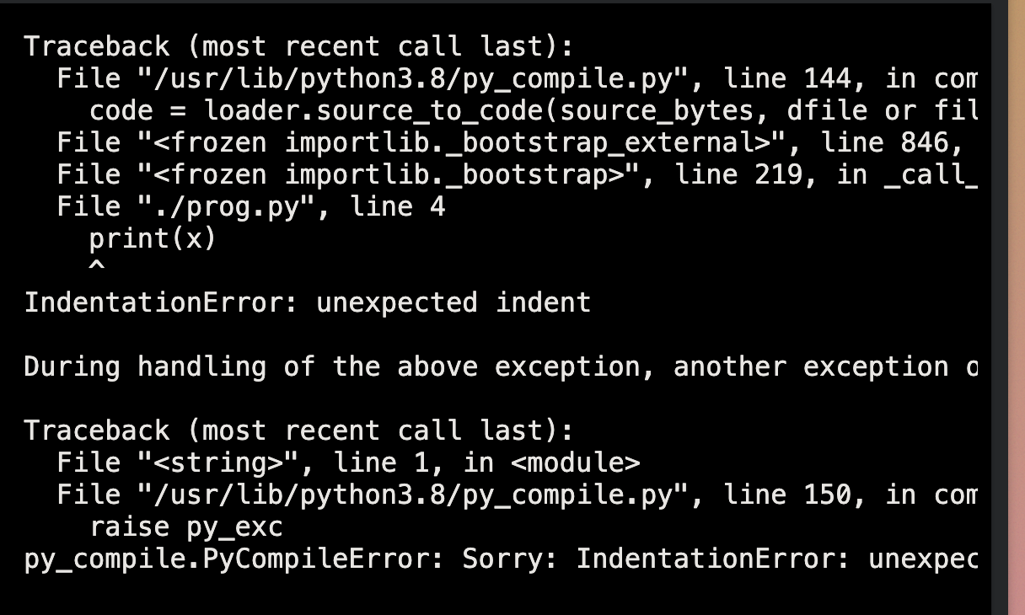
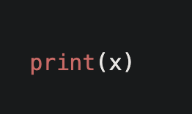
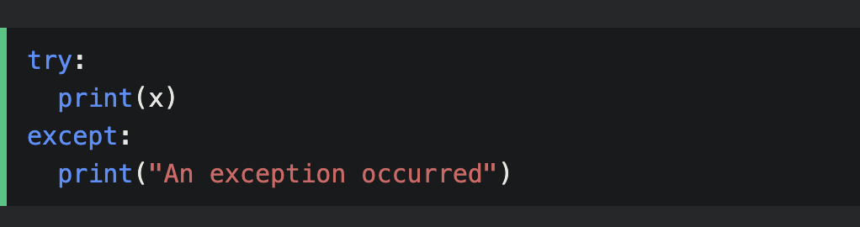
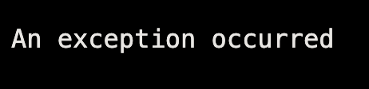
Try: except

Slide 15




Thank you

