Slide 1
REVIEW WOOOHOOOOOOOHOWHWHODOAW

Slide 2
String methods
String methods:
.upper()
Make all text in string uppercase
.lower()
Opposite of .upper()
.capitalize()
Makes te first character in the string uppercase

Slide 3
String methods
.capitalize()
Makes te first character in the string uppercase
.count(string)
Counts the amount of time a string appears in another string/list
.isalpha()
Returns whether or not a string includes only characters from the alphabet (True or False)
.replace(string1, string2)
Replace all string1 in a string variable with string2

Slide 4
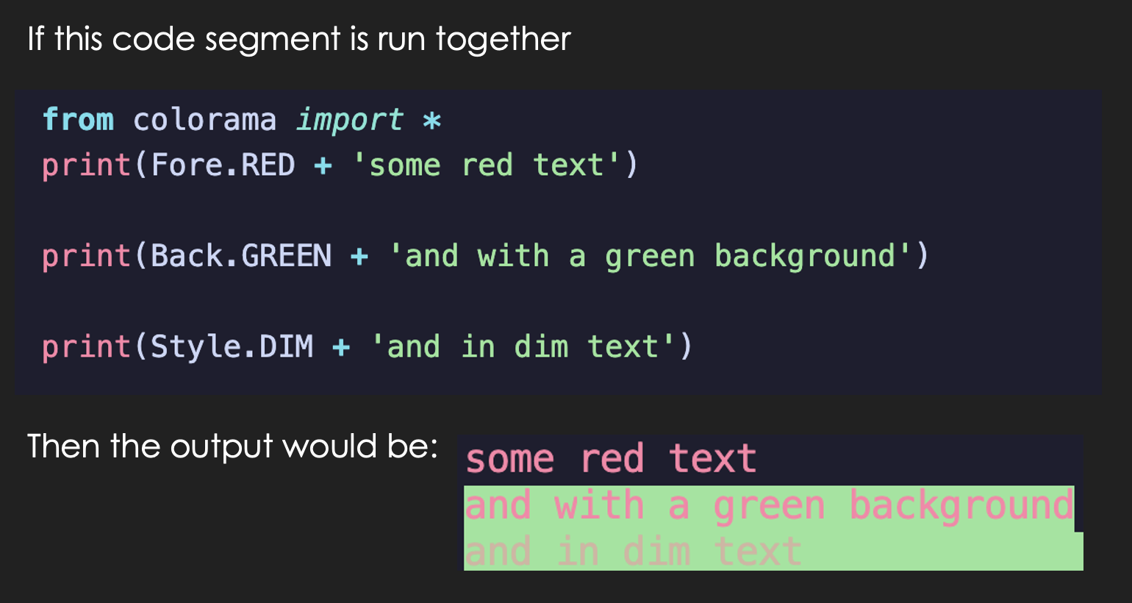
Colored text

Slide 5
Dictionary
Write me a dictionary about a car that describes its model, manufacturing year, manufacturing country, and brand
car = { “brand”: “Ford”, (COMPLETE THE REST OF THE CODE) }

Slide 6
Dictionary
Now change the car brand to “I dunno” and remove the manufacturing year.

Slide 7
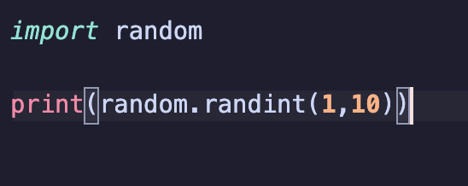
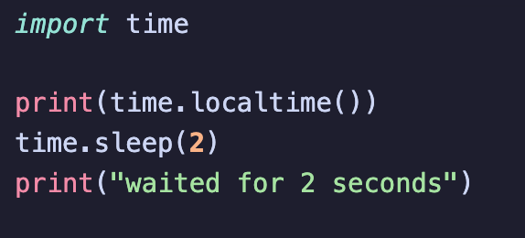
Packages
Time Random

Slide 8
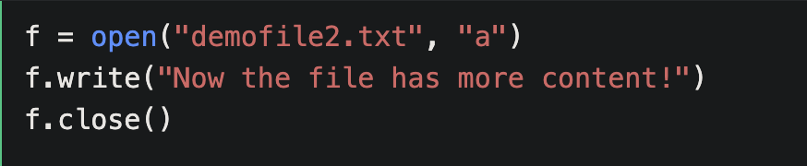
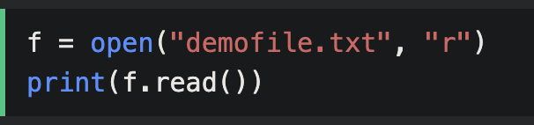
.write().read()

Slide 9
