Slide 1
Python advanced
Tkinter, Day 1

Slide 2
tkinter
Wowowowowwowo
What is tkinter?
Tkinter is a python library that can be used to render simple interactive windows using python
Its an introduction to GUI programming in python

Slide 3
Installing tkinter
Tkinter is a library that is built-in to python from 3.0 onwards, so you shouldnt need to download it
Simply import the package into the code (see if you remember how to import a package)

Slide 4
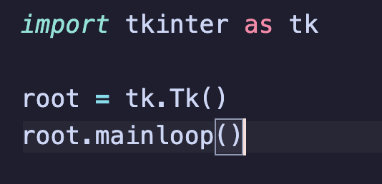
Creating a widnow
Before you can put cool stuff in a window, you have to make a windows first
Below is piece of code to create an empty window.

Slide 5
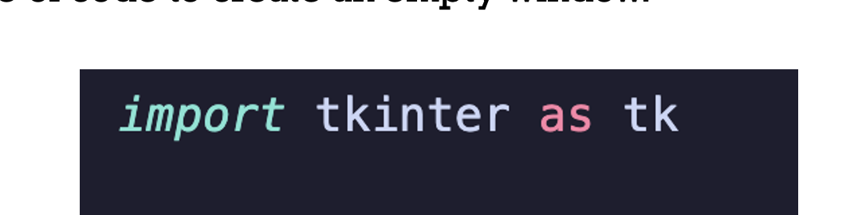

Slide 6
What was that
Imports tkinter with a shortened name of tk (not required but useful)

Slide 7
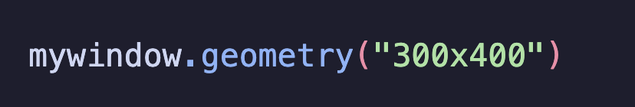
Set size

Slide 8
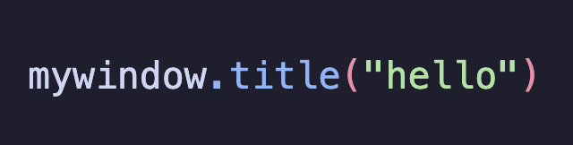

Set Title

Slide 9
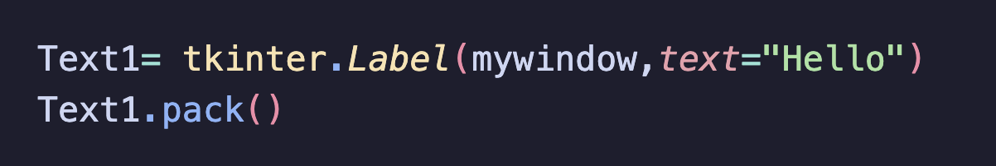
Add text

Slide 10
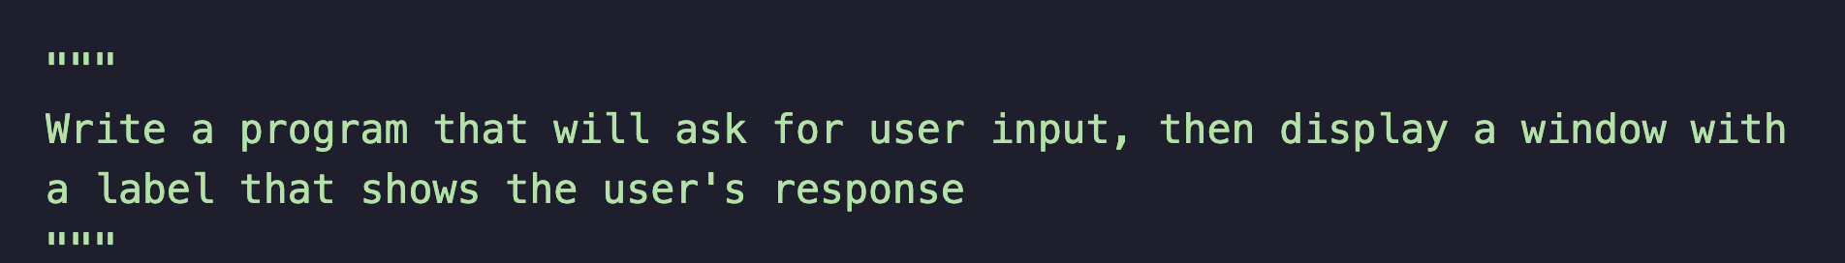
HOMEWORKHHAAHHAA

