Slide 1

Python Final Review Day

Slide 2
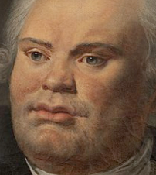
Variable Data types
String
Integer
Float
Boolean
Lists

Slide 3
conditions
If
Else
elif

Slide 4
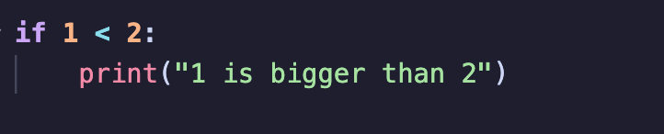
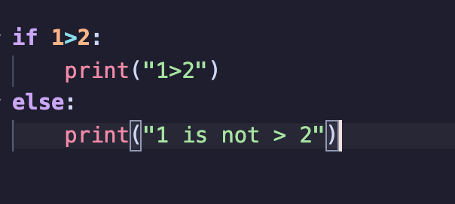
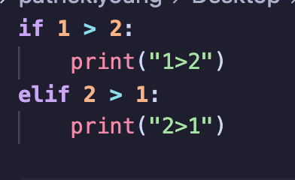

Slide 5
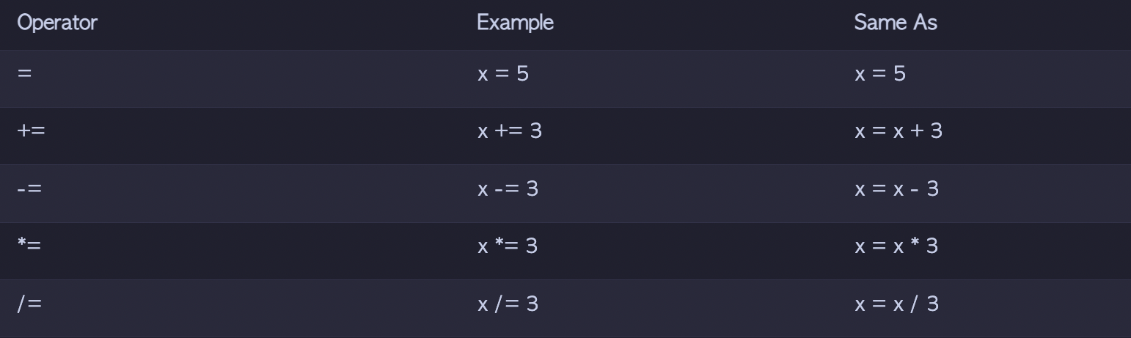
operators

Slide 6
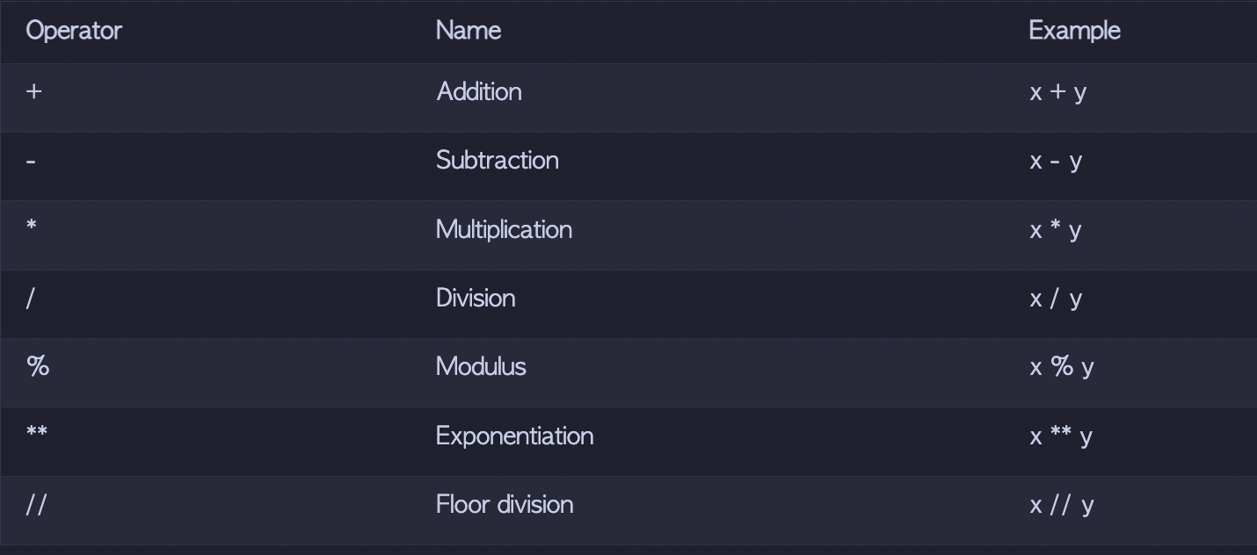
operators

Slide 7
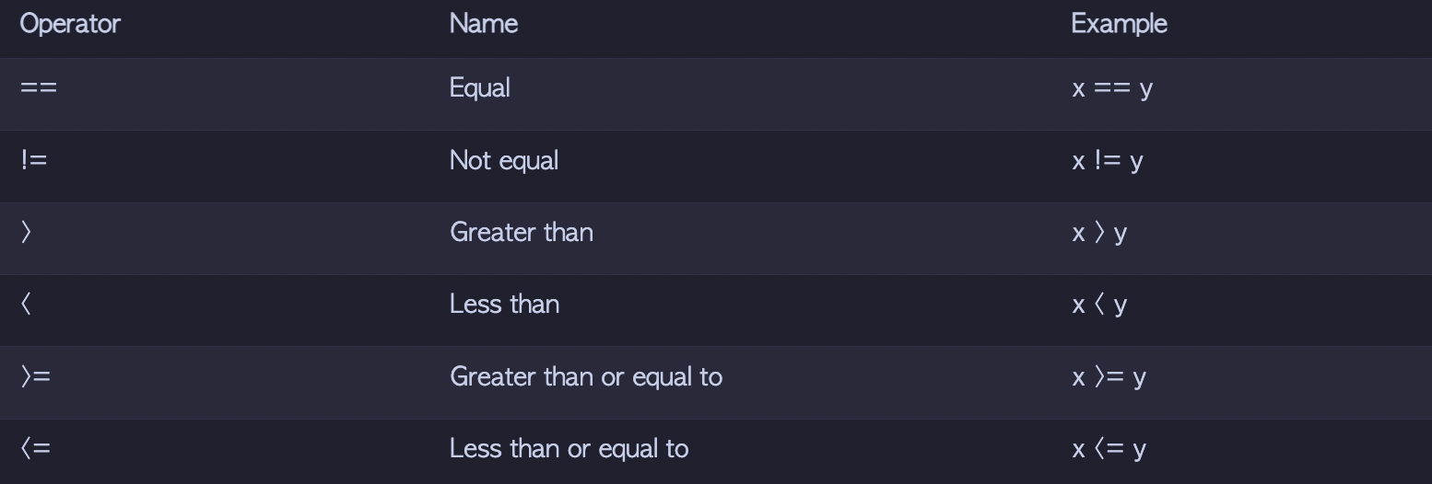
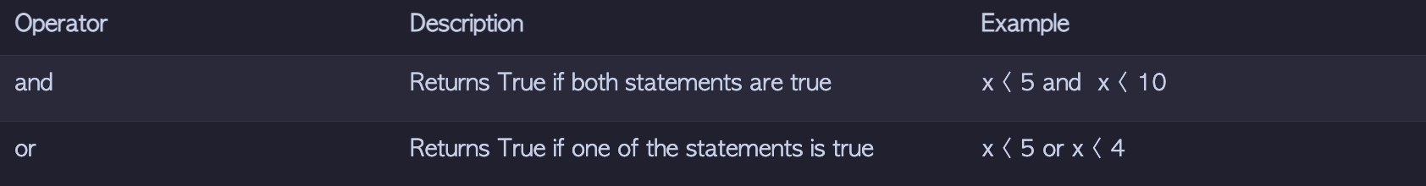
operators

Slide 8
Loops
For
while

Slide 9
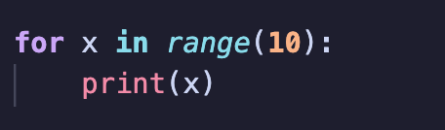
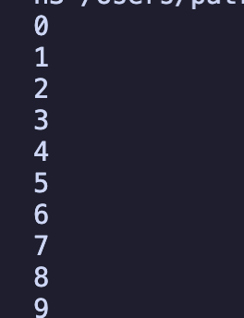
For
For
while

Slide 10
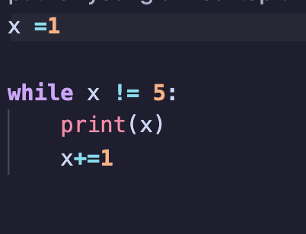

While
For
while

Slide 11
Practice
Write an if condition that prints ”hi” if one number is bigger than the other.

Slide 12

Input

Slide 13
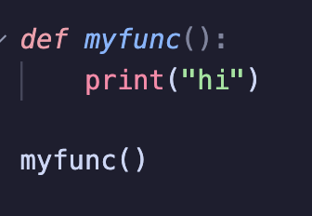
Functions

Slide 14
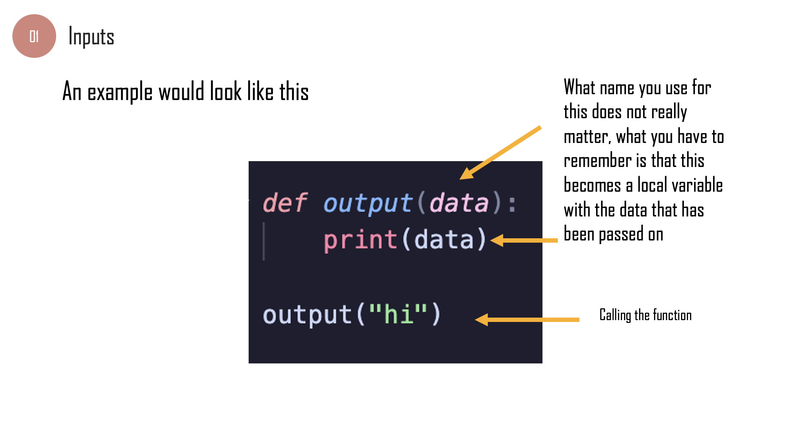
Functions

Slide 15
Packages
Time
Random

Slide 16



Slide 17
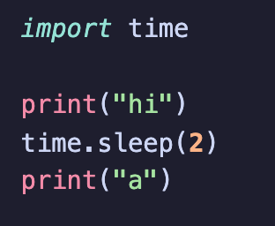
Time

Slide 18
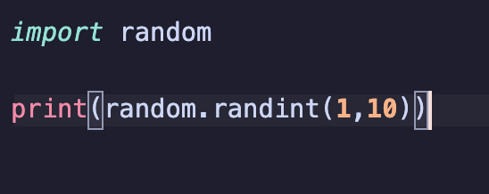
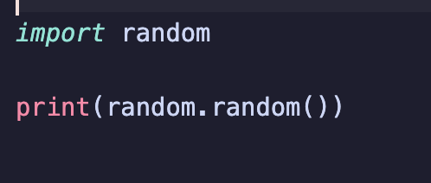
Random

Slide 19
Random
Write a while loop that will print 10 random numbers between 1 and 20

