Slide 1
NATIONAL ACADEMY (Our Faculty Our Family)
A way to success

Slide 2
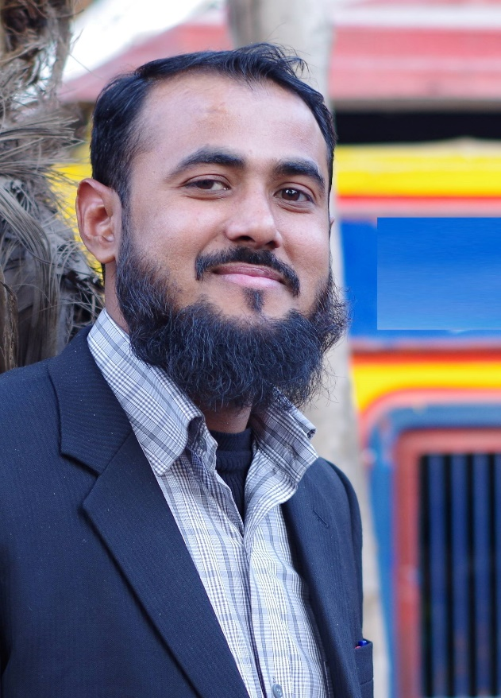
SIR Naveed Ahmad Siddiqui
Subjects: Urdu, Islamiat, Pak Studies, Arts
Qualification: M.A (Islamiat, Arabic), Persian Diploma
Teaching Experience: 12 years
2017 Result: 1st Year 2nd Year
Urdu 87/100 00
Islamiat: 47/50 00
Future Plan: Shadi

Slide 3
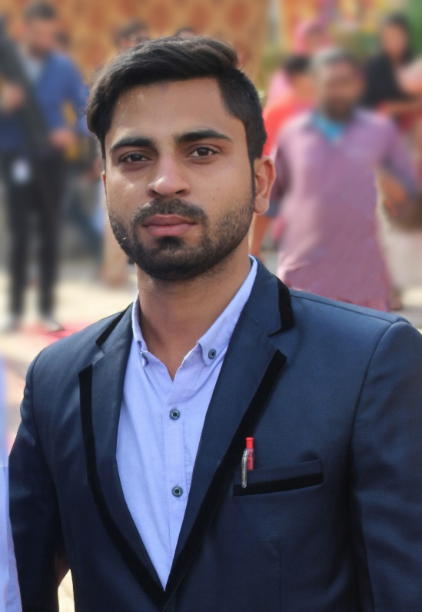
SIR WAQAS JAVAID
Subjects: Urdu, Pak Studies
Qualification: B.Com (Hons.)
Teaching Experience: 3 years
Latest Result: 48/50 (Waleed Saif)
Future Plan: MBA in Finance and PhD.

Slide 4
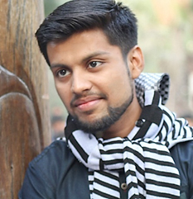
Sir Mehran Tariq (Mechanical Engineer )
Subjects: Chemistry (Matric)
Qualification: B.Sc Mechanical Engineering (UET Lahore)
Teaching Experience: 04 years and counting
2017 Result:
9th 60/60 ( Atif Naseer ) 59/60 (Ayesha Tahir)
10th 60/60 ( Rabia Tahir ) 60/60 (Amir Sohail)
11th 83/85 (Amna Shuaib) 92/85 (Iqra Mehmood)
Future Plan: MTO , MBA

Slide 5
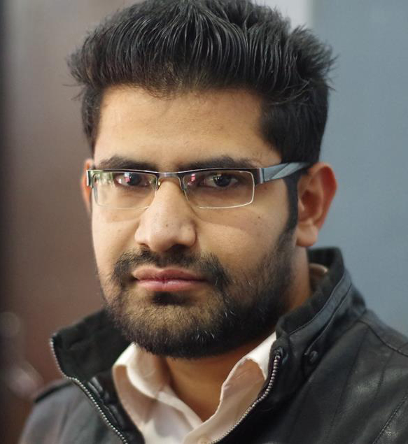
Sir Muneeb (Computer Scientist, IT Professional, Developer)
Subjects: Computer Science
Qualification: BSIT (Punjab University)
Teaching Experience: 03 years and counting
2017 Result: 73 | 75 ( Zargham Asim )
71 | 75 ( Ammar )
69 | 75 (Ayesha Haider)
Future Plan: to be a Researcher, Inventor & Innovator

Slide 6
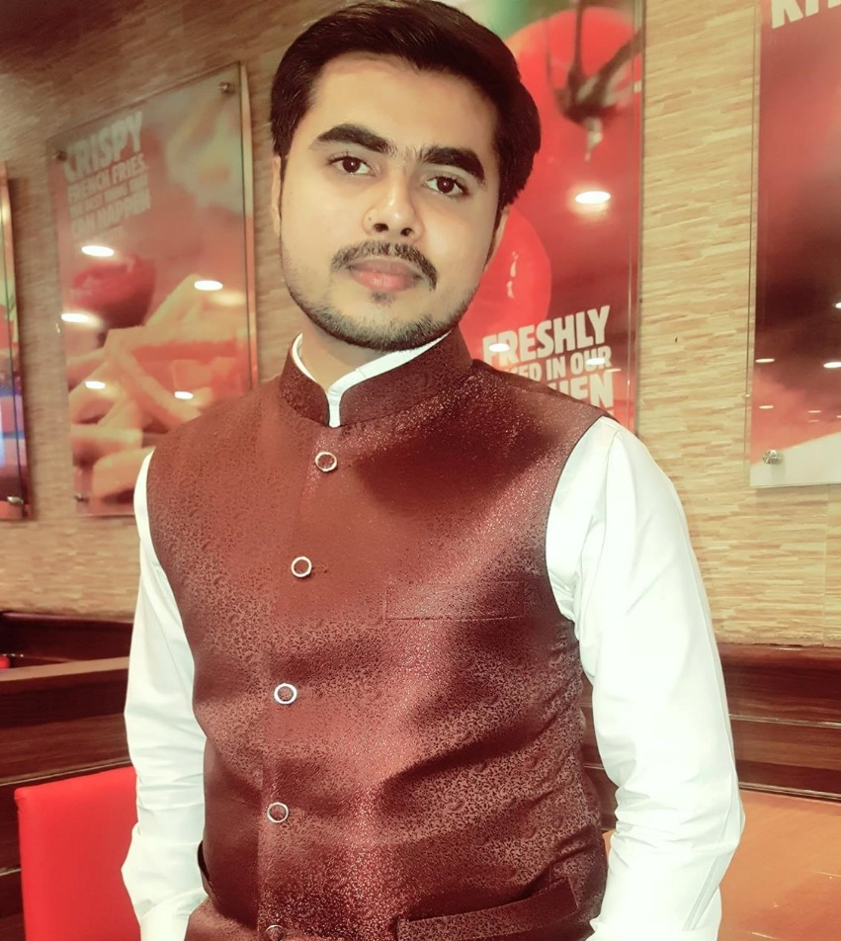
Sir Murtaza Ali (Computer Engineer & Developer)
Subjects: Computer Science & Physics
Qualification: BS-CS (GC-University)
Teaching Experience: 4-Years and counting..
2017 Result
9th 60/60 ( Atif Naseer ) 59/60 (Ayesha Tahir)
10th 59/60 ( Rabia Tahir ) 60/60 (Amir Sohail)
11th 84/85 (Zainab) 82/85 (Zargham Asim)
80/85 (Esha Tahir)
Future Plan: phD & Becoming a Professor

Slide 7
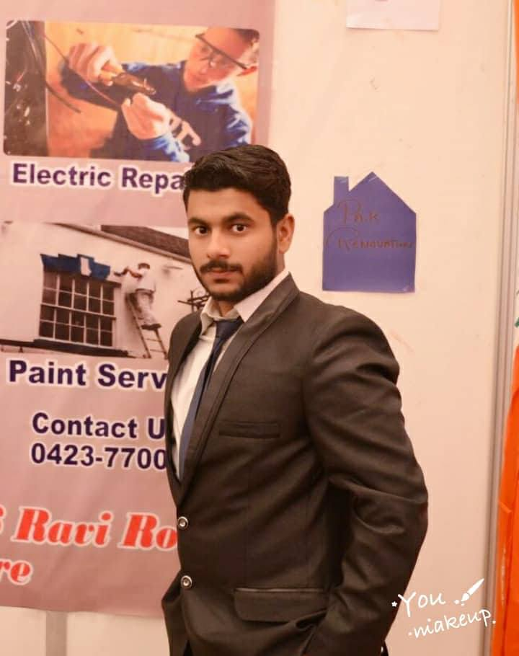
Sir Hussain Mughal()
Subjects:
Qualification: B.Com (Hons.)
M.Com Last year (Hailey College of Commerce)
Teaching Experience: 1 Year and Counting..
2017 Result:
86 | 100 (Haroon)
72 | 100 (Muskan Mehmood)
68 | 100 (Shohaib)
Future Plan:

Slide 8
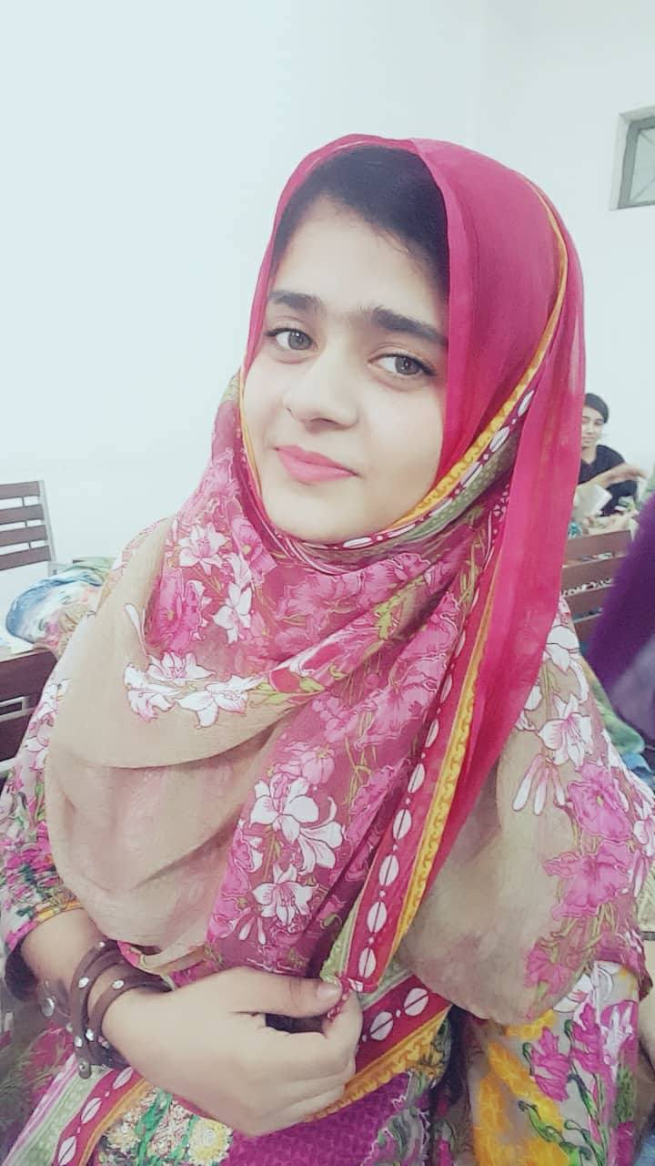
Miss Wasifa
Subjects: Physics
Qualification: BS-Physics (LCWU)
Teaching Experience: Fresh
Future Plan

Slide 9
OUR RESULTS THIS YEAR (2017)
9th Class
10th Class
 | Hajra Naeem | 489/505
 | Atif Naseer | 477/505
 | Abdullah Shaiq | 461/505
 | Rabia Tahir | 958/1100
 | Haris Zahid | 945/1100
 | Amir Sohail | 925/1100

Slide 10

OUR RESULTS THIS YEAR (2017)
1st Year
 | Zainab Butt | 464/505
 | Zargham Asim | 458/505
 | Esha Tahir | 453/505
Name | Marks | Name | Marks
Amna | 424/505 | Mahnoor | 411/505
Sehar | 417/505 | Rabia | 411/505
Minahil | 412/505 | Rafia | 400/505

Slide 11
Our Teachers
Senior Teachers
Sir Shahid Waseem
Sir Nasir
Sir Muneeb
Sir Hafiz Mehran Tariq
Sir Hashim
Sir Murtaza Ali
Sir Asif

Slide 12
Our Teachers
Middle Teachers
Sir Asad
Sir Hassan
Sir Fahad Tariq
Sir Fahad Amir
Sir Zeshan Asim
Sir Hamza
Sir Zohaib
Mis Fareeha
Sir Hussain
Sir Rehan
Sir Ali Raza

Slide 13
Our Teachers
Fresh Teachers
Miss Wasifa
Sir Mudassir
Sir Kamran
Sir Bilal
Sir Umer
Sir Fahad (Urdu)
Miss Farzeen
Miss Ayesha

