Slide 1
Weather and Uber/Lyft Ridership
John Cruz

Slide 2
Introduction
The National Oceanic and Atmospheric Administration
Heat index is the apparent temperature of what the temperature feels like to the human body when relative humidity is combined with the air temperature.
New York City subway platform during the summer can be 104 degrees, compared to 86 degrees outside
Alternative modes of transportation, particularly ridesharing companies such as Uber and Lyft.

Slide 3
Research Question
Does high heat index days (>=90 degrees) increase the number of trips taken with Uber or Lyft compared to non-high heat index days?

Slide 4
Data Sources
Weather (Oikolab)
Data was collected using Oikolab API historical data API service. It collects its data from the ECWMF and NOAA. Each case represents hourly weather measurements in August 2022.
Uber & Lyft Trips (NYC Taxi and Limousine Commission)
Data was collected using the available ‘parquet files’. The agency collects the data from Uber and Lyft. Each case represents a trip taken either via Uber or Lyft in the month of August 2022.

Slide 5
Variables
Dependent
The response variable is total trips and is numerical
Independent Variable(s) The independent variables are:
type_of_day: categorical
precipitation: numerical
day_of_week: categorical
Note: Other potential factors that are important but not included: special events (i.e. sporting event), major delays with public transportation (MTA Subway) or alternative transportation such as Citi bikes.

Slide 6
Required Libraries
library(tidyverse) library(arrow) library(lubridate) library(infer) library(psych)

Slide 7
Data Preparation
Historical Weather Data
Calculate Heat Index
Converted from Celsius to Fahrenheit.
Relative humidity
Calculated using the temperature and dewpoint temperature.
Heat index
Calculated using the temperature and relative humidity.
datetime_ny | temp_deg_f | rel_humidity | heat_idx | total_precip
2022-07-31 20:00:00 | 79.34 | 69.89607 | 82 | 0.0007874
2022-07-31 21:00:00 | 78.69 | 73.22915 | 81 | 0.0003937
2022-07-31 22:00:00 | 78.17 | 75.51439 | 80 | 0.0055118
2022-07-31 23:00:00 | 77.13 | 77.92819 | 78 | 0.0000000
2022-08-01 00:00:00 | 76.59 | 77.55404 | 78 | 0.0000000
2022-08-01 01:00:00 | 75.56 | 79.02121 | 77 | 0.0000000
Note: The data has been cleaned and filtered using weather_filter.Rmd

Slide 8
Uber and Lyft Trips
All the trips performed in August were found to be within two separate files for both August and September.
Day of Week
Determine the day of the week and transform the data type with factor levels.
The datetime_utc will also be updated to New York’s local time to match the trip records.
Trips were filtered because of huge outliers that were present such as:
Trip time had to be >0 seconds and <= 5 hours.
Trip miles had to be >= 0.
Driver pay > $0.01.
Base passenger fare > $0.01.
Pickup locations had to be within the NYC region and not unknown/outside of it.
pickup_datetime | total_trips | total_trip_dist | total_trip_time | total_base_fare
2022-08-01 00:00:00 | 16367 | 95228.86 | 16290733 | 392988.8
2022-08-01 01:00:00 | 9386 | 49653.46 | 8660832 | 191243.2
2022-08-01 02:00:00 | 6842 | 36202.17 | 6285157 | 140393.1
2022-08-01 03:00:00 | 5736 | 33645.40 | 5453926 | 131228.5
2022-08-01 04:00:00 | 6362 | 46159.03 | 6863760 | 206663.8
2022-08-01 05:00:00 | 10228 | 74357.79 | 11680789 | 317810.9
Note: The data has been cleaned and filtered using tlc_data_filter.Rmd

Slide 9
Merge Datasets
trip_weather_data <- tlc_trips |> left_join(weather, by = join_by(pickup_datetime == datetime_ny)) |> mutate(pickup_date = date(pickup_datetime)) |> select(!pickup_datetime) |> group_by(pickup_date) |> mutate(daily_trips = sum(total_trips), daily_trip_dist = sum(total_trip_dist), daily_trip_time = sum(total_trip_time), daily_base_fare = sum(total_base_fare), max_temp_deg_f = max(temp_deg_f), max_heat_idx = max(heat_idx), daily_precip = sum(total_precip), .keep = "none") |> distinct() |> mutate(type_of_day = ifelse(max_heat_idx >= 90, 'hot', 'not_hot'), day_of_week = factor(wday(pickup_date, label = TRUE, week_start = 1), ordered = FALSE)) trip_weather_data$day_of_week = relevel(trip_weather_data$day_of_week, ref='Mon') trip_weather_data$type_of_day = relevel(factor(trip_weather_data$type_of_day, ordered = FALSE), ref='not_hot') write_parquet(trip_weather_data, "trip_weather_data.parquet")

Slide 10
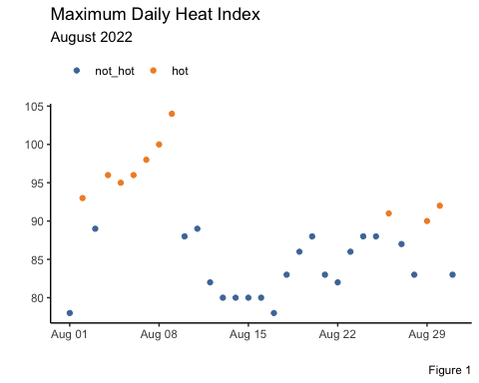
Summary Statistics
Maximum Daily Heat Index Highest Daily Heat Index throughout August 2022
trip_weather_data |> ggplot(aes(x = pickup_date, y = max_heat_idx, color = type_of_day)) + geom_point(stat = 'identity') + theme_classic() + labs(x = '', y ='', title = "Maximum Daily Heat Index", subtitle = "August 2022", caption = "Figure 1") + theme(legend.position = "top", legend.justification = c(0, 1)) + scale_color_manual(values = c('#4E79A7', '#F28E2B'), name = '')

Slide 11
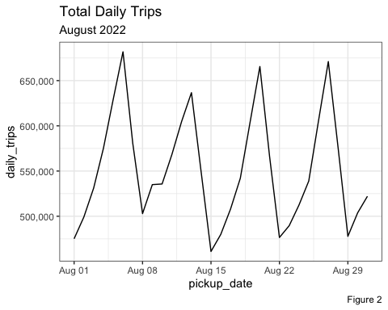
Total Daily Trips Total daily trips in August.
trip_weather_data |> ggplot(aes(x = pickup_date, y = daily_trips)) + geom_line(stat = 'identity') + scale_y_continuous(labels = scales::comma) + theme_bw() + labs(title = "Total Daily Trips", subtitle = "August 2022", caption = "Figure 2")

Slide 12
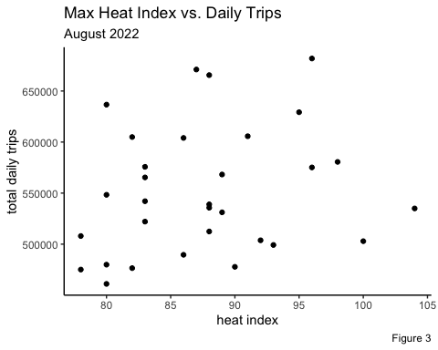
Heat Index vs. Daily Trips
trip_weather_data |> ggplot(aes(x = max_heat_idx, y = daily_trips)) + geom_point(stat = 'identity') + labs(title = 'Max Heat Index vs. Daily Trips', subtitle = 'August 2022', caption = "Figure 3", x = 'heat index', y = 'total daily trips') + theme_classic()

Slide 13
Observed Differences
comparison <- trip_weather_data |> group_by(type_of_day) |> summarise(avg_trips = mean(daily_trips), n = n()) knitr::kable(comparison, caption = "Observed Differences")
type_of_day | avg_trips | n
not_hot | 548213.7 | 21
hot | 559114.9 | 10

Slide 14
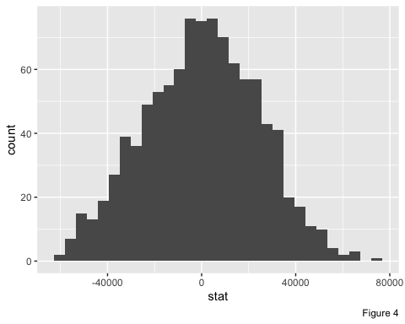
Hypothesis Testing
To test if the small increase of ridership is statistically significant, a hypothesis test will be used to confirm this. The test will utilize bootstrapping to create a normal distribution of the one-month sample.
set.seed(2023)
obs_diff <- trip_weather_data %>% specify(daily_trips ~ type_of_day) %>% calculate(stat = "diff in means", order = c("hot", "not_hot"))
null_dist <- trip_weather_data %>% specify(daily_trips ~ type_of_day) %>% hypothesize(null = "independence") %>% generate(reps = 1000, type = "permute") %>% calculate(stat = "diff in means", order = c("hot", "not_hot"))
ggplot(data = null_dist, aes(x = stat)) + geom_histogram(bins = 30) + labs(caption = "Figure 4")

Slide 15
T-Test
After confirming the normality of the distribution a two-tailed t-test will be performed.
t.test(daily_trips ~ type_of_day, data = trip_weather_data)
## ## Welch Two Sample t-test ## ## data: daily_trips by type_of_day ## t = -0.43742, df = 16.491, p-value = 0.6675 ## alternative hypothesis: true difference in means between group not_hot and group hot is not equal to 0 ## 95 percent confidence interval: ## -63605.41 41802.94 ## sample estimates: ## mean in group not_hot mean in group hot ## 548213.7 559114.9
Using a 95% confidence t-test, it tells us that we are unable to reject the null hypothesis and claim that a high heat index increases the total daily trips taken using Uber or Lyft. We see in the confidence interval, it includes zero, where as the p-value is also 0.6675 which is >0.05 alpha threshold.

Slide 16
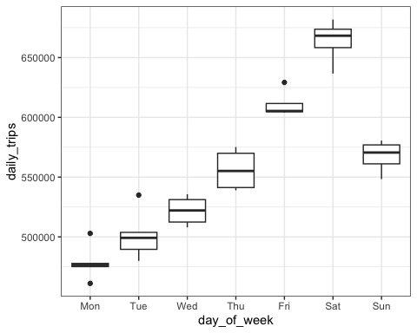
Even with the failure to reject the null hypothesis, there are other controlling variables to account for that may influence how a heat index may be prove to be useful.
A multiple linear regression model will be created to account for the previous seasonal variability accounted for in Figure 2.
This will factor out each day of the week, having Monday as the reference variable. Also included, will be the daily total precipitation.
ggplot(data = trip_weather_data, aes(x = day_of_week, y = daily_trips)) + geom_boxplot() + theme_bw()

Slide 17
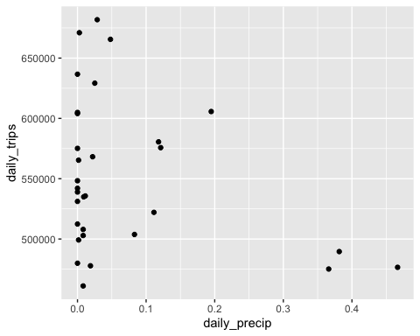
ggplot(data = trip_weather_data, aes(x = daily_precip, y = daily_trips)) + geom_point()

Slide 18
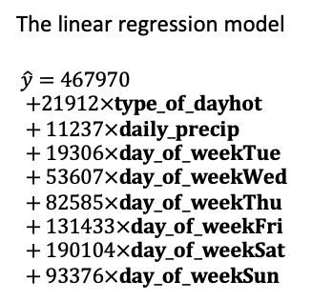
Linear Regression Model
lm_mod <- lm(daily_trips ~ type_of_day + daily_precip + day_of_week, data = trip_weather_data) summary(lm_mod)
## ## Call: ## lm(formula = daily_trips ~ type_of_day + daily_precip + day_of_week, ## data = trip_weather_data) ## ## Residuals: ## Min 1Q Median 3Q Max ## -21427 -8832 1532 7288 25691 ## ## Coefficients: ## Estimate Std. Error t value Pr(>|t|) ## (Intercept) 467970 7699 60.782 < 2e-16 *** ## type_of_dayhot 21912 5693 3.849 0.000871 *** ## daily_precip 11237 22534 0.499 0.622962 ## day_of_weekTue 19306 8518 2.267 0.033586 * ## day_of_weekWed 53607 9429 5.685 1.02e-05 *** ## day_of_weekThu 82585 9712 8.503 2.11e-08 *** ## day_of_weekFri 131433 9190 14.302 1.28e-12 *** ## day_of_weekSat 190104 9584 19.836 1.58e-15 *** ## day_of_weekSun 93376 9274 10.068 1.07e-09 *** ## --- ## Signif. codes: 0 '***' 0.001 '**' 0.01 '*' 0.05 '.' 0.1 ' ' 1 ## ## Residual standard error: 13140 on 22 degrees of freedom ## Multiple R-squared: 0.9671, Adjusted R-squared: 0.9551 ## F-statistic: 80.83 on 8 and 22 DF, p-value: 1.624e-14
The linear regression model
$\hat{y}=467970$
$$+21912×type_of_dayhot+11237×daily_precip+19306×day_of_weekTue+53607×day_of_weekWed+82585×day_of_weekThu+131433×day_of_weekFri+190104×day_of_weekSat+93376×day_of_weekSun$$

Slide 19
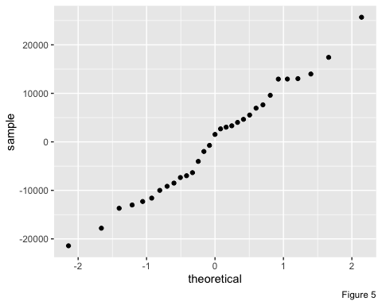
Checking Assumptions
Normality The Q-Q plot shows there is some “S” curvature within the band of residuals, but overall is straight.
ggplot(data = lm_mod, aes(sample = .resid)) + stat_qq() + labs(caption = "Figure 5")

Slide 20
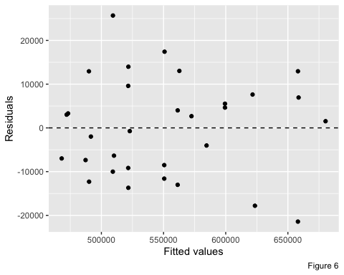
Constant variability The spread around zero does appear to have some heteroskedasticity as it is cone-shaped from the middle but overall nothing alarming.
ggplot(data = lm_mod, aes(x = .fitted, y = .resid)) + geom_point() + geom_hline(yintercept = 0, linetype = "dashed") + xlab("Fitted values") + ylab("Residuals") + labs(caption = "Figure 6")
Linearity It does not pass the linearity test as from Figure 3, there is not a linear shape for heat index and trips taken.

Slide 21
Conclusion
Heat index as a measure of trips taken…
Alone it does not seem to be an indicator of higher trips being taken via Uber and Lyft.
However, when controlling for the seasonal effects on the day of the week, it does become a good indicator of trip counts.
There are some concerns about the high results of the adjusted R^2 and small scale of data used.

Slide 22
Recommendations
For future research and without limitations to processing capacity, I would want to increase the data from being just using August 2022 and study the trends for a few years worth of summer data.
It is also important to that this analysis focuses on the unique environment of NYC but can the same be said for other hot climates such as Miami or Los Angeles.

