Slide 1
Weather and Rideshare Ridership
John Cruz

Slide 2
Introduction
The National Oceanic and Atmospheric Administration (‘NOAA’) defines the heat index as the apparent temperature of what the temperature feels like to the human body when relative humidity is combined with the air temperature. This has important considerations for the human body’s comfort. When the body gets too hot, it begins to perspire or sweat to cool itself off.
As for the New York City subway system during the summer, it is notoriously known to have unbearable temperatures where the platform can be 104 degrees, compared to 86 degrees outside (‘Curbed NY’).
Given the health risks, and general discomfort during high heat days, this project will look into alternative modes of transportation, particularly ridesharing companies such as Uber and Lyft.

Slide 3
Research question
Does high heat index days (>=90 degrees) increase the number of trips taken with Uber or Lyft compared to non-high heat index days?

Slide 4
Data Source
Weather (Oikolab)
Data was collected using Oikolab API historical data API service. It collects its data from the ECWMF and NOAA. Each case represents hourly weather measurements in August 2022.
Uber & Lyft Trips (NYC Taxi and Limousine Commission)
Data was collected using the available ‘parquet files’. The agency collects the data from Uber and Lyft. Each case represents a trip taken either via Uber or Lyft in the month of August 2022.

Slide 5
Type of study
This is an observational study.

Slide 6
Variables
Dependent The response variable is total trips and is numerical
Independent Variable(s) The independent variables are:
type_of_day: categorical
precipitation: numerical
day_of_week: categorical
Note: Other potential factors that are important but not included: special events (i.e. sporting event), major delays with public transportation (MTA Subway) or alternative transportation such as Citi bikes.

Slide 7
Required Libraries
library(tidyverse) library(arrow) library(lubridate) library(infer) library(psych)

Slide 8
Data Preparation
datetime_ny | temp_deg_f | rel_humidity | heat_idx | total_precip
2022-07-31 20:00:00 | 79.34 | 69.89607 | 82 | 0.0007874
2022-07-31 21:00:00 | 78.69 | 73.22915 | 81 | 0.0003937
2022-07-31 22:00:00 | 78.17 | 75.51439 | 80 | 0.0055118
2022-07-31 23:00:00 | 77.13 | 77.92819 | 78 | 0.0000000
2022-08-01 00:00:00 | 76.59 | 77.55404 | 78 | 0.0000000
2022-08-01 01:00:00 | 75.56 | 79.02121 | 77 | 0.0000000
Load Historical Weather Data
Calculate Heat Index
The measurements for the United States is generally in Fahrenheit. The weather data will be converted from Celsius to Fahrenheit using the weathermetrics library.
Relative humidity is calculated using the temperature and dewpoint temperature.
Heat index is calculated using the temperature and relative humidity.
Day of Week
Using the lubridate library, we will determine the day of the week and transform the data type with factor levels. The datetime_utc will also be updated to New York’s local time to match the trip records.
weather <- read_parquet('weather.parquet') |> janitor::clean_names() knitr::kable(head(weather))

Slide 9
app | pickup_floor | total_trips | avg_trip_dist | avg_trip_time | avg_base_fare
Lyft | 2022-08-01 00:00:00 | 5833 | 5.078416 | 1159.078 | 23.66116
Lyft | 2022-08-01 01:00:00 | 7857 | 4.311040 | 1137.815 | 21.77827
Lyft | 2022-08-01 02:00:00 | 7849 | 4.691822 | 1138.027 | 20.12130
Lyft | 2022-08-01 03:00:00 | 6947 | 4.977280 | 1203.712 | 19.93163
Lyft | 2022-08-01 04:00:00 | 6777 | 5.068789 | 1219.372 | 19.71429
Lyft | 2022-08-01 05:00:00 | 6737 | 5.054369 | 1225.231 | 20.44661
Load Uber and Lyft Trips
The NYC Taxi and Limousine Commission provides a data dictionary ‘here’. The rideshare app companies such as Uber is coded as (HV0003) and Lyft (HV0005).
Note: The data has been cleaned and filtered using the R script tlc_data_filter.R that is within the same GitHub repo. Here are the changes:
All the trips performed in August were found to be within two separate files for both August and September.
Trips were filtered because of huge outliers that were present such as:
Trip time had to be >0 seconds and <= 5 hours.
Trip miles had to be >= 0.
Driver pay > $0.01.
Base passenger fare > $0.01.
Pickup locations had to be within the NYC region and not unknown/outside of it.
tlc_trips <- read_parquet('tlc_trips.parquet')
tlc_trips_hourly <- tlc_trips |> group_by(app, pickup_floor) |> summarise(total_trips = n(), avg_trip_dist = mean(trip_miles), avg_trip_time = mean(trip_time), avg_base_fare = mean(base_passenger_fare)) knitr::kable(head(tlc_trips_hourly))

Slide 10
Merge Datasets
trip_weather_data <- tlc_trips_hourly |> left_join(weather, by = join_by(pickup_floor == datetime_ny)) |> mutate(type_of_day = ifelse(heat_idx >= 90, 'hot', 'not_hot')) seasonal <- trip_weather_data |> mutate(day_of_week = factor(wday(pickup_floor, label = TRUE, week_start = 1), ordered = FALSE)) seasonal$day_of_week = relevel(seasonal$day_of_week, ref='Mon') seasonal$type_of_day = relevel(factor(seasonal$type_of_day, ordered = FALSE), ref='not_hot') write_parquet(seasonal, "seasonal.parquet")

Slide 11
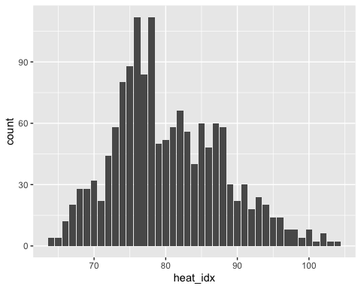
Summary Statistics
Count of hours for heat index throughout the month of August 2022.
seasonal |> mutate(hour = hour(pickup_floor)) |> group_by(heat_idx) |> summarise(count = n()) |> ggplot(aes(x = heat_idx, y = count)) + geom_bar(stat = 'identity')

Slide 12
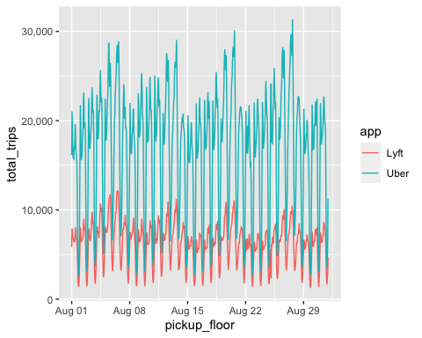
Count of trips by Uber and Lyft in August.
seasonal |> ggplot(aes(x = pickup_floor, y = total_trips, colour = app)) + geom_line(stat = 'identity') + scale_y_continuous(labels = scales::comma)

Slide 13
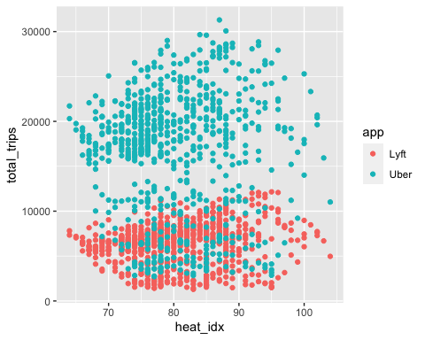
trip_weather_data |> ggplot(aes(x = heat_idx, y = total_trips, color = app)) + geom_point(stat = 'identity')

Slide 14
Observed Difference
seasonal |> group_by(type_of_day) |> summarise(avg_trips = mean(total_trips), n = n())
## # A tibble: 2 × 3 ## type_of_day avg_trips n ## <fct> <dbl> <int> ## 1 not_hot 11439. 1306 ## 2 hot 11893. 182

Slide 15
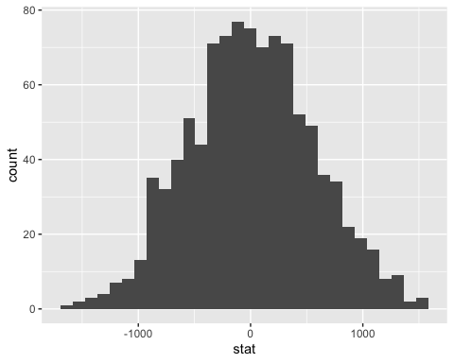
Hypothesis Testing
obs_diff <- seasonal %>% specify(total_trips ~ type_of_day) %>% calculate(stat = "diff in means", order = c("hot", "not_hot"))
null_dist <- seasonal %>% specify(total_trips ~ type_of_day) %>% hypothesize(null = "independence") %>% generate(reps = 1000, type = "permute") %>% calculate(stat = "diff in means", order = c("hot", "not_hot"))
ggplot(data = null_dist, aes(x = stat)) + geom_histogram(bins = 30)

Slide 16
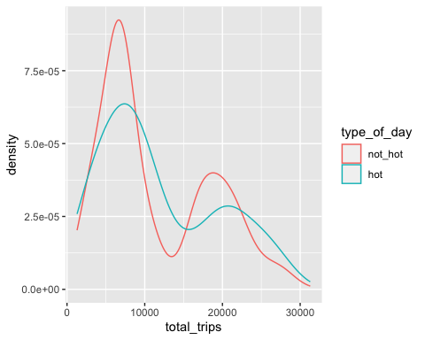
null_dist %>% get_p_value(obs_stat = obs_diff, direction = "two_sided")
## # A tibble: 1 × 1 ## p_value ## <dbl> ## 1 0.442
seasonal |> ggplot(aes(x = total_trips, color = type_of_day)) + geom_density()

Slide 17
t.test(total_trips ~ type_of_day, data = seasonal)
## ## Welch Two Sample t-test ## ## data: total_trips by type_of_day ## t = -0.76329, df = 229.14, p-value = 0.4461 ## alternative hypothesis: true difference in means between group not_hot and group hot is not equal to 0 ## 95 percent confidence interval: ## -1624.5442 717.3333 ## sample estimates: ## mean in group not_hot mean in group hot ## 11439.04 11892.65

Slide 18
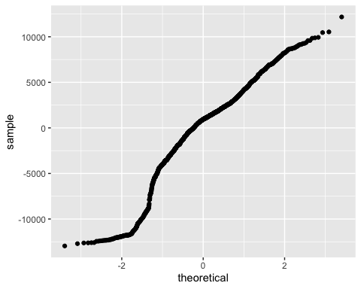
Linear Regression Model
lm_mod <- lm(total_trips ~ app + type_of_day + total_precip + day_of_week, data = seasonal) summary(lm_mod)
## ## Call: ## lm(formula = total_trips ~ app + type_of_day + total_precip + ## day_of_week, data = seasonal) ## ## Residuals: ## Min 1Q Median 3Q Max ## -12957.3 -2225.4 927.8 2733.5 12174.9 ## ## Coefficients: ## Estimate Std. Error t value Pr(>|t|) ## (Intercept) 4228.5 347.5 12.170 < 2e-16 *** ## appUber 10405.3 248.3 41.898 < 2e-16 *** ## type_of_dayhot 660.5 389.2 1.697 0.089847 . ## total_precip 30502.8 11501.3 2.652 0.008085 ** ## day_of_weekTue 838.0 441.5 1.898 0.057906 . ## day_of_weekWed 1553.8 446.0 3.483 0.000509 *** ## day_of_weekThu 2401.5 471.0 5.099 3.86e-07 *** ## day_of_weekFri 4136.5 467.3 8.852 < 2e-16 *** ## day_of_weekSat 4487.2 469.6 9.555 < 2e-16 *** ## day_of_weekSun 702.7 467.0 1.505 0.132586 ## --- ## Signif. codes: 0 '***' 0.001 '**' 0.01 '*' 0.05 '.' 0.1 ' ' 1 ## ## Residual standard error: 4790 on 1478 degrees of freedom ## Multiple R-squared: 0.5647, Adjusted R-squared: 0.562 ## F-statistic: 213 on 9 and 1478 DF, p-value: < 2.2e-16
Normality The Q-Q plot shows there is a strong “S” curvature in the left side of the band of residuals, especially -1 standard deviation away.
ggplot(data = lm_mod, aes(sample = .resid)) + stat_qq()

Slide 19
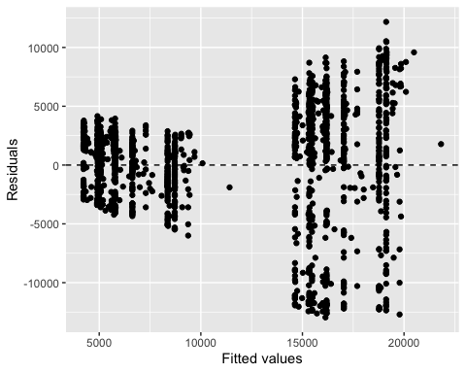
Constant variability The spread around zero does appear to have some heteroskedasticity as it is cone-shaped
ggplot(data = lm_mod, aes(x = .fitted, y = .resid)) + geom_point() + geom_hline(yintercept = 0, linetype = "dashed") + xlab("Fitted values") + ylab("Residuals")

Slide 20
Linearity It generally passes the linearity test but again because of the cone shape of the residuals, some caution needs to be used.

