Slide 1
Weather and Uber & Lyft Ridership
John Cruz

Slide 2
Introduction
The National Oceanic and Atmospheric Administration (‘NOAA’) defines the heat index as the apparent temperature of what the temperature feels like to the human body when relative humidity is combined with the air temperature. This has important considerations for the human body’s comfort. When the body gets too hot, it begins to perspire or sweat to cool itself off.
As for the New York City subway system during the summer, it is notoriously known to have unbearable temperatures where the platform can be 104 degrees, compared to 86 degrees outside (‘Curbed NY’).
Given the health risks, and general discomfort during high heat index days, this project will look into alternative modes of transportation, particularly ridesharing companies such as Uber and Lyft.

Slide 3
Research question
Does high heat index days (>=90 degrees) increase the number of trips taken with Uber or Lyft compared to non-high heat index days?

Slide 4
Data Source
Weather (Oikolab)
Data was collected using Oikolab API historical data API service. It collects its data from the ECWMF and NOAA. Each case represents hourly weather measurements in from 2021-2022.
Uber & Lyft Trips (NYC Taxi and Limousine Commission)
Data was collected using the available ‘parquet files’. The agency collects the data from Uber and Lyft. Each case represents a trip taken either via Uber or Lyft between 2021-2022.

Slide 5
Type of study
This is an observational study.

Slide 6
Variables
Dependent - total trips: numerical
Independent Variable(s) The independent variables are:
type_of_day: categorical
precipitation: numerical
day_of_week: categorical
month: categorical
year: categorical
Note: Other potential factors that are important but not included: special events (i.e. sporting event), major delays with public transportation (MTA Subway) or alternative transportation such as Citi bikes.

Slide 7
Required Libraries
library(tidyverse) library(arrow) library(DBI) library(lubridate) library(weathermetrics) library(infer) library(psych)

Slide 8
Data Preparation
datetime_ny | temp_deg_f | rel_humidity | heat_idx | total_precip
2021-01-01 00:00:00 | 32.63 | 73.61101 | 33 | 0
2021-01-01 01:00:00 | 31.35 | 75.52820 | 31 | 0
2021-01-01 02:00:00 | 31.05 | 76.68467 | 31 | 0
2021-01-01 03:00:00 | 30.51 | 78.82627 | 31 | 0
2021-01-01 04:00:00 | 30.58 | 79.00774 | 31 | 0
2021-01-01 05:00:00 | 25.43 | 87.89063 | 25 | 0
Load Historical Weather Data
Calculate Heat Index - Relative humidity is calculated using the temperature and dewpoint temperature. - Heat index is calculated using the temperature and relative humidity.
weather <- read_csv('data//oikolabs.csv') |> janitor::clean_names() weather <- weather |> mutate(temp_deg_f = celsius.to.fahrenheit(temperature_deg_c), rel_humidity = dewpoint.to.humidity(t = temperature_deg_c, dp = dewpoint_temperature_deg_c, temperature.metric = "celsius"), heat_idx = heat.index(t = temp_deg_f, rh = rel_humidity), total_precipitation_mm_of_water_equivalent = total_precipitation_mm_of_water_equivalent / 25.4) |> rename(total_precip = total_precipitation_mm_of_water_equivalent) weather <- weather |> mutate(day_of_week = wday(datetime_utc, label = TRUE, week_start = 1, abbr = FALSE), day_of_week = as.factor(day_of_week), datetime_ny = with_tz(datetime_utc, "America/New_York")) |> relocate(datetime_ny) |> select(datetime_ny, temp_deg_f, rel_humidity, heat_idx, total_precip) |> filter(between(datetime_ny, as.Date("2021-01-01"), as.Date("2022-12-31")))
Weather Data

Slide 9
pickup_datetime | total_trips | total_trip_dist | total_trip_time | total_base_fare
2021-01-01 00:00:00 | 30252 | 139167.71 | 26305805 | 512676.3
2021-01-01 01:00:00 | 35654 | 169601.16 | 31351009 | 700459.8
2021-01-01 02:00:00 | 33028 | 158558.99 | 28793246 | 639599.2
2021-01-01 03:00:00 | 26075 | 125819.15 | 22655554 | 452191.8
2021-01-01 04:00:00 | 16787 | 83757.50 | 14703813 | 314495.0
2021-01-01 05:00:00 | 12244 | 64789.97 | 10810829 | 270542.1
Load Uber and Lyft Trips
The NYC Taxi and Limousine Commission provides a data dictionary ‘here’. The rideshare app companies such as Uber is coded as (HV0003) and Lyft (HV0005).
Trips were filtered because of huge outliers that were present such as:
Trip time had to be >0 seconds and <= 5 hours.
Trip miles had to be >= 0.
Driver pay > $0.01.
Base passenger fare > $0.01.
Pickup locations had to be within the NYC region and not unknown/outside of it.
Given the large amounts of data to be processed, some of the data cleaning and filtering was done through DuckDB. DuckDB contains columnar-vectorized query execution engine where it allows for memory resources not to be severely depleted while trying to aggregate through the data. For more information visit ‘DuckDB’
cnxn = dbConnect(duckdb::duckdb(), dbdir=":memory:") dbExecute(cnxn, "CREATE VIEW tlc_trips AS SELECT CASE WHEN hvfhs_license_num == 'HV0003' THEN 'Uber' WHEN hvfhs_license_num == 'HV0005' THEN 'Lyft' ELSE 'Other' END AS app, pickup_datetime, dropoff_datetime, PULocationID, trip_miles, trip_time, base_passenger_fare FROM 'data\\*.parquet' WHERE trip_time >= 0 AND trip_time < 18000 AND trip_miles >= 0 AND driver_pay > 0.01 AND base_passenger_fare > 0.01 AND PULocationID NOT IN (264, 265)" )
## [1] 0
query <- "WITH floor_date AS( SELECT app, time_bucket(interval '1 hour', pickup_datetime) AS pickup_datetime, PULocationID, trip_miles, trip_time, base_passenger_fare FROM tlc_trips ) SELECT app, pickup_datetime, PULocationID, COUNT(*) as trips, SUM(trip_miles) AS trip_miles, SUM(trip_time) AS trip_time, SUM(base_passenger_fare) AS base_passenger_fare FROM floor_date GROUP BY app, pickup_datetime, PULocationID " db_trips <- dbGetQuery(cnxn, query) tlc_trips <- db_trips |> mutate(pickup_datetime = force_tz(pickup_datetime, tzone = 'America/New_York')) tlc_trips <- tlc_trips |> group_by(pickup_datetime) |> summarise(total_trips = sum(trips), total_trip_dist = sum(trip_miles), total_trip_time = sum(trip_time), total_base_fare = sum(base_passenger_fare)) knitr::kable(head(tlc_trips), caption = 'Uber & Lyft Trips')
Uber & Lyft Trips

Slide 10
total_trips | temp_deg_f | heat_idx | pickup_date | trip_dist | trip_time | base_fare | precip | type_of_day | day_of_week | month | year
403177 | 38.32 | 38 | 2021-01-01 | 1929395 | 354153513 | 7512445 | 0.3200787 | normal | Fri | Jan | 2021
329487 | 49.78 | 48 | 2021-01-02 | 1579836 | 313366813 | 5972419 | 0.1027559 | normal | Sat | Jan | 2021
297537 | 37.67 | 38 | 2021-01-03 | 1454448 | 267116540 | 5305180 | 0.2992126 | normal | Sun | Jan | 2021
317646 | 41.58 | 40 | 2021-01-04 | 1491053 | 304136151 | 5587092 | 0.0503937 | normal | Mon | Jan | 2021
333590 | 39.97 | 40 | 2021-01-05 | 1505182 | 320034529 | 5786943 | 0.0031496 | normal | Tue | Jan | 2021
352620 | 40.14 | 40 | 2021-01-06 | 1557586 | 339948313 | 6076668 | 0.0000000 | normal | Wed | Jan | 2021
Merge Datasets
The data from both sources will be merged together based on the datetime columns. It is important to note that due to the large size of source files, a parquet file of the cleaned data will be exported as trip_weather_data.parquet and provided in the repo. For the original files, access them from the previously mentioned methods.
trip_weather_data <- tlc_trips |> left_join(weather, by = join_by(pickup_datetime == datetime_ny)) |> mutate(pickup_date = date(pickup_datetime)) |> select(!pickup_datetime) |> group_by(pickup_date) |> mutate(total_trips = sum(total_trips), trip_dist = sum(total_trip_dist), trip_time = sum(total_trip_time), base_fare = sum(total_base_fare), temp_deg_f = max(temp_deg_f), heat_idx = max(heat_idx), precip = sum(total_precip), .keep = "none") |> distinct() |> mutate(type_of_day = case_when(heat_idx >= 90 ~ 'hot', .default = 'normal'), day_of_week = factor(wday(pickup_date, label = TRUE, week_start = 1), ordered = FALSE), day_of_week = fct_relevel(day_of_week, "Mon", "Tue", "Wed", "Thu", "Fri", "Sat", "Sun"), month = month(pickup_date, label = TRUE), year = year(pickup_date)) |> drop_na() trip_weather_data$day_of_week = relevel(trip_weather_data$day_of_week, ref='Mon') trip_weather_data$type_of_day = relevel(factor(trip_weather_data$type_of_day, ordered = FALSE), ref='normal') trip_weather_data$month = relevel(factor(trip_weather_data$month, ordered = FALSE), ref='Jan') trip_weather_data$year = relevel(factor(trip_weather_data$year, ordered = FALSE), ref='2021') write_parquet(trip_weather_data, "trip_weather_data.parquet") knitr::kable(head(trip_weather_data))

Slide 11
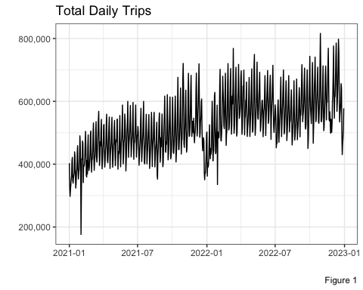
Summary Statistics
Total Daily Trips
Here we can see the total number of daily trips taken via Uber and Lyft in NYC between 2021-2022. There is a seasonality trend occurring between the dates that we will look further into.
trip_weather_data |> ggplot(aes(x = pickup_date, y = total_trips)) + geom_line(stat = 'identity') + scale_y_continuous(labels = scales::comma) + theme_bw() + labs(title = "Total Daily Trips", caption = "Figure 1", x = '', y = '')

Slide 12
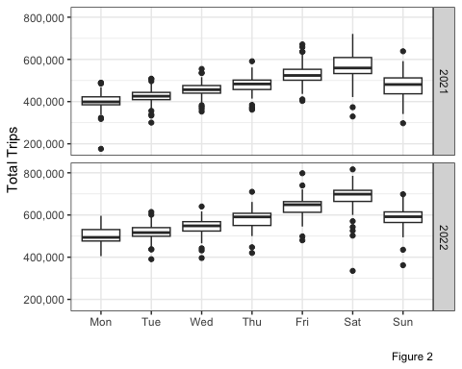
Day of the Week vs. Total Trips
Plotting each year’s total trips and the day of the week, we do see a seasonal trend where on average Monday’s have the lowest trip counts and it progressively increases until Sunday’s drop.
ggplot(aes(x = day_of_week, y = total_trips), data = trip_weather_data) + geom_boxplot() + facet_grid(rows = vars(year(pickup_date))) + theme_bw() + labs(x = '', y = 'Total Trips', caption = 'Figure 2') + scale_y_continuous(labels = scales::comma)

Slide 13
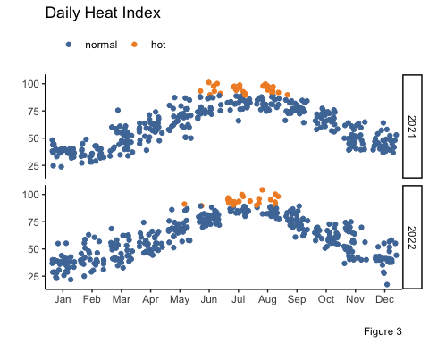
Daily Heat Index
Continuing looking into seasonal trends, we see both years have the same shape between the daily heat index and how it varies month to month. The high heat index months of interest is usually between late May until early August, which coincides with the summer months of NYC.
trip_weather_data |> ggplot(aes(x = month, y = heat_idx, color = type_of_day)) + geom_jitter(stat = 'identity') + facet_grid(rows = vars(year(pickup_date))) + theme_classic() + labs(x = '', y ='', title = "Daily Heat Index", caption = "Figure 3") + theme(legend.position = "top", legend.justification = c(0, 1)) + scale_color_manual(values = c('#4E79A7', '#F28E2B'), name = '')

Slide 14
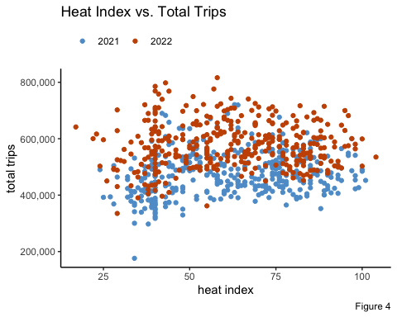
Heat Index vs. Daily Trips
Finally, let us look at the relationship of heat index to total number of trips. The scatter plot shows us that there is some bend initially as the heat index rises, but overall no strong trend. However, both years again follow the same seasonal patters.
trip_weather_data |> ggplot(aes(x = heat_idx, y = total_trips, color = year)) + geom_point(stat = 'identity') + labs(title = 'Heat Index vs. Total Trips', caption = "Figure 4", x = 'heat index', y = 'total trips') + theme_classic() + theme(legend.position = "top", legend.justification = c(0, 1)) + scale_color_manual(values = c('#5F9ED1', '#C85200'), name = '') + scale_y_continuous(labels = scales::comma)

Slide 15
type_of_day | avg_trips | n
normal | 526,154.8 | 678
hot | 520,064.5 | 51
Observed Difference
Viewing the observed difference, we can see out of two years worth of data, there were 51 days where the heat index was >= 90 degrees. However, on average, the trips taken on hot days compared to normal days were slightly lower by about 6,000 trips.
comparison <- trip_weather_data |> group_by(type_of_day) |> summarise(avg_trips = mean(total_trips), n = n()) knitr::kable(comparison, caption = "Observed Differences")
Observed Differences

Slide 16
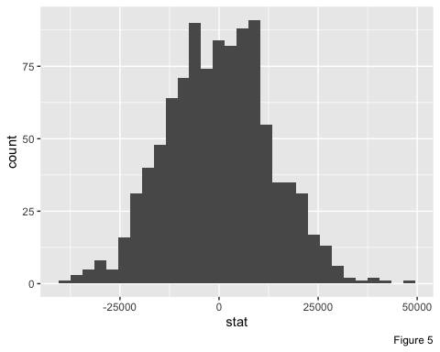
Hypothesis Testing
To test the observed differences between both high heat index days and non-high heat index days, a hypothesis test will be performed. To account for the possible differences in the two year data, a bootstrap was performed to account for such variability.
set.seed(2000)
obs_diff <- trip_weather_data %>% specify(total_trips ~ type_of_day) %>% calculate(stat = "diff in means", order = c("hot", "normal"))
null_dist <- trip_weather_data %>% specify(total_trips ~ type_of_day) %>% hypothesize(null = "independence") %>% generate(reps = 1000, type = "permute") %>% calculate(stat = "diff in means", order = c("hot", "normal"))
We can see through the histogram distribution, that our data is normally distributed.
ggplot(data = null_dist, aes(x = stat)) + geom_histogram(bins = 30) + labs(caption = "Figure 5")

Slide 17
After confirming the normality of the distribution a two-tailed t-test will be performed.
t.test(total_trips ~ type_of_day, data = trip_weather_data)
## ## Welch Two Sample t-test ## ## data: total_trips by type_of_day ## t = 0.56513, df = 63.91, p-value = 0.574 ## alternative hypothesis: true difference in means between group normal and group hot is not equal to 0 ## 95 percent confidence interval: ## -15439.73 27620.44 ## sample estimates: ## mean in group normal mean in group hot ## 526154.8 520064.5
Using a 95% confidence t-test, it tells us that we are unable to reject the null hypothesis and claim that a high heat index differs from non-high heat days. We see in the confidence interval (-15439.73, 27620.44), it includes zero, where as the p-value is also 0.6675 which is >0.05 alpha threshold.

Slide 18
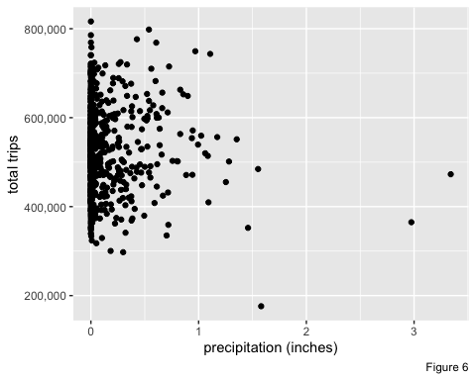
Alternative Heat Index Model
While we failed to reject the null hypothesis, using a t-test, there are other controlling variables to account for that may influence how a heat index may prove to be useful. A multiple linear regression model will be used to account for the seasonal variability in our previous figures. day_of_week will factor out each day of the week, having Monday as the reference variable, month will factor out each month of the year, having January as the reference variable and year, factoring out for the two year data collected, having 2021 as the reference variable. Lastly, total precipitation will be added as well.
Precipitation
Here we can see no linear trend of precipitation to total daily trips.
ggplot(aes(x = precip, y = total_trips), data = trip_weather_data) + geom_point() + labs(x = 'precipitation (inches)', y = 'total trips', caption = 'Figure 6') + scale_y_continuous(labels = scales::comma)

Slide 19
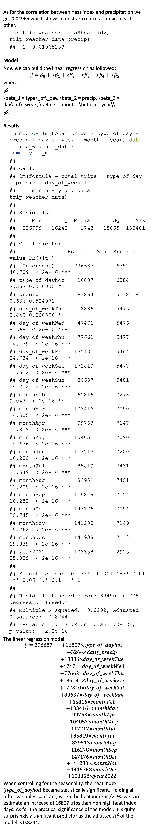
As for the correlation between heat index and precipitation we get 0.01965 which shows almost zero correlation with each other.
cor(trip_weather_data$heat_idx, trip_weather_data$precip)
## [1] 0.01965289
Model
Now we can build the linear regression as followed:
$$\hat{y}=β_{0}+xβ_{1}+xβ_{2}+xβ_{3}+xβ_{4}+xβ_{5}$$
where
$$ \beta_1 = type\_of\_day, \beta_2 = precip, \beta_3 = day\_of\_week, \beta_4 = month, \beta_5 = year\\ $$
Results
lm_mod <- lm(total_trips ~ type_of_day + precip + day_of_week + month + year, data = trip_weather_data) summary(lm_mod)
## ## Call: ## lm(formula = total_trips ~ type_of_day + precip + day_of_week + ## month + year, data = trip_weather_data) ## ## Residuals: ## Min 1Q Median 3Q Max ## -236799 -16242 1743 18865 130481 ## ## Coefficients: ## Estimate Std. Error t value Pr(>|t|) ## (Intercept) 296687 6352 46.709 < 2e-16 *** ## type_of_dayhot 16807 6584 2.553 0.010900 * ## precip -3264 5132 -0.636 0.524971 ## day_of_weekTue 18886 5476 3.449 0.000596 *** ## day_of_weekWed 47471 5476 8.669 < 2e-16 *** ## day_of_weekThu 77662 5477 14.179 < 2e-16 *** ## day_of_weekFri 135131 5464 24.734 < 2e-16 *** ## day_of_weekSat 172810 5477 31.552 < 2e-16 *** ## day_of_weekSun 80637 5481 14.712 < 2e-16 *** ## monthFeb 65816 7278 9.043 < 2e-16 *** ## monthMar 103416 7090 14.585 < 2e-16 *** ## monthApr 99763 7147 13.959 < 2e-16 *** ## monthMay 104052 7090 14.676 < 2e-16 *** ## monthJun 117217 7200 16.280 < 2e-16 *** ## monthJul 85819 7431 11.549 < 2e-16 *** ## monthAug 82951 7401 11.208 < 2e-16 *** ## monthSep 116278 7154 16.253 < 2e-16 *** ## monthOct 147176 7094 20.745 < 2e-16 *** ## monthNov 141280 7149 19.762 < 2e-16 *** ## monthDec 141938 7118 19.939 < 2e-16 *** ## year2022 103358 2925 35.339 < 2e-16 *** ## --- ## Signif. codes: 0 '***' 0.001 '**' 0.01 '*' 0.05 '.' 0.1 ' ' 1 ## ## Residual standard error: 39450 on 708 degrees of freedom ## Multiple R-squared: 0.8292, Adjusted R-squared: 0.8244 ## F-statistic: 171.9 on 20 and 708 DF, p-value: < 2.2e-16
The linear regression model
$$\begin{matrix}\hat{y}=296687 & +16807×type_of_dayhot \\ & −3264×daily_precip \\ & +18886×day_of_weekTue \\ & +47471×day_of_weekWed \\ & +77662×day_of_weekThu \\ & +135131×day_of_weekFri \\ & +172810×day_of_weekSat \\ & +80637×day_of_weekSun \\ & +65816×monthFeb \\ & +103416×monthMar \\ & +99763×monthApr \\ & +104052×monthMay \\ & +117217×monthJun \\ & +85819×monthJul \\ & +82951×monthAug \\ & +116278×monthSep \\ & +147176×monthOct \\ & +141280×monthNov \\ & +141938×monthDec \\ & +103358×year2022\end{matrix}$$
When controlling for the seasonality, the heat index (type_of_dayhot) became statistically significant. Holding all other variables constant, when the heat index is />=90 we can estimate an increase of 16807 trips than non high heat index days. As for the practical significance of the model, it is quite surprisingly a significant predictor as the adjusted $R^{2}$ of the model is 0.8244.

Slide 20
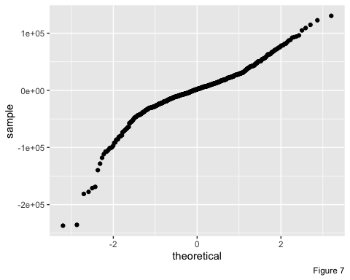
Checking Assumptions
Normality The Q-Q plot shows there is some “S” curvature within the band of residuals, but overall is straight.
ggplot(data = lm_mod, aes(sample = .resid)) + stat_qq() + labs(caption = "Figure 7")

Slide 21
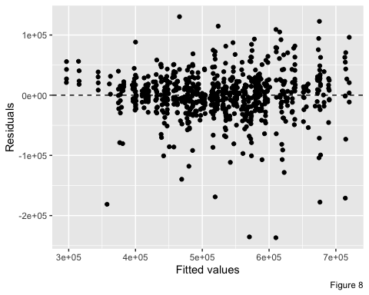
Constant variability The spread around zero does appear to have some heteroskedasticity as it is cone-shaped but overall nothing alarming.
ggplot(data = lm_mod, aes(x = .fitted, y = .resid)) + geom_point() + geom_hline(yintercept = 0, linetype = "dashed") + xlab("Fitted values") + ylab("Residuals") + labs(caption = "Figure 8")

Slide 22
Linearity It passes the linearity test, even though there is some initial curve in Figure 4.

Slide 23
Conclusion
When using the heat index as a measure of trips taken, it alone does not seem to be an indicator of higher trips being taken via Uber and Lyft. However, when controlling for the seasonal effects, it does become a statistically significant indicator of trip counts.
There are some concerns about the high results of the adjusted R^2 and the yearly data used. Since the years were being held constant, this is partially because of the recovery of the industry since the pandemic. Trip counts are not fully where it was prior and more investigating has to be performed to understand riders behaviors commuting around the NYC region. It is also important to be aware that this analysis focuses on the unique environment of NYC but can the same be said for other hot climates such as Miami or Los Angeles?

