Slide 1

非线性规划
Nonlinear Programming
——Matlab 优化工具箱
方利翔、吴鑫杰、屠嘉骏、胡明贵

Slide 2
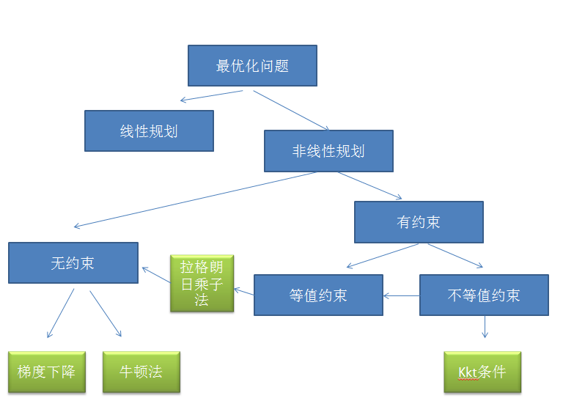
optimization problem
Nonlinear Programming
linear programming
Constrained
Unconstrained
lagrange multiplier
techniques
Unequal value constraint
Equivalent constraint
Newton's method
Karush-Kuhn-Tucker
gradient descent

Slide 3

Definition of Nonlinear Programming
Nonlinear programming is a method to solve the optimization problem of one or more non-linear functions in objective function or constraints.
非线性规划是一种求解目标函数或约束条件中有一个或几个非线性函数的最优化问题的方法。
比如非线性函数：$y=x^{2}+2x+1\text{的最小值}$
That is to say, the problem of non-linear optimization is to find the optimal value of a non-linear function. The solution is to derive the function, and then make the derivative zero, we find the extreme point.
就是说，非线性优化问题是针对一个非线性函数求最值的问题。求解方法就是对函数求导，再令导数为零，我们就找到了极值点。

Slide 4
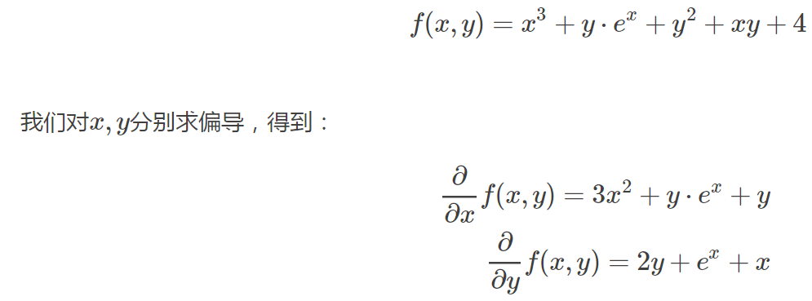
But for many cases, it is impossible to find the extremum point through zero derivative analysis.
但是对于很多情况，通过导数为零求解析的求出极值点，是做不到的。​​

Slide 5
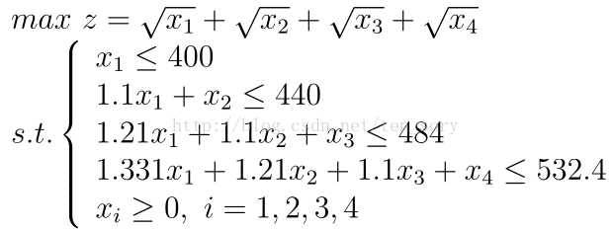
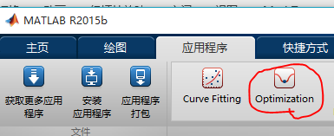
Solution by Toolbox
利用工具箱求解

Slide 6
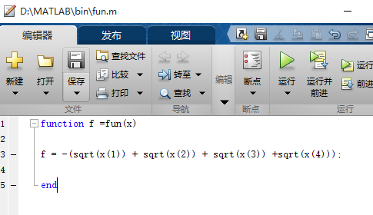
First step
Firstly, the M-function file of the objective function is compiled. Since the maximum value is obtained, it is first reduced to the minimum value problem, and then the negative sign is added before the original objective function. The M-function file is as follows, which is saved as fun.m.
首先，编写目标函数的M函数文件，由于求得是最大值，所以先化为求最小值问题，再原目标函数前面添加负号即可，M函数文件如下，保存为fun.m.

Slide 7
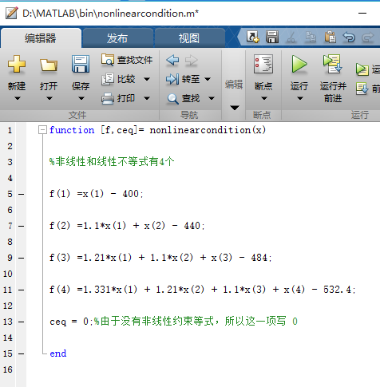
Second step
Write M-function files of linear and non-linear constrained inequalities that have been non-linear constrained equations and save them as ‘nonlineararcondition.m’
编写线性和非线性约束不等式已经非线性约束等式的M函数文件，保存为nonlinearcondition.m

Slide 8
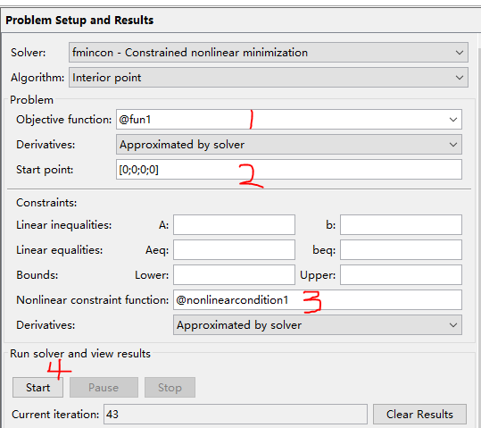
Third step

Slide 9
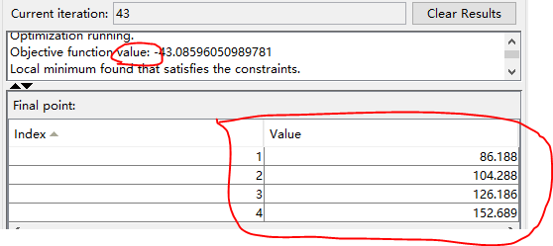
结果：

Slide 10
optimization problem
Nonlinear Programming
linear programming
Constrained
Unconstrained
lagrange multiplier
techniques
Unequal value constraint
Equivalent constraint
Newton's method
Karush-Kuhn-Tucker
gradient descent

Slide 11

Equivalent constraint
等值约束条件
设目标函数为f(x)，约束条件为hk(x)，如下：

Slide 12
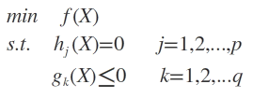
Unequal value constraint
不等式约束条件
设目标函数f(x)，不等式约束为g(x)，有的教程还会添加上等式约束条件h(x)。此时的约束优化问题描述如下：

Slide 13

Lagrange multiplier techniques
We define Lagrange multiplier techniques under inequality constraints, then L expression is:
The purpose of constructing Lagrange equation is to put constraints into objective function, so that the constrained optimization problem can be transformed into unconstrained optimization problem.
构造拉格朗日方程的目的是将约束条件放到目标函数中，从而将有约束优化问题转换为无约束优化问题。

Slide 14
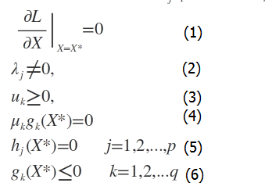
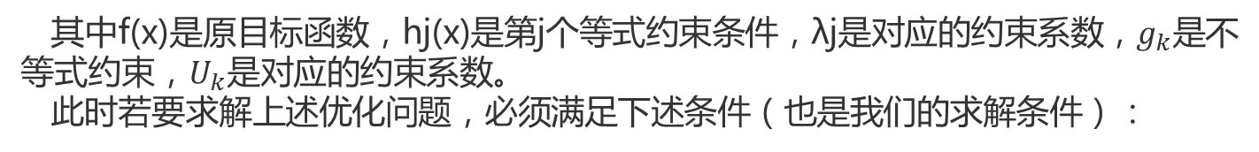
Karush-Kuhn-Tucher
Where f (x) is the original objective function, HJ (x) is the first equality constraint condition, lambda J is the corresponding constraint coefficient, GK is the inequality constraint, UK is the corresponding constraint coefficient.In order to solve the above-mentioned optimization problems, the following conditions must be satisfied (which is also our solution condition):
其中f(x)是原目标函数，hj(x)是第j个等式约束条件，λj是对应的约束系数，$g_{k}$是不等式约束，$U_{k}$是对应的约束系数。
此时若要求解上述优化问题，必须满足下述条件（也是我们的求解条件）：
这些求解条件就是KKT条件(Karush-Kuhn-Tucher)。(1)是对拉格朗日函数取极值时候带来的一个必要条件，(2)是拉格朗日系数约束（同等式情况），(3)是不等式约束情况，(4)是互补松弛条件，(5)、(6)是原约束条件。

Slide 15


拉格朗日乘子法
具体方法
然后，解变量的偏导方程：
If there are I constraints, there should be I + 1 equation. The solution of the equation system may be the optimal value (the extreme value mentioned in higher mathematics). The solution can be obtained by bringing the result back to the original equation for verification.
如果有i个约束条件，就应该有i+1个方程。求出的方程组的解就可能是最优化值（高等数学中提到的极值），将结果带回原方程验证就可得到解。

Slide 16
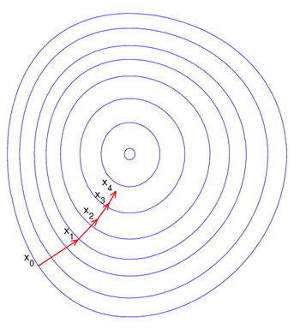
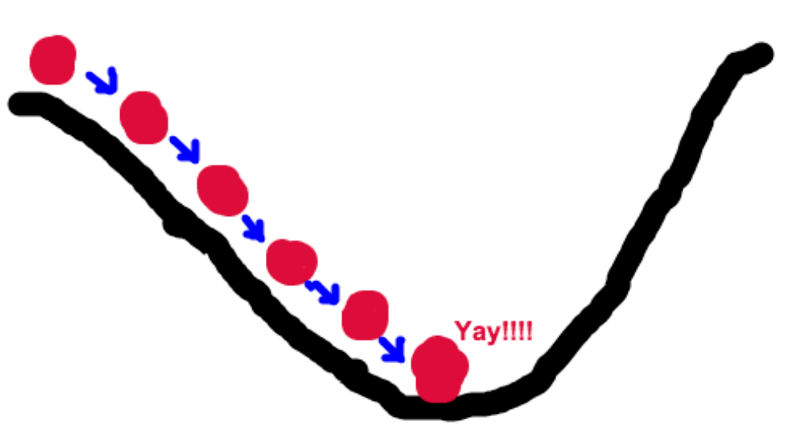
gradient descent
梯度下降
Let's imagine a scenario where a person needs to come down from a mountain. At this point, he can use the gradient descent algorithm to help himself down the hill. Specifically speaking, based on his current position, that is, to climb to the top of the mountain, then we should go up in the steepest direction at this time. Then every time you walk a certain distance, you repeat the same method, and finally you can reach the valley successfully.
假设这样一个场景：一个人需要从山上下来。这个时候，他就可以利用梯度下降算法来帮助自己下山。具体来说就是，以他当前的所处的位置为基准，寻找这个位置最陡峭的地方，然后朝着山的高度下降的地方走，同理，如果我们的目标是上山，也就是爬到山顶，那么此时应该是朝着最陡峭的方向往上走。然后每走一段距离，都反复采用同一个方法，最后就能成功的抵达山谷。

Slide 17
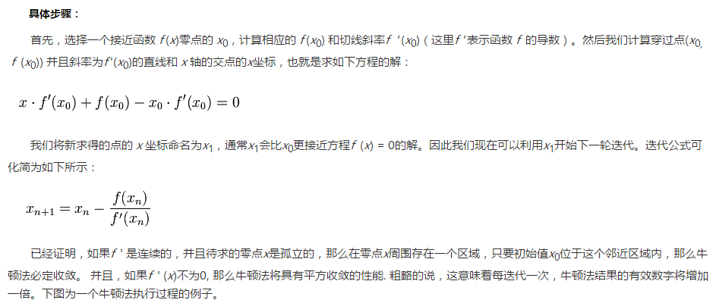
牛顿法（Newton's method）
Newton's method is an approximate method for solving equations in real and complex fields. Methods The first several terms of Taylor series of function f (x) are used to find the root of equation f (x) = 0. The most important feature of Newton's method is its fast convergence rate.
牛顿法是一种在实数域和复数域上近似求解方程的方法。方法使用函数f (x)的泰勒级数的前面几项来寻找方程f (x) = 0的根。牛顿法最大的特点就在于它的收敛速度很快。

Slide 19
Thank you！

