Slide 1
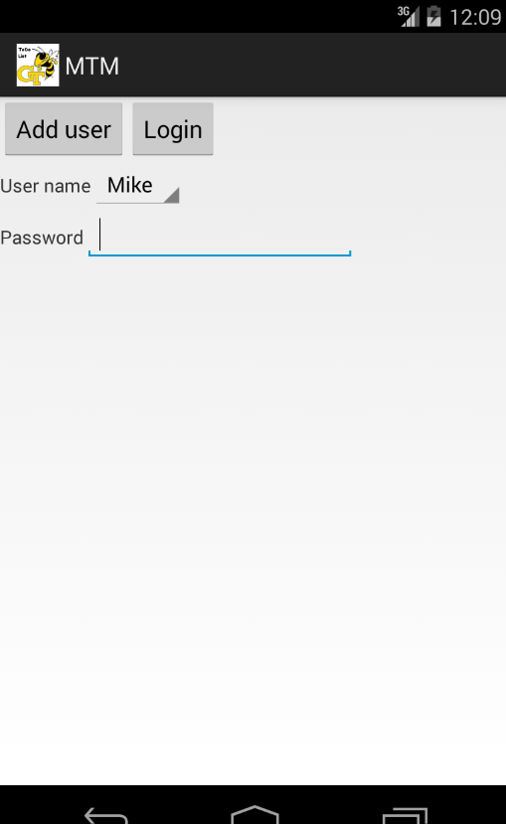
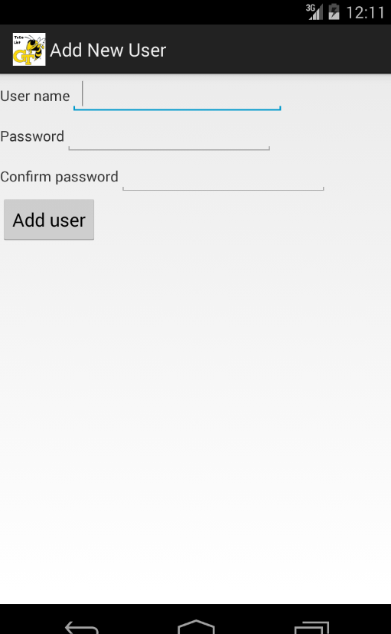
Screen #1. Main
Screen #2. Add New User

Slide 2
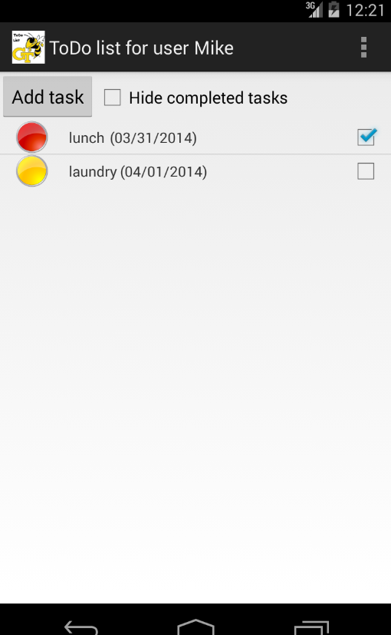
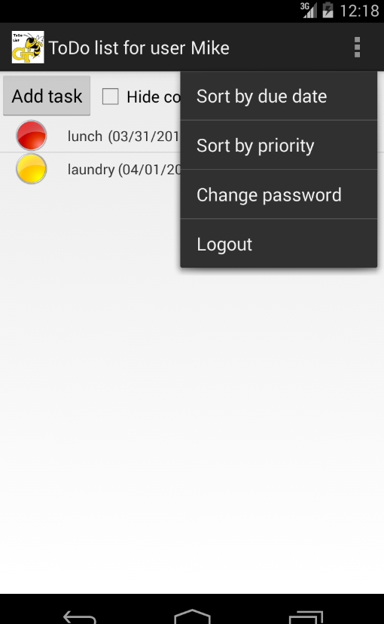
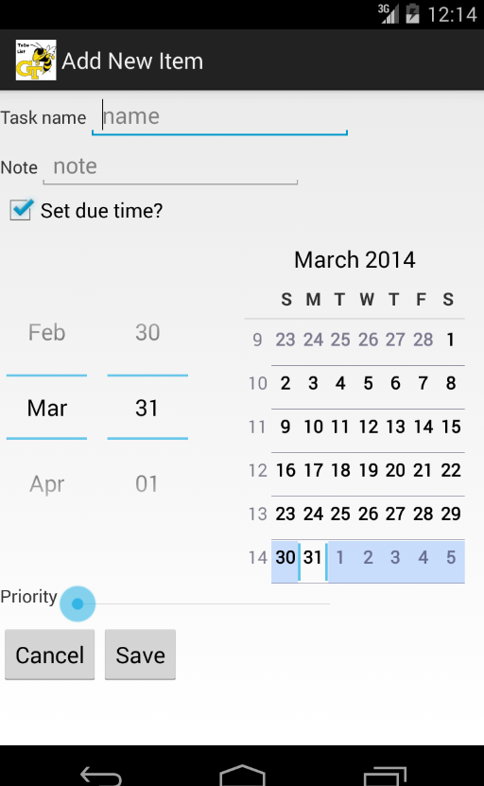
Screen #3-1. View List for All Tasks
Screen #3-2. Action Bar Options
Screen #4. Add New Item

