Slide 1
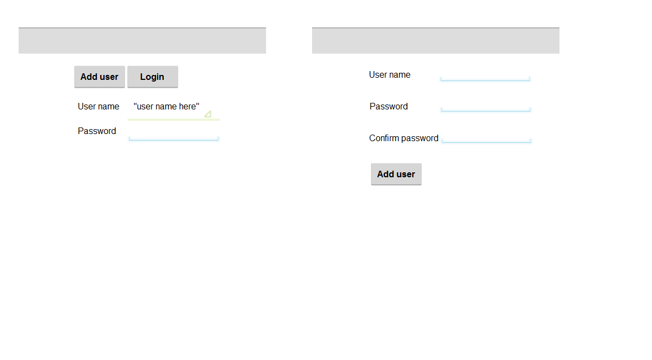

Screen #1. Main
WTM

Slide 2
Screen #2. Add New User
Add New User

Slide 3
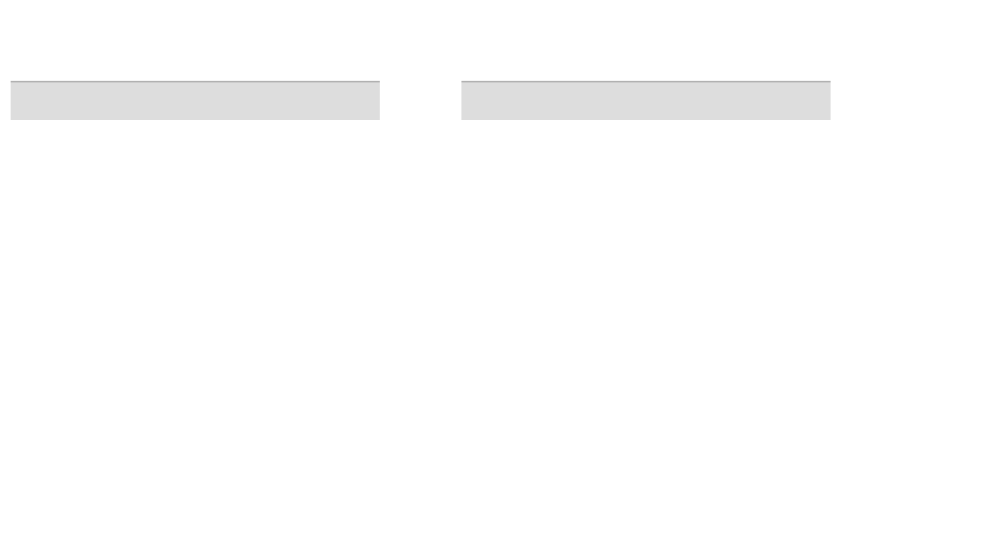
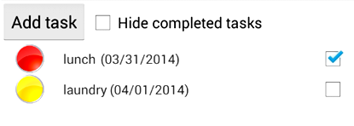
Screen #3-1. View List for All Tasks
ToDo list for user

Slide 4
Screen #3-2. Action Bar Options
ToDo list for user
Sort by due date
Sort by priority
Change password
Logout

Slide 5

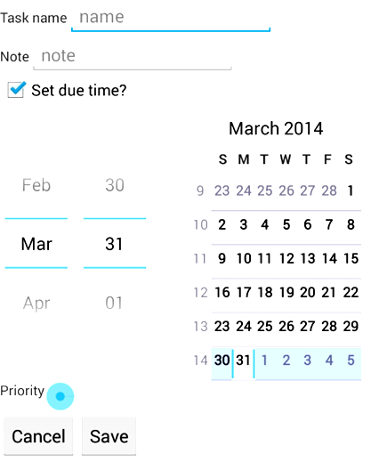
Screen #4. Add New Item
Add New Item

