Slide 1
Rev2 DATA
Number of users,items and relevant graphs

Slide 2
 | Music Instruments | Amazon video | Digital Music | Patio,Lawn,garden | Automotive | Beauty | Toys and games | Health and care | Cell phones
reviews | 500,176 | 583,933 | 836,006 | 993,490 |  |  | 2,252,771 | 2,982,326 | 3,447,249
No. users | 339231 | 426922 | 478235 | 714791
No. items | 83046 | 23965 | 266414 | 105984

Slide 3
 | # REVIEWS | # REVIEWERS | # PRODUCTS | TIME Ranges | # BENIGN/FRAUDSTER
ALPHA | 24185 | 3285 | 3754 | Min: 2010-11-08 00:00:00 Max: 2016-01-22 00:00:00 | 137/102
OTC | 35591 | 4814 | 5858 |  | 135/180
EPINIONS | 13668103 | 120486 | 132585 | Min:2001/0 max:2002/05/30 | 9291/1012
AMAZON | 568453 | 256058 | 74257 | Min:1999-10-07 20:00:00 Max: 2012-10-25 20:00:00 | 2357/241

Slide 4
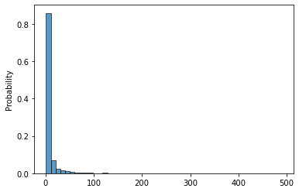
ALPHA_NUM OF SRC

Slide 5
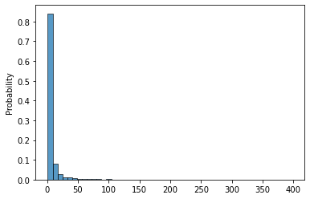
ALPHA_NUM OF DEST

Slide 6
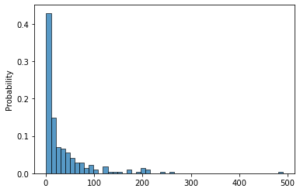
ALPHA_NUM OF SRC FILTERED FROM GT

Slide 7
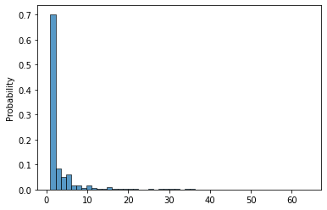
ALPHA_NUM OF DEST FILTERED FROM GT

Slide 8
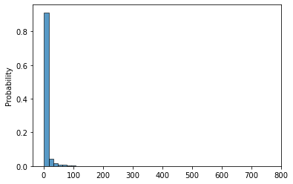
OTC _NUM OF SRC

Slide 9
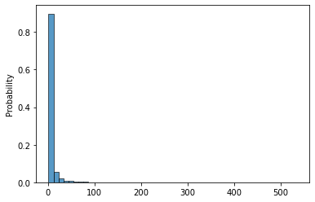
OTC _NUM OF DEST

Slide 10
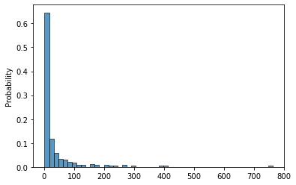
OTC _NUM OF SRC FILTERED FROM GT

Slide 11
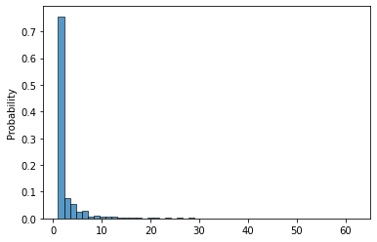
OTC _NUM OF DEST FILTERED FROM GT

Slide 12
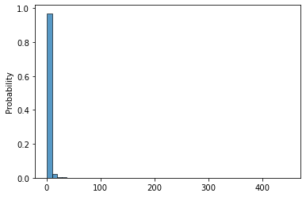
AMAZON_NUM OF SRC

Slide 13
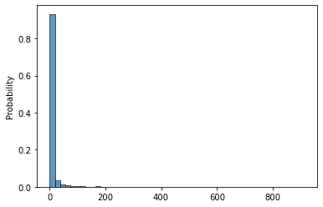
AMAZON _NUM OF DEST

Slide 14
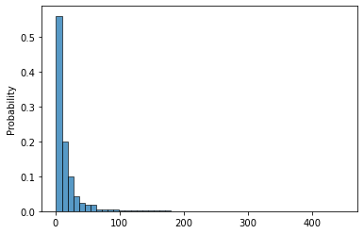
AMAZON_NUM OF SRC FILTERED FROM GT

Slide 15
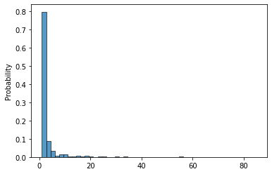
AMAZON_NUM OF DEST FILTERED FROM GT

Slide 16
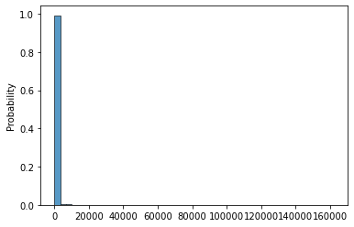
EPINIONS _NUM OF SRC

Slide 17
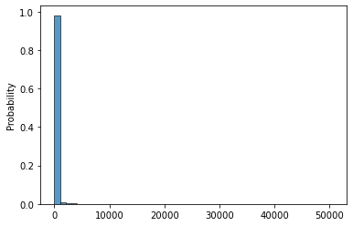
EPINIONS _NUM OF DEST

Slide 18
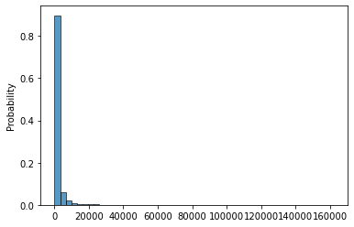
EPINIONS _NUM OF SRC FILTERED FROM GT

Slide 19
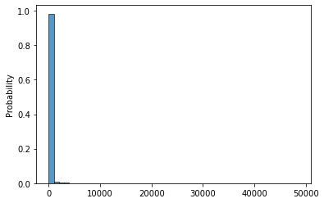
EPINIONS _NUM OF DEST FILTERED FROM GT

