Slide 1
Sockfarm

Slide 2
Implement the interactive environment

Slide 3
Sockpuppet identification algorithms
Rev2: Srijan Kumar, et al. REV2: Fraudulent User Prediction in Rating Platforms. (WSDM 2018)
Bad: Abhinav Mishra, Arnab Bhattacharya. Finding the Bias and Prestige of Nodes in Networks based on Trust Scores. (WWW 2011)
Birdnest: Bryan Hooi, et al. Bayesian Inference for Ratings-Fraud Detection. (SIAM 2016)
Trust: Guan Wang, Sihong Xie, Bing Liu, Philip Yu. Review graph based online store review spammer detection. (ICDM 2011)
FraudEagle: Leman Akoglu et al. Opinion Fraud Detection in Online Reviews by Network Effects. (AAAI 2013)
FRAUDAR: Bryan Hooi et al. Fraudar: Bounding Graph Fraud in the Face of Camouflage. (KDD 2016)

Slide 4
More recent works
FdGars: Fraudster Detection via Graph Convolutional Networks in Online App Review System (WWW’19)
Enhancing Graph Neural Network-based Fraud Detectors against Camouflaged Fraudsters (CIKM’20)
Fraudulent User Detection on Rating Networks Based on Expanded Balance Theory and GCNs (ASONAM’19)
DeepTrust: An Automatic Framework to Detect Trustworthy Users in Opinion-based Systems (CODASPY’20)
Recommending Inferior Results: A General and Feature-Free Model for Spam Detection (CIKM’20)
Graph Convolutional Networks with Markov Random Field Reasoning for Social Spammer Detection (AAAI’20)
Robust Spammer Detection by Nash Reinforcement Learning (KDD’20)

Slide 5
FdGars: Fraudster Detection via Graph Convolutional Networks in Online App Review System (WWW’19)
Authors:
Jianyu Wang, Rui Wen, Chunming Wu, Yu Huang, Jian Xiong
Data:
Tencent App Store
GNN based
Features to construct graph:
Content features
Text
Behavior features
Review time distribution
Score distribution
Code available
Yes

Slide 6
Enhancing Graph Neural Network-based Fraud Detectors against Camouflaged Fraudsters (CIKM’20)
Authors:
Yingtong Dou, Zhiwei Liu , Li Sun, Yutong Deng, Hao Peng , Philip S. Yu
Data:
Yelp (45,954 reviews) and Amazon (11,944 reviews)
GNN based
Features to construct graph:
Content features
Text
Relation features
Review same product with similar ratings
Code available
Yes

Slide 7
Fraudulent User Detection on Rating Networks Based on Expanded Balance Theory and GCNs (ASONAM’19)
Authors:
Wataru Kudo, Mao Nishiguchi, Fujio Toriumi
Data:
OTC, ALPHA, Amazon, Epinions (exactly same)
GNN based
2-hop signed GCN
Code available:
No

Slide 8
DeepTrust: An Automatic Framework to Detect Trustworthy Users in Opinion-based Systems (CODASPY’20)
Authors:
Edoardo Serra, Anu Shrestha, Francesca Spezzano, Anna Squicciarini
Data:
Amazon (5.5k reviewers, 65.6k reviews)
GNN based
Features:
Graph is bipartite
Temporal information of user behavior
Code available
No

Slide 9
Robust Spammer Detection by Nash Reinforcement Learning (KDD’20)
Authors:
Yingtong Dou, Guixiang Ma, Philip S. Yu, Sihong Xie
Data:
Yelp (45,954 reviews)
Unsupervised, game theory
Code available
Yes

Slide 10
Data at http://odds.cs.stonybrook.edu/
YelpCHI | 67,395 hotel and restaurant reviews | Reviews from Yelp.com for Chicago Hotels and Restaurants.
YelpNYC | 359,052 restaurant reviews | Reviews from Yelp.com for NYC restaurants
YelpZip | 608,598 restaurant reviews | Zip code wise reviews from Yelp.com for NY, NJ, VT, CT, and PA.
YelpAcademic | 2.7M yelp reviews | Reviews of various businesses from Yelp.com for academic challenge.
AmazonReview | 34,686,770 product reviews | Reviews from Amazon.com
SWMReview | 1, 132, 373 reviews | SWM Review dataset contains reviews under the entertainment category from a popular online software marketplace.
BeerAdvocate | 1,586,259 beer reviews | Beer reviews from BeerAdvocate
RateBeer | 2,924,127 beer reviews | Beer reviews from RateBeer
CellarTracker | 2,025,995 wine reviews | Wine reviews from CellarTracker
FineFoods | 568,454 food reviews | Food reviews from Amazon
Movies | 7,911,684 movie reviews | Movie reviews from Amazon
requested
No ground truth
Not available anymore

Slide 11
Data
 | # REVIEWS | # REVIEWERS | # PRODUCTS | TIME Ranges | # BENIGN/FRAUDSTER
ALPHA | 24185 | 3285 | 3754 | Min: 2010-11-08 00:00:00 Max: 2016-01-22 00:00:00 | 137/102
OTC | 35591 | 4,814 | 5,858 |  | 135/180
EPINIONS | 13,668,103 | 120,486 | 132,585 | Min:2001/0 max:2002/05/30 | 9291/1012
AMAZON | 568,453 | 256,058 | 74,257 | Min:1999-10-07 20:00:00 Max: 2012-10-25 20:00:00 | 2357/241

Slide 12
To evaluate sockfarm and defense
Compare the overall performance (existing accounts + new created accounts):
Performance under no attack
Performance under naïve attacks
Performance under sockfarm
Performance under sockfarm and defense
Performance is evaluated on a time base
Precision, Recall, F1 score at K (or @ q, same as RTV)

Slide 13
Process to evaluate
Partition the data on time basis (10 folds) evenly and use rolling window (6 folds for each window)
Alpha: 2010-11-08 -> 2016-01-22
Epinions: 2001 -> 2002-05-30
Amazon: 1999-10-17 -> 2012-10-25
For each data split, we apply attacks
No attack
Naïve attack
Sockfarm attack
Evaluate the metrics after attacks
Precision, recall, f1 score

Slide 14
Baseline attacks
Requests:
Targeting certain products to boost the review score and to promote the revenue (giving maximum score)
Baseline attacks
It receives a set of requests
It has an amount of budget
It creates a set of sockpuppets parametrized by costs
It randomly picks sockpuppets to review products by ILP
It does not minimize the detectability for sockpuppets

Slide 15
Sockfarm attacks
Sockfarm
It has a set of requests for certain product
It wisely creates sockpuppets
It wisely picks sockpuppets to review products
The output is pairs of (sockpuppet, product)
It minimizes the detectability for sockpuppets
It maximizes reward given the cost: reward – cost

Slide 16
Results are updated in experiments.xlsx

Slide 17
Fraudar - ALPHA
FRAUDAR
budget | 100 | 200 | 300 | 400
Precision
no-attack | 0.368 | 0.376 | 0.376 | 0.376
baseline-0.2 | 0.359 | 0.37 | 0.376 | 0.379
baseline-0.4 | 0.368 | 0.364 | 0.378 | 0.369
baseline-0.6 | 0.37 | 0.363 | 0.396 | 0.372
baseline-0.8 | 0.368 | 0.371 | 0.405 | 0.363
sockfarm | 0.366 | 0.366 | 0.366 | 0.366
sockdef | 0.42 | 0.376 | 0.376 | 0.378
Recall
no-attack | 0.877 | 0.917 | 0.917 | 0.917
baseline-0.2 | 0.726 | 0.669 | 0.616 | 0.572
baseline-0.4 | 0.662 | 0.526 | 0.47 | 0.389
baseline-0.6 | 0.597 | 0.437 | 0.411 | 0.306
baseline-0.8 | 0.535 | 0.391 | 0.37 | 0.241
sockfarm | 0.421 | 0.278 | 0.208 | 0.166
sockdef | 0.598 | 0.31 | 0.231 | 0.185
F1-Score
no-attack | 0.519 | 0.533 | 0.533 | 0.533
baseline-0.2 | 0.481 | 0.476 | 0.467 | 0.455
baseline-0.4 | 0.473 | 0.43 | 0.419 | 0.379
baseline-0.6 | 0.457 | 0.396 | 0.403 | 0.336
baseline-0.8 | 0.436 | 0.38 | 0.384 | 0.29
sockfarm | 0.364 | 0.289 | 0.239 | 0.204
sockdef | 0.489 | 0.34 | 0.286 | 0.248

Slide 18
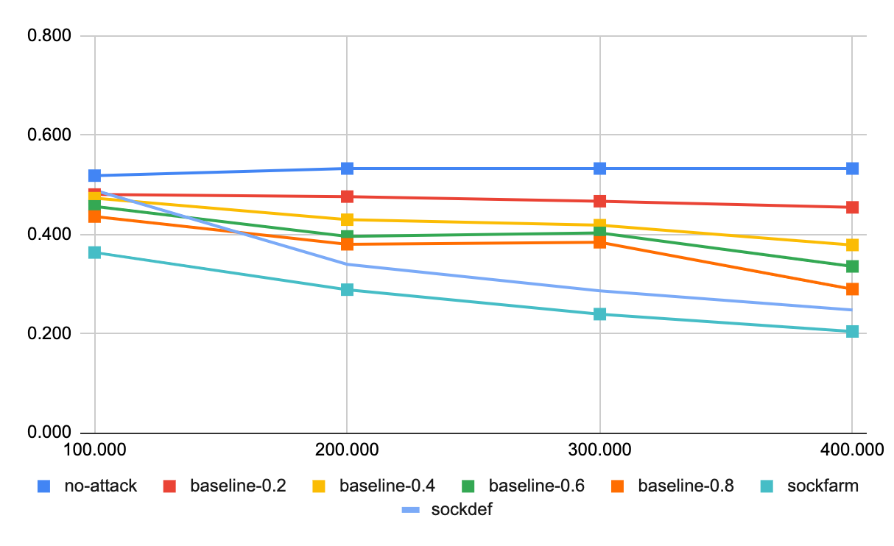
FRAUDAR – ALPHA – F1

Slide 19
RSD - ALPHA
 | precision
budget | 100.000 | 200.000 | 300.000 | 400.000
no-attack | 0.869 | 0.867 | 0.867 | 0.867
baseline-0.2 | 0.881 | 0.889 | 0.906 | 0.910
baseline-0.4 | 0.884 | 0.910 | 0.922 | 0.927
baseline-0.6 | 0.904 | 0.921 | 0.931 | 0.940
baseline-0.8 | 0.911 | 0.931 | 0.941 | 0.950
sockfarm-rsd | 0.867 | 0.867 | 0.867 | 0.867
 | recall
budget | 100.000 | 200.000 | 300.000 | 400.000
no-attack | 0.230 | 0.227 | 0.227 | 0.227
baseline-0.2 | 0.238 | 0.225 | 0.216 | 0.207
baseline-0.4 | 0.219 | 0.205 | 0.202 | 0.187
baseline-0.6 | 0.216 | 0.199 | 0.183 | 0.178
baseline-0.8 | 0.209 | 0.200 | 0.182 | 0.180
sockfarm-rsd | 0.110 | 0.072 | 0.054 | 0.043
 | f1
budget | 100.000 | 200.000 | 300.000 | 400.000
no-attack | 0.362 | 0.358 | 0.358 | 0.358
baseline-0.2 | 0.374 | 0.358 | 0.348 | 0.337
baseline-0.4 | 0.350 | 0.335 | 0.331 | 0.311
baseline-0.6 | 0.347 | 0.326 | 0.304 | 0.299
baseline-0.8 | 0.339 | 0.329 | 0.305 | 0.302
sockfarm-rsd | 0.194 | 0.133 | 0.101 | 0.082

Slide 20
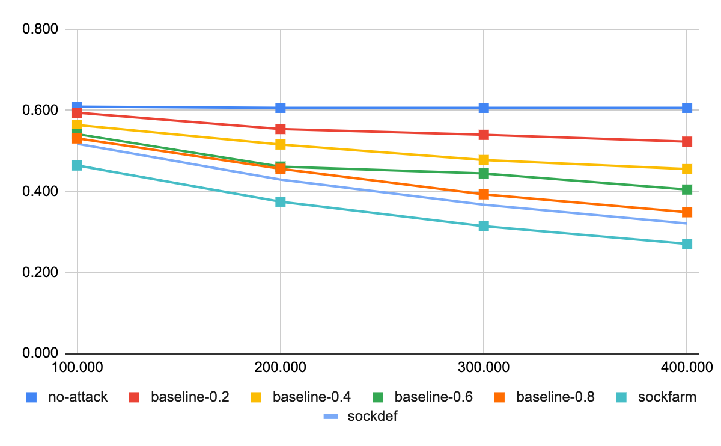
RSD – ALPHA – F1

Slide 21
REV2-ALPHA
 | precision
budget | 100.000 | 200.000 | 300.000 | 400.000
no-attack | 0.349 | 0.364 | 0.364 | 0.364
baseline-0.2 | 0.349 | 0.364 | 0.364 | 0.364
baseline-0.4 | 0.337 | 0.349 | 0.364 | 0.364
baseline-0.6 | 0.345 | 0.341 | 0.364 | 0.366
baseline-0.8 | 0.334 | 0.341 | 0.355 | 0.370
sockfarm-rev2
 | recall
budget | 100.000 | 200.000 | 300.000 | 400.000
no-attack | 0.196 | 0.209 | 0.209 | 0.209
baseline-0.2 | 0.169 | 0.159 | 0.141 | 0.128
baseline-0.4 | 0.141 | 0.120 | 0.107 | 0.092
baseline-0.6 | 0.130 | 0.097 | 0.086 | 0.072
baseline-0.8 | 0.111 | 0.083 | 0.068 | 0.059
sockfarm-rev2
 | f1
budget | 100.000 | 200.000 | 300.000 | 400.000
no-attack | 0.251 | 0.266 | 0.266 | 0.266
baseline-0.2 | 0.228 | 0.221 | 0.204 | 0.189
baseline-0.4 | 0.199 | 0.178 | 0.165 | 0.147
baseline-0.6 | 0.189 | 0.151 | 0.139 | 0.120
baseline-0.8 | 0.167 | 0.133 | 0.115 | 0.102
sockfarm-rev2

Slide 22
FRAUDAR - OTC
 | precision
budget | 100.000 | 200.000 | 300.000 | 400.000
no-attack | 0.482 | 0.480 | 0.480 | 0.480
baseline-0.2 | 0.487 | 0.477 | 0.480 | 0.481
baseline-0.4 | 0.482 | 0.479 | 0.475 | 0.481
baseline-0.6 | 0.485 | 0.468 | 0.483 | 0.480
baseline-0.8 | 0.486 | 0.483 | 0.475 | 0.467
sockfarm-fraudar | 0.500 | 0.500 | 0.500 | 0.500
 | recall
budget | 100.000 | 200.000 | 300.000 | 400.000
no-attack | 0.831 | 0.826 | 0.826 | 0.826
baseline-0.2 | 0.767 | 0.664 | 0.619 | 0.575
baseline-0.4 | 0.681 | 0.562 | 0.483 | 0.435
baseline-0.6 | 0.617 | 0.456 | 0.414 | 0.352
baseline-0.8 | 0.589 | 0.435 | 0.336 | 0.279
sockfarm-fraudar | 0.433 | 0.300 | 0.229 | 0.186
 | f1
budget | 100.000 | 200.000 | 300.000 | 400.000
no-attack | 0.609 | 0.606 | 0.606 | 0.606
baseline-0.2 | 0.595 | 0.554 | 0.540 | 0.523
baseline-0.4 | 0.564 | 0.516 | 0.478 | 0.455
baseline-0.6 | 0.542 | 0.462 | 0.445 | 0.405
baseline-0.8 | 0.531 | 0.456 | 0.393 | 0.349
sockfarm-fraudar | 0.464 | 0.375 | 0.315 | 0.271

Slide 23
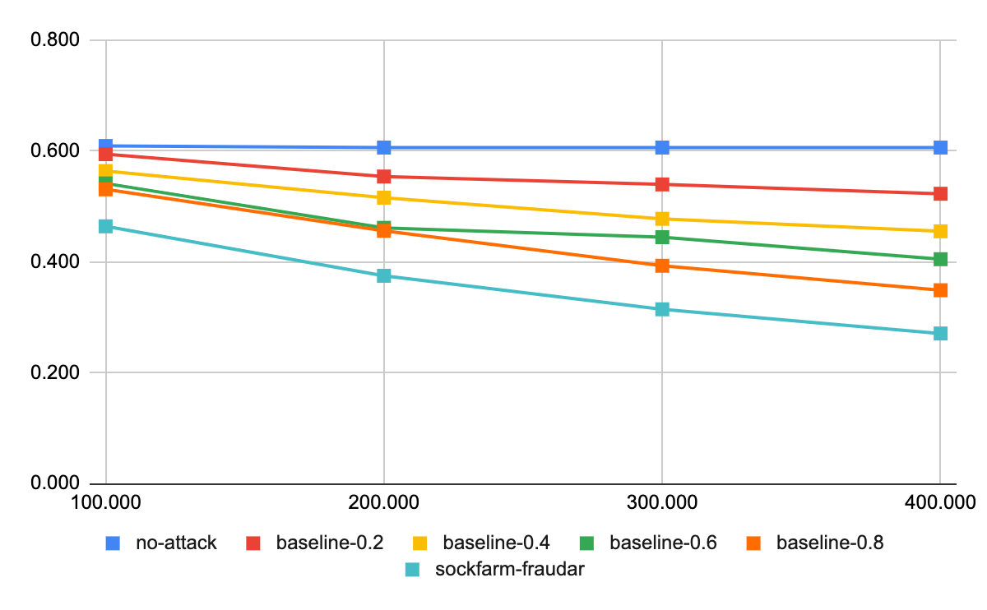
FRAUDAR – OTC – F1

Slide 24
RSD - OTC
 | precision
budget | 100.000 | 200.000 | 300.000 | 400.000
no-attack | 0.943 | 0.942 | 0.942 | 0.942
baseline-0.2 | 0.934 | 0.925 | 0.943 | 0.945
baseline-0.4 | 0.936 | 0.934 | 0.945 | 0.939
baseline-0.6 | 0.938 | 0.942 | 0.940 | 0.950
baseline-0.8 | 0.933 | 0.938 | 0.940 | 0.942
sockfarm-rsd | 1.000 | 1.000 | 1.000 | 1.000
 | recall
budget | 100.000 | 200.000 | 300.000 | 400.000
no-attack | 0.488 | 0.486 | 0.486 | 0.486
baseline-0.2 | 0.455 | 0.408 | 0.371 | 0.352
baseline-0.4 | 0.429 | 0.363 | 0.306 | 0.281
baseline-0.6 | 0.383 | 0.324 | 0.270 | 0.239
baseline-0.8 | 0.357 | 0.289 | 0.250 | 0.209
sockfarm-rsd | 0.294 | 0.204 | 0.156 | 0.126
 | f1
budget | 100.000 | 200.000 | 300.000 | 400.000
no-attack | 0.643 | 0.641 | 0.641 | 0.641
baseline-0.2 | 0.612 | 0.566 | 0.532 | 0.512
baseline-0.4 | 0.588 | 0.523 | 0.462 | 0.432
baseline-0.6 | 0.543 | 0.482 | 0.420 | 0.382
baseline-0.8 | 0.516 | 0.442 | 0.395 | 0.342
sockfarm-rsd | 0.455 | 0.339 | 0.270 | 0.224

Slide 25
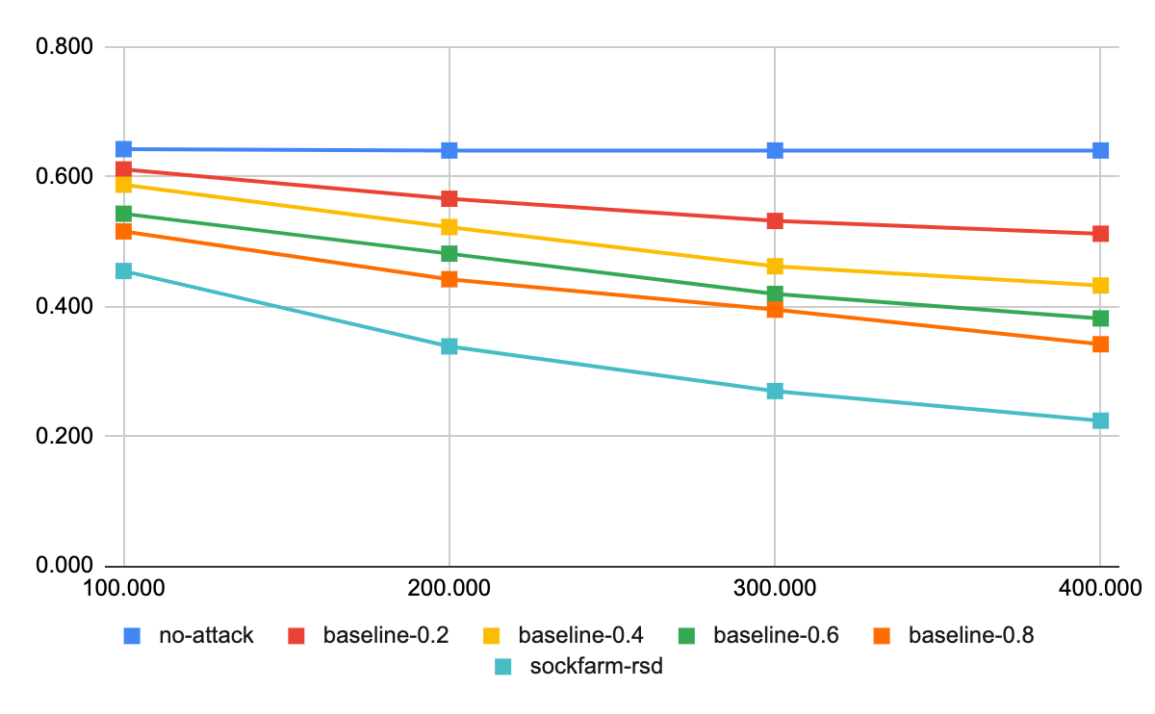
RSD – OTC – F1

Slide 26
REV2 - OTC
 | precision
budget | 100.000 | 200.000 | 300.000 | 400.000
no-attack | 0.636 | 0.645 | 0.645 | 0.645
baseline-0.2 | 0.635 | 0.642 | 0.645 | 0.645
baseline-0.4 | 0.637 | 0.641 | 0.645 | 0.645
baseline-0.6 |  | 0.638 | 0.645 | 0.645
baseline-0.8 |  | 0.635 | 0.640 | 0.645
sockfarm-rev2
 | recall
budget | 100.000 | 200.000 | 300.000 | 400.000
no-attack | 0.358 | 0.371 | 0.371 | 0.371
baseline-0.2 | 0.320 | 0.300 | 0.278 | 0.257
baseline-0.4 | 0.292 | 0.252 | 0.222 | 0.196
baseline-0.6 |  | 0.215 | 0.185 | 0.159
baseline-0.8 |  | 0.188 | 0.155 | 0.133
sockfarm-rev2
 | f1
budget | 100.000 | 200.000 | 300.000 | 400.000
no-attack | 0.458 | 0.471 | 0.471 | 0.471
baseline-0.2 | 0.425 | 0.409 | 0.389 | 0.367
baseline-0.4 | 0.400 | 0.362 | 0.331 | 0.301
baseline-0.6 |  | 0.322 | 0.288 | 0.255
baseline-0.8 |  | 0.290 | 0.249 | 0.221
sockfarm-rev2

Slide 27
FRAUDAR - AMAZON
 | precision
budget | 100.000 | 200.000 | 300.000 | 400.000
no-attack | 0.086 | 0.085 | 0.085 | 0.085
baseline-0.2 | 0.085 | 0.085 | 0.085 | 0.085
baseline-0.4 | 0.085 | 0.086 | 0.085 | 0.085
baseline-0.6 | 0.085 | 0.085 | 0.085 | 0.085
baseline-0.8 | 0.085 | 0.085 | 0.085 | 0.085
 | recall
budget | 100.000 | 200.000 | 300.000 | 400.000
no-attack | 0.343 | 0.340 | 0.340 | 0.340
baseline-0.2 | 0.311 | 0.287 | 0.268 | 0.250
baseline-0.4 | 0.287 | 0.252 | 0.223 | 0.201
baseline-0.6 | 0.268 | 0.223 | 0.191 | 0.168
baseline-0.8 | 0.250 | 0.201 | 0.168 | 0.145
 | f1
budget | 100.000 | 200.000 | 300.000 | 400.000
no-attack | 0.136 | 0.135 | 0.135 | 0.135
baseline-0.2 | 0.133 | 0.131 | 0.129 | 0.127
baseline-0.4 | 0.131 | 0.128 | 0.123 | 0.120
baseline-0.6 | 0.129 | 0.123 | 0.118 | 0.113
baseline-0.8 | 0.127 | 0.120 | 0.113 | 0.107

Slide 28
RSD - AMAZON
 | precision
budget | 100.000 | 200.000 | 300.000 | 400.000
no-attack | 0.148 | 0.148 | 0.148 | 0.148
baseline-0.2 | 0.148 | 0.151 | 0.152 | 0.153
baseline-0.4 | 0.150 | 0.153 | 0.155 | 0.155
baseline-0.6 | 0.150 | 0.153 | 0.154 | 0.154
baseline-0.8 | 0.152 | 0.156 | 0.162 | 0.162
 | recall
budget | 100.000 | 200.000 | 300.000 | 400.000
no-attack | 0.556 | 0.558 | 0.558 | 0.558
baseline-0.2 | 0.515 | 0.488 | 0.460 | 0.435
baseline-0.4 | 0.484 | 0.434 | 0.394 | 0.357
baseline-0.6 | 0.455 | 0.389 | 0.340 | 0.301
baseline-0.8 | 0.433 | 0.357 | 0.309 | 0.269
 | f1
budget | 100.000 | 200.000 | 300.000 | 400.000
no-attack | 0.232 | 0.232 | 0.232 | 0.232
baseline-0.2 | 0.227 | 0.227 | 0.225 | 0.222
baseline-0.4 | 0.225 | 0.222 | 0.217 | 0.210
baseline-0.6 | 0.222 | 0.214 | 0.205 | 0.196
baseline-0.8 | 0.221 | 0.211 | 0.204 | 0.193

Slide 29
REV2 - AMAZON
 | precision
budget | 100.000 | 200.000 | 300.000 | 400.000
no-attack | 0.475 | 0.476 | 0.476 | 0.476
baseline-0.2 | 0.471 | 0.476 | 0.476 | 0.476
baseline-0.4 | 0.472 | 0.475 | 0.476 | 0.476
baseline-0.6 | 0.471 | 0.473 | 0.475 | 0.476
baseline-0.8 | 0.470 | 0.473 | 0.474 | 0.476
 | recall
budget | 100.000 | 200.000 | 300.000 | 400.000
no-attack | 0.516 | 0.517 | 0.517 | 0.517
baseline-0.2 | 0.467 | 0.443 | 0.414 | 0.390
baseline-0.4 | 0.436 | 0.388 | 0.348 | 0.316
baseline-0.6 | 0.406 | 0.346 | 0.301 | 0.266
baseline-0.8 | 0.381 | 0.312 | 0.264 | 0.231
 | f1
budget | 100.000 | 200.000 | 300.000 | 400.000
no-attack | 0.490 | 0.491 | 0.491 | 0.491
baseline-0.2 | 0.462 | 0.451 | 0.434 | 0.418
baseline-0.4 | 0.445 | 0.417 | 0.391 | 0.367
baseline-0.6 | 0.427 | 0.388 | 0.356 | 0.329
baseline-0.8 | 0.411 | 0.364 | 0.327 | 0.299

Slide 30
Progress
 |  | ALPHA | OTC | AMAZON | EPINIONS
baselines | Fraudar | x | x | x | p
 | rsd | x | x | x | p
 | Rev2 | x | x | x | p
sockfarm | Fraudar | x | x
 | rsd | x | x
 | Rev2 | x | p
sockdef | Fraudar
 | rsd
 | Rev2
x means complete. p means partial complete.

Slide 32
Recommending Inferior Results: A General and Feature-Free Model for Spam Detection (CIKM’20)

Slide 33
Graph Convolutional Networks with Markov Random Field Reasoning for Social Spammer Detection (AAAI’20)
Authors:
Yongji Wu, Defu Lian, Yiheng Xu, Le Wu, Enhong Chen
Code available:
No

