Slide 1
SeaX Agent Coach

Slide 2
Contact Center
Pain Points

Slide 3

Contact Center
Pain Points
Training new agents takes time and money
1

Slide 4
Contact Center
Pain Points
Training new agents takes time and money
1
Supervisors aren’t omnipresent
2

Slide 5
Contact Center
Pain Points
Training new agents takes time and money
1
Supervisors aren’t omnipresent
2
Difficult for agents to get real-time feedback
3

Slide 6
AI Agent Coaching
Real-time transcriptions
Customizable conversational goals
Automated checklist
AI-powered tips and feedback
Agent analytics for supervisors and managers

Slide 7
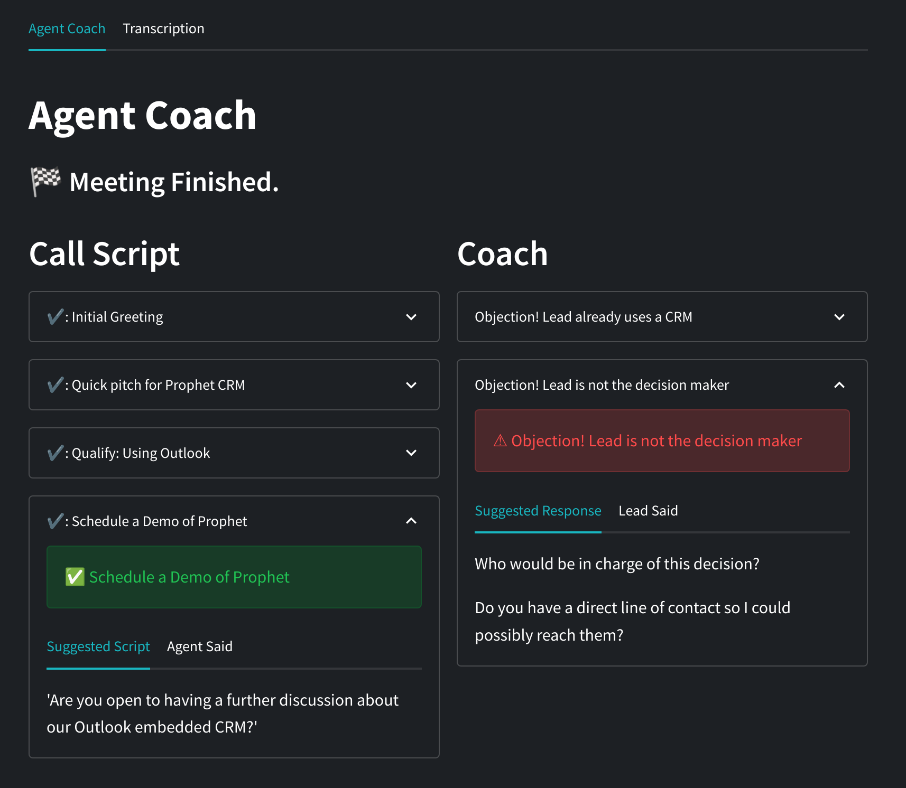
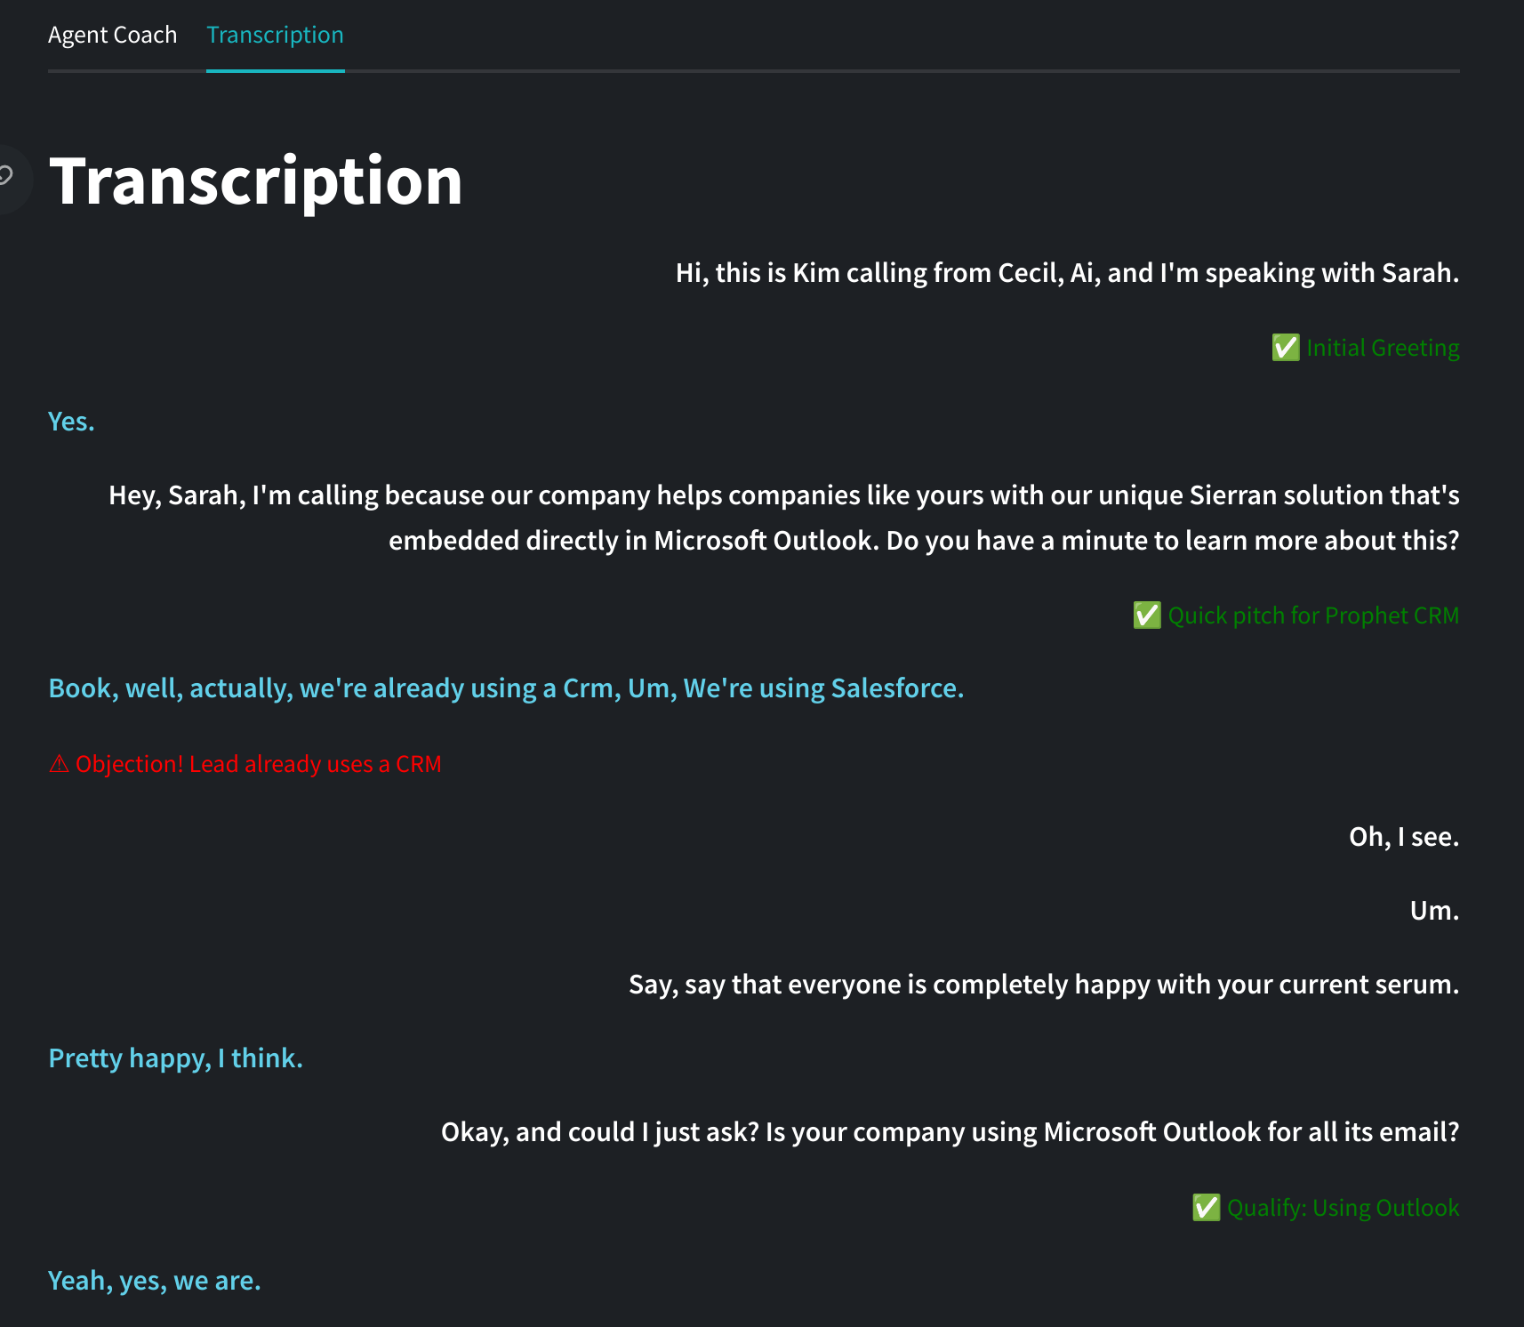

Slide 8
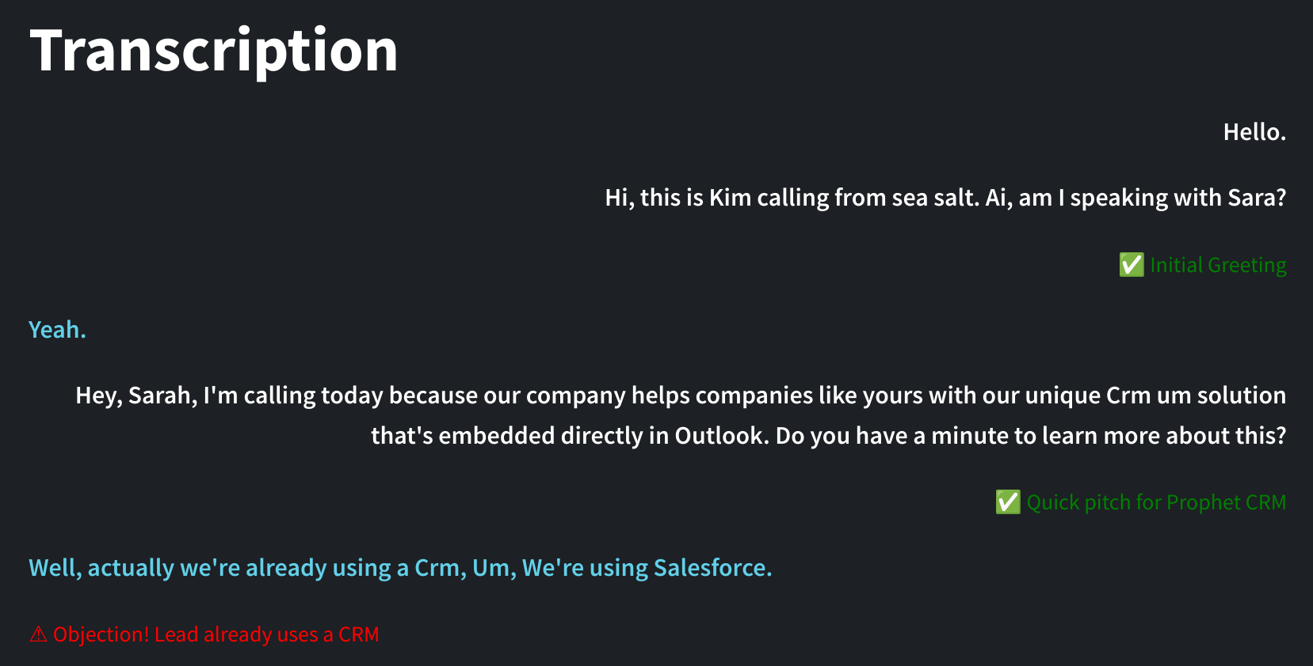
Real-time transcriptions
Customizable conversational goals
Automated checklist
AI-powered tips and feedback
Agent analytics for supervisors and managers

Slide 9
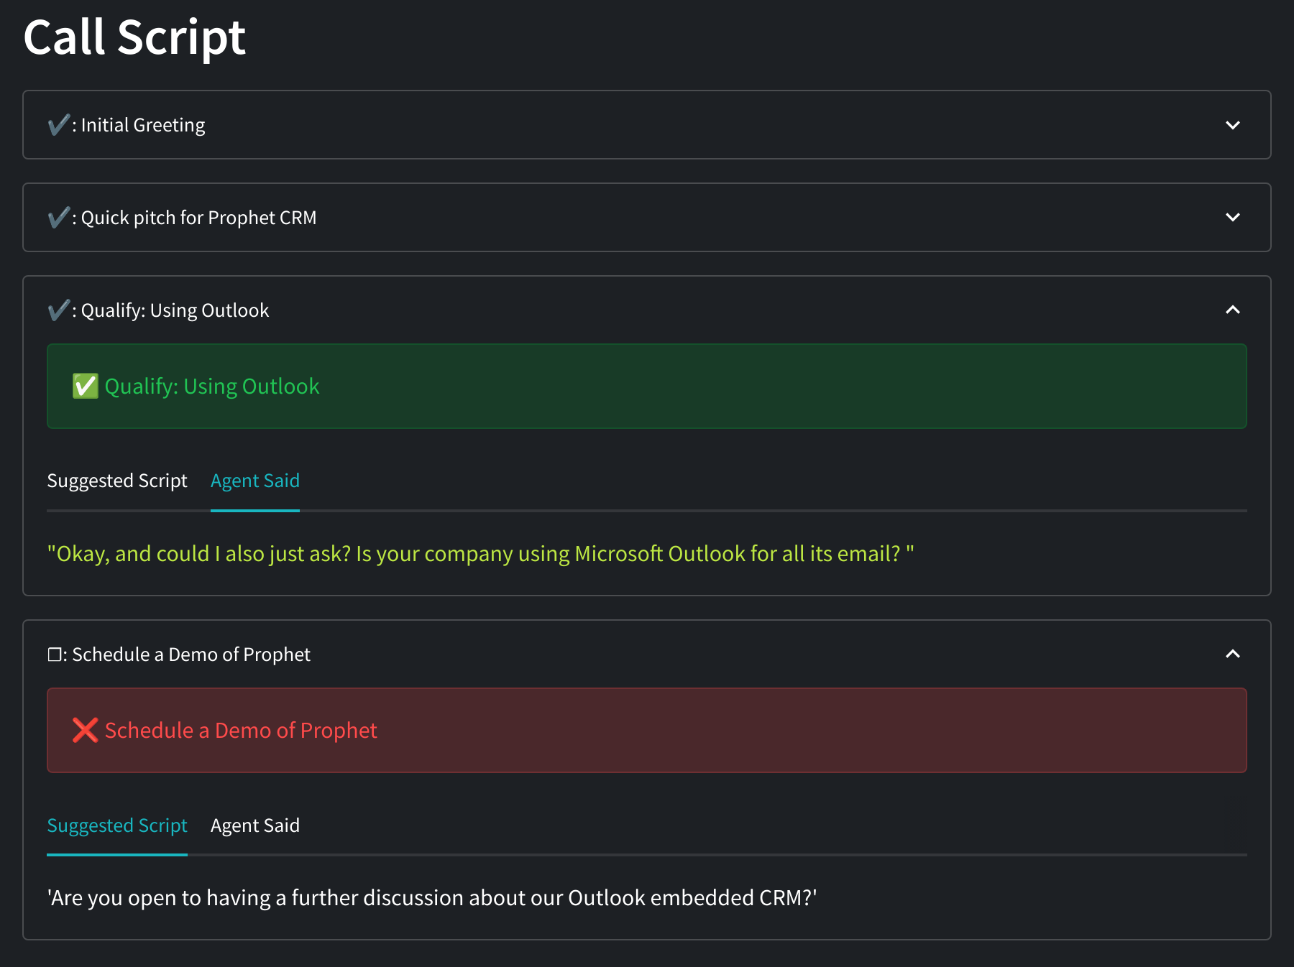
Real-time transcriptions
Customizable conversational goals
Automated checklist
AI-powered tips and feedback
Agent analytics for supervisors and managers

Slide 10
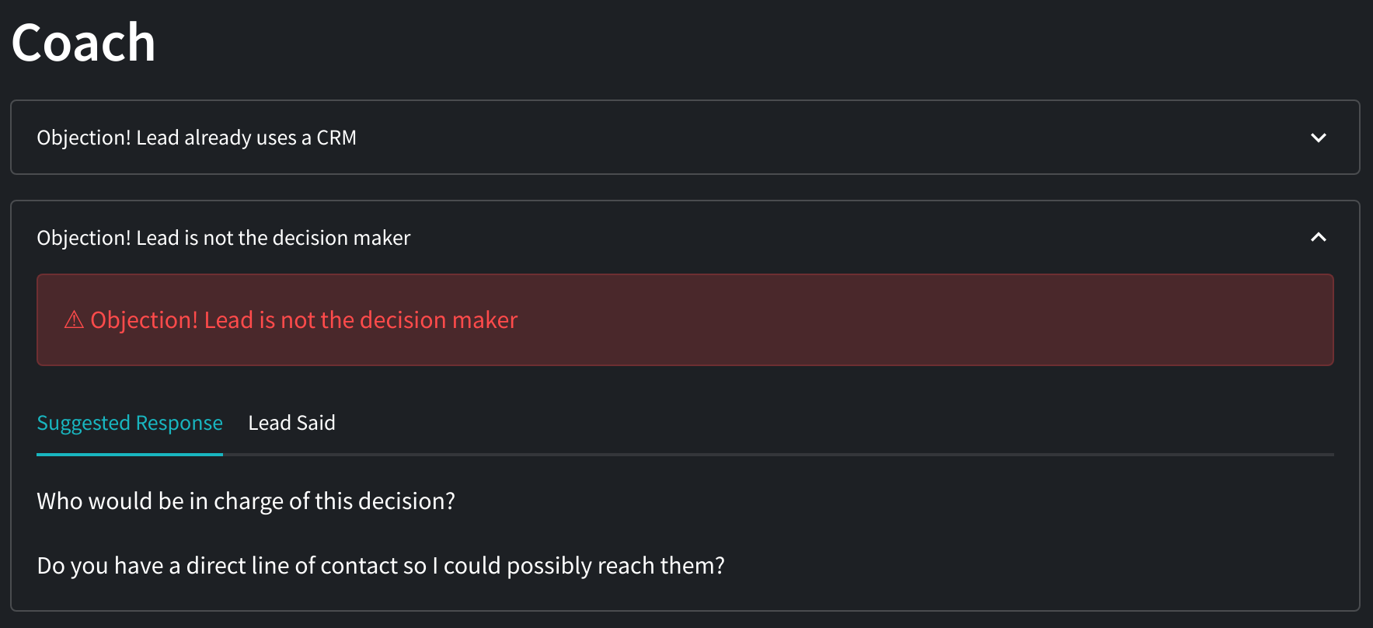
Real-time transcriptions
Customizable conversational goals
Automated checklist
AI-powered tips and feedback
Agent analytics for supervisors and managers

Slide 11
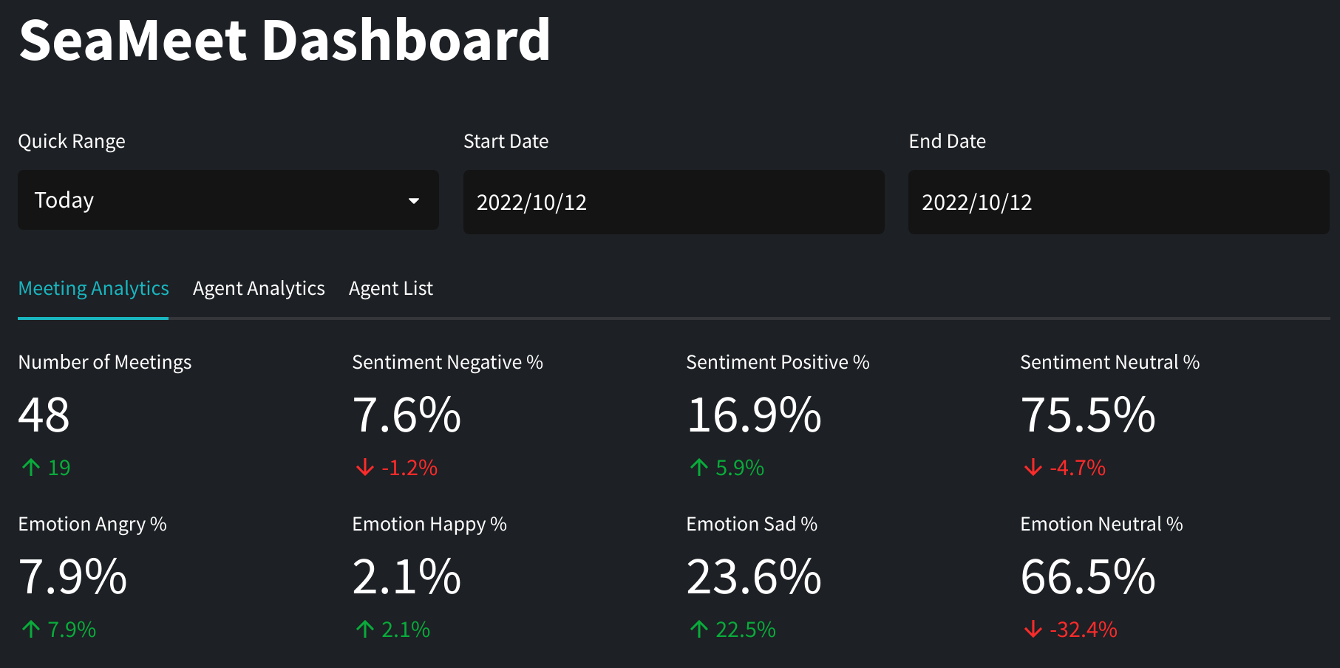
Real-time transcriptions
Customizable conversational goals
Automated checklist
AI-powered tips and feedback
Agent analytics for supervisors and managers

Slide 12

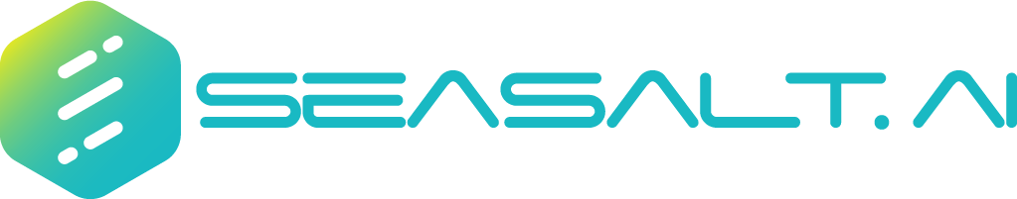
SeaX
Agent Coaching
Demo

Slide 13
SeaX Agent Coaching
Feature | Outcome
Live transcription | Every call is documented, so agents can take fewer notes, avoid asking repeat question, and focus entirely on the call.
Automated checklist | Agents are trained faster, and miss fewer key questions & tasks
AI-powered coaching | Agents perform better in challenging situations thanks to real-time personalized tips and feedback
Agent analytics | Agents learn quicker by reviewing their own conversations Supervisors can more efficiently monitor agent performance
Notes:
Thanks to live transcription, agents can take fewer notes & avoid asking repeat questions, and instead focus entirely on the call. Our customizable call checklist helps new agents train faster - and ensures that no qualifying questions or important tasks are missed. AI_powered agent coaching takes this a step further by providing real-time suggestions for challenging situations, such as heightened emotions, uncommon questions, or customer objections. Finally, everything that happens in the call is aggregated and made available to agents and managers for review - providing insights on agent performance, common objections, and more. On the whole SeaX Agent Coach can improve contact center productivity and efficiency by ensuring that agents are trained quickly and perform well while simultaneously taking some of the burden off supervisors and providing them with more important insights into conversations and agent performance.
Thank you for taking the time to learn about SeaX’s Agent Coaching feature. For a personalized demo, please fill out our “Book a Demo” form in the video description.

