Slide 1
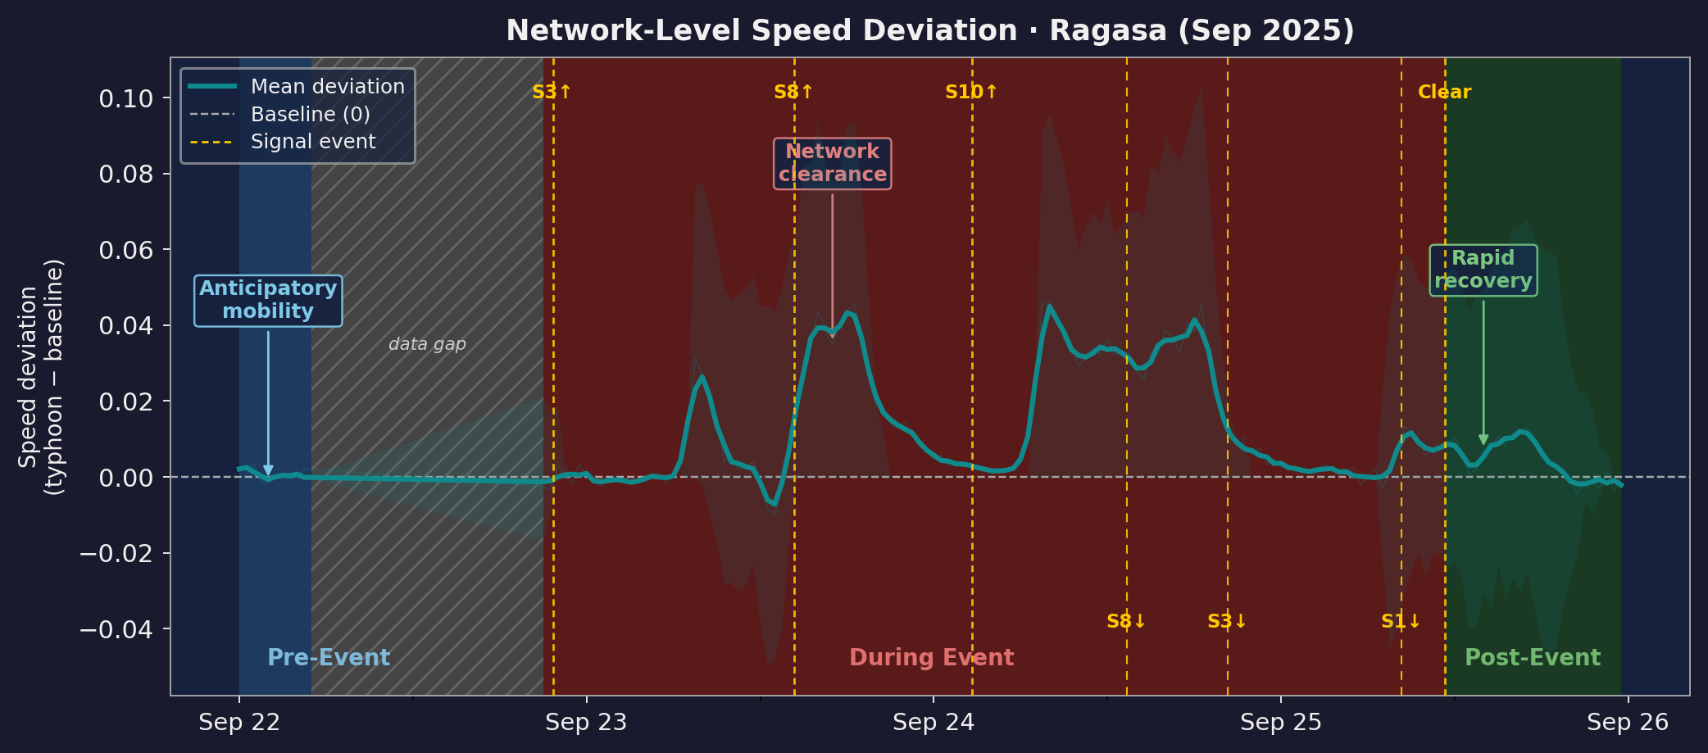
04
RQ1 · RQ2 · RQ4
Overview: Network Response across All Typhoon Phases
Pre-event
During
Post-event
S8 is the behavioural trigger: pre-S8 midday congestion dip
S8 triggers rapid network clearance (−0.010 → +0.045 in 5h)
Recovery within ~100 min of All Clear; no rebound
Ragasa (Sep 2025) | 30-min TomTom data | ~6,000 roads per slot | peak +0.046 at S10 morning

