Slide 1
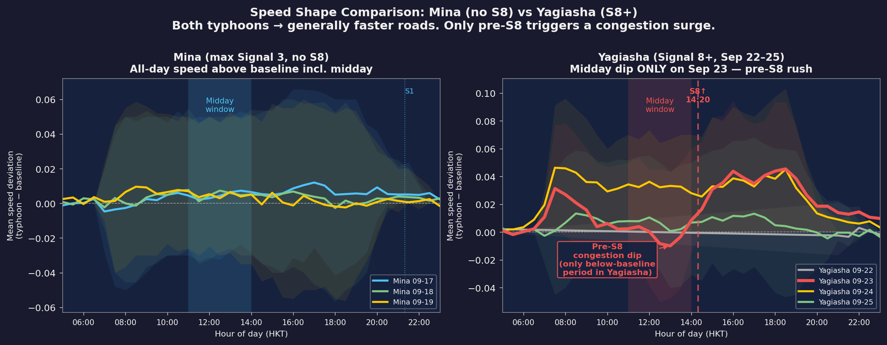
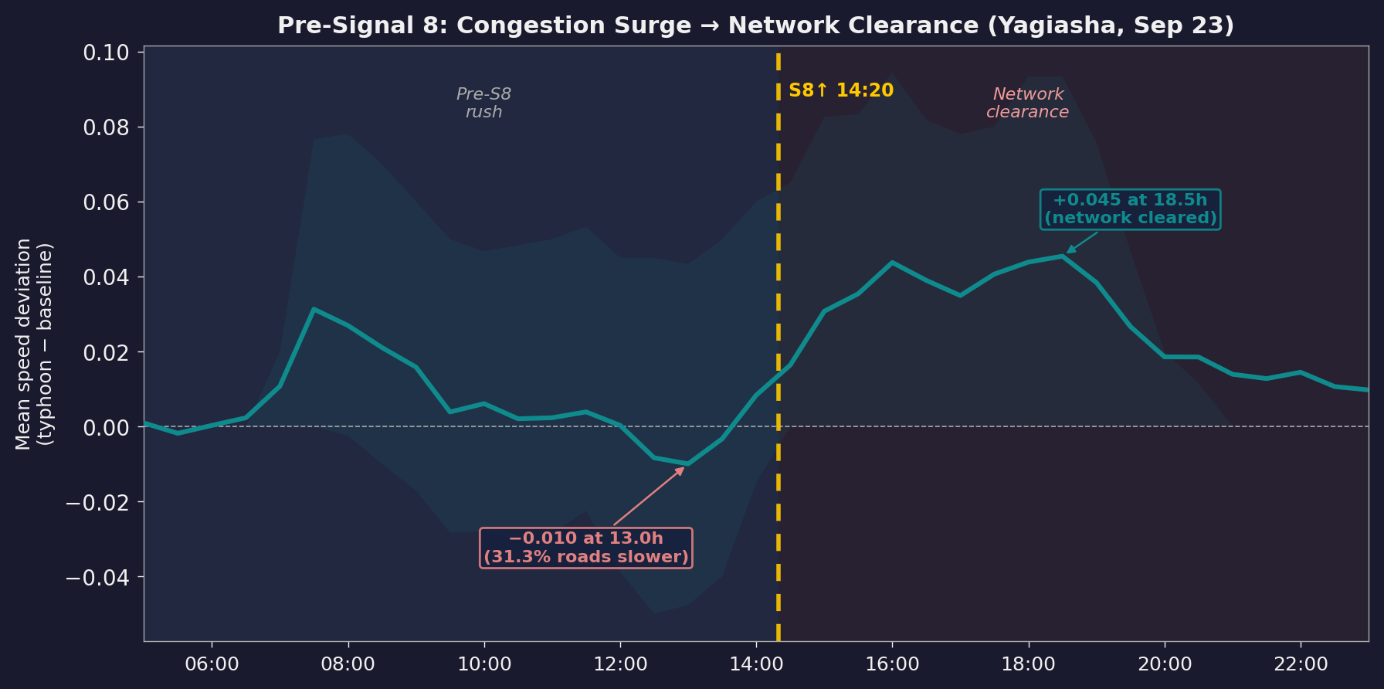
05
RQ1 · RQ2
Pre-Event: S8 Is the True Behavioural Trigger
A Mina (no S8): all-day elevated speeds, including midday — Yagiasha (S8+): midday dip ONLY on Sep 23 (pre-S8)
B Yagiasha Sep 23: Pre-S8 dip → S8 clearance in detail
Key Evidence
Mina (max S3, no S8)
Sep 18–19 midday: speeds +0.005 to +0.015 above baseline → No congestion surge; demand already suppressed
Yagiasha (S8 raised 14:20)
Sep 23 midday: speed dips to −0.010 at 13:00 → 31.3% roads slower, system-wide last-minute rush
5-hour swing
−0.010 (13:00) → +0.045 (19:30) after S8 → S8 is the behavioural tipping point, not S1 or S3
Pre-event phase | S3→S8 anticipatory window | S8 raised at 14:20 Sep 23 | Mina (no S8) = no midday dip

